Slide 1
Project: IEEE P802.15 Working Group for Wireless Personal Area Networks (WPANs)
Submission Title: [Suitability of IEEE 802.11ah for LPWAN Applications]
Date Submitted: [12 March, 2017]
Source: [Joerg ROBERT] Company [Friedrich-Alexander University Erlangen-Nuernberg]
Address [Am Wolfsmantel 33, 91058 Erlangen, Germany]
Voice:[+49 9131 8525373], FAX: [+49 9131 8525102], E-Mail:[joerg.robert@fau.de]
Re: []
Abstract: [This documents analyzes the suitability of IEEE 802.11ah for LPWAN applications]
Purpose: [Presentation within IG LPWA]
Notice: This document has been prepared to assist the IEEE P802.15. It is offered as a basis for discussion and is not binding on the contributing individual(s) or organization(s). The material in this document is subject to change in form and content after further study. The contributor(s) reserve(s) the right to add, amend or withdraw material contained herein.
Release: The contributor acknowledges and accepts that this contribution becomes the property of IEEE and may be made publicly available by P802.15.

Slide 2
Suitability of IEEE 802.11ah for LPWAN Applications
Joerg Robert
FAU Erlangen-Nuernberg

Slide 3
Motivation
IEEE 802.11ah is an amendment operated in sub-GHz bands with focus on IoT applications
  OFDM based
  Powerful FEC, sophisticated MAC with single-hop
  Minimum bandwidth of 1MHz
  The performance for IEEE 802.11ah given in 802.11-11/1137r15
Is 802.11ah able to fulfill certain LP-WAN use-cases defined in 16/770r3?

Slide 4
Channel Model
Indoor
Outdoor Rural
Outdoor Urban
OFDM is robust wrt. multi-path propagation
The high bandwidth of at least 1 MHz offers significant diversity gain

Slide 5
Interference Model
None
Low
Medium
Dense
The high bandwidth and the powerful forward error correction result in a good interference resistance
However, in case of many interferes the high bandwidth will collect high interference levels

Slide 6
Active Interfering Users
Low
Medium
High
Very High
The high bandwidth generally limits the number of parallel users
The use of sophisticated multi-antenna schemes increases the performance in case of many users

Slide 7
Communication Mode
Uplink
Downlink
Uplink / Broadcast Downlink
802.11ah has been designed for up- and downlink communication

Slide 8
Data Period
Occasionally, less than 1/day
Occasionally 1/day
Occasionally 1/hour
Occasionally, more than 1/hour
Periodically 1/day
Periodically 1/hour
Periodically, more than 1/hour
The use of DSSS is independent of the data period

Slide 9
Data Length
<= 16 bytes
<= 64 bytes
<= 256 bytes
> 256 bytes
The use of DSSS is independent of the data length

Slide 10
Availability
Best effort ( > 90%)
Medium ( > 99% )
High ( > 99.9% )
Packet retransmissions and powerful MAC mechanisms ensure a high availability

Slide 11
Latency
< 0.25s
< 1s
< 10s
< 1min
< 10min
< 60 min
< 1day
The high data rates offer a high latency
Short latencies may not be met if power saving techniques are used

Slide 12
LP-WAN Localization
< 10m
< 100m
Not required
The high bandwidth of the signal may allow for good and precise localization if multiple access points are used

Slide 13
Typical Power Supply
CR 2025
2xAA
Energy harvesting
External
The use of OFDM may result in inefficient transmission in case of higher transmit powers

Slide 14
Frequency Regulation
NA
ETSI
FCC
ETSI/FCC
Current status within ETSI not completely clear, may be used with 25mW EIRP and low duty cycle in bands to are also used by RFID applications with high power

Slide 15
Minimum Sensitivity Requirements
Required input level of -98dBm
for most robust mode
Source: 802.11-11/1137r15
(PER of 10% for a PSDU length of 256 octets)

Slide 16
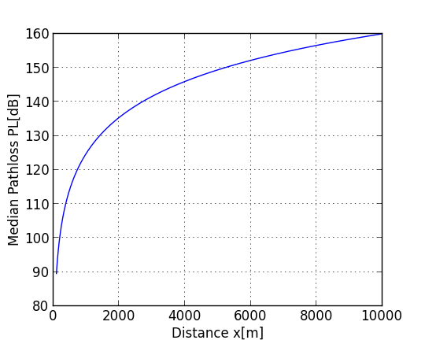
Maximum Acceptable Path Loss
Outdoor Model as defined in 17/36r1
Base-Station antenna height = 30m
Mobile-Station antenna height = 2m
Transmit power 10dBm (0 dBi TX antenna gain)
10dBi RX antenna gain
Max pathloss 118dB
Small cell size

Slide 17
Cell Radius
< 1 km
< 5 km
< 10 km
< 50 km
> 50 km
The high payload bit-rates in (reflected in the required minimum input power of -98dBm) do not allow for long-range transmission
In case of exposed antennas the system will be interfered by other users due to its high bandwidth

Slide 18
Data Security
Layer-2
Layer-3
End-to-End
Secure Authentication
IEEE 802.11ah implements already security
Additional security can be added on higher layers

Slide 19
Node Velocity
3 km/h
30 km/h
120 km/h
OFDM parameters may allow also high speed operation in case of a sophisticated receiver

Slide 20
Results of the Suitability Evaluation
IEEE 802.11ah does not support:
  Scenarios with strong interference
  ETSI regulation
  Medium/Large cell radiuses
Results are evaluate using use-cases in 16/770r3
A use-case is not supported if at least one criteria is not fulfilled

Slide 21
Results of the Suitability Evaluation
Access Control | Public Lighting
Alarms and Security | Smart Grid - Fault Monitoring
Asset Tracking | Smart Grid - Load Control
Assisted Living | Smart Metering
Cattle Monitoring | Smart Parking
Field Monitoring | Smoke Detectors
Global Tracking | Structural Health Monitoring
Industrial Plant Condition Monitoring | Vending Machines - general
Industrial Production Monitoring | Vending Machines - privacy
Light Switch | Waste Management
Pet Tracking | Water Pipe Leakage Monitoring
Pipeline Monitoring - Terrestrial

Slide 22
Thank You!
Questions or Comments?

