Slide 1
Project: IEEE P802.15 Working Group for Wireless Personal Area Networks (WPANs)
Submission Title: [Candidate Technology Suitability Evaluation]
Date Submitted: [12 March, 2017]
Source: [Joerg ROBERT] Company [Friedrich-Alexander University Erlangen-Nuernberg]
Address [Am Wolfsmantel 33, 91058 Erlangen, Germany]
Voice:[+49 9131 8525373], FAX: [+49 9131 8525102], E-Mail:[joerg.robert@fau.de]
Re: []
Abstract: [This documents describes the proposed suitability evaluation]
Purpose: [Discussion within group.]
Notice: This document has been prepared to assist the IEEE P802.15. It is offered as a basis for discussion and is not binding on the contributing individual(s) or organization(s). The material in this document is subject to change in form and content after further study. The contributor(s) reserve(s) the right to add, amend or withdraw material contained herein.
Release: The contributor acknowledges and accepts that this contribution becomes the property of IEEE and may be made publicly available by P802.15.

Slide 2
Candidate Technology Suitability Evaluation
Joerg Robert
FAU Erlangen-Nuernberg

Slide 3
Motivation
One task of the IG LPWA is the identification of candidate technologies wrt. their applicability in Low Power Wide Area Networks (16/729r0)
Potential use-cases and their requirements have been defined in the use-case list (16/770r3)
This document presents a method for the suitability evaluation using DSSS as an example

Slide 4
General Evaluation Proposal
Suitability
Analysis the general suitability of a candidate technology
(this document)
Qualitative Evaluation
Analysis pros and cons, and dependency on other technologies
Quantitative Evaluation
Exact performance (only for selected technologies)

Slide 5
Example: DSSS Modulation
Suitability analysis of DSSS (Direct Sequence Spread Spectrum) modulation
  Data is spread using DSSS modulation
  Same sequence for all users
  Assumption of linear correlation receiver
DSSS is compared wrt. requirements defined in use-case document 16/770r3

Slide 6
Use-Case Parameters
Channel Model
Interference Model
Active Interfering Users
Communication Mode
Data Period
Data Length
Availability
Latency
LP-WAN Localization
Typical Power Supply
Frequency Regulation
Cell Radius
Data Security
Node Velocity
Description in 16/770r3

Slide 7
Channel Model
Indoor
Outdoor Rural
Outdoor Urban
DSSS is robust wrt. multi-path propagation
The high bandwidth to spreading offers additional robustness in fading channels

Slide 8
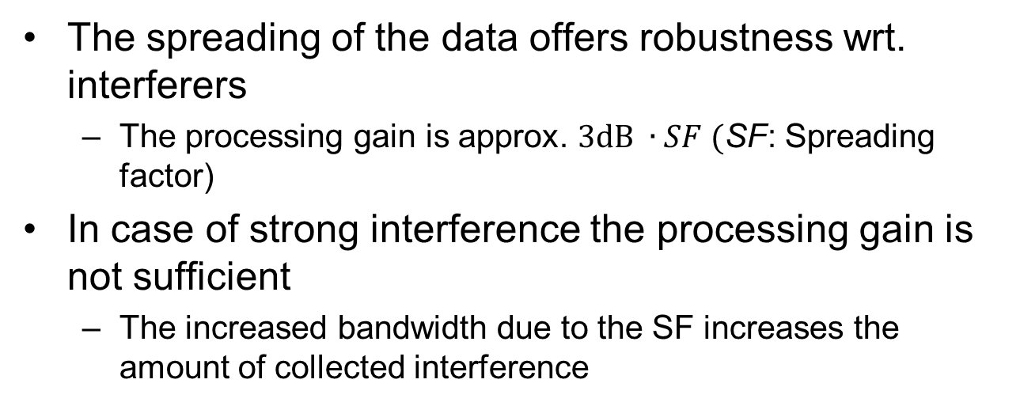
Interference Model
None
Low
Medium
Dense
The spreading of the data offers robustness wrt. interferers
  The processing gain is approx. $3dB ∙SF ($SF: Spreading factor)
In case of strong interference the processing gain is not sufficient
  The increased bandwidth due to the SF increases the amount of collected interference

Slide 9
Active Interfering Users
Low
Medium
High
Very High
The SF increases the duration and the bandwidth of the data packets
As all users use the identical DSSS the available resources are significantly reduces

Slide 10
Communication Mode
Uplink
Downlink
Uplink / Broadcast Downlink
The use of DSSS is independent of the communication mode

Slide 11
Data Period
Occasionally, less than 1/day
Occasionally 1/day
Occasionally 1/hour
Occasionally, more than 1/hour
Periodically 1/day
Periodically 1/hour
Periodically, more than 1/hour
The use of DSSS is independent of the data period

Slide 12
Data Length
<= 16 bytes
<= 64 bytes
<= 256 bytes
> 256 bytes
The use of DSSS is independent of the data length

Slide 13
Availability
Best effort ( > 90%)
Medium ( > 99% )
High ( > 99.9% )
The limited robustness wrt. to interference may require additional mechanisms to ensure a high availability in case of dense scenarios

Slide 14
Latency
< 0.25s
< 1s
< 10s
< 1min
< 10min
< 60 min
< 1day
DSSS offers high payload bit-rates and therefore supports all required latency modes

Slide 15
LP-WAN Localization
< 10m
< 100m
Not required
The high bandwidth of the DSSS signal offers excellent localization characteristics using Time Difference of Arrival (TDOA) measurements if multiple receiver stations are used

Slide 16
Typical Power Supply
CR 2025
2xAA
Energy harvesting
External
DSSS has an almost constant Peak to Average Power Ratio (PAPR) and hence allows for highly power efficient transmitters

Slide 17
Frequency Regulation
NA
ETSI
FCC
ETSI/FCC
DSSS is widely used by IEEE 802.15.4 and is well accepted
FCC limits the transmit duration without hopping to 4s for higher transmit powers
  Reduced range

Slide 18
Cell Radius
< 1 km
< 5 km
< 10 km
< 50 km
> 50 km
The limited robustness in dense application / interference scenarios in addition to the potential FCC limitations makes DSSS unsuitable for larger cell radiuses

Slide 19
Data Security
Layer-2
Layer-3
End-to-End
Secure Authentication
DSSS in general supports all data security levels

Slide 20
Node Velocity
3 km/h
30 km/h
120 km/h
DSSS can be decoded up to high Doppler shifts

Slide 21
Results of the Suitability Evaluation
DSSS does not support:
  Scenarios with strong interference
  Many active users
  Large cell radiuses
Results can be used to evaluate use-cases in 16/770r3
A use-case is not supported if at least one criteria is not fulfilled

Slide 22
Results of the Suitability Evaluation
Access Control | Public Lighting
Alarms and Security | Smart Grid - Fault Monitoring
Asset Tracking | Smart Grid - Load Control
Assisted Living | Smart Metering
Cattle Monitoring | Smart Parking
Field Monitoring | Smoke Detectors
Global Tracking | Structural Health Monitoring
Industrial Plant Condition Monitoring | Vending Machines - general
Industrial Production Monitoring | Vending Machines - privacy
Light Switch | Waste Management
Pet Tracking | Water Pipe Leakage Monitoring
Pipeline Monitoring - Terrestrial

Slide 23
Thank You!
Comments? Questions?

