Slide 1
Project: IEEE P802.15 Working Group for Wireless Personal Area Networks (WPANs)
Submission Title: APP based informational broadcast configuration
Date Submitted: February 2017
Source: Rick Roberts (Intel), Yeong Min Jang, Trang Nguyen (Kookmin U.)
Address
E-Mail: richard.d.roberts@intel.com
Re:
Abstract:
Purpose:
Notice: This document has been prepared to assist the IEEE P802.15. It is offered as a basis for discussion and is not binding on the contributing individual(s) or organization(s). The material in this document is subject to change in form and content after further study. The contributor(s) reserve(s) the right to add, amend or withdraw material contained herein.
Release: The contributor acknowledges and accepts that this contribution becomes the property of IEEE and may be made publicly available by P802.15.

Slide 2
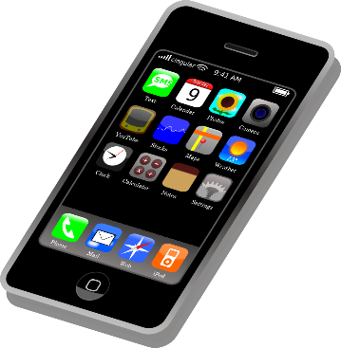
Basic Concept …
You’re going shopping at Big Box Mart
Before leaving home you download the Big Box Mart APP onto your phone
The Big Box Mart APP enables multiple user experiences while at Big Box Mart
One of those user experiences is Optical Camera Communication unidirectional data broadcast from the store’s lighting and signage

Slide 3
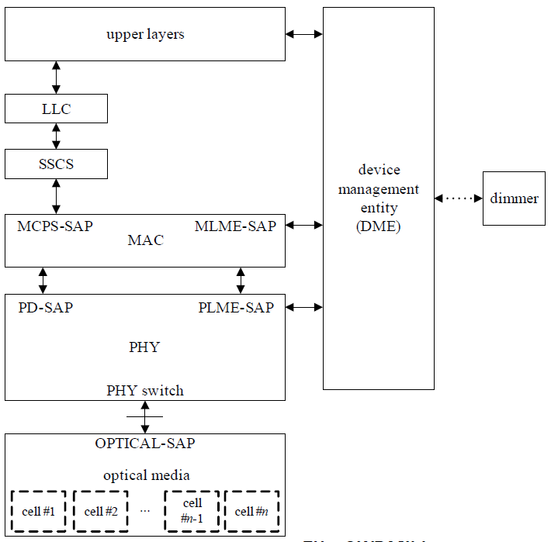
Problem: in 802.15.7m there are multiple OCC modulation formats … how does your phone know which one to use at Big Box Mart?
Answer: the APP contains this information, which is passed to the MAC/PHY PIB via the DME.
What’s new: the PHY/MAC layer “reads” the PIB and sets up the camera signal processing accordingly. There is no over-the-air configuration.
Big Box
Mart APP

Slide 4
APP based configuration is a new paradigm as contrasted with the more traditional “common mode” configuration philosophy.
This topic is currently under discussion in 802.15.7m.
Any comments from 802.15.WG?

