Slide 1
Project: IEEE P802.15 Working Group for Wireless Personal Area Networks (WPANs)
Submission Title: [The Potentials of IEEE 802.15.4 CSMA/CA to operate in Dense Metering Networks with Hidden Nodes]
Date Submitted: [22 February, 2017]
Source: [Tallal Elshabrawy¹, Ezzeldin Shereen¹, Mohamed Ashour¹, and Joerg Robert²] Company [¹The German University in Cairo, ²Friedrich-Alexander University Erlangen-Nuernberg]
Address¹ [German University in Cairo - GUC, New Cairo City - Main Entrance of Al Tagamoa Al Khames, Egypt]
Address² [Wolfsmantel 33, 91058 Erlangen, Germany]
Voice:[+202-27595525], FAX¹: [+202 27581041], E-Mail:[tallal.el-shabrawy@guc.edu.eg]
Abstract: [In this document, a simple analytical model to evaluate the report success probability as well as meters’ battery lifetime within IEEE 802.15.4-based metering networks is introduced. The model is utilized for proper configuration of the IEEE 802.15.4 network given a target report success probability performance. It is shown that the expected battery lifetime of meters could be optimized by controlling the percentage of hidden nodes combined with proper setting of the maximum number of allowable backoff attempts by each meter.]
Purpose: [Presentation within IEEE802.15 Interest Group LPWA]
Notice: This document has been prepared to assist the IEEE P802.15. It is offered as a basis for discussion and is not binding on the contributing individual(s) or organization(s). The material in this document is subject to change in form and content after further study. The contributor(s) reserve(s) the right to add, amend or withdraw material contained herein.
Release: The contributor acknowledges and accepts that this contribution becomes the property of IEEE and may be made publicly available by P802.15.

Slide 2
The Potentials of IEEE 802.15.4 CSMA/CA to operate in Dense Metering Networks with Hidden Nodes
Tallal Elshabrawy¹, Ezzeldin Shereen¹, Mohamed Ashour¹, and Joerg Robert²
¹The German University in Cairo,
²Friedrich-Alexander University Erlangen-Nuernberg

Slide 3
Motivation
Dense Metering Networks
  Thousands of Meters
  Periodic Reports
  Inevitable Hidden Nodes
Dimensioning and Parameter Configuration of 802.15.4 CSMA/CA-based Metering Networks
  Target Report Success Probability
  Maximize Battery Lifetime

Slide 4
Metering Network Model
Dense Meters Population
Periodic Reporting
CAP CSMA/CA
Star Configuration between Meters and Basestation
Each Meter M_{t} has q% of Hidden Nodes
Collisions at Base station

Slide 5
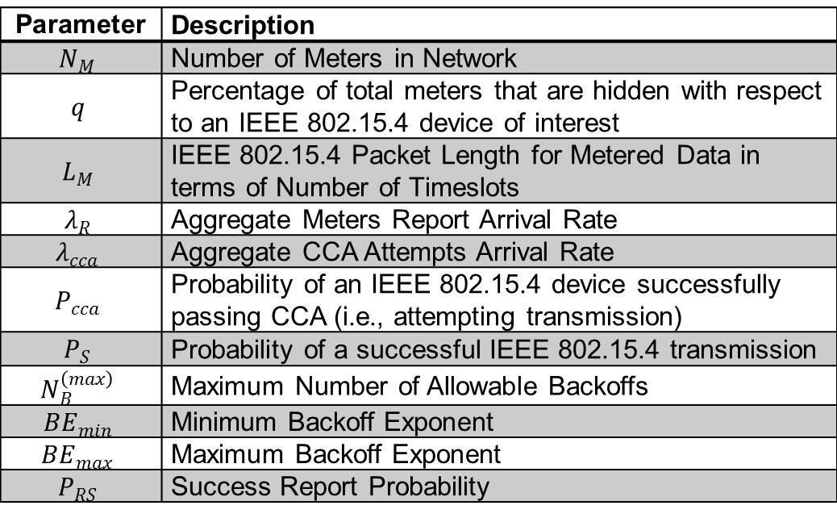
Model Parameters for Success Report Probability
$$\text{Parameter}$$ | Description
$$N_{M}$$ | Number of Meters in Network
$$q$$ | Percentage of total meters that are hidden with respect to an IEEE 802.15.4 device of interest
$$L_{M}$$ | IEEE 802.15.4 Packet Length for Metered Data in terms of Number of Timeslots
$$λ_{R}$$ | Aggregate Meters Report Arrival Rate
$$λ_{cca}$$ | Aggregate CCA Attempts Arrival Rate
$$P_{cca}$$ | Probability of an IEEE 802.15.4 device successfully passing CCA (i.e., attempting transmission)
$$P_{S}$$ | Probability of a successful IEEE 802.15.4 transmission
$$N_{B}^{\left(max\right)}$$ | Maximum Number of Allowable Backoffs
$$BE_{min}$$ | Minimum Backoff Exponent
$$BE_{max}$$ | Maximum Backoff Exponent
$$P_{RS}$$ | Success Report Probability

Slide 6

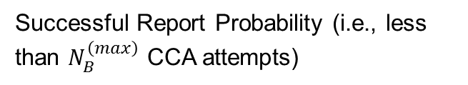
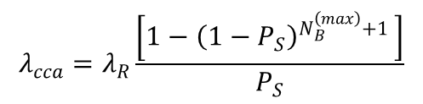

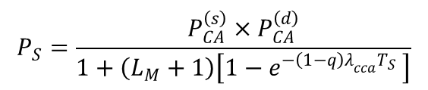

Report Success Probability Analytical Model
Poisson-Based Model
Aggregate CCA Attempts Rate
$$λ_{cca}=λ_{R}\frac{\left[1−{\left(1−P_{S}\right)}^{N_{B}^{\left(max\right)}+1 }\right]}{P_{S}}$$
Probability of Collision Free Transmission
Collision Avoidance Probability w.r.t to Visible Nodes
$$P_{S}=\frac{P_{CA}^{\left(s\right)}×P_{CA}^{\left(d\right)}}{1+\left(L_{M}+1\right)\left[1−e^{−{\left(1−q\right)λ}_{cca}T_{S} }\right]}$$
$$P_{CA}^{\left(s\right)}=e^{−{\left(1−q\right)λ}_{cca}T_{S} }$$
Successful Report Probability (i.e., less than $N_{B}^{\left(max\right)}$ CCA attempts)
Collision Avoidance Probability w.r.t to Hidden Nodes
$$P_{RS}=\frac{λ_{cca}P_{S}}{λ_{R}}$$
$$P_{CA}^{\left(d\right)}=e^{−qλ_{cca}P_{cca}T_{S}×\left(L_{M}−1\right)}×e^{−qλ_{cca}T_{S}×L_{M}}$$

Slide 7
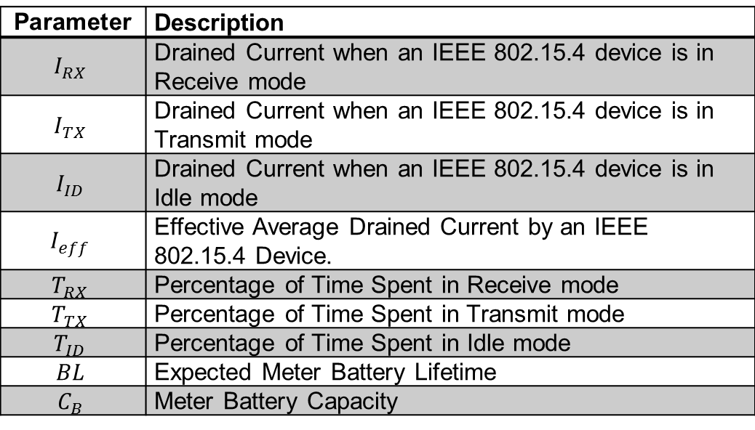
Model Parameters for Battery Lifetime
$$\text{Parameter}$$ | Description
$$I_{RX}$$ | Drained Current when an IEEE 802.15.4 device is in Receive mode
$$I_{TX}$$ | Drained Current when an IEEE 802.15.4 device is in Transmit mode
$$I_{ID}$$ | Drained Current when an IEEE 802.15.4 device is in Idle mode
$$I_{eff}$$ | Effective Average Drained Current by an IEEE 802.15.4 Device.
$$T_{RX}$$ | Percentage of Time Spent in Receive mode
$$T_{TX}$$ | Percentage of Time Spent in Transmit mode
$$T_{ID}$$ | Percentage of Time Spent in Idle mode
$$BL$$ | Expected Meter Battery Lifetime
$$C_{B}$$ | Meter Battery Capacity

Slide 8

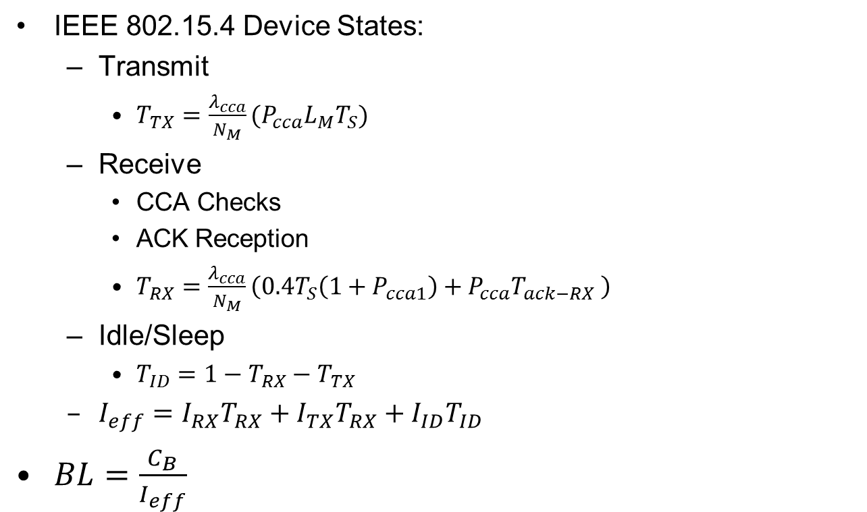
Battery Lifetime Analysis
IEEE 802.15.4 Device States:
  Transmit
    $T_{TX}=\frac{λ_{cca}}{N_{M}}(P_{cca}L_{M}T_{S})$
  Receive
    CCA Checks
    ACK Reception
    $T_{RX}=\frac{λ_{cca}}{N_{M}}\left(0.4T_{S}\left(1+P_{cca1}\right)+P_{cca}T_{ack−RX} \right)$
  Idle/Sleep
    $T_{ID}=1−T_{RX}−T_{TX}$
  $I_{eff}=I_{RX}T_{RX}+I_{TX}T_{RX}+I_{ID}T_{ID}$
$BL=\frac{C_{B}}{I_{eff}}$
Probability of Passing First CCA
$$P_{cca1}=1−\left[1−e^{−{\left(1−q\right)λ}_{cca}T_{S} }\right]L_{M}P_{cca}$$

Slide 9
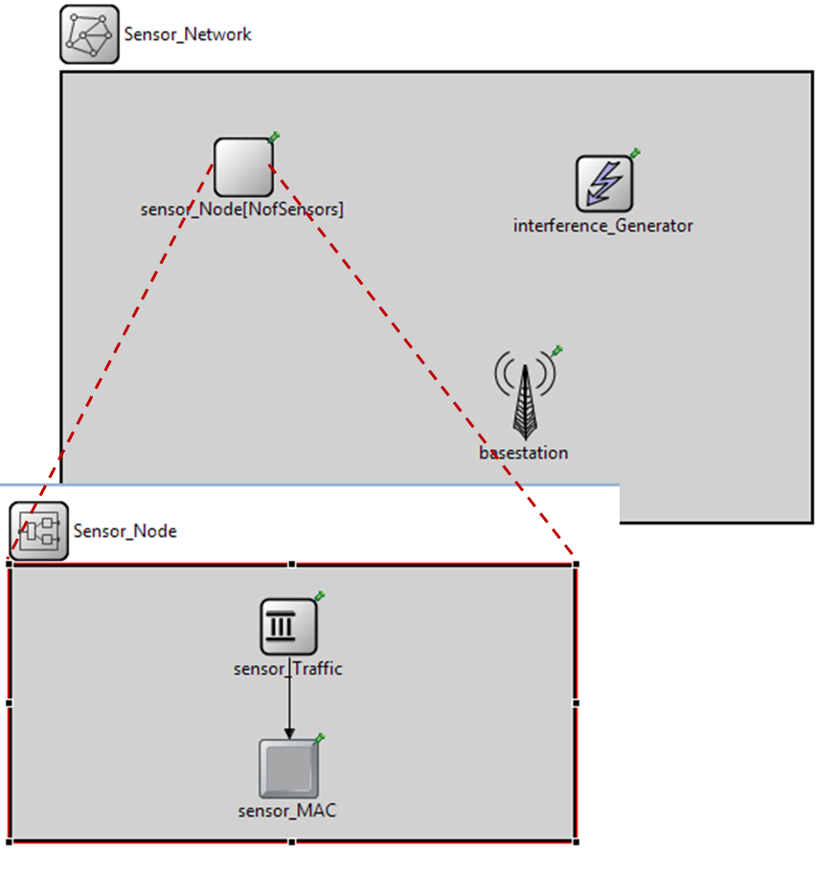

OMNET++ Simulation Model
Note: external interference disabled
$$100 ×100 m^{2}$$
Communication Range Vs Percentage of Hidden Nodes

Slide 10
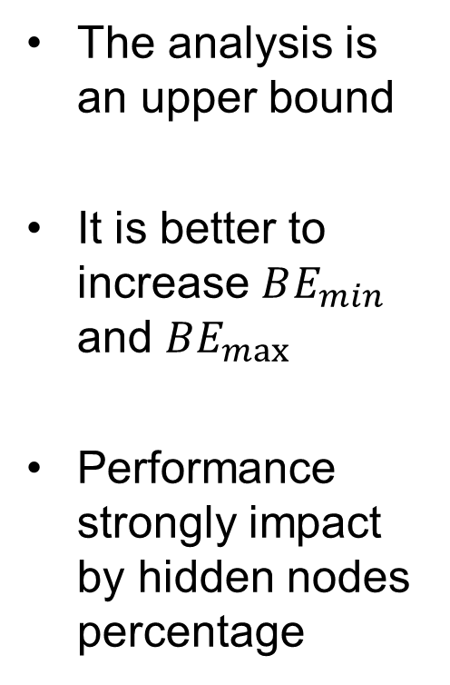
Analytical Model Verification
The analysis is an upper bound
It is better to increase $BE_{min}$ and $BE_{max}$
Performance strongly impact by hidden nodes percentage

Slide 11
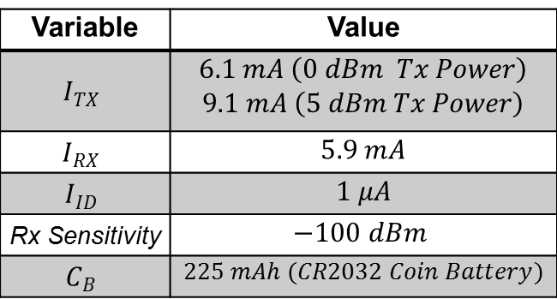


Mapping Hidden Nodes to Tx Power
TI CC2630 Datasheet
$d_{Max}$ to Percentage of Hidden Nodes from OMNET++ Model in Urban Environment
$$d_{Max}=\sqrt[n]{{10}^{\frac{\left(P_{Tx}−Rx Sensitivity−105\right)}{10}}×{503}^{2}}$$
Variable | Value
$$I_{TX}$$ | $$6.1 mA \left(0 dBm Tx Power\right)$$ $$9.1 mA \left(5 dBm Tx Power\right)$$
$$I_{RX}$$ | $$5.9 mA$$
$$I_{ID}$$ | $$1 μA$$
Rx Sensitivity | $$−100 dBm$$
$$C_{B}$$ | $$225 mAh (CR2032 Coin Battery)$$

Slide 12
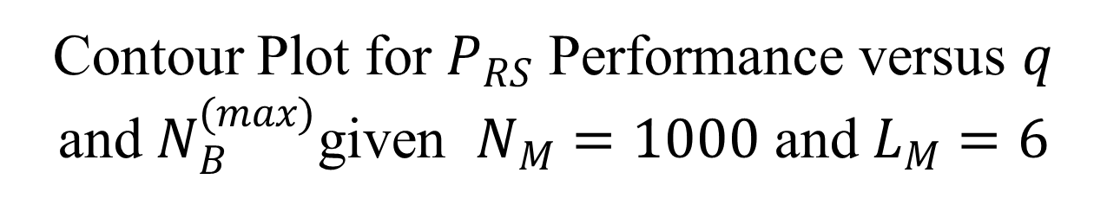
Contour Plot for $P_{RS}$ Performance versus $q$ and $N_{B}^{(max)}$given $N_{M}=1000$ and $L_{M}=6$

Slide 13
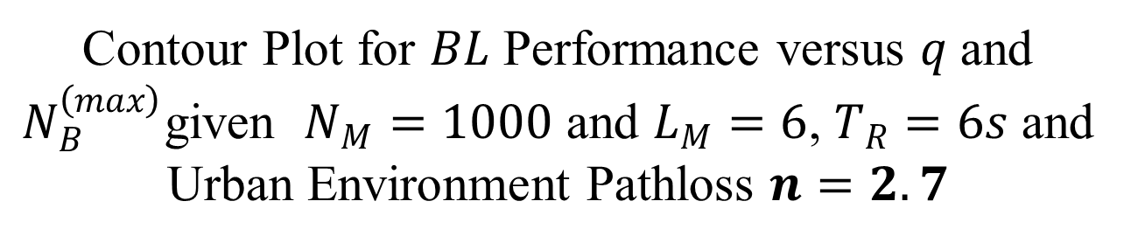
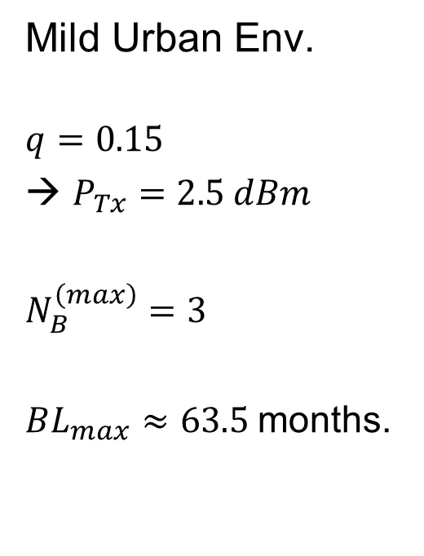
Contour Plot for $BL$ Performance versus $q$ and $N_{B}^{\left(max\right)}$given $N_{M}=1000$ and $L_{M}=6$, $T_{R}=6s$ and Urban Environment Pathloss $n=2.7$
Mild Urban Env.
$$q=0.15$$
→ $P_{Tx}=2.5 dBm$
$N_{B}^{\left(max\right)}=3$
$BL_{max}≈63.5$months.

Slide 14
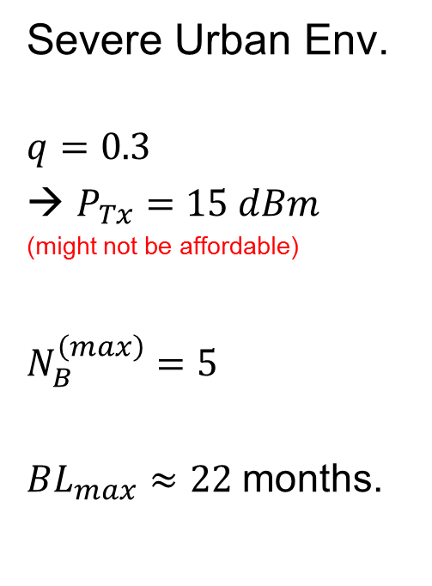
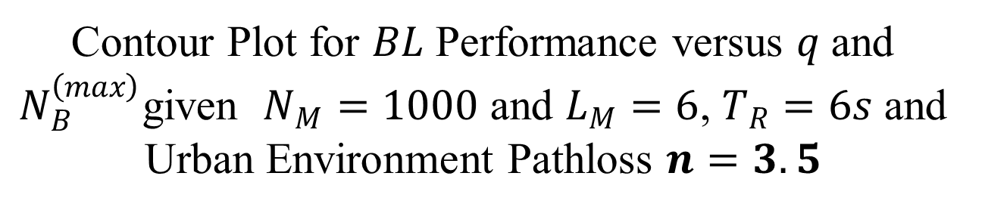
Contour Plot for $BL$ Performance versus $q$ and $N_{B}^{\left(max\right)}$given $N_{M}=1000$ and $L_{M}=6$, $T_{R}=6s$ and Urban Environment Pathloss $n=3.5$
Severe Urban Env.
$$q=0.3$$
→ $P_{Tx}=15 dBm$
(might not be affordable)
$N_{B}^{\left(max\right)}=5$
$BL_{max}≈22$months.

Slide 15
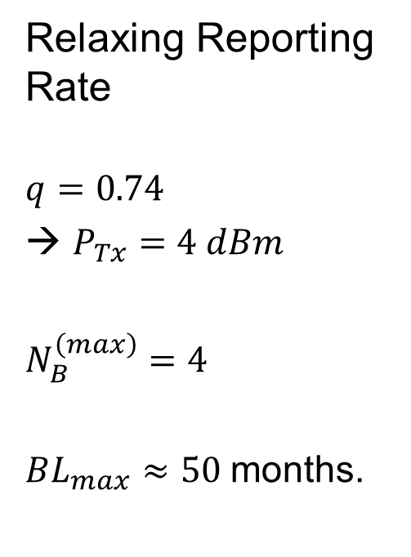
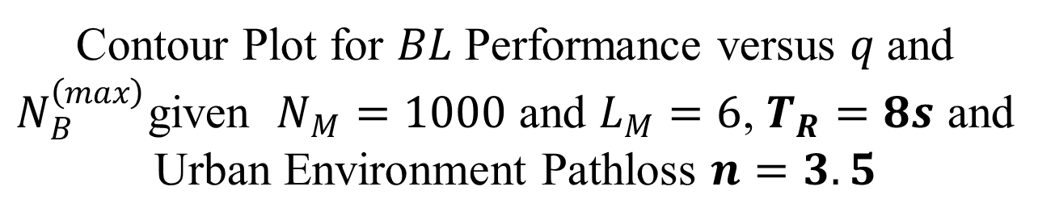
Contour Plot for $BL$ Performance versus $q$ and $N_{B}^{\left(max\right)}$given $N_{M}=1000$ and $L_{M}=6$, $T_{R}=8s$ and Urban Environment Pathloss $n=3.5$
Relaxing Reporting Rate
$$q=0.74$$
→ $P_{Tx}=4 dBm$
$N_{B}^{\left(max\right)}=4$
$BL_{max}≈50$months.

Slide 16
Conclusions & Further Proposals
Report Success Probability is improved by setting the backoff exponents to the maximum value
Report Probability Performance is affected by Hidden Nodes Percentage and Maximum Number of Backoffs
Controlling Hidden Nodes by Transmit Power can signifcantly improve performance
Further Proposals
  Controlling Hidden Nodes by Enhancing Sensing Algorithms
  Controlling Hidden Nodes by Base station Time Scheduling of Multiple PAN IDs

Slide 17
Thank You
Discussion?

