Slide 1
Project: IEEE P802.15 Working Group for Wireless Personal Area Networks (WPANs)
Submission Title: [Channel Modeling for MHN-E System]
Date Submitted: [13 March, 2017]
Source: [Junhyeong Kim¹, Ke Guan², Danping He², Gosan Noh¹, Bing Hui¹, Hee-Sang Chung¹ and Il Gyu Kim¹] Company [¹ETRI, ²Beijing Jiaotong University]
Address [218 Gajeong-ro, Yuseong-gu, Daejeon, 34129, KOREA]
Voice:[+82-42-860-6239], FAX: [+82-42-861-1966], E-Mail:[jhkim41jf@etri.re.kr]
Abstract: [This document presents channel modeling for MHN-E system]
Purpose: [For discussion]
Notice: This document has been prepared to assist the IEEE P802.15. It is offered as a basis for discussion and is not binding on the contributing individual(s) or organization(s). The material in this document is subject to change in form and content after further study. The contributor(s) reserve(s) the right to add, amend or withdraw material contained herein.
Release: The contributor acknowledges and accepts that this contribution becomes the property of IEEE and may be made publicly available by P802.15.

Slide 2
Contents
Objective
Ray-tracing Channel Modeling
  Simulation Configurations and Scenario Models
  Simulation Results
3GPP Channel Modeling
Future Plans

Slide 3
Contents
Objective
Ray-tracing Channel Modeling
  Simulation Configurations and Scenario Models
  Simulation Results
3GPP Channel Modeling
Future Plans

Slide 4
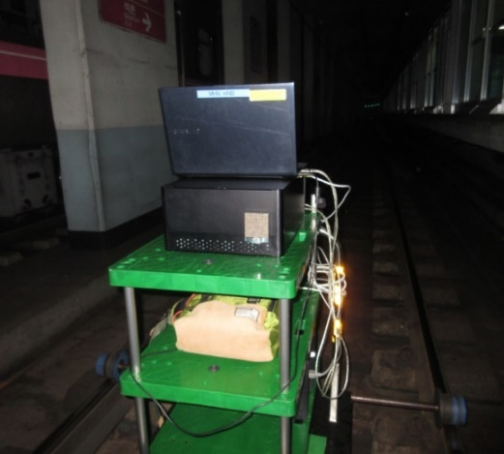
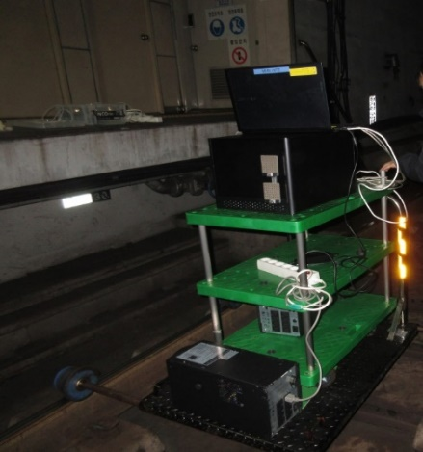
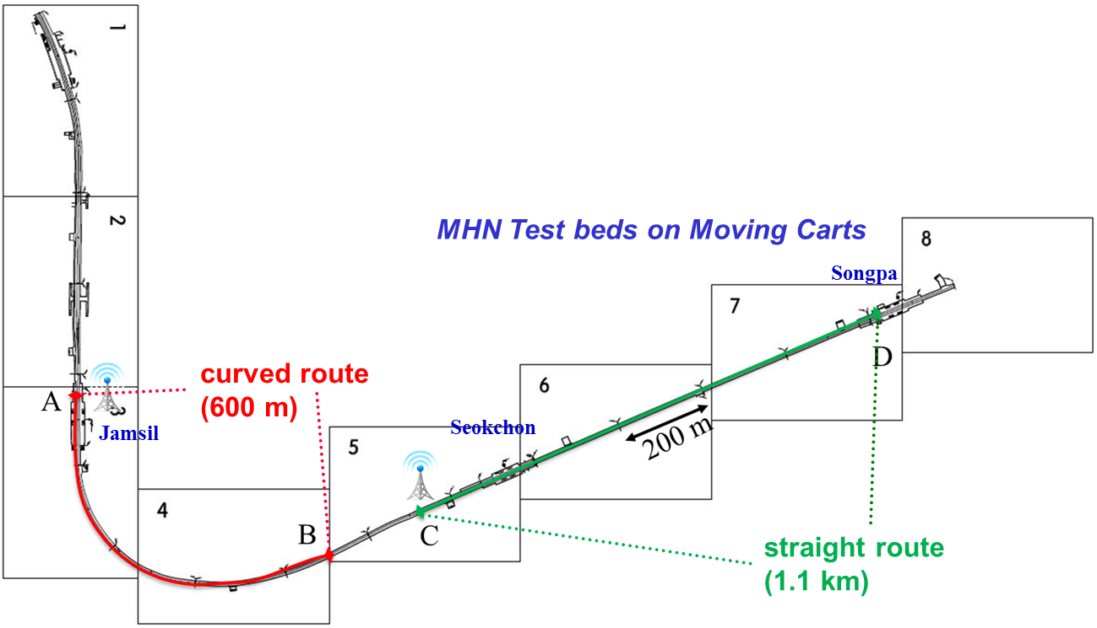
Objective
Coverage test of MHN system at Seoul subway line 8^{[1][2]}
  Very small delay spread, which was less than 60 ns
mRU/mDU
mTE
Antenna 0
Antenna 1

Slide 5
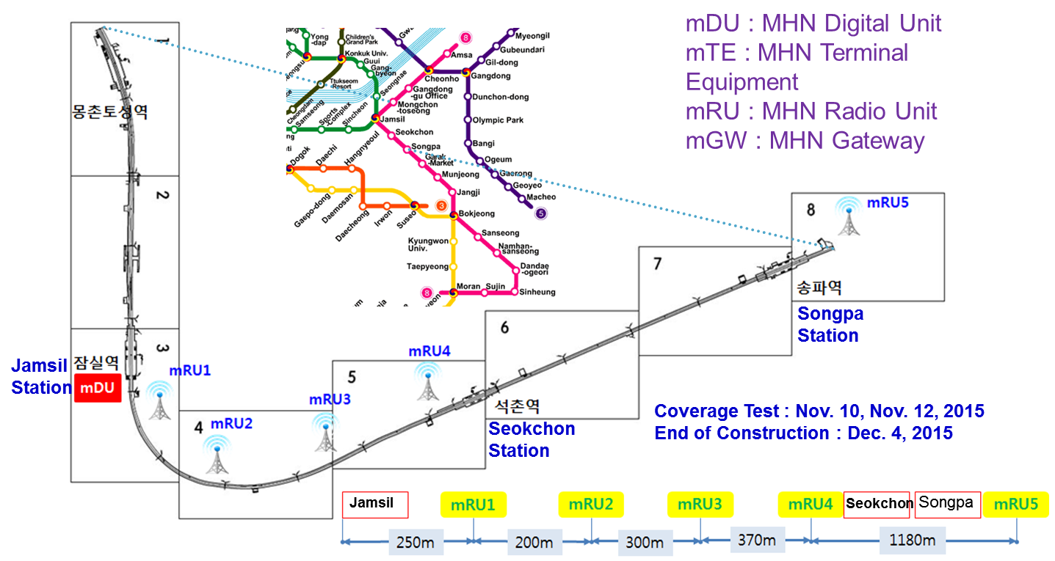
Objective
Field Trial of MHN system^{[1][3]}
  MHN test bed installation along Seoul subway line 8

Slide 6
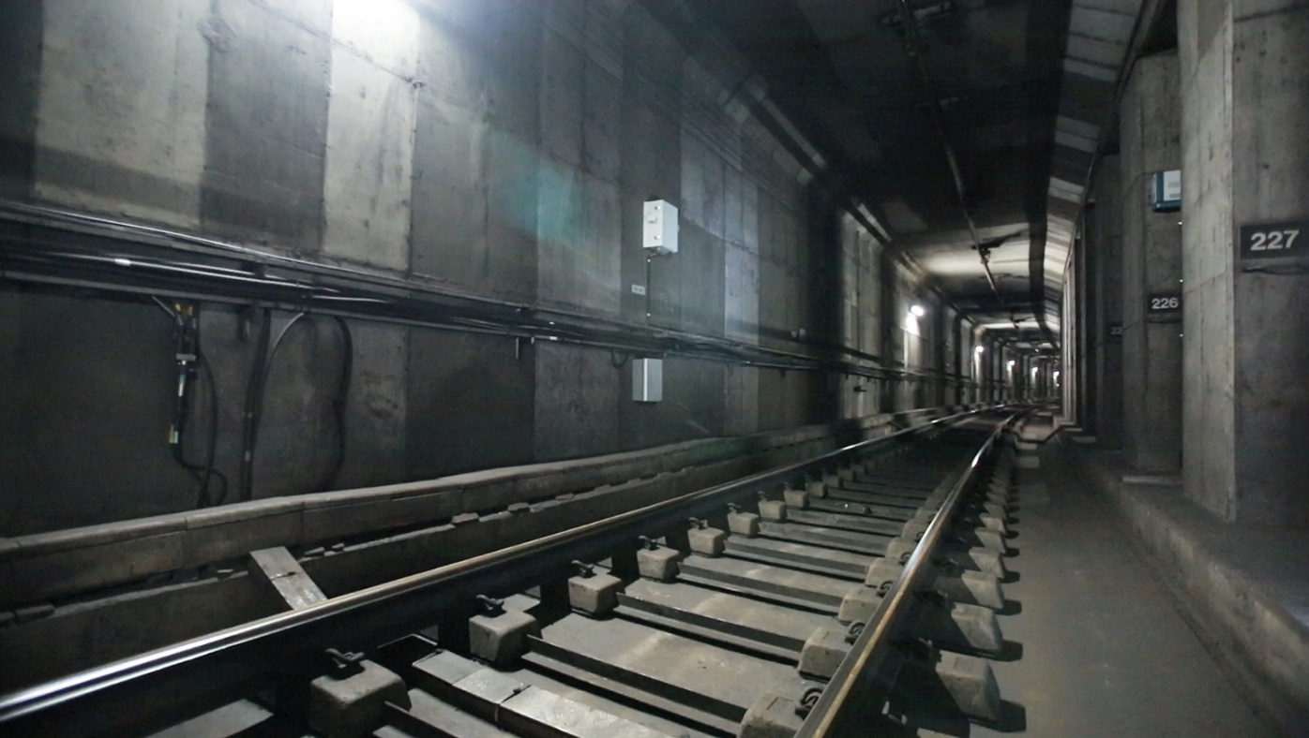
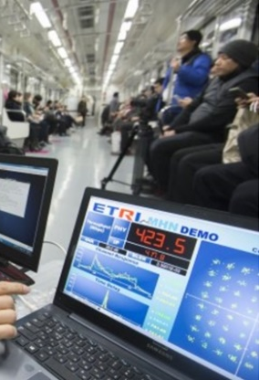
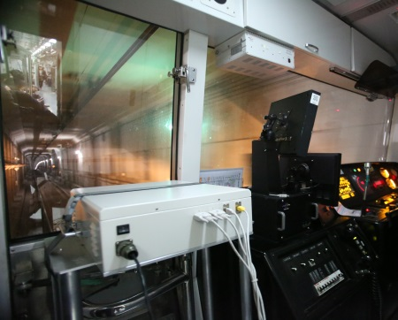
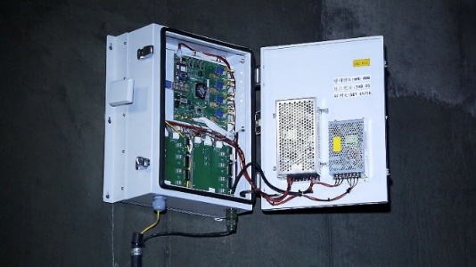
Objective
Field Trial of MHN system^{[1][3]}
  mRU & mTE test bed installation and performance evaluation of MHN system in the moving subway train
    Peak data rate of over 400Mbps was achieved
mTE
mRU

Slide 7
Contents
Objective
Ray-tracing Channel Modeling
  Simulation Configurations and Scenario Models
  Simulation Results
3GPP Channel Modeling
Future Plans

Slide 8
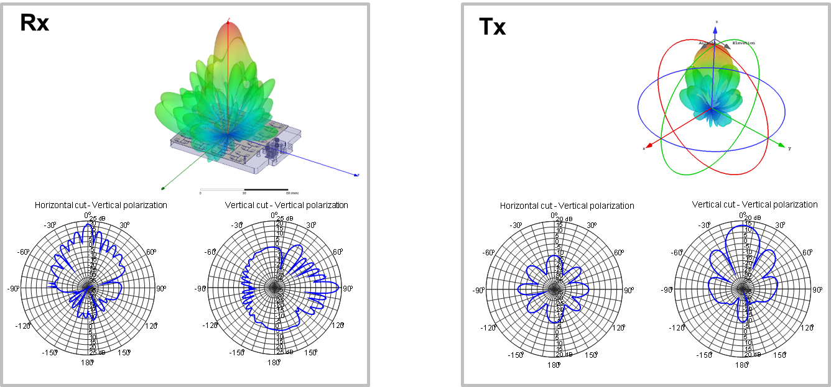
Simulation Configurations and Scenario Models
Antenna Parameters of MHN-E system
Name or ID | Pattern | Gain (dBi) | Polarization | Array size
Rx | HPBW_E=8 HPBW_H=8 | 22 | Dual polarized | 8x8
Tx | HPBW_E=16 HPBW_H= 16 | 16 | Dual polarized | 8x8

Slide 9
Simulation Configurations and Scenario Models
Frequencies and bandwidths
Mobility, distance and antenna selection for each scenario
Selection of applications and scenario types
Carrier Frequencies (GHz) | Simulated Bandwidth (MHz) | Bandwidth for analysis (MHz)
24 – 26.5 GHz | 2500 | 500
Application | Route shape | Speed (Km/h) |  |  | Distance (m) |  | Sample Interval(ms)
 |  |  |  |  |  |  | 0.25 | 10
Railway | Straight | 120 | 250 | 500 | 1000 | 1500 | ✓
 |  | ✓ |  | ✓ | ✓
 | Curve | 100 | 200 | 300 | 500 | 1000
 |  | ✓ |  |  | ✓
Application | Route shape | Scenarios
 |  | Outdoor
 |  | Urban | Rural | Station | Tunnel | Mountain
Railway | Straight | ✓ | ✓ |  | ✓
 | Curve | ✓ |  |  | ✓

Slide 10
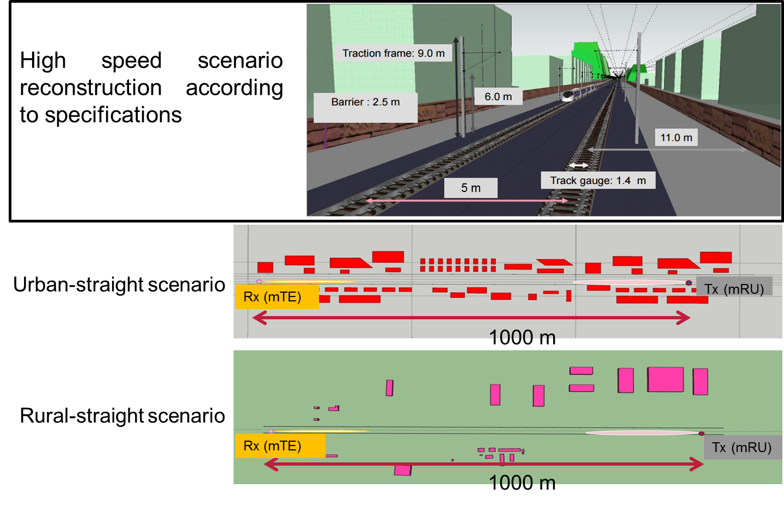
Simulation Configurations and Scenario Models
Reconstructed Environment Models for Straight Route

Slide 11
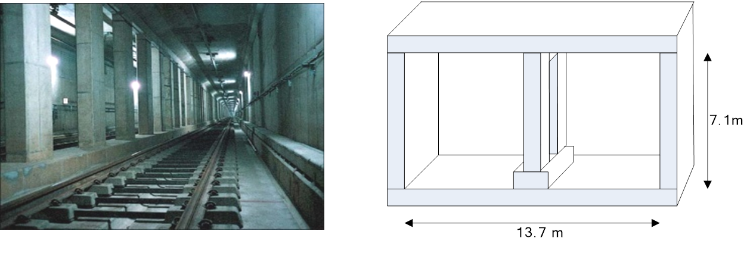

Simulation Configurations and Scenario Models
Reconstructed Environment Models for Straight Route
  Tunnel structure of Seoul subway line 8
  Reconstructed straight Tunnel
Tx (mRU)
1000 m

Slide 12
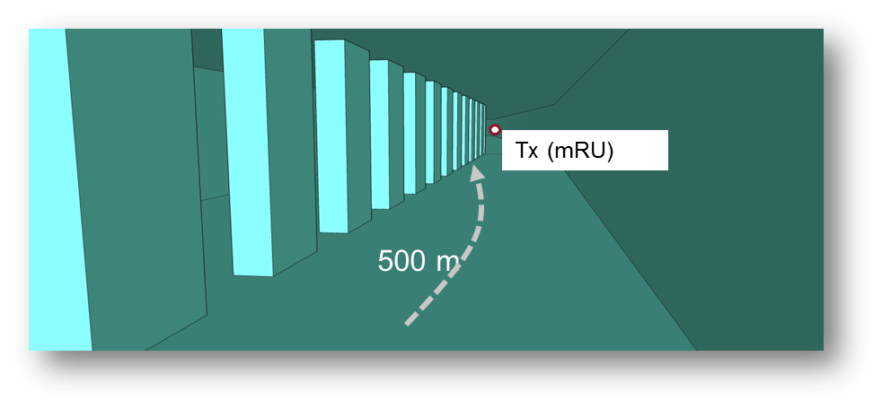
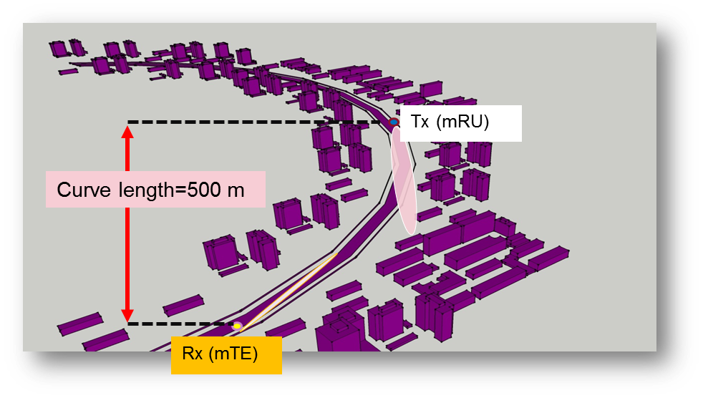
Simulation Configurations and Scenario Models
Reconstructed Environment Models for Curved Route
  Tunnel-curved
  Urban-curved

Slide 13
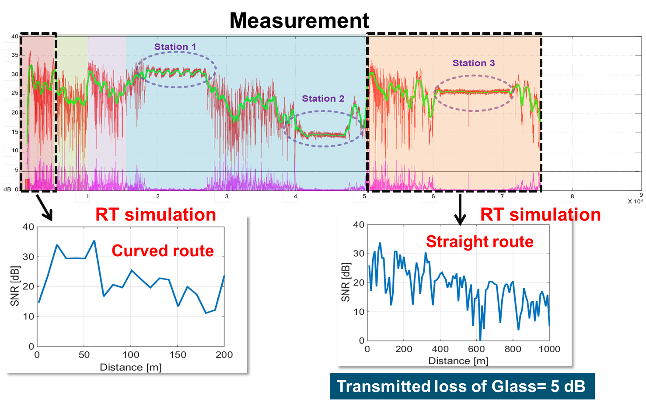
Simulation Results
Calibration of Raytracer – Measurement

Slide 14
Simulation Results
Simulation scenarios
Simulation metrics
  Rician K-factor
  RMS delay
  Coherence bandwidth
  Doppler effect (Doppler shift, Doppler spread)
  Coherence time
  Angular domain (AoA, AoD, EoA, EoD, ASA, ASD, ESA, ESD)
  XPD
  CPR
Application | Route shape | Scenarios
 |  | Outdoor
 |  | Urban | Rural | Station | Tunnel | Mountain
Railway | Straight | ✓ | ✓ |  | ✓
 | Curve | ✓ |  |  | ✓

Slide 15
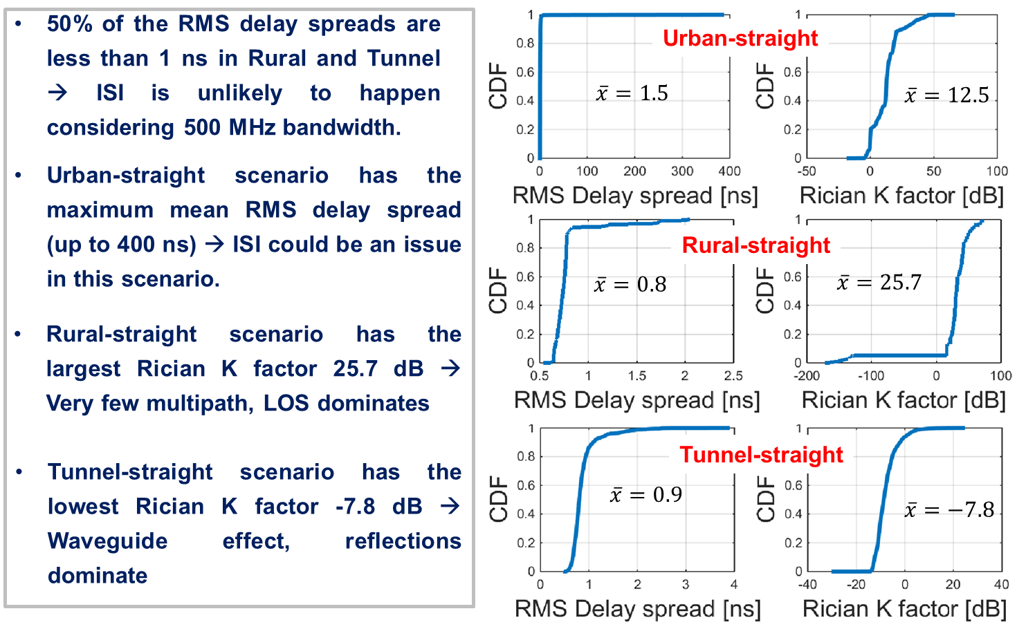
Simulation Results
RMS Delay Spread and Rician K Factor – Straight Route

Slide 16
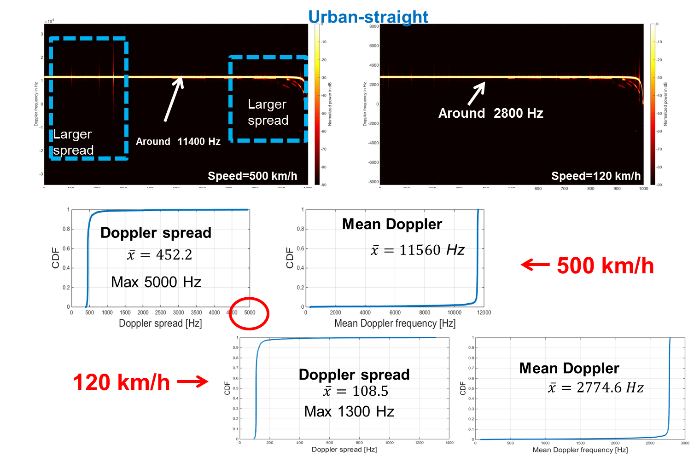
Simulation Results
Doppler Effect – Straight Route

Slide 17
Simulation Results
Simulation Results
  50% of the Doppler spreads are less than 452.3 Hz at 500 km/h
  50% of the Doppler spreads are less than 108.5 Hz at 120 km/h
  The mean of Doppler spread of all the scenarios are quite similar
  Tunnel has the maximum Doppler spread which reaches 22.5 KHz at 500 km/h, and 5.5 KHz at 120 km/h.

Slide 18
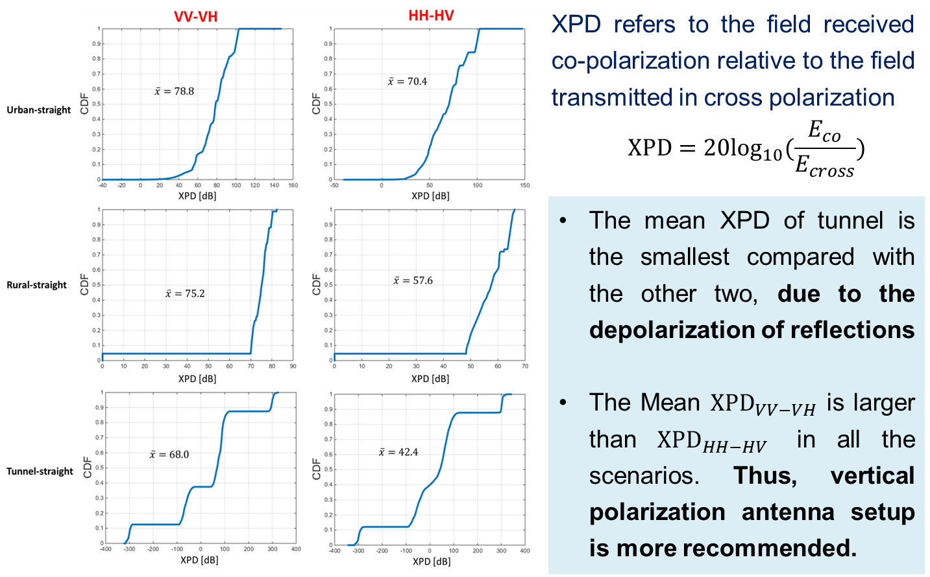
Simulation Results
XPD – Straight Route

Slide 19
Contents
Objective
Ray-tracing Channel Modeling
  Simulation Configurations and Scenario Models
  Simulation Results
3GPP Channel Modeling
Future Plans

Slide 20
3GPP channel model overview
3GPP channel model for above 6 GHz^{[4]}
  Supported carrier frequency = 6~100 GHz
  Supported channel bandwidth: Up to 10% of carrier frequency
  Supports 3D channel model
  mmWave propagation characteristics, e.g., blocking and atmosphere attenuation
  Scenarios for system level evaluation
    UMi (Urban micro): Street canyon, open area
    UMa (Urban macro): O2O and O2I
    Indoor: Office and shopping malls
    Backhaul
    D2D/V2V
  Models for link level evaluation
    Clustered Delay Line (CDL) models (for MIMO evaluation)
      NLOS: CDL-A/B/C, LOS: CDL-D/E
    Tapped Delay Line (TDL) models (for non-MIMO evaluation)
      NLOS: TDL-A/B/C, LOS: TDL-D/E

Slide 21
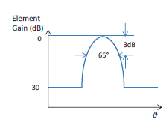
3GPP channel model overview
Antenna modeling
  Rectangular panel array antenna
  Dual-polarization
  Antenna element radiation pattern
    3-dB beam width = 65º
    Maximum directional gain = 8 dBi

Slide 22
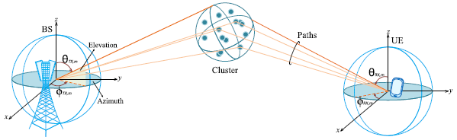
3GPP channel model overview
3D modeling concept
  Channel coefficients
  Each cluster is characterized by
    Delay
    Spatial angle of departure (AoD)
    Spatial angle of arrival (AoA)

Slide 23
3GPP channel model overview
Channel examples for link level evaluation

Slide 24
Contents
Objective
Ray-tracing Channel Modeling
  Simulation Configurations and Scenario Models
  Simulation Results
3GPP Channel Modeling
Future Plans

Slide 25
Future plans
Further performance validation of ray-tracing simulation through measurement campaign
  Collaboration with Fraunhofer HHI
Joint simulation is currently underway
  Link-level simulator and ray-tracing simulator of MHN and MHN-E systems
Link-level performance evaluation based on the 3GPP channel modeling for the purpose of numerology study

Slide 26
References
[1] | S. W. Choi et al., “Performance Evaluation of Millimeter-wave-based Communication System in Subway Tunnels”, IEEE 802.15-16-0185-01-hrrc, Mar. 2016
[2] | S. W. Choi et al., "Performance Evaluation of Millimeter-Wave-Based Communication System in Tunnels," 2015 IEEE Globecom Workshops, San Diego, CA, USA, 2015, pp. 1-5.
[3] | S. W. Choi, H. Chung, J. Kim, J. Ahn, and I. Kim, "Mobile Hotspot Network System for High-Speed Railway Communications Using Millimeter Waves," ETRI Journal, vol. 38, no. 6, pp. 1042-1051, December 2016.
[4] | 3GPP TR 38.900, “Channel model for frequency spectrum above 6 GHz,” V.1.0.1, Jun. 2016.

Slide 27
Thank you

