Slide 1
Project: IEEE P802.15 Working Group for Wireless Personal Area Networks (WPANs)
Submission Title: [TG12 ULI Report for Mar 2017 Session]
Date Submitted: [14 Mar 2017]
Source: [Patrick Kinney] Company [Kinney Consulting LLC]
Address [Chicago area, IL, USA]
Voice:[+1.847.960.3715], E-Mail:[pat.kinney@ieee.org]
Re: [TG12 Report for Mar 2017 Session.]
Abstract: [Report for the March Session]
Purpose: []
Notice: This document has been prepared to assist the IEEE P802.15. It is offered as a basis for discussion and is not binding on the contributing individual(s) or organization(s). The material in this document is subject to change in form and content after further study. The contributor(s) reserve(s) the right to add, amend or withdraw material contained herein.
Release: The contributor acknowledges and accepts that this contribution becomes the property of IEEE and may be made publicly available by P802.15.

Slide 2
Instructions for the WG Chair
The IEEE-SA strongly recommends that at each WG meeting the chair or a designee:
Show slides #1 through #4 of this presentation
Advise the WG attendees that:
The IEEE’s patent policy is described in Clause 6 of the IEEE-SA Standards Board Bylaws;
Early identification of patent claims which may be essential for the use of standards under development is strongly encouraged;
There may be Essential Patent Claims of which the IEEE is not aware. Additionally, neither the IEEE, the WG, nor the WG chair can ensure the accuracy or completeness of any assurance or whether any such assurance is, in fact, of a Patent Claim that is essential for the use of the standard under development.
Instruct the WG Secretary to record in the minutes of the relevant WG meeting:
That the foregoing information was provided and that slides 1 through 4 (and this slide 0, if applicable) were shown;
That the chair or designee provided an opportunity for participants to identify patent claim(s)/patent application claim(s) and/or the holder of patent claim(s)/patent application claim(s) of which the participant is personally aware and that may be essential for the use of that standard
Any responses that were given, specifically the patent claim(s)/patent application claim(s) and/or the holder of the patent claim(s)/patent application claim(s) that were identified (if any) and by whom.
The WG Chair shall ensure that a request is made to any identified holders of potential essential patent claim(s) to complete and submit a Letter of Assurance.
It is recommended that the WG chair review the guidance in IEEE-SA Standards Board Operations Manual 6.3.5 and in FAQs 14 and 15 on inclusion of potential Essential Patent Claims by incorporation or by reference.
Note: WG includes Working Groups, Task Groups, and other standards-developing committees with a PAR approved by the IEEE-SA Standards Board.

Slide 3
Participants, Patents, and Duty to Inform
All participants in this meeting have certain obligations under the IEEE-SA Patent Policy.
Participants [Note: Quoted text excerpted from IEEE-SA Standards Board Bylaws subclause 6.2]:
“Shall inform the IEEE (or cause the IEEE to be informed)” of the identity of each “holder of any potential Essential Patent Claims of which they are personally aware” if the claims are owned or controlled by the participant or the entity the participant is from, employed by, or otherwise represents
“Should inform the IEEE (or cause the IEEE to be informed)” of the identity of “any other holders of potential Essential Patent Claims” (that is, third parties that are not affiliated with the participant, with the participant’s employer, or with anyone else that the participant is from or otherwise represents)
The above does not apply if the patent claim is already the subject of an Accepted Letter of Assurance that applies to the proposed standard(s) under consideration by this group
Early identification of holders of potential Essential Patent Claims is strongly encouraged
No duty to perform a patent search
Slide #1

Slide 4
Patent Related Links
All participants should be familiar with their obligations under the IEEE-SA Policies & Procedures for standards development.
Patent Policy is stated in these sources:
IEEE-SA Standards Boards Bylaws
http://standards.ieee.org/develop/policies/bylaws/sect6-7.html#6
IEEE-SA Standards Board Operations Manual
http://standards.ieee.org/develop/policies/opman/sect6.html#6.3
Material about the patent policy is available at
http://standards.ieee.org/about/sasb/patcom/materials.html
If you have questions, contact the IEEE-SA Standards Board Patent Committee Administrator at patcom@ieee.org or visit http://standards.ieee.org/about/sasb/patcom/index.html
This slide set is available at https://development.standards.ieee.org/myproject/Public/mytools/mob/slideset.ppt
Slide #2

Slide 5
Call for Potentially Essential Patents
If anyone in this meeting is personally aware of the holder of any patent claims that are potentially essential to implementation of the proposed standard(s) under consideration by this group and that are not already the subject of an Accepted Letter of Assurance:
Either speak up now or
Provide the chair of this group with the identity of the holder(s) of any and all such claims as soon as possible or
Cause an LOA to be submitted
Slide #3

Slide 6
TG12 Officers
Chair Pat Kinney
Vice Chair Charlie Perkins
Slide 6
Notes:
March 17
Page 6

Slide 7
TG 12 Status Update
Discussion on mandatory elements of 802.15.12
Management Protocol Module
Configuration: adopted the concept of a profile methodology where each identified profile consists of the configuration parameters for a specific, identified implementation for either the 15.4 device or another protocol module
Management/Monitor: adopts and extends the OMA LWM2M object definitions for 802.15.4
Discovery: function will determine if an end device is ULI capable or not
PDE
Will leverage the MMI concepts
Fragmentation block is eliminated, it is inherent in the 6LoWPAN protocol module
MMI
Will leverage the 802.15.9 multiplex concepts, using MPX IE and ULI IE
Fragmentation block is eliminated, it is inherent in the MMI header structure
Use of lower 32 dispatch addresses allow 2-octet Protocol ID to be elided
PassThru
Required to allow 6LoWPAN communications to pass through PDE and MMI to 802.15.4 device
Required to allow application to directly configure 802.15.4 device via MLME SAP and send messaging via MCPS SAP
Slide 7
Notes:
March 17
Page 7

Slide 8
TG 12 Status Update (continued)
Discussion on optional elements of 802.15.12
6LoWPAN
Moved fragmentation function back into protocol module
Ranging and Location Support -- RLS Protocol Module:
Document 15-17-0082-00-0012 presented, advancing the operating concepts for the RLS module, including active two-way ranging and passive gathering of location enabling information, and beginning the definition of the SAP operations necessary to support this functionality.
Slide 8
Notes:
March 17
Page 8

Slide 9
TG12 Meeting Goals (agenda: 15-17-0158-00)
Tuesday 14 Mar, AM1: Opening report, Agenda, Status and Functional decomposition review
Tuesday 14 Mar, AM2: Session focus: Header Compression, PDE, MMI, Management Protocols Module (MPM), assignment of functional blocks not already assigned
Wednesday 15 Mar, AM1: Detailed discussion on PDE
Thursday 16 Mar, AM1: Detailed discussion on MMI
Thursday 16 Mar, AM2: Detailed discussion on MPM
Thursday 16 Mar, PM2: Detailed discussion on header compression, Generic Module, Assigned module status, recap on week’s efforts, define the next steps, timetable for completion, phone calls
Slide 9
Notes:
March 17
Page 9

Slide 10
TG12 Meeting
Tuesday 14 Mar, AM1: Opening report, Agenda, Status and Functional decomposition review
Approve Agenda 15-17-0158-00
Approve Minutes from previous session, 15-17-0083-00
Status Update
Functional Decomposition Review
Slide 10
Notes:
March 17
Page 10

Slide 11
Backup Slides

Slide 12
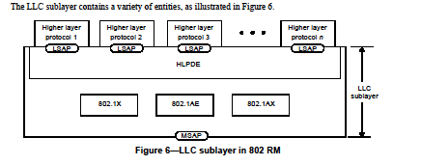
802-2014 Reference Model
Slide 12
Notes:
March 17
Page 12

Slide 13
802-2014 Reference Model
Slide 13
Notes:
March 17
Page 13

Slide 14
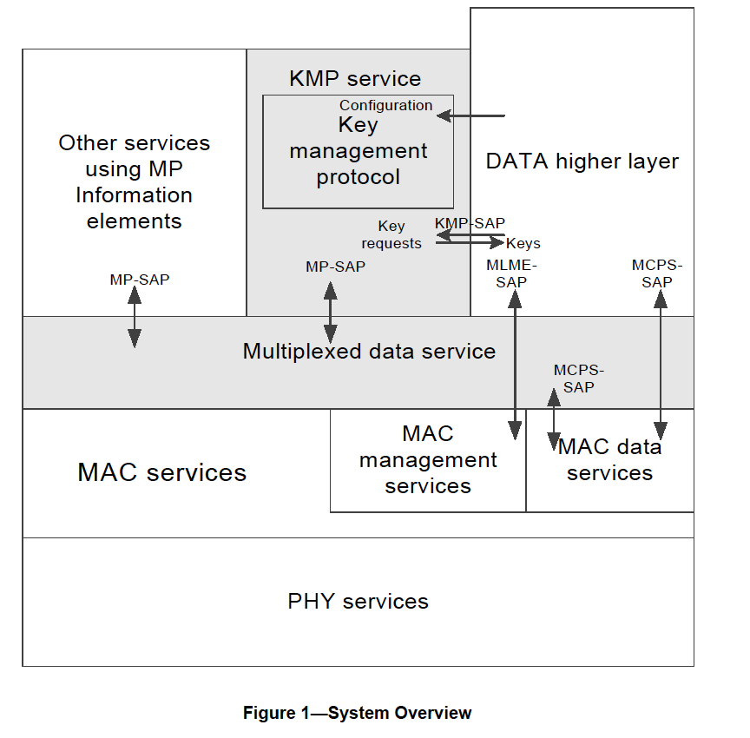
802.15.9 Functional Decomposition

Slide 15
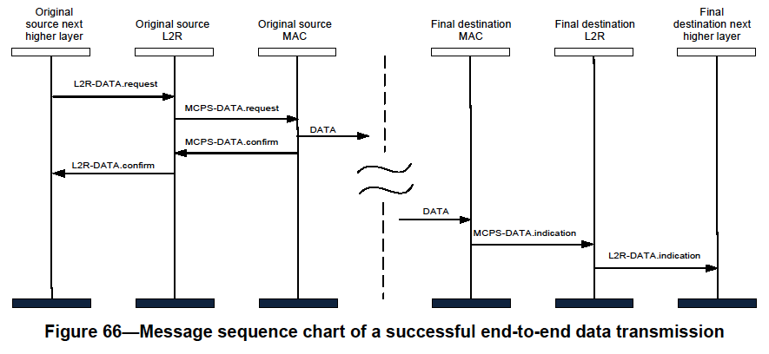
802.15.10 Functional Decomposition
The Data SAP and the MCPS-SAP are used for Multicast as indicated in Figure 19 and Figure 66
The MGMT SAP and the MLME-SAP are used as indicated in Figures 3 through 13

Slide 16
Deliverables
Deliverables
Management SAP
Configuration Management
Dynamic PHY management
B Rolfe to provide
Network
Set-Up
MAC
Set-Up
PHY
Set-Up
Security
Set-Up
TSCH set-up
P Kinney to provide
Channel Hopping
Yang Modeling
L2 Routing
C Perkins to provide
Data SAP
Protocol Differentiation
EtherType
Security
KMP (802.15.9)
ETSI TS102887-2
802.1x
Internet Key Exchange (IKE)
Dragonfly
PANA
Vendor specific
MAC Resource Management
Priority
GTS management
TSCH Operation
P Kinney to provide
Fragmentation
Adaptive
PHY (PSDU)
UpperLayer
802.15.9
6LoWPAN
Location awareness
Ranging
B Verso to provide
Slide 16
Notes:
March 17
Page 16

Slide 17
Deliverables
Management SAP
Configuration Management
PHY
Set-Up
Channel
Center frequency
Channel number
Regional band
Bandwidth
Modulation
Channel page
Preamble
Code
Repetition
FCS size
Packet Length
Data Rate
Transmit Power level
Data Whitening
Common Signalling Mode
ED Threshold
Spreading Factor
DSSS code
CCA
Mode
duration
FEC?
Rate
Coding
Interleaving
SFD
Size
value
Slide 17
Notes:
March 17
Page 17

Slide 18
Deliverables
Management SAP
Configuration Management
MAC
Set-Up
FFD?
Beacon-enabled?
DSME?
Seong-Soon Joo to provide
Superframe parameters
Low Energy?
Parameters
Channel Hopping?
parameters
Association?
Fast?
Synchronization
Superframe
TSCH
ACK required?
Promiscuous mode?
Ask Packet Sniffer vendors or chipset vendors
Device Announcement
UL IEs?
parameters
Slide 18
Notes:
March 17
Page 18

Slide 19
Deliverables
Management SAP
Configuration Management
Network
Set-Up
PAN Coordinator?
Beacon-enabled?
Low Energy?
Association?
Fast?
Permit to Join?
Criteria to accept
Short Address?
Assignment
Channel Scan
Slide 19
Notes:
March 17
Page 19

Slide 20
Management Protocol Configuration Parameters via MGMT SAP - MAC
Operational | Op enumerations
Device Type | FFD, RFD, RFD-TX, RFD-RX
PAN | Set-up, discovery
Slide 20
Notes:
March 17
Page 20

Slide 21
Management Protocol Configuration Parameters via MGMT SAP - MAC
Optional Modes | Configuration set-up
Generic (GTS) [beacon-enabled] | Superframe
DSME | Superframe
TSCH | Slotframe
SUN [Nonbeacon-enabled] |  | phyCurrentChannel, ChanCenterFreq0 NumChan, ChanSpacing phyCurrentPage, phyCurrentSUNPageEntry, phyNumSUNPageEntriesSupported phySUNPageEntriesSupported macPanId, macCoordShortAddress phySUNChannelsSupported
TVWS
LECIM (lp-wan)
RFID
RCC
Generic [non-beacon-enabled]
Slide 21
Notes:
March 17
Page 21

Slide 22
Management Protocol Configuration Parameters via MGMT SAP - MAC
Option behaviors | Option details
Association
Security | Integrity, Encryption
Promiscuous
Ranging
Low Energy | CSL, RIT, IRIT
Priority
Metrics | MAC Metrics IE/All MAC Metrics IE
Channel Hopping | Channel hopping IE, macHoppingSequenceLength, macHoppingSequenceList, macHoppingSequenceId, macNumberofChannels, macPhyConfiguration, macExtendedBitmap
IEs | Header, Payload
TRLE
Spectrum Tracking
Slide 22
Notes:
March 17
Page 22

Slide 23
Management Protocol Configuration Parameters via MGMT SAP
PHY Parameters | PHY Parameters - detail
Channel | phyCurrentChannel = Number: phyCurrentPage
Modulation type | O-QPSK, BPSK, FSK, MSK, OFDM, CSS, UWB-HR, UWB-LR, ASK
Preamble | Code/repetition: phyFskPreambleLength, SecondaryFskPreambleLength
FCS size | 2, or 4
Packet Length | aMaxPhyPacketSize = 127, or 2047, or phyLecimDsssPsduSize
Operating Mode
Data Rate (kb/s) | 2.4, 4.8, 6.25, 9.6, 10, 12.5, 16, 19.2, 20, 25, 31.25, 32, 36, 38.4, 40, 50, 100, 110, 150, 156, 200, 234, 250, 300, 312, 468, 600, 624, 800, 850, 936, 1000, 1404, 1562.5, 1638, 2000, 3125, 6250, 6810, 27240
Transmit power level | phyTxPower
CCA | 1, 2, 3, 4, 5, 6, : aCcatime/phyCCADuration
FEC | Off/On, rate, code, interleaving: phyFskFecEnabled, phyFskFecInterleavingRsc, phyFskFecScheme/phyTvwsFskFecScheme, phyLecimFecTailBitingEnabled
SFD | Size/value: phySunFskSfd, phyTvwsSfdLength, phyLecimDsssSfdPresent, SecondaryFskSfd
Slide 23
Notes:
March 17
Page 23

Slide 24
Management Protocol Configuration Parameters via MGMT SAP
PHY Parameters (cont’d) | PHY Parameters - detail
TX<->RX | aTurnaroundTime
ED threshold
Spreading factor
DSSS code
Data whitening
Common signaling mode
Slide 24
Notes:
March 17
Page 24

Slide 25
Example of Options Used for Secured SUN FSK Device
Slide 25
Notes:
March 17
Page 25

Slide 26
Example of Options Used for LECIM O-QPSK Device
Slide 26
Notes:
March 17
Page 26

Slide 27
Example of Options Used for 6tisch O-QPSK Device
Slide 27
Notes:
March 17
Page 27

Slide 28
Future Efforts
Functional Module Technical Details
PDE P Kinney
MMI P Kinney
Management Protocol H Yokota
6LoWPAN
KMP
802.1X
L2R C Perkins
6tisch
Ranging B Verso
Generic
Functional Block Overview
How do they work?
What functions do they include?
How do the SAPs work?
What primitives are required?
What parameters are required?
Slide 28
Notes:
March 17
Page 28

Slide 29
Meeting Accomplishments
Discussion on mandatory elements of 802.15.12
Management Protocol Module
Configuration: adopted the concept of a profile methodology where each identified profile consists of the configuration parameters for a specific, identified implementation for either the 15.4 device or another protocol module
Management/Monitor: adopts and extends the OMA LWM2M object definitions for 802.15.4
Discovery: function will determine if an end device is ULI capable or not
PDE
Will leverage the MMI concepts
Fragmentation block is eliminated, it is inherent in the 6LoWPAN protocol module
MMI
Will leverage the 802.15.9 multiplex concepts, using MPX IE or ULI IE
Fragmentation block is eliminated, it is inherent in the MMI header structure
Use of lower 32 dispatch addresses allow 2-octet Protocol ID to be elided
PassThru
Required to allow 6LoWPAN communications to pass through PDE and MMI to 802.15.4 device
Required to allow application to directly configure 802.15.4 device
Slide 29
Notes:
March 17
Page 29

Slide 30
Meeting Accomplishments
Discussion on optional elements of 802.15.12
6LoWPAN
Moved fragmentation function back into protocol module
Ranging and Location Support -- RLS Protocol Module:
Document 15-17-0082-00-0012 presented, advancing the operating concepts for the RLS module, including active two-way ranging and passive gathering of location enabling information, and beginning the definition of the SAP operations necessary to support this functionality.
L2R
No progress this session
KMP
No progress this session
6top
No progress this session
Slide 30
Notes:
March 17
Page 30

Slide 31
Schedule
TASK | Start | Completed
TG12 | May, 2016 | Mar, 2019
Concept and Architecture | May, 2016 | Nov, 2016
Baseline definition | Nov, 2016 | July, 2017
Draft | May, 2017 | Nov, 2017
TG Comment Collection | Sept, 2017 | Jan, 2018
WG Letter Ballot | Dec, 2017 | Mar, 2018
Sponsor Ballot | Aug, 2018 | Jan, 2019
NesCom | Jan, 2019 | Mar, 2019
IEEE-SA Publication | Mar, 2019 | June, 2019
Slide 31
Notes:
March 17
Page 31

