Slide 1
Project: IEEE P802.15 Working Group for Wireless Personal Area Networks (WPANs)
Submission Title: [Liaison Report on 802.11 for January 2017]
Date Submitted: [19, January, 2017 ]
Source: [Al Petrick 802.11] Company [Jones-Petrick and Associates]
Address [Orlando, Florida, 32832]
Voice:[321-235-3269], FAX: [], E-Mail:[al@jpasoc.com ]
Re: [Liaison Report on 802.11 for January, 2017]
[If this is a response to a Call for Contributions, cite the name and date of the Call for Contributions to which this document responds, as well as the relevant item number in the Call for Contributions.]
[Note: Contributions that are not responsive to this section of the template, and contributions which do
not address the topic under which they are submitted, may be refused or consigned to the “General Contributions” area.]
Abstract: [Liaison Report on 802.11 for January, 2017]
Purpose: [Informative]
Notice: This document has been prepared to assist the IEEE P802.15. It is offered as a basis for discussion and is not binding on the contributing individual(s) or organization(s). The material in this document is subject to change in form and content after further study. The contributor(s) reserve(s) the right to add, amend or withdraw material contained herein.
Release: The contributor acknowledges and accepts that this contribution becomes the property of IEEE and may be made publicly available by P802.15.
NOTE: Update all red fields replacing with your information; they are required. This is a manual update in appropriate
fields. All Blue fields are informational and are to be deleted. Black stays. After updating delete this box/paragraph.

Slide 2
802.11 Liaison Report
Grand Hyatt Buckhead
Atlanta, Georgia January 2017

Slide 3
IEEE 802.11 Standards Pipeline
MAC
802.11
-2016
802.11aq
PAD
802.11az
NGP
802.11ak
GLK
802.11ba
WUR
802.11ai
FILS
WNG
Light Comms
(LC) TIG
802.11ax
HEW
802.11ah
< 1Ghz
802.11ay
NG60
802.11aj
CMMW
MAC & PHY
Discussion Topics
TIG/Study
groups
TG without
Approved draft
WG
Letter Ballot
Sponsor
Ballot
Published
Amendment
Published
Standard
3
Notes:
doc.: IEEE 802.11-11/0483r0
May 2011
Bruce Kraemer (Marvell)
Page 3

Slide 4
802.11 Task Groups in Comment Resolution
Task Group | Ballot | Draft | Comments | Resolved | Plans March 2017 | Closing Report
TGax | LB225 | D1.0 | 6,000 ;-( | ~200 ;-) | Continue comment resolution | 17/0179r0
TGaq | SB #1 | D7.0 | 235 | 216 ;-) | Continue comment resolution SB recirc #1 | 17/0165r0
TGaj | LB226 | D4.0 | 27 | ALL | Prepare D5.0 for 15-day WG recirc LB and prepare for Sponsor Balloting | 17/0160r0
TGak | LB227 | D3.0 | 57 | 49 | Continue comment resolution | 17/0182r0

Slide 5
802.11ax (HEW)
LB225 on D1.0 completed January 8, 2017
LB 225 failed (58% approval)
6,000+ comments
~ 200 technical comments resolved
Slow progress with comment resolution
Spatial Reuse (SR) was discussed in detail
Plans for March 2017
Hold comment resolution Ad-hoc meeting in SanDiego, CA March 8 – 10, 2017 (week before Vancouver 802 session)
Closing report: 17/0179r0

Slide 6
802.11WNG (Wireless Next Generation)
Presentations reviewed
“Issue of 802.11 WLAN on Congested Primary Channel,” Kazuto Yano, Advanced Telecommunications Research Institute International (ATR)
https://mentor.ieee.org/802.11/dcn/17/11-17-0129-03-0wng-issue-of-congested-primary-channel-in-802-11-wlan.pptx
Need additional data for WNG consideration
Closing report:17/0172r0

Slide 7
802.11ba [WUR –(Wake-Up Radio)]
Held 1st session as Task Group TGba
Reviewed 21 presentations
WUR - Discovery, usage models, WUR front-ends –OOK receiver
Confirmed Secretary
Agreed to a target Timeline
TGba Draft D1.0 – March 2018
REVcom 2020
Plans for March 2017
Elect 2 - Vice-Chairs and Editor
Begin work on Use Cases, Functional Requirements, Evaluation Methodology and Simulation scenarios
Closing Report: 17/0175r0

Slide 8
802.11ay (Next Generation 60 GHz (20Gb/s)
29 technical submissions
Channel model
Specification Framework Document (SFD)
Review Draft D0.1
Plans for March 2017
Review technical submissions
Complete draft D0.2 for internal comment review
Closing report: 17/0002

Slide 9
Light Communications (LC) (Topic Interest Group)
Approved framework for LC report
Technical applicability documents presented
17/0125r0
17/0168r1
Plans for March 2017
Reach out to other industry stakeholders and organizations for liaisons to 802.11 LC TIG
Provide Tutorial at IEEE 802 in Vancouver
Continue work on technical feasibly LC report
Complete LC report in May 2017
Closing report: 17/0176r0

Slide 10
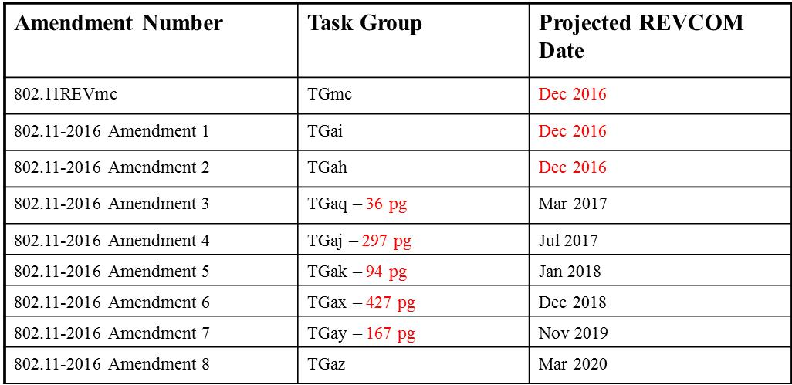
Editor’s Projected Completion of 802.11 Amendments
Closing report: 17/0008r2

Slide 11
Thank you !!

