Slide 1
Project: IEEE P802.15 Working Group for Wireless Personal Area Networks (WPANs)
Submission Title: [Proposal for sub-GHz Interference Model]
Date Submitted: [13 October, 2017]
Source: [Joerg ROBERT, Hendrik LIESKE, Sebastian RAUH] Company [Friedrich-Alexander University Erlangen-Nuernberg]
Address [Am Wolfsmantel 33, 91058 Erlangen, Germany]
Voice:[+49 9131 8525373], FAX: [+49 9131 8525102], E-Mail:[joerg.robert@fau.de]
Abstract: [This document presents a proposal for an interference channel model for LPWAN]
Purpose: [Presentation within IEEE802.15 Interest Group LPWA]
Notice: This document has been prepared to assist the IEEE P802.15. It is offered as a basis for discussion and is not binding on the contributing individual(s) or organization(s). The material in this document is subject to change in form and content after further study. The contributor(s) reserve(s) the right to add, amend or withdraw material contained herein.
Release: The contributor acknowledges and accepts that this contribution becomes the property of IEEE and may be made publicly available by P802.15.

Slide 2
Proposal for sub-GHz Interference Model
Joerg Robert, Hendrik Lieske, Sebastian Rauh FAU Erlangen-Nuernberg

Slide 3
Motivation
License-exempt frequency bands are shared with other users / systems
LPWAN systems have to cope with uncoordinated interference from other systems
Especially important in case of highly exposed reception antennas
Interference from other systems has to be modeled to estimate the degradation on LPWAN algorithms

Slide 4
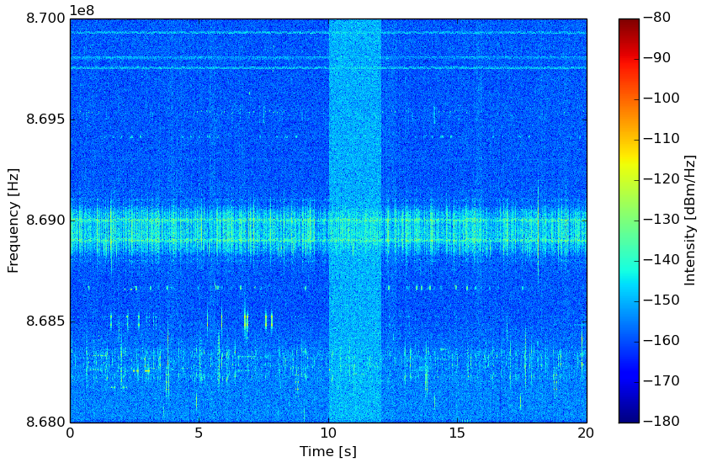
Example: Measured Spectrum in 868MHz Band in Germany
Antenna height of 140m over ground

Slide 5
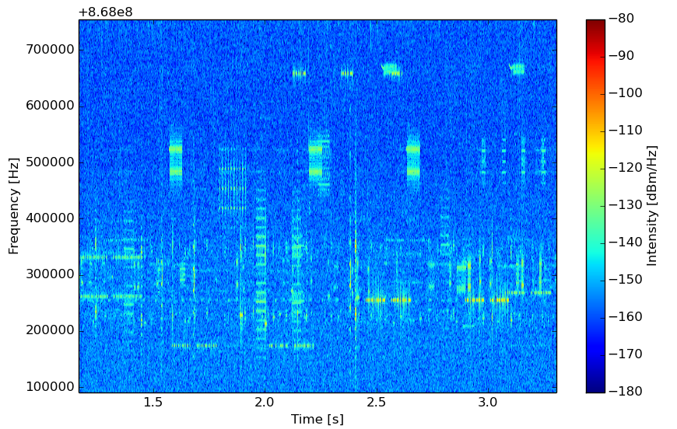

Slide 6
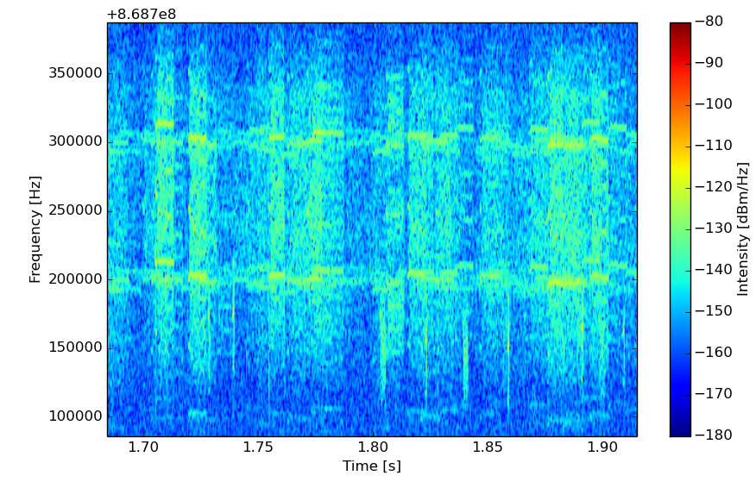

Slide 7
Assumptions
No coordination between different interferers
Interferers are randomly placed with defined density
Interferers and desired signals use the same propagation models ($PL(d)$)
Interferes are modelled using white Gaussian noise with defined bandwidth
No additional log-normal fading nor multi-path propagation are considered for the interferers

Slide 8
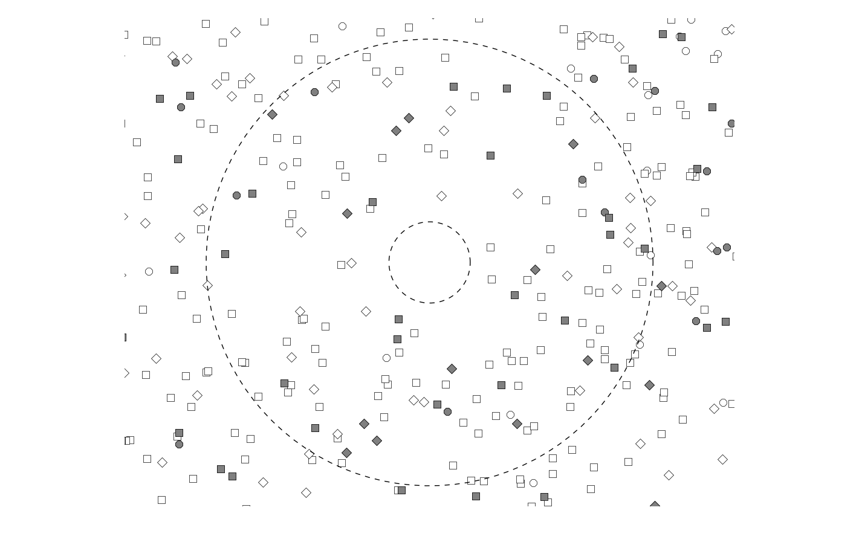
Assumption of Infinite Plane
$$r_{max}$$
$$r_{min}$$
$r_{min}$ is the minimum distance between the base-station and the closest interferer (required by channel model)
$r_{max}$ is the distance in which interferes impair the base-station (no impact if below thermal noise level, depends on path-loss model)

Slide 9
Arrival Rate of Interferers
The data traffic can be modeled using the well-known arrival process [1], as all interferes are assumed to be uncoordinated
➔ Interferes will follow Poison distribution
$λ$ is the arrival rate (i.e. the mean number of active interferes per second)
$λ∙τ$ is the average number of arrivals in the time interval $τ$
The inter-arrival times between two arrivals is given by $P\left\{τ_{n}≤s\right\}=1−e^{−λs}$ with $s≥0$. , i.e. an exponential distribution

Slide 10
Properties of the Arrival Process
$$Δt_{0}$$
$$Δt_{1}$$
$$Δt_{2}$$
$$t_{0}$$
$$t_{1}$$
$$t_{2}$$
$$t_{3}$$
$t_{x}$ denote the position of the $x−th$ arrival
$Δt\sim Exp(λ)$, i.e. $Δt$ are exponentially distributed
$Δt_{x}$ are mutually independent
Modelling requires only parameter $λ$

Slide 11
Further Model Requirements
Model has to be valid in different antenna configurations
Indoor, ..., highly exposed antenna
Model should be valid for all types of modulation schemes (e.g. narrow-band and spreading)
Effects such as the simulation bandwidth (not the signal bandwidth) should not have any effect
The model should support multiple interferer types (interference layers) with different parameters such as length and bandwidth

Slide 12
Proposed Model Definition
Definition of multiple layers to cover different interferer types
Required layer parameters are bandwidth, transmit power, bandwidth and the signal length
Example layer configuration:
Layer | Mean Arrival Rate $λ^{′}$[1/s/km²/MHz] | Power [dBm] | Bandwidth [kHz] | Length [ms]
1 | 0.8 | 10 | 100 | 5
2 | 0.15 | 10 | 20 | 5
3 | 0.04 | 10 | 10 | 100
4 | 0.01 | 10 | 1,000 | 30

Slide 13
Calculation of Channel Realization (I/II)
Calculate radius $r_{max}$, i.e. the max. distance in which the interferers impair the receiver
Calculate the area and the resulting activity $λ$
Calculate the time of the arrivals
For each arrival calculate a random position between $r_{min}<d<r_{max}$, assume a uniform distribution within the area
For each arrival calculate the path loss $PL(d)$

Slide 14
Calculation of Channel Realization (II/II)
For each arrival generate white Gaussian noise of the desired interferer length and filter the signal to limit the signal bandwidth to the desired layer bandwidth
For each arrival correct the signal power to the defined layer power
For each arrival apply the path-loss and add the signal to the play-ground
The calculation has to be repeated for each layer

Slide 15
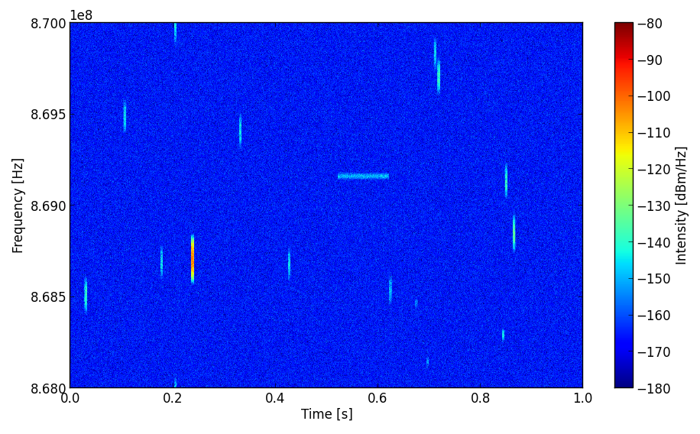
Device-to-Device Path-Loss Model
Based on parameters used given in the example layer configuration

Slide 16
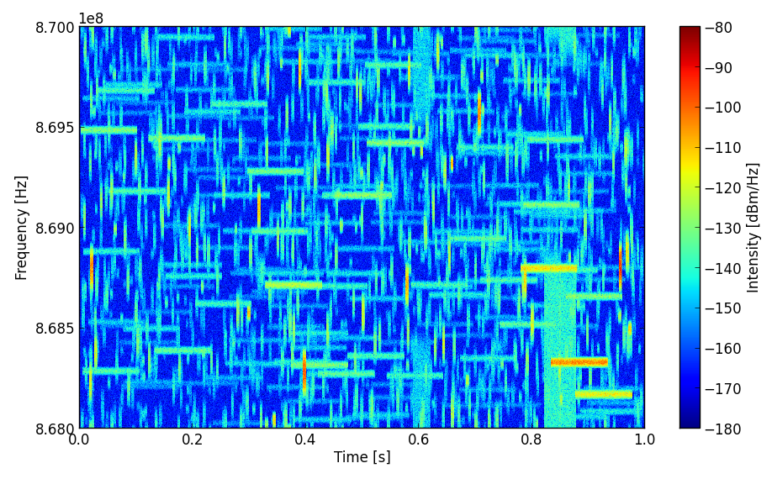
Outdoor Urban Path-Loss Model
Similar parameter configuration as previous slide, only $PL(d)$adapted

Slide 17
Layer Parametrization
Use-case document [2] defines four interference models
None, low, medium, dense
Proposal
Identical ratios between the mean arrival rates of the different layers
Scaling factor for modeling the mean arrival rate summed over all layers
Parametrization of the layers using channel measurements and consideration of future systems

Slide 18
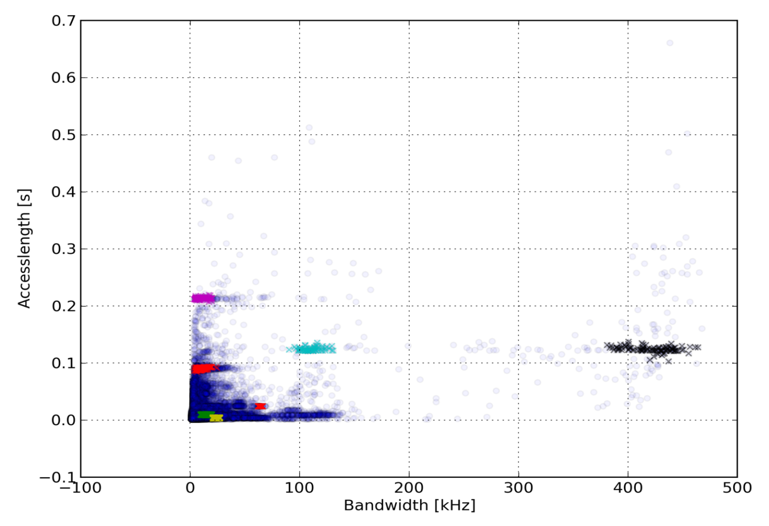
Clustering of Measured Signals
Measured data can be used to derive the number and the parameters of the layers
Current work topic at FAU Erlangen-Nuernberg

Slide 19
Proposal for Mean Arrival Rate
Class | Mean Arrival Rate over all layers $λ′$ [1/s/km²/MHz]
None | 0
Low | 1
Medium | 10
Dense | 50
The mean arrival rate is the sum of the arrival rates of all layers

Slide 20
Thank You! Discussion?

Slide 21
Literature
[1] Bertsekas, D., Gallager, R. Data networks. Vol. 2. New Jersey: Prentice-Hall International, 1992
[2] Potential Use-Cases for LPWA, IEEE 802.15-16/770r2

