Slide 1
Project: IEEE P802.15 Working Group for Wireless Personal Area Networks (WPANs)
Submission Title: [Proposal of LPWAN Channel Models, Rev. 1]
Date Submitted: [9 February, 2017]
Source: [Joerg ROBERT] Company [Friedrich-Alexander University Erlangen-Nuernberg]
Address [Am Wolfsmantel 33, 91058 Erlangen, Germany]
Voice:[+49 9131 8525373], FAX: [+49 9131 8525102], E-Mail:[joerg.robert@fau.de]
Re: [Proposal of LPWAN Channel Models]
Abstract: [Proposal of LPWAN channel models for future work within IG LWPA]
Purpose: [Discussion within IEEE 802.15 IG LPWA]
Notice: This document has been prepared to assist the IEEE P802.15. It is offered as a basis for discussion and is not binding on the contributing individual(s) or organization(s). The material in this document is subject to change in form and content after further study. The contributor(s) reserve(s) the right to add, amend or withdraw material contained herein.
Release: The contributor acknowledges and accepts that this contribution becomes the property of IEEE and may be made publicly available by P802.15.

Slide 2
Revised LPWAN Channel Models
Joerg Robert
FAU Erlangen-Nuernberg

Slide 3
Motivation
Four different classes proposed in use-case document [2]
  Indoor, Outdoor Urban, Outdoor Rural, Satellite
Comparison of different technology options requires definition of channel models
Proposal: Use subset of IEEE 802.11ah channel models [1] and adapt where required
  11ah has been developed for 900 MHz operation

Slide 4
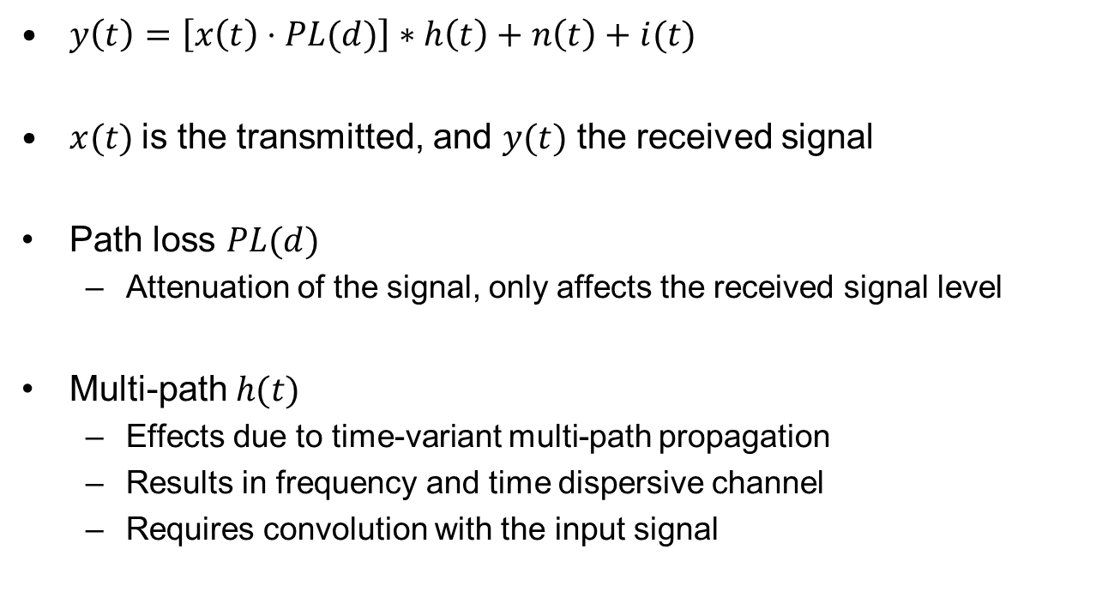
Basic Channel Model Structure ( I / II )
$y\left(t\right)=\left[x\left(t\right)⋅PL(d)\right]∗h\left(t\right)+n\left(t\right)+i(t)$
$x(t)$is the transmitted, and $y(t)$ the received signal
Path loss $PL(d)$
  Attenuation of the signal, only affects the received signal level
Multi-path $h(t)$
  Effects due to time-variant multi-path propagation
  Results in frequency and time dispersive channel
  Requires convolution with the input signal

Slide 5
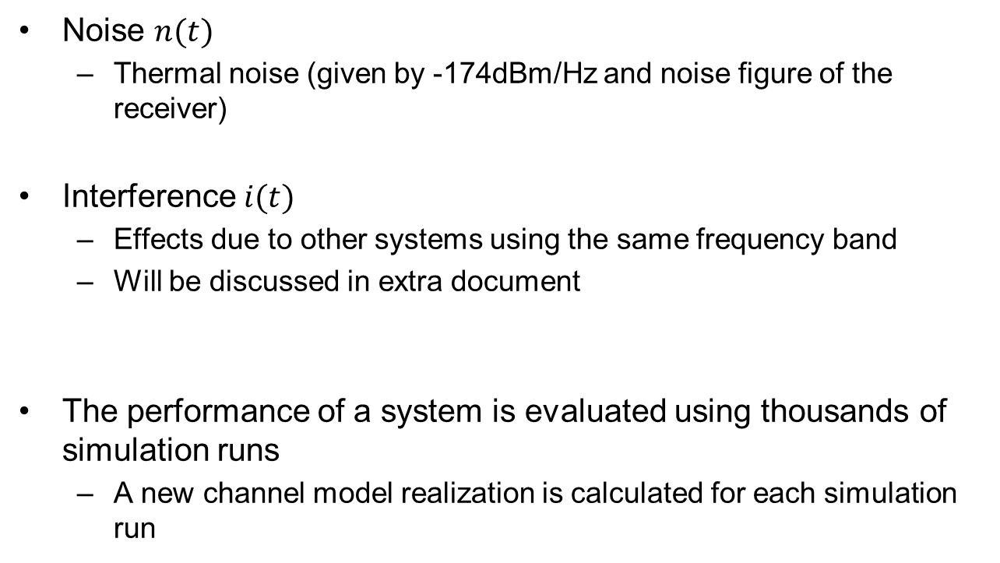
Basic Channel Model Structure ( II / II )
Noise $n(t)$
  Thermal noise (given by -174dBm/Hz and noise figure of the receiver)
Interference $i(t)$
  Effects due to other systems using the same frequency band
  Will be discussed in extra document
The performance of a system is evaluated using thousands of simulation runs
  A new channel model realization is calculated for each simulation run

Slide 6
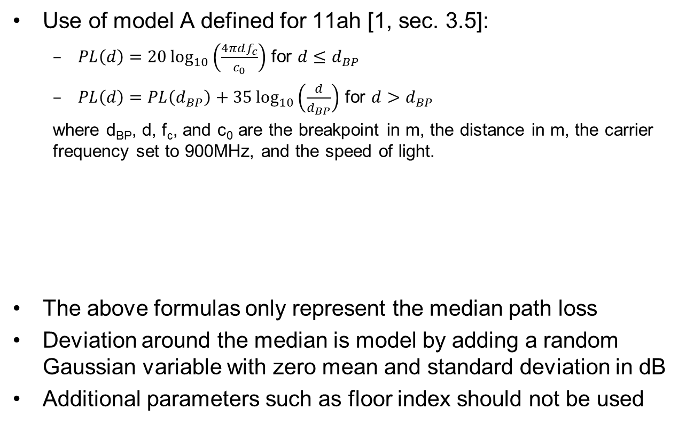
Indoor Path-Loss Model ( I / II )
Use of model A defined for 11ah [1, sec. 3.5]:
  $PL\left(d\right)=20\log_{10}\left(\frac{4πdf_{c}}{c_{0}}\right)$ for $d≤d_{BP}$
  $PL\left(d\right)=PL\left(d_{BP}\right)+35\log_{10}\left(\frac{d}{d_{BP}}\right)$ for $d>d_{BP}$
  where d_{BP}, d, f_{c}, and c₀ are the breakpoint in m, the distance in m, the carrier frequency set to 900MHz, and the speed of light.
The above formulas only represent the median path loss
Deviation around the median is model by adding a random Gaussian variable with zero mean and standard deviation in dB
Additional parameters such as floor index should not be used
d_{BP}[m] | Slope before d_{BP} | Slope after d_{BP} | Shadow fading [dB] before d_{BP} | Shadow fading [dB] after d_{BP}
5 | 2 | 3.5 | 2 | 3

Slide 7
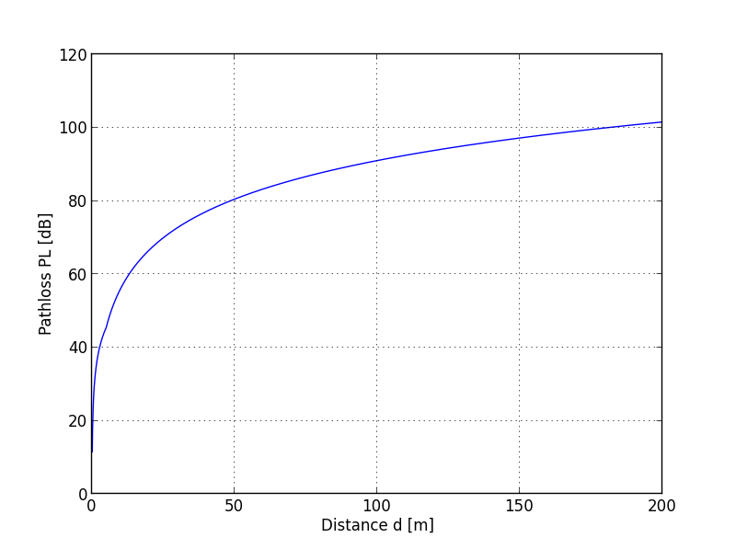
Indoor Path-Loss Model ( II / II )

Slide 8
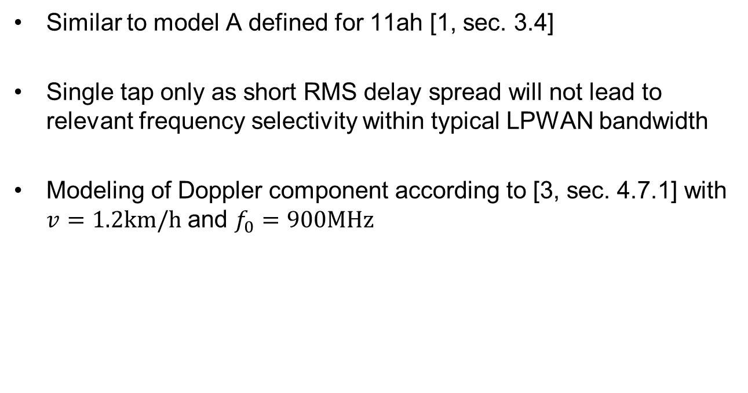
Indoor Multi-Path Model
Similar to model A defined for 11ah [1, sec. 3.4]
Single tap only as short RMS delay spread will not lead to relevant frequency selectivity within typical LPWAN bandwidth
Modeling of Doppler component according to [3, sec. 4.7.1] with $v=1.2km/h$ and $f_{0}=900MHz$

Slide 9
Outdoor Urban Model
Use of the 3GPP Spatial Channel model scenario “Urban Macro” [4, sec. 5]
    Similar approach followed by 11ah [1, sec. 3.2]
Model defines path-loss and multi-path for base-stations with exposed antennas and a typical distance of 3km
Additional parameters
  Frequency set to f=900MHz
  Speed set to v=3km/h
  Use of single polarization only

Slide 10
Outdoor Rural Model
Use of the 3GPP Spatial Channel model scenario “Suburban Macro” [4, sec. 5]
    Similar approach followed by 11ah [1, sec. 3.2]
Model defines path-loss and multi-path for base-stations with exposed antennas and a typical distance of 3km
Additional parameters
  Frequency set to f=900MHz
  Speed set to v=3km/h
  Use of single polarization only

Slide 11
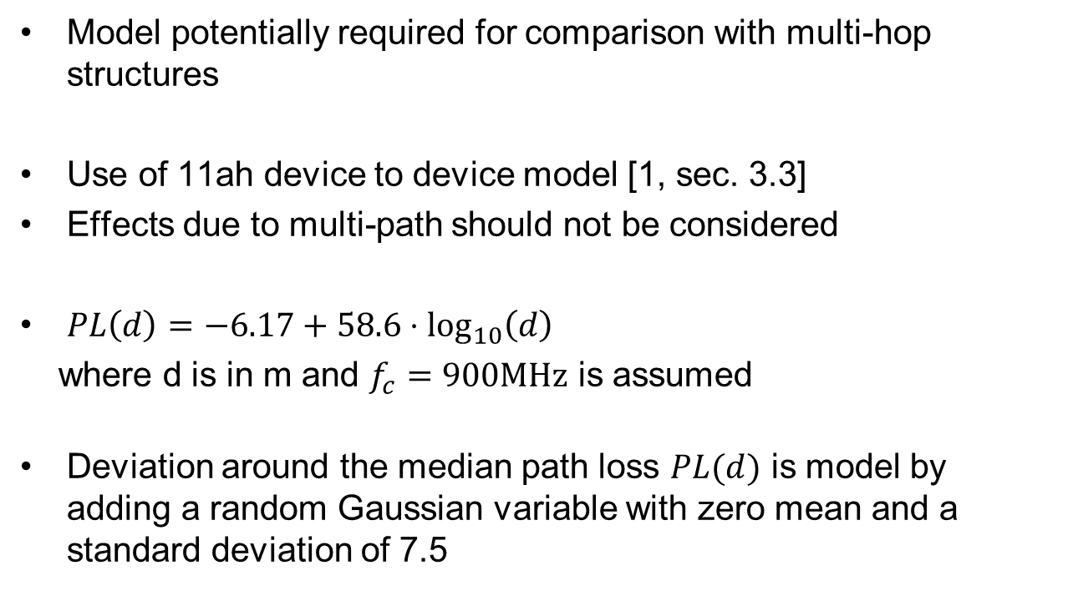
Outdoor Device-to-Device
Model potentially required for comparison with multi-hop structures
Use of 11ah device to device model [1, sec. 3.3]
Effects due to multi-path should not be considered
$PL\left(d\right)=−6.17+58.6⋅\log_{10}\left(d\right)$
where d is in m and $f_{c}=900MHz$ is assumed
Deviation around the median path loss $PL(d)$ is model by adding a random Gaussian variable with zero mean and a standard deviation of 7.5

Slide 12

Noise Figure
$F=3dB$ for base-stations
$F=6dB$ for nodes

Slide 13
Mobility for Outdoor Models
Stationary
  Device does not move
  Channel model assumes Doppler of 3km/h to consider movements in surrounding environment
Pedestrian
  Multi-path channel model assumes 3km/h
Urban
  Multi-path channel model assumes 30km/h
High speed
  Multi-path channel model assumes 120km/h

Slide 14
Literature
[1] IEEE 802.11 TGah Channel Model, IEEE 802.11-11/968r4
[2] Potential Use-Cases for LPWA, IEEE 802.15-16/770r2
[3] IEEE 802.11 TGn Channel Model, IEEE 802.11-03/940r4
[4] Spatial channel model for Multiple Input Multiple Output (MIMO) simulations (Release 13), 3GPP TR 25.996, V13.0.0, Dec. 2015

