Slide 1
Project: IEEE P802.15 Working Group for Wireless Personal Area Networks (WPANs)
Submission Title: [Number of Active Interfering Users]
Date Submitted: [15 January, 2017]
Source: [Joerg ROBERT] Company [Friedrich-Alexander University Erlangen-Nuernberg]
Address [Am Wolfsmantel 33, 91058 Erlangen, Germany]
Voice:[+49 9131 8525373], FAX: [+49 9131 8525102], E-Mail:[joerg.robert@fau.de]
Re: []
Abstract: [Proposal for number of active interfering users for simulation model]
Purpose: [Discussion within IEEE 802.15 IG LPWA]
Notice: This document has been prepared to assist the IEEE P802.15. It is offered as a basis for discussion and is not binding on the contributing individual(s) or organization(s). The material in this document is subject to change in form and content after further study. The contributor(s) reserve(s) the right to add, amend or withdraw material contained herein.
Release: The contributor acknowledges and accepts that this contribution becomes the property of IEEE and may be made publicly available by P802.15.

Slide 2
Number of Active Interfering Users
Joerg Robert FAU Erlangen-Nuernberg

Slide 3
Motivation
The available frequency spectrum is highly limited
The performance in dense networks is an important criteria to evaluate the suitability of algorithms
Here: Intra-system interference
Four different classes proposed in use-case document [2]
Low, Medium, High, Very High
Potential parametrization is focus of this document

Slide 4
Population Density in Different Areas
Region | Population Density (1/km²)
Paris | 21,000
Paris (Metropolitan area) | 722
London | 5,518
London (Metropolitan area) | 1,655
Berlin | 4,000
Atlanta (Metropolitan area) | 255
Germany | 227
France | 116
USA | 35
Kansas | 13.5
Source: Wikipedia

Slide 5
Usage Assumptions
On average every person has 10 devices
The average activity of a device is 1 transmission / h
Each person results in $2.7⋅{10}^{−3}$ accesses per second
Parameters to demonstrate resulting traffic
Cell radius of 10km →314km²
Cell radius of 1km →3.14km²

Slide 6
Resulting Arrival Rates
Area | Mean Arrival Rate $λ′$[1/s/km²] | 1km-Mean Arrival Rate $λ$[1/s] | 10km-Mean Arrival Rate $λ$[1/s]
Paris | 58.3 | 183 | 18,325
Paris (M.a.) | 2.0 | 6.3 | 630
London | 15.3 | 48 | 4,815
London (M.a.) | 4.6 | 14.4 | 1,444
Berlin | 11.1 | 34.9 | 3,490
Atlanta (M.a.) | 0.71 | 2.2 | 223
Germany | 0.63 | 2.0 | 198
France | 0.32 | 1.0 | 101
USA | 0.097 | 0.31 | 31
Kansas | 0.038 | 0.12 | 12

Slide 7
Proposed Classes
Class | Mean Arrival Rate $λ′$ [1/s/km²]
Low | 0.1
Medium | 1
High | 10
Very High | 50

Slide 8
Further Assumptions
Assumption of Poisson arrival process [1]
Activity of nodes is mutually independent
MAC simulations have to consider cell size to calculate mean arrival rate $λ$ within cell
PHY simulations have to consider “infinite plane” to estimate impact
Also nodes outside the actual cell may interfere
Weighting of interfering nodes using channel model
Interfering nodes are randomly located

Slide 9
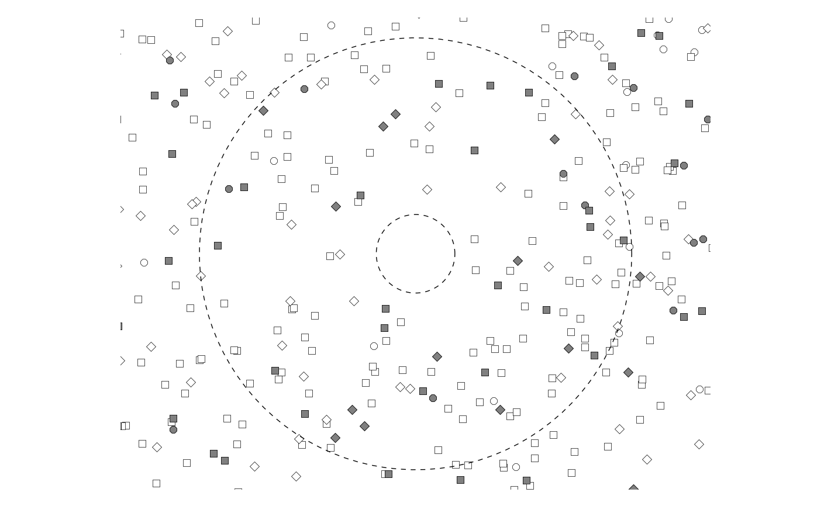
“Infinite Plane”
$$r_{max}$$
$$r_{min}$$
$r_{min}$ is the minimum distance between the base-station and the closest interferer (required by channel model)
$r_{max}$ is the distance up to the interferer impairs the base-station (no impact if below thermal noise level, depends on pathloss model)

Slide 10
Open Issues
Do we have to consider the available bandwidth?
Mean arrival rate per MHz?
Parameters of the interfering traffic?
Short 16 byte packets?
...?

Slide 11
Thank You! Discussion?

Slide 12
Literature
[1] Bertsekas, D., Gallager, R. Data networks. Vol. 2. New Jersey: Prentice-Hall International, 1992
[2] Potential Use-Cases for LPWA, IEEE 802.15-16/770r2

