Slide 1
Project: IEEE P802.15 Working Group for Wireless Personal Area Networks (WPANs)
Submission Title: [TG12 ULI Report for Jan 2017 Session]
Date Submitted: [16 Jan 2017]
Source: [Patrick Kinney] Company [Kinney Consulting LLC]
Address [Chicago area, IL, USA]
Voice:[+1.847.960.3715], E-Mail:[pat.kinney@ieee.org]
Re: [TG12 Report for Jan 2017 Session.]
Abstract: [Report for the January Session]
Purpose: []
Notice: This document has been prepared to assist the IEEE P802.15. It is offered as a basis for discussion and is not binding on the contributing individual(s) or organization(s). The material in this document is subject to change in form and content after further study. The contributor(s) reserve(s) the right to add, amend or withdraw material contained herein.
Release: The contributor acknowledges and accepts that this contribution becomes the property of IEEE and may be made publicly available by P802.15.

Slide 2
Instructions for the WG Chair
The IEEE-SA strongly recommends that at each WG meeting the chair or a designee:
  Show slides #1 through #4 of this presentation
  Advise the WG attendees that:
    The IEEE’s patent policy is described in Clause 6 of the IEEE-SA Standards Board Bylaws;
    Early identification of patent claims which may be essential for the use of standards under development is strongly encouraged;
    There may be Essential Patent Claims of which the IEEE is not aware. Additionally, neither the IEEE, the WG, nor the WG chair can ensure the accuracy or completeness of any assurance or whether any such assurance is, in fact, of a Patent Claim that is essential for the use of the standard under development.
  Instruct the WG Secretary to record in the minutes of the relevant WG meeting:
    That the foregoing information was provided and that slides 1 through 4 (and this slide 0, if applicable) were shown;
    That the chair or designee provided an opportunity for participants to identify patent claim(s)/patent application claim(s) and/or the holder of patent claim(s)/patent application claim(s) of which the participant is personally aware and that may be essential for the use of that standard
    Any responses that were given, specifically the patent claim(s)/patent application claim(s) and/or the holder of the patent claim(s)/patent application claim(s) that were identified (if any) and by whom.
  The WG Chair shall ensure that a request is made to any identified holders of potential essential patent claim(s) to complete and submit a Letter of Assurance.
  It is recommended that the WG chair review the guidance in IEEE-SA Standards Board Operations Manual 6.3.5 and in FAQs 14 and 15 on inclusion of potential Essential Patent Claims by incorporation or by reference.
  Note: WG includes Working Groups, Task Groups, and other standards-developing committees with a PAR approved by the IEEE-SA Standards Board.

Slide 3
Participants, Patents, and Duty to Inform
All participants in this meeting have certain obligations under the IEEE-SA Patent Policy.
  Participants [Note: Quoted text excerpted from IEEE-SA Standards Board Bylaws subclause 6.2]:
    “Shall inform the IEEE (or cause the IEEE to be informed)” of the identity of each “holder of any potential Essential Patent Claims of which they are personally aware” if the claims are owned or controlled by the participant or the entity the participant is from, employed by, or otherwise represents
    “Should inform the IEEE (or cause the IEEE to be informed)” of the identity of “any other holders of potential Essential Patent Claims” (that is, third parties that are not affiliated with the participant, with the participant’s employer, or with anyone else that the participant is from or otherwise represents)
  The above does not apply if the patent claim is already the subject of an Accepted Letter of Assurance that applies to the proposed standard(s) under consideration by this group
  Early identification of holders of potential Essential Patent Claims is strongly encouraged
  No duty to perform a patent search
Slide #1

Slide 4
Patent Related Links
  All participants should be familiar with their obligations under the IEEE-SA Policies & Procedures for standards development.
  Patent Policy is stated in these sources:
  IEEE-SA Standards Boards Bylaws
  http://standards.ieee.org/develop/policies/bylaws/sect6-7.html#6
  IEEE-SA Standards Board Operations Manual
  http://standards.ieee.org/develop/policies/opman/sect6.html#6.3
  Material about the patent policy is available at
  http://standards.ieee.org/about/sasb/patcom/materials.html
If you have questions, contact the IEEE-SA Standards Board Patent Committee Administrator at patcom@ieee.org or visit http://standards.ieee.org/about/sasb/patcom/index.html
This slide set is available at https://development.standards.ieee.org/myproject/Public/mytools/mob/slideset.ppt
Slide #2

Slide 5
Call for Potentially Essential Patents
If anyone in this meeting is personally aware of the holder of any patent claims that are potentially essential to implementation of the proposed standard(s) under consideration by this group and that are not already the subject of an Accepted Letter of Assurance:
  Either speak up now or
  Provide the chair of this group with the identity of the holder(s) of any and all such claims as soon as possible or
  Cause an LOA to be submitted
Slide #3

Slide 6
TG12 Officers
Chair Pat Kinney
Vice Chair Charlie Perkins
Slide 6
Notes:
January 17
Page 6

Slide 7
TG12 Meeting Goals (agenda: 15-17-0026-00)
Monday 16 Jan, PM1: Opening report, Agenda, Status and Functional decomposition review
Monday 16 Jan, PM2: Session focus: Header Compression, PDE, MMI, Management Protocols Module (MPM), assignment of functional blocks not already assigned
Tuesday 17 Jan, PM1: Detailed discussion on PDE
Wednesday 18 Jan, PM1: Detailed discussion on MMI
Wednesday 18 Jan, PM2: Detailed discussion on MMI
Thursday 19 Jan, AM1: Detailed discussion on MPM
Thursday 10 Nov, AM2: Detailed discussion on header compression, Generic Module, Assigned module status, recap on week’s efforts, define the next steps, timetable for completion, phone calls
Slide 7
Notes:
January 17
Page 7

Slide 8
TG12 Meeting
Monday 16 Jan, PM1: Opening report, Agenda, Status and Functional decomposition review
  Approve Agenda 15-17-0026-00
  Approve Minutes from previous session, 15-16-0838-00
  Status Update (slide 9)
  Functional Decomposition Review (slide 10)
Slide 8
Notes:
January 17
Page 8

Slide 9
TG 12 Status Update
Discussion on the concepts necessary for 802.15.12
  Ranging Protocol Module
    Work in progress, concept has been defined
  L2R
    Reviewed Warsaw’s presentation, some changes resulting from draft update have been added
  Management Protocol Module
    PHY configuration table will use the capability IE as starting point
Discussion on the architecture for 802.15.12
  IE devices will use a payload IE designated for ULI; devices not responding are either non-ULI or non-IE capable(multiple discovery packets should be sent since a packet may not be received)
  Non-IE device discovery will use a “well known” key to secure a discovery ULI packet, devices not responding to this discovery packet could be assumed to be non-ULI (multiple discovery packets should be sent since a packet may not be received)
  Non-IE devices will use 0xff as 1st payload octet in accordance with 6LoWPAN Paging Dispatch, the 2nd octet denotes page 15 and will be defined in the future
Slide 9
Notes:
January 17
Page 9

Slide 10
PHY and DLL
Functional Decomposition
Slide 10
Notes:
January 17
Page 10

Slide 11
802.15.12 Protocol Discrimination Entity (PDE)
  Purpose:
  Directs and optionally modifies information from the higher layer SAP to the appropriate protocol module directly or via fragmentation module
  Directs and optionally modifies information from protocol module SAP to the appropriate higher layer SAP directly or via defragmentation module
  Overview
  For frames going to the higher layer, the PDE determines the appropriate SAP for delivery, as determined by the ULI header, removes the ULI header, reconstitutes the appropriate header, and then directs the datagram to the SAP.
  For datagrams coming from a higher layer, the PDE determines the SAP to which the datagram is to be sent based upon the configuration of the device as set by the Management Protocols entity, and forwards it to the appropriate SAP.
  Further details may be found in 15-16-0656-02

Slide 12
802.15.12 Multiplexed MAC interface
(MMI)
Purpose
  Directs and may modify information from a protocol module SAP to the appropriate MAC SAP or another protocol module SAP
Overview
Provides multiplex and fragmentation service to the packets sent by the ULI functions and send them to either the MCPS-SAP, the MLME-SAP, or to another function module SAP within the ULI. The process of sending the packets includes formatting the ULI IE or prepending the appropriate headers into the payload of the frame for transmission.
The interface between the MMI and the ULI function modules includes the Multiplex ID and the payload to be sent or the payload received.
The mechanism for the MMI, i.e. the ability to send the data to the proper SAP, will be similar to the mechanism defined in IEEE 802.15.9 for the multiplexed data service.
  Further details may be found in 15-16-0656-02

Slide 13
802.15.12 Management Protocol
The management protocol module has three primary functions:
it provides configuration parameters to the MAC and PHY using configuration data received from a higher layer
it provides configuration parameters to other protocol modules received from a higher layer or stored in the management protocol module
it provides network device monitoring or management. The monitoring function provides device monitoring metrics to a higher layer application using either the 802.15.4 primitives or a well-known interface such as the Yang modeling interface. The management function uses data collected from the device to optimize the device’s configuration for better spectral use.
For details see document 15-16-0767

Slide 14
    802.15.12 Discovery Techniques
Dedicated IEs
  Reserved for use with devices using 15.4e-2012, or 15.4-2015
  Payload IE, reserved for 15.12, sent out with defined discovery payload
  Devices not understanding this IE will reject the IE with no ill effects
  Devices with 802.15.12 ULI will receive the IE and respond appropriately
Payload encrypted with well known key
  Reserved for use with devices using older firmware (< 2011), i.e. no IEs
  Defined discovery payload is sent using security with a well known key
  Devices not knowing this key will reject packet with no ill effects
  Devices with 802.15.12 ULI will decrypt payload and respond appropriately
Slide 14
Notes:
January 17
Page 14

Slide 15
    Frame Composition
Slide 15
Notes:
January 17
Page 15

Slide 16
802.15.12 Optional Protocols
802.1X provides authentication, authorization, and cryptographic key agreement mechanisms to support secure communication between end stations connected to 802 networks.
802.15.9 (KMP) provides a methodology to enable key management by providing a transport for key management protocols outside the application layers. Additionally, provides a fragmentation and multiplexing layer for those packets so they can be delivered over smaller MAC layer frames and multiplexed on the recipient end to the right processing service.
802.15.10 (L2R) provides the following functions: topology construction, L2R mesh discovery/join/update/recovery, hop-by-hop retransmission, unicast/multicast/broadcast routing, data concatenation, short address assignment, and security

Slide 17
802.15.12 Optional Protocols
6LoWPAN provides the function of MAC frame modification into a frame format for transmission of IPv6 packets and the method of forming IPv6 link-local addresses and statelessly autoconfigured addresses on IEEE 802.15.4 networks. Additional functions include a header compression scheme using shared context and provisions for packet delivery in IEEE 802.15.4 meshes.
6tisch functions as an abstraction of an IP link over the TSCH mode of the MAC sublayer by providing network formation and maintenance, multi-hop topology, assign time source neighbor, resource management, dataflow control, scheduling mechanisms, and security.

Slide 18
802.15.12 Optional Protocols
Ranging: provides calls for ranging packets and ranging metrics, and provides a higher layer application such as a location solver with the raw data from the MAC/PHY or with a ranging estimate derived from the aforementioned raw data. Timestamps and/or range info, can generate packets to derive range info
Generic: the generic protocol block allows an upper layer application to either access the MAC SAPs or to access a protocol block’s SAP using the MMI data service.
PassThru provides protocols at the PDE sublayer (e.g. fragmentation) or above (e.g. layer 3 protocols such as ZigBee) to access the 802.15.4 MAC via the MMI sublayer

Slide 19
Backup Slides

Slide 20
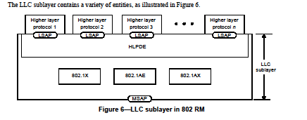
802-2014 Reference Model
Slide 20
Notes:
January 17
Page 20

Slide 21
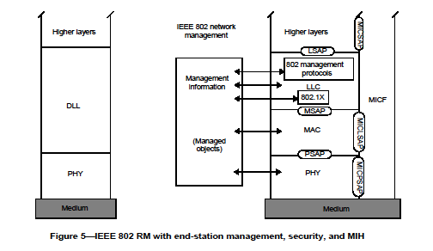
802-2014 Reference Model
Slide 21
Notes:
January 17
Page 21

Slide 22
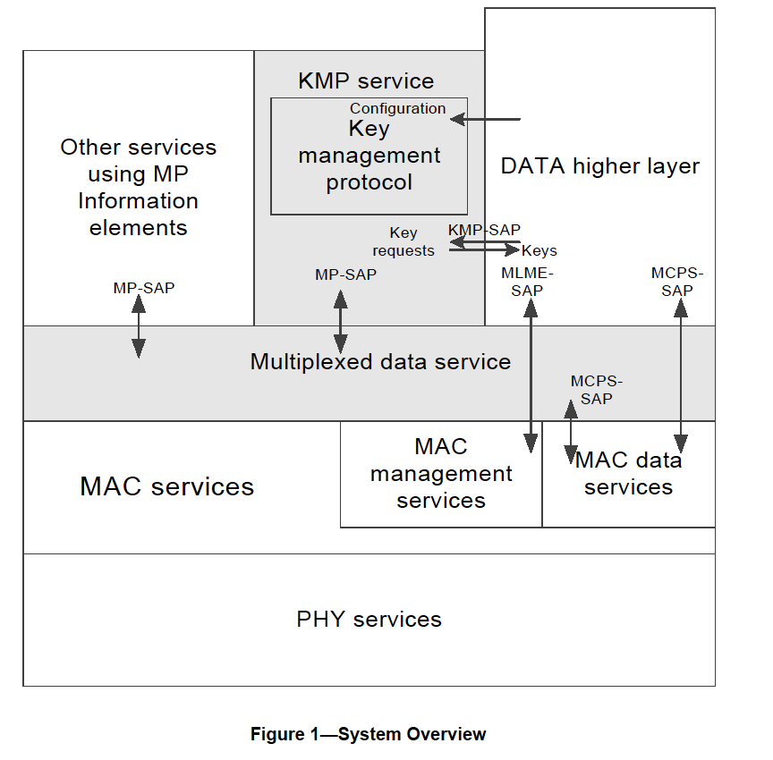
802.15.9 Functional Decomposition

Slide 23
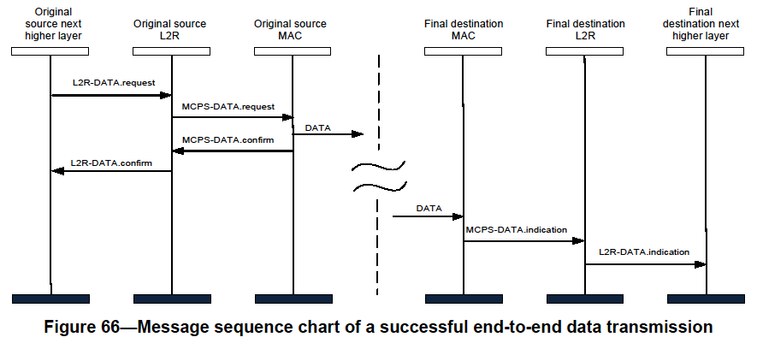
802.15.10 Functional Decomposition
The Data SAP and the MCPS-SAP are used for Multicast as indicated in Figure 19 and Figure 66
The MGMT SAP and the MLME-SAP are used as indicated in Figures 3 through 13

Slide 24
    Deliverables
Deliverables
Management SAP
  Configuration Management
    Dynamic PHY management
      B Rolfe to provide
    Network
      Set-Up
    MAC
      Set-Up
    PHY
      Set-Up
    Security
      Set-Up
    TSCH set-up
      P Kinney to provide
    Channel Hopping
  Yang Modeling
  L2 Routing
    C Perkins to provide
Data SAP
  Protocol Differentiation
    EtherType
  Security
    KMP (802.15.9)
      ETSI TS102887-2
      802.1x
      Internet Key Exchange (IKE)
      Dragonfly
      PANA
      Vendor specific
  MAC Resource Management
    Priority
    GTS management
  TSCH Operation
    P Kinney to provide
  Fragmentation
    Adaptive
    PHY (PSDU)
    UpperLayer
      802.15.9
      6LoWPAN
  Location awareness
    Ranging
    B Verso to provide
Slide 24
Notes:
January 17
Page 24

Slide 25
    Deliverables
Management SAP
  Configuration Management
    PHY
      Set-Up
        Channel
          Center frequency
          Channel number
          Regional band
        Bandwidth
        Modulation
          Channel page
        Preamble
          Code
          Repetition
        FCS size
        Packet Length
        Data Rate
        Transmit Power level
        Data Whitening
        Common Signalling Mode
        ED Threshold
        Spreading Factor
        DSSS code
        CCA
          Mode
          duration
        FEC?
          Rate
          Coding
          Interleaving
        SFD
          Size
          value
Slide 25
Notes:
January 17
Page 25

Slide 26
    Deliverables
Management SAP
  Configuration Management
    MAC
      Set-Up
        FFD?
        Beacon-enabled?
          DSME?
            Seong-Soon Joo to provide
          Superframe parameters
        Low Energy?
          Parameters
        Channel Hopping?
          parameters
        Association?
          Fast?
        Synchronization
          Superframe
          TSCH
        ACK required?
        Promiscuous mode?
          Ask Packet Sniffer vendors or chipset vendors
        Device Announcement
        UL IEs?
          parameters
Slide 26
Notes:
January 17
Page 26

Slide 27
    Deliverables
Management SAP
  Configuration Management
    Network
      Set-Up
        PAN Coordinator?
          Beacon-enabled?
          Low Energy?
          Association?
            Fast?
            Permit to Join?
              Criteria to accept
          Short Address?
            Assignment
        Channel Scan
Slide 27
Notes:
January 17
Page 27

Slide 28
Management Protocol Configuration Parameters via MGMT SAP - MAC
Operational | Op enumerations
Device Type | FFD, RFD, RFD-TX, RFD-RX
PAN | Set-up, discovery
Slide 28
Notes:
January 17
Page 28

Slide 29
Management Protocol Configuration Parameters via MGMT SAP - MAC
Optional Modes | Configuration set-up
Generic (GTS) [beacon-enabled] | Superframe
DSME | Superframe
TSCH | Slotframe
SUN [Nonbeacon-enabled] |  | phyCurrentChannel, ChanCenterFreq0 NumChan, ChanSpacing phyCurrentPage, phyCurrentSUNPageEntry, phyNumSUNPageEntriesSupported phySUNPageEntriesSupported macPanId, macCoordShortAddress phySUNChannelsSupported
TVWS
LECIM (lp-wan)
RFID
RCC
Generic [non-beacon-enabled]
Slide 29
Notes:
January 17
Page 29

Slide 30
Management Protocol Configuration Parameters via MGMT SAP - MAC
Option behaviors | Option details
Association
Security | Integrity, Encryption
Promiscuous
Ranging
Low Energy | CSL, RIT, IRIT
Priority
Metrics | MAC Metrics IE/All MAC Metrics IE
Channel Hopping | Channel hopping IE, macHoppingSequenceLength, macHoppingSequenceList, macHoppingSequenceId, macNumberofChannels, macPhyConfiguration, macExtendedBitmap
IEs | Header, Payload
TRLE
Spectrum Tracking
Slide 30
Notes:
January 17
Page 30

Slide 31
Management Protocol Configuration Parameters via MGMT SAP
PHY Parameters | PHY Parameters - detail
Channel | phyCurrentChannel = Number: phyCurrentPage
Modulation type | O-QPSK, BPSK, FSK, MSK, OFDM, CSS, UWB-HR, UWB-LR, ASK
Preamble | Code/repetition: phyFskPreambleLength, SecondaryFskPreambleLength
FCS size | 2, or 4
Packet Length | aMaxPhyPacketSize = 127, or 2047, or phyLecimDsssPsduSize
Operating Mode
Data Rate (kb/s) | 2.4, 4.8, 6.25, 9.6, 10, 12.5, 16, 19.2, 20, 25, 31.25, 32, 36, 38.4, 40, 50, 100, 110, 150, 156, 200, 234, 250, 300, 312, 468, 600, 624, 800, 850, 936, 1000, 1404, 1562.5, 1638, 2000, 3125, 6250, 6810, 27240
Transmit power level | phyTxPower
CCA | 1, 2, 3, 4, 5, 6, : aCcatime/phyCCADuration
FEC | Off/On, rate, code, interleaving: phyFskFecEnabled, phyFskFecInterleavingRsc, phyFskFecScheme/phyTvwsFskFecScheme, phyLecimFecTailBitingEnabled
SFD | Size/value: phySunFskSfd, phyTvwsSfdLength, phyLecimDsssSfdPresent, SecondaryFskSfd
Slide 31
Notes:
January 17
Page 31

Slide 32
Management Protocol Configuration Parameters via MGMT SAP
PHY Parameters (cont’d) | PHY Parameters - detail
TX<->RX | aTurnaroundTime
ED threshold
Spreading factor
DSSS code
Data whitening
Common signaling mode
Slide 32
Notes:
January 17
Page 32

Slide 33
Example of Options Used for Secured SUN FSK Device
Slide 33
Notes:
January 17
Page 33

Slide 34
Example of Options Used for LECIM O-QPSK Device
Slide 34
Notes:
January 17
Page 34

Slide 35
Example of Options Used for 6tisch O-QPSK Device
Slide 35
Notes:
January 17
Page 35

Slide 36
    Future Efforts
Functional Module Technical Details
PDE P Kinney
MMI P Kinney
Management Protocol H Yokota
6LoWPAN
KMP
802.1X
L2R C Perkins
6tisch
Ranging B Verso
Generic
Functional Block Overview
How do they work?
What functions do they include?
How do the SAPs work?
What primitives are required?
What parameters are required?
Slide 36
Notes:
January 17
Page 36

Slide 37
Meeting Accomplishments
Discussion on the concepts necessary for 802.15.12
  Ranging Protocol Module
    Work in progress, concept has been defined
  L2R
    Reviewed Warsaw’s presentation, some changes resulting from draft update have been added
  Management Protocol Module
    PHY configuration table will use the capability IE as starting point
Discussion on the architecture for 802.15.12
  IE devices will use a payload IE designated for ULI; devices not responding are either non-ULI or non-IE capable(multiple discovery packets should be sent since a packet may not be received)
  Non-IE device discovery will use a “well known” key to secure a discovery ULI packet, devices not responding to this discovery packet could be assumed to be non-ULI (multiple discovery packets should be sent since a packet may not be received)
  Non-IE devices will use 0xff as 1st payload octet in accordance with 6LoWPAN Paging Dispatch, the 2nd octet denotes page 15 and will be defined in the future
Slide 37
Notes:
January 17
Page 37

Slide 38
    Schedule
TASK | Start | Completed
TG12 | May, 2016 | Mar, 2019
Concept and Architecture | May, 2016 | Nov, 2016
Baseline definition | Nov, 2016 | May, 2017
Draft | May, 2017 | Sept, 2017
TG Comment Collection | Sept, 2017 | Nov, 2017
WG Letter Ballot | Dec, 2017 | July, 2018
Sponsor Ballot | Aug, 2018 | Jan, 2019
NesCom | Jan, 2019 | Mar, 2019
IEEE-SA Publication | Mar, 2019 | June, 2019
Slide 38
Notes:
January 17
Page 38

