Slide 1
Project: IEEE P802.15 Working Group for Wireless Personal Area Networks (WPANs)
Submission Title: [Recent Studies on HRRC Technologies]
Date Submitted: [8 November, 2016]
Source: [Junhyeong Kim, Gosan Noh, Bing Hui, Hee-Sang Chung and Il Gyu Kim] Company [ETRI]
Address [218 Gajeong-ro, Yuseong-gu, Daejeon, 34129, KOREA]
Voice:[+82-42-860-6239], FAX: [+82-42-861-1966], E-Mail:[jhkim41jf@etri.re.kr]
Abstract: [This document presents recent studies on HRRC technologies]
Purpose: [For discussion]
Notice: This document has been prepared to assist the IEEE P802.15. It is offered as a basis for discussion and is not binding on the contributing individual(s) or organization(s). The material in this document is subject to change in form and content after further study. The contributor(s) reserve(s) the right to add, amend or withdraw material contained herein.
Release: The contributor acknowledges and accepts that this contribution becomes the property of IEEE and may be made publicly available by P802.15.

Slide 2
Contents
Mobility Management
Numerology Study

Slide 3
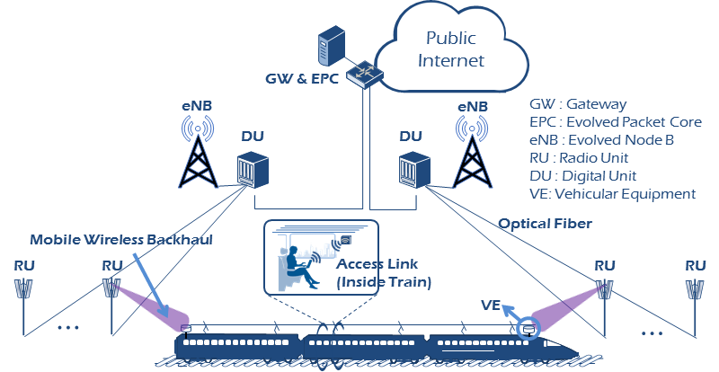
Mobility Management
Observations on HST communication environment
  Bi-directional network deployment
    Lead to high radio link failure rate during handover [handover from lower power to higher power]
  On-board mobile relay is carried on the train
  Within coverage of each cell, only 1 active relay for safety
    The headway distance should be more than 8 km when mobility is 300 km/h^{[1]}
<Concept of high-speed train (HST) communications>

Slide 4
Mobility Management
Observations on HST communication environment
  Performance of Zadoff-Chu sequence in 3GPP PRACH is sensitive to frequency offset
    May not be suitable for HST scenario
  Timing advance (TA) accuracy is hardly to be guaranteed for HST
    Difficult to estimate TA value accurately at BS and feedback the updated TA value in time to relay

Slide 5
Mobility Management
Conclusions
  High robustness and low latency are critical for HST scenario
    Reduce random access (RA) latency [handover interruption time] and guarantee RA [handover] successful rate
  Simplification of handover procedure and random access
    Simplified 2-step random access procedure would be sufficient for HST scenario [without Msg.3 & 4 for contention resolution]
  Unify initial access procedure and handover procedure for HST scenario
    Same RA procedure for both initial access/re-access and handover
  Mobility management algorithm
    To reduce handover interruption time and guarantee handover successful rate for HST scenario

Slide 6
Mobility Management
TDD frame structure design enabling dynamic UL reception without use of preamble and TA
<Corresponding BS & TE behavior>
<TDD frame structure design
enabling dynamic UL reception w.o. use of preamble & TA>

Slide 7
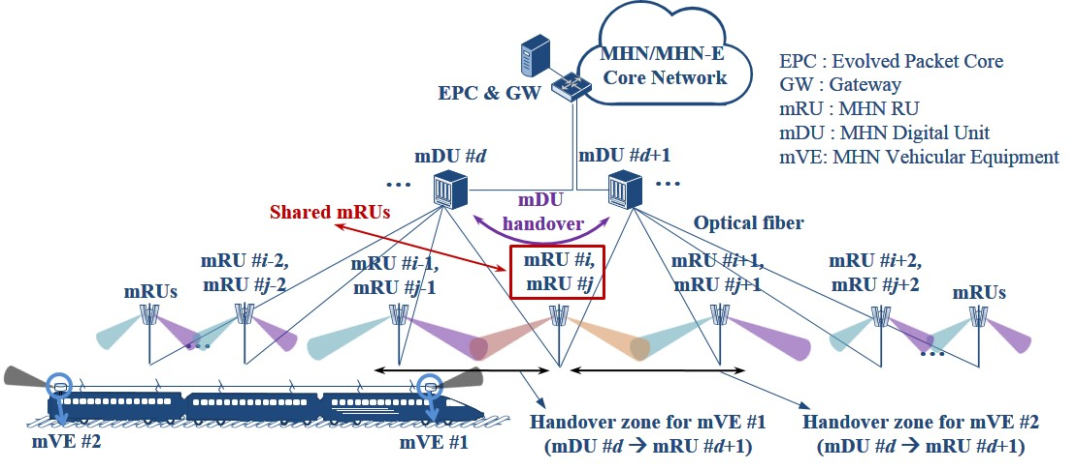
Mobility Management
A handover scheme based on single frequency network (SFN)
  A proper handover zone can be created using shared mRUs
  Expected to significantly improve handover performance and simplify its procedure
    No inter-mRU handover, but a simple antenna (mRU) selection is needed
    Inter-mDU handover needs to be defined
<SFN with shared RU for HST communications>

Slide 8
Mobility Management
A handover scheme based on single frequency network (SFN)
  Inter-mDU handover is triggered after a mVE is connected to a shared mRU
  The handover process is performed while the mVE (mVE #1/mVE #2) is being connected to the shared RU (mRU #i/mRU #j), which could be able to
    maintain the communication link between them
    provide a sufficient time for the handover
<SFN with shared RU for HSR communications>

Slide 9
Mobility Management
A handover scheme based on single frequency network (SFN)
  Pros
    TA and RACH are not necessary in the case of inter-mRU handover
      Uplink timing can be constantly tracked
    High handover successful rate owing to the sufficient handover time
    Handover procedure can be simplified
    There would be no interruption time
  Cons
    Additional cost is incurred due to an additional optical fiber needs to be installed

Slide 10
Mobility Management
Preliminary simulation result^{[2]}
  Simulation assumptions
    Omnidirectional antenna at both RU and TE
  Simulation parameters
Parameters | Values
Total transmit power with normally noise power | 86dBm
path loss model | 31.5+35log₁₀(d)
Shadowing standard deviation | 4dB
Signal Threshold | -40dBm
The number of shared RUs | 2
RU height, TE/VE height | 10m, 2m
Distance between adjacent RUs | 1200m
Distance between adjacent TEs | 200m
Distance between railway and RUs | 100m

Slide 11
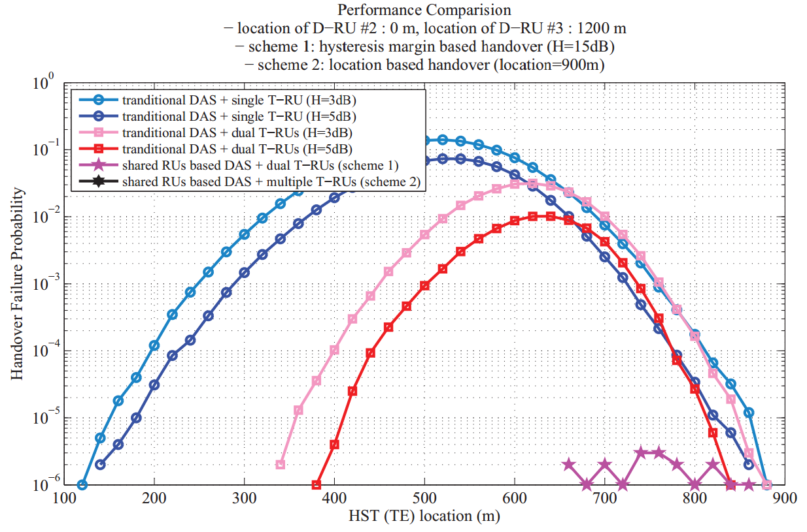
Mobility Management
Preliminary simulation result^{[2]}
  Handover failure probability
    It is observed that handover failure probabilities achieved in the shared RUs-based schemes are close to zero
* Simulation for the directional antenna case will be presented in a future work

Slide 12
Numerology Study
Need for the new numerology
  Use of mmWave (e.g. around 30 GHz)
    Maximum Doppler shift is proportional to carrier frequency
    RF oscillators underperforms at mmWave bands
  Higher mobility (up to 500 km/h)
    Maximum Doppler shift is proportional to speed
  Overall, the use of larger subcarrier spacing is needed
Numerology design principles
  Scalable subcarrier spacing
    Scaling factor = 2^{n}
  Scalable FFT size
    2^{n}-point FFT → Enable radix-2 architecture
  Constant CP overhead
    Same as LTE ~7%

Slide 13
Numerology Study
Numerology sets for the carrier frequency around 30 GHz
  Supporting a wide range of subcarrier spacings
    From 15 kHz to 480 kHz
 | Set 1 | Set 2 | Set 3 | Set 4 | Set 5 | Set 6
Subcarrier spacing (kHz) | 15 | 30 | 60 | 120 | 240 | 480
System bandwidth (MHz) | 80 | 80 | 80 | 80 | 80 | 80
FFT size | 8192 | 4096 | 2048 | 1024 | 512 | 256
Sampling rate (MHz) | 122.88 | 122.88 | 122.88 | 122.88 | 122.88 | 122.88
Number of used subcarriers | 4800 | 2400 | 1200 | 600 | 300 | 150
OFDM symbol length (us) | 66.67 | 33.33 | 16.67 | 8.33 | 4.17 | 2.08
CP length of the 1st symbol (us) | 6.05 | 3.08 | 1.54 | 0.82 | 0.46 | 0.28
CP length of the remaining symbols (us) | 4.66 | 2.33 | 1.16 | 0.58 | 0.28 | 0.14
Number of symbols per subframe | 14 | 14 | 14 | 14 | 14 | 14
Subframe length (us) | 1000 | 500 | 250 | 125 | 62.5 | 31.25

Slide 14
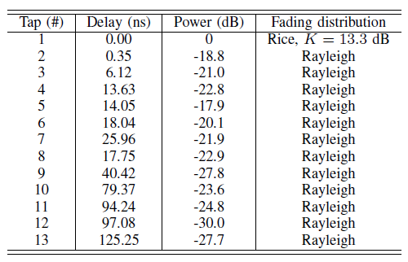
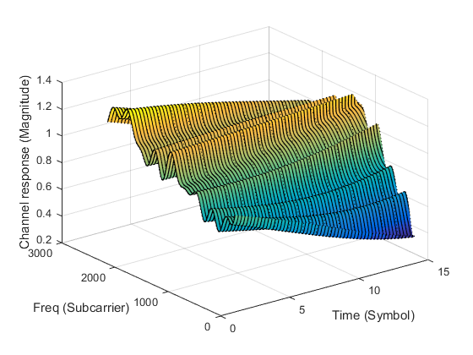
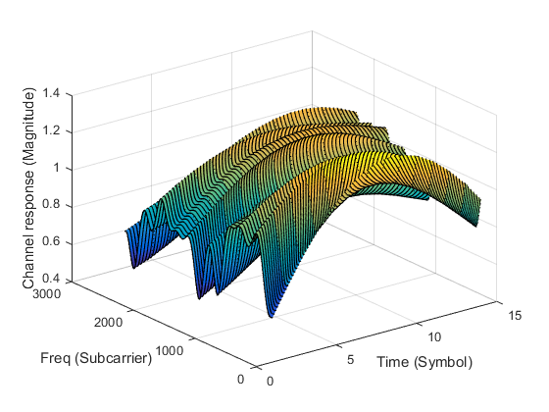
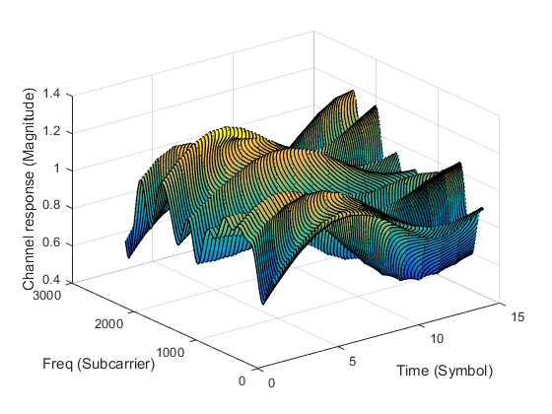
Numerology Study
3GPP 5G channel model^{[3]}
  TDL-D model is employed
    Consists of LoS and NLoS paths
    Scaling of delay spread = 10ns
    High K-factor = 13.3 dB
  Time-frequency channel responses
    Subcarrier spacing = 30 kHz
< Low-speed: 100 km/h >
< Mid-speed: 300 km/h >
< High-speed: 500 km/h >

Slide 15
Numerology Study
Effect of phase noise
  Common phase error
    Rotation of the entire constellation → Can be compensated
  ICI
    AWGN-like behavior on the constellation → Cannot be compensated
Phase noise model
  Characterized by single-sided phase noise PSD (dBc/Hz)

Slide 16
Numerology Study
Simulation parameters
  For the link-level evaluation
Parameter | Value
Carrier frequency | 30 GHz
System bandwidth | 80 MHz
Channel coding | Turbo
MCS | 16QAM 2/3, 64QAM 3/4, 256QAM 3/4
Number of layers | 1
Control channel | None
Channel estimation | Ideal
Equalizer | LMMSE
Channel model | TDL-D (DS = 10ns, K-factor = 13.3 dB)
Phase noise model | Multi-pole/zero model*
UE speed | {100, 300, 500} km/h

Slide 17
Numerology Study
BLER results
  BLER is shown to be remarkably degraded for shorter subcarrier spacing such as 15 kHz and 30 kHz
  In an extreme environment such as 256QAM with code rate 3/4 and 500 km/h train speed, only subcarrier spacing values larger than 120 kHz will result in satisfactory BLER performance
< Low-speed: 100 km/h >
< Mid-speed: 300 km/h >
< High-speed: 500 km/h >

Slide 18
Numerology Study
Spectrum efficiency results
  The use of large subcarrier spacing (≥120 kHz) ensures satisfactory spectrum efficiency performance in most cases
  Large subcarrier spacing values at least 120 kHz should be considered for the support of the high mobility in a carrier frequency of 30 GHz
< Low-speed: 100 km/h >
< Mid-speed: 300 km/h >
< High-speed: 500 km/h >

Slide 19
References
[1] | Piers Connor, “Rules for high speed line capacity”, in Railway Technical Web Pages, Aug. 2011.
[2] | J. Kim, S. W. Choi and I. G. Kim, "A shared RUs based distributed antenna system for high-speed trains," The 18th IEEE International Symposium on Consumer Electronics (ISCE 2014), JeJu Island, 2014, pp. 1-2.
[3] | 3GPP TR 38.900, “Channel model for frequency spectrum above 6 GHz,” V.1.0.1, Jun. 2016.

Slide 20
Thank you

