Slide 1
Project: IEEE P802.15 Working Group for Wireless Personal Area Networks (WPANs)
Submission Title: [MHN-E System for HRRC]
Date Submitted: [8 November, 2016]
Source: [Junhyeong Kim, Gosan Noh, Bing Hui, Hee-Sang Chung and Il Gyu Kim] Company [ETRI]
Address [218 Gajeong-ro, Yuseong-gu, Daejeon, 34129, KOREA]
Voice:[+82-42-860-6239], FAX: [+82-42-861-1966], E-Mail:[jhkim41jf@etri.re.kr]
Abstract: [This document presents MHN-E system for HRRC]
Purpose: [For discussion]
Notice: This document has been prepared to assist the IEEE P802.15. It is offered as a basis for discussion and is not binding on the contributing individual(s) or organization(s). The material in this document is subject to change in form and content after further study. The contributor(s) reserve(s) the right to add, amend or withdraw material contained herein.
Release: The contributor acknowledges and accepts that this contribution becomes the property of IEEE and may be made publicly available by P802.15.

Slide 2
Contents
Background
Overview of MHN-E System
Demonstration Plan

Slide 3
Background
Motivation
  People want to access Internet every time and every where
  Current Wi-Fi services provided in high-speed trains and subways are hard to satisfy onboard passengers’ demand
    Need performance enhancement
  Increasing data rate is possible by using abundant spectrum available in millimeter wave
Our recent achievement
  Successfully demonstrated the mmWave-based MHN system in the moving subway showing a peak data rate of over 400Mbps^{[1]}
Our ambition
  to further develop MHN towards MHN enhancement is to significantly increase the capacity and improve link reliability through an introduction of advanced technologies.

Slide 4
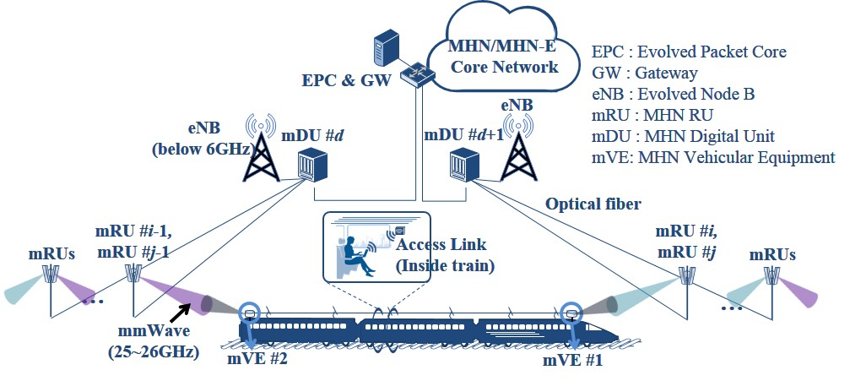
Background
Basic System Architecture of MHN/MHN-E
  Mobile wireless backhaul
  User access link

Slide 5
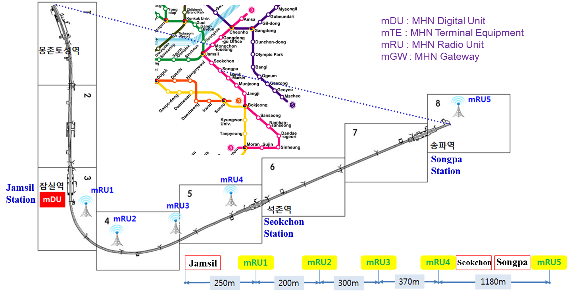
Background
Field Trial of MHN System
  MHN Test Bed Installation along Seoul Subway Line 8

Slide 6
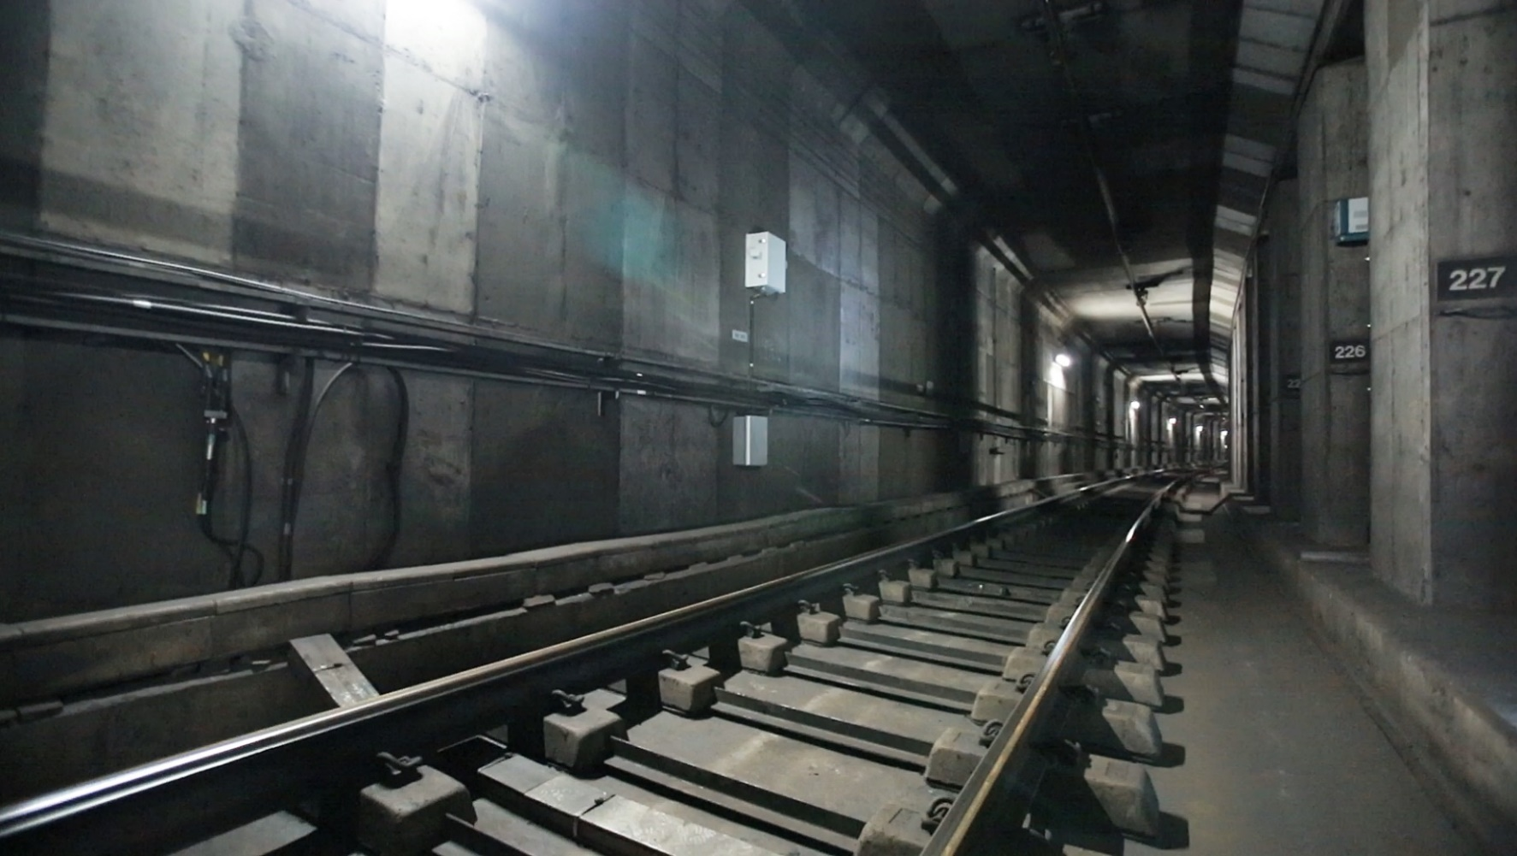
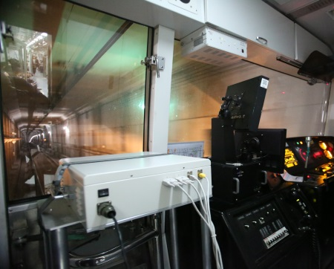

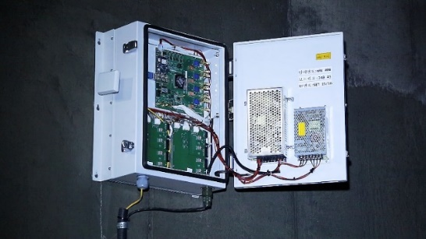
Background
Field Trial of MHN System
  Demonstration of the MHN system in the moving subway showing a peak data rate of over 400Mbps^{[1]}
mTE
mRU

Slide 7
Overview of MHN-E System
Objective
  Significantly increase the capacity and improve link reliability through an introduction of advanced technologies
MHN-E System Design Goals
  Key Performance Indicators (KPIs) and new features
Design Parameters | Comparison
 | MHN-E | MHN
Frequency | 25.5 GHz* | 31.625 GHz
Bandwidth | 1 GHz | 250 MHz
EIRP | 36 dBm** | 42 dBm
Mobility support | Up to 500 km/h | Up to 400 km/h
Modulation order | QPSK, 16QAM, 64QAM, 256QAM | QPSK, 16QAM, 64QAM
Antenna configurations | 2x2 SFMF 2x2 MIMO | 2x2 SFMF 1x1 SISO
Maximum throughput | 10Gbps | 1Gbps
* Unlicensed frequency bands in the range of 25~26GHz, called Flexible Access Common Spectrum (FACS) in Korea
** Mandatory to meet Effective Isotropic Radiated Power (EIRP) requirement regulated by Korean government, where the maximum EIRP allowed is 36dBm

Slide 8
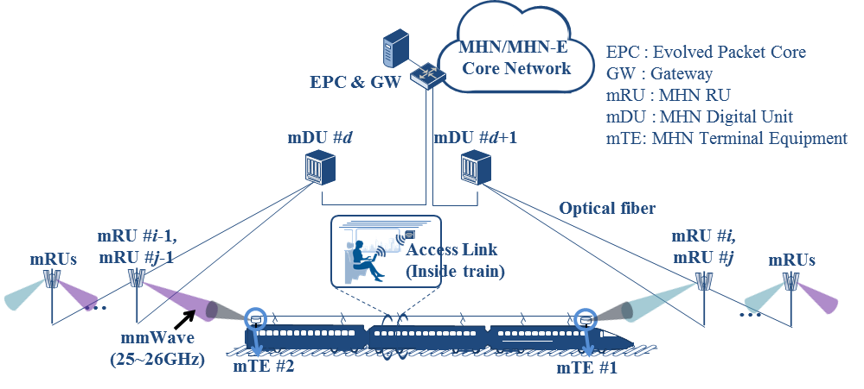
Overview of MHN-E System
New features
  Support higher mobility of up to 500km/h
  Carrier aggregation (CA)
    Aggregation of a maximum of eight Component Carriers (CCs) to attain a total transmission bandwidth of up to 1GHz
    At least two CCs should be supported as mandatory
    Three different cell types are defined
      Primary cell (PCell)
      Secondary cell (SCell)
      Tertiary cell (TCell)
    <Contiguous intra-band carrier aggregation of 8×125MHz component carriers in MHN-E>

Slide 9
Overview of MHN-E System
New features
  A new frame structure for MHN-E CA
    Based on OFDM and TDD (UL/DL duplexing)
    Different resource allocation
      PCell, SCell, TCell
    Resource nulling
      SCell vacates the resources in order to detect target cell signal without interference from serving cell
<Received SNR of mVE #1 >
<TDD frame structure of MHN-E>
<A new frame structure for MHN-E carrier aggregation>

Slide 10
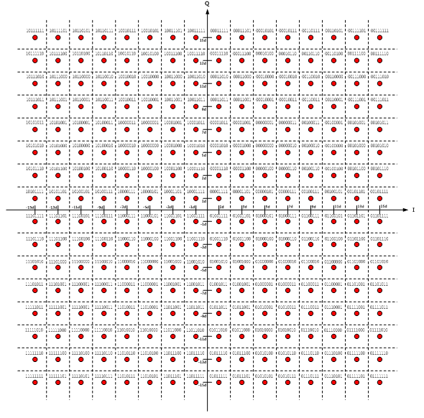
Overview of MHN-E System
New features
  2x2 MIMO transmission
    Open-loop MIMO
    Closed-loop MIMO (FFS)
  Higher order modulation
    256-QAM
  Physical layer procedure design
256 QAM
open-loop MIMO

Slide 11
Demonstration Plan
Demonstration plan 1
  Performance validation for 500km/h high-speed train (HST) environment
    Demonstration at a testbed deployed on a train (500km/h) is somewhat unrealistic
    Instead, a link-level simulation with proper HST channel models will be conducted to validate the system feasibility
      Various channel models for HST scenario

Slide 12
Demonstration Plan
Preliminary simulation result
  Average Spectral Efficiency
    It can reach beyond 3.3bps/Hz (equivalently, data rate of 3.3Gbps can be achieved using 1GHz bandwidth)
    It is expected to be further improved by introduction of MIMO technology (spatial multiplexing) for each mTE
Parameters | Setting
Channel model | Multipath-cluster channel model with Rician fading channel (K=20dB)
Carrier frequency | 26GHz
Velocity | 500km/h
Code rate | 0.8
Modulation order | QPSK, 16-QAM, 64-QAM
Transmission scheme | 2x2 single-frequency multi-flow (SFMF)
Transmission mode (each mTE) | 1x1 single antenna port (SAP), 2x2 transmit diversity (TXD)
Receiver | AFC for Doppler compensation, Turbo decoder

Slide 13
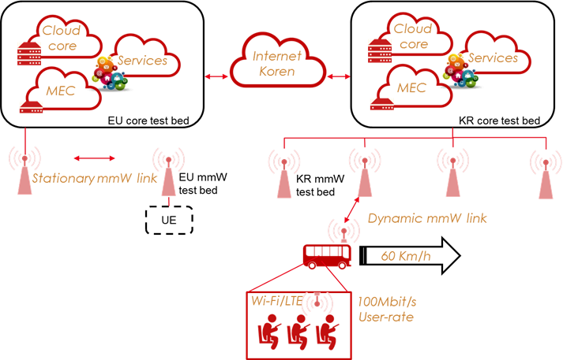
Demonstration Plan
Demonstration plan 2
  Proof-of-concept (PoC) demonstration
  The EU-KR demonstration architecture for broadband application in stationary and dynamic scenarios
Service | Target KPIs | Technology
broadband connectivity over stationary mmW backhaul (EU testbed) | Intersystem interoperability 100 Mbit/s user-experience 2.5 Gbit/s mmW wireless backhaul SDN/NFV in vEPC | End-user connectivity via Wi-Fi or 5G (if available), SDN/NFV, mmW radios and multi-RAT Reliable internet/KOREN end-user equipment
broadband connectivity over moving hot-spot (KR testbed) | Intersystem interoperability 100 Mbit/s user-experience 2.5 Gbit/s mmW wireless backhaul SDN/NFV in vEPC | End-user connectivity via Wi-Fi or 5G (if available), SDN/NFV, mmW radios and multi-RAT Mobility management Reliable internet/KOREN end-user equipment

Slide 14
References
[1] | IEEE 802.15-16-0185-01-hrrc, “Performance Evaluation of Millimeter-wave-based Communication System in Subway Tunnels”

Slide 15
Thank you

