Slide 1
Project: IEEE P802.15 Working Group for Wireless Personal Area Networks (WPANs)
Submission Title: Preliminary Performance of FEC Schemes in TG3d Channels
Date Submitted: 06 November 2016
Source: Alexander Fricke, Bile Peng, Thomas Kürner, TU Braunschweig
E-Mail: {fricke,peng,kuerner}@ifn.ing.tu-bs.de
Re: n/a
Abstract: This contribution provides a first assessment of the considered modulation and coding schemes for realistic channels from the TG3d channel model.
Purpose: Contribution towards developing the PHY for use in TG 3d
Notice: This document has been prepared to assist the IEEE P802.15. It is offered as a basis for discussion and is not binding on the contributing individual(s) or organization(s). The material in this document is subject to change in form and content after further study. The contributor(s) reserve(s) the right to add, amend or withdraw material contained herein.
Release: The contributor acknowledges and accepts that this contribution becomes the property of IEEE and may be made publicly available by P802.15.

Slide 2
Preliminary Performance of
FEC Schemes in TG3d Channels
Alexander Fricke, Bile Peng,
Thomas Kürner
TU Braunschweig

Slide 3
Outline
MCS / Scenario Overview
MCS Performance
  Close Proximity P2P
  Intra-Device
  Backhaul / Fronthaul
  Data Center
ISI Impact Estimation

Slide 4
MCS/Scenario Overview
    The following modulation schemes have been simulated so far:
      On/Off-Keying
      BPSK
      QPSK
      16-QAM
      64-QAM
    The following forward error correction types have been implemented:
      (7,4) – Hamming code
      Reed-Solomon Code (255,239) in GF(2⁸)
      Rate 11/15 LDPC (1440,1056)
      Rate 14/15 LDPC (1440,1344)
    The following transfer functions from the data sets defined in the CMD have been utilized:
      Close-Proximity: #m1 of CloseProximityP2P_S1_TX12_RX12.txt
      Intra-Device: #m1 of TG3d_Intra_Device_B2Bv_6dBi.txt
      #m1 of TG3d_Intra_Device_B2Bv_18dBi.txt
      Back-/Fronthaul: AWGN Channel
      Data Center: #m1 of TG3d_Data_Center_Type_1&2_position_1_antenna_1.txt
      #m1 of TG3d_Data_Center_Type_1&2_position_1_antenna_3.txt
Alexander Fricke (TU Braunschweig)

Slide 5
MCS Performance
    Up to now, the MCSs under test have been evaluated by simulations using at most 10⁸ modulation symbols.
    Above that, the SNR/BER curves have been extrapolated based on a function of the form
    (BER_{log}) = a∙(SNR_{log})^{b} + c to predict at which SNR a target BER of 10⁻¹² is reached
    When the simulations for all envisaged application cases and MCSs are finished, a selected sub-set of simulations will be performed with a higher number of symbols to verify the extrapolated behavior.
Alexander Fricke (TU Braunschweig)

Slide 6
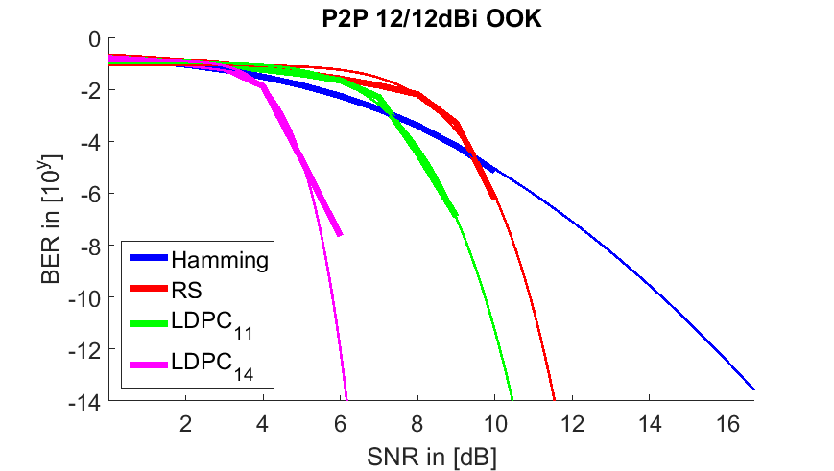
Close Proximity: 12dBi Tx / 12dBi Rx
Alexander Fricke (TU Braunschweig)

Slide 7
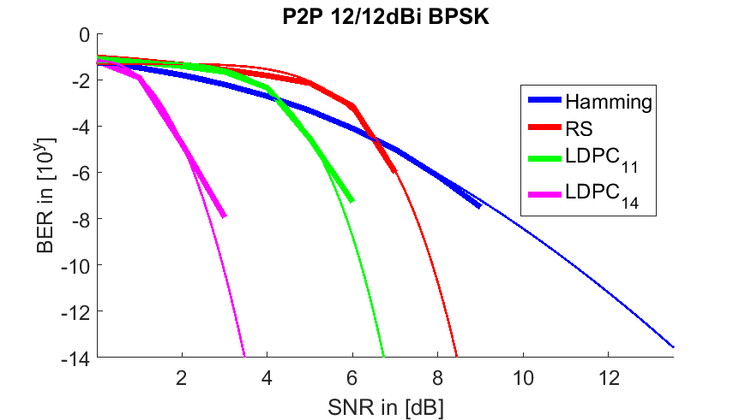
Close Proximity: 12dBi Tx / 12dBi Rx
Alexander Fricke (TU Braunschweig)

Slide 8
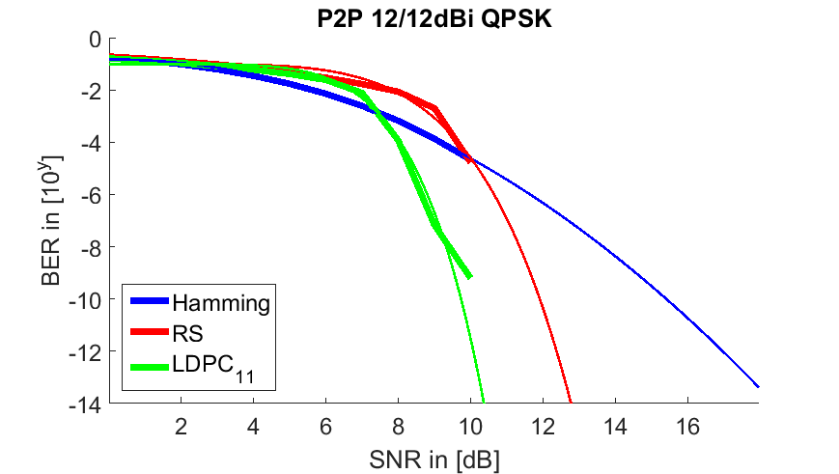

Close Proximity: 12dBi Tx / 12dBi Rx
Alexander Fricke (TU Braunschweig)

Slide 9
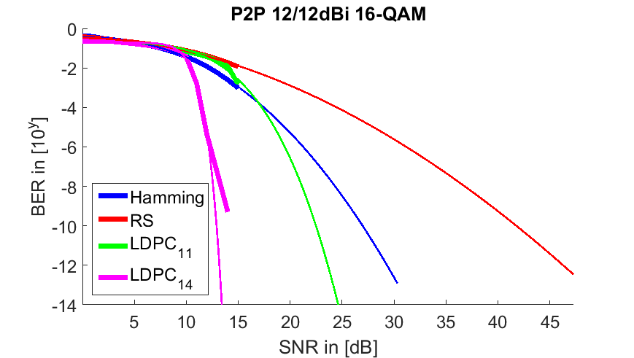
Close Proximity: 12dBi Tx / 12dBi Rx
Alexander Fricke (TU Braunschweig)

Slide 10
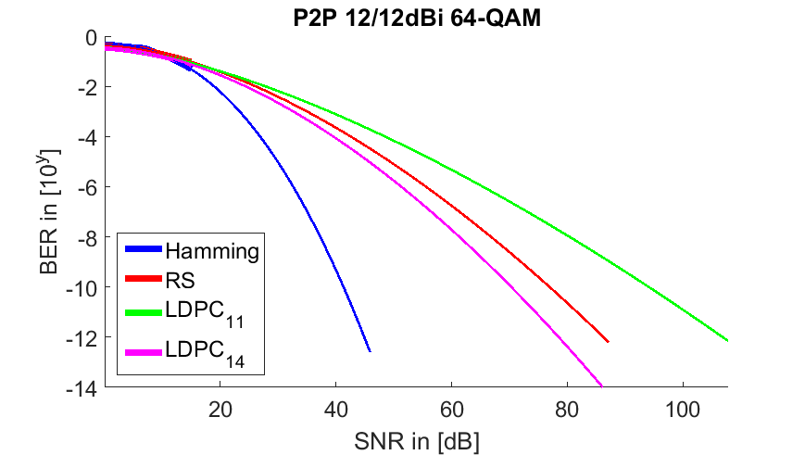
Close Proximity: 12dBi Tx / 12dBi Rx
Alexander Fricke (TU Braunschweig)

Slide 11
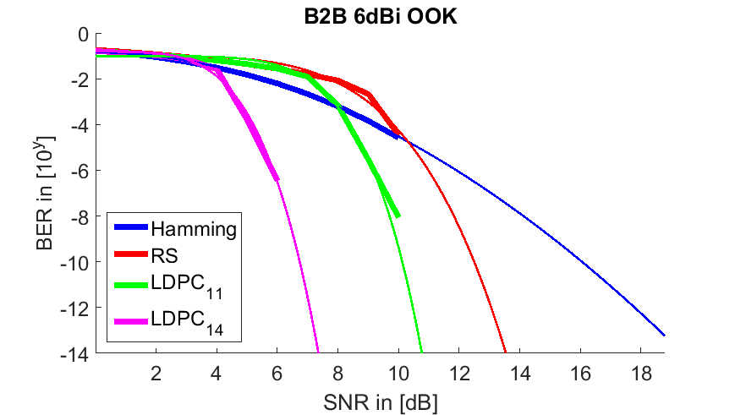
Intra-Device: 6dBi
Alexander Fricke (TU Braunschweig)

Slide 12
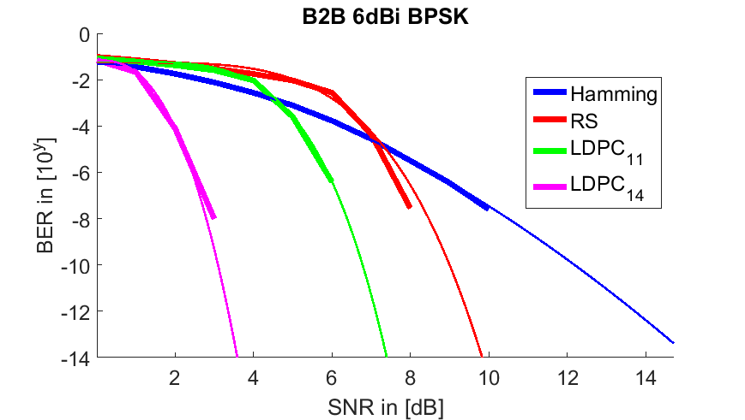
Intra-Device: 6dBi
Alexander Fricke (TU Braunschweig)

Slide 13
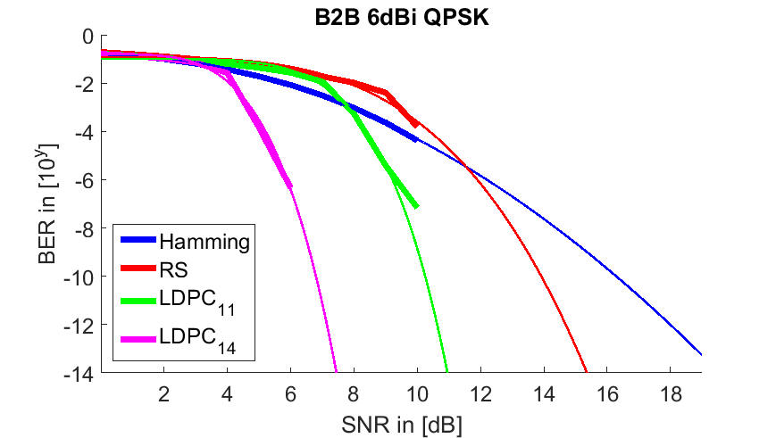
Intra-Device: 6dBi
Alexander Fricke (TU Braunschweig)

Slide 14
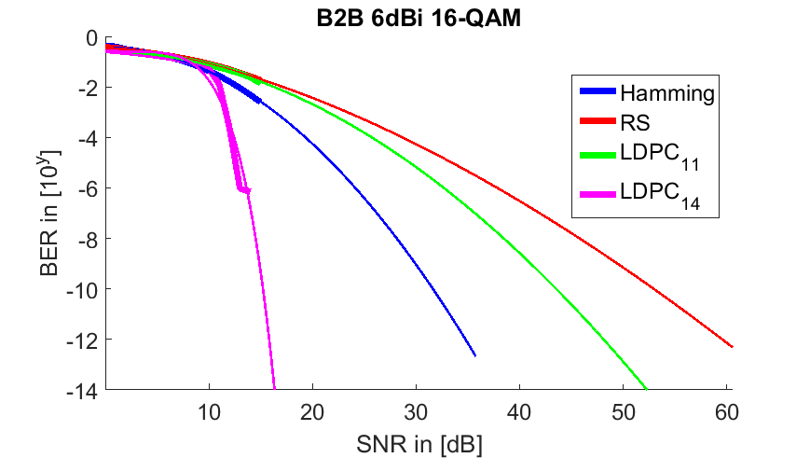
Intra-Device: 6dBi
Alexander Fricke (TU Braunschweig)

Slide 15
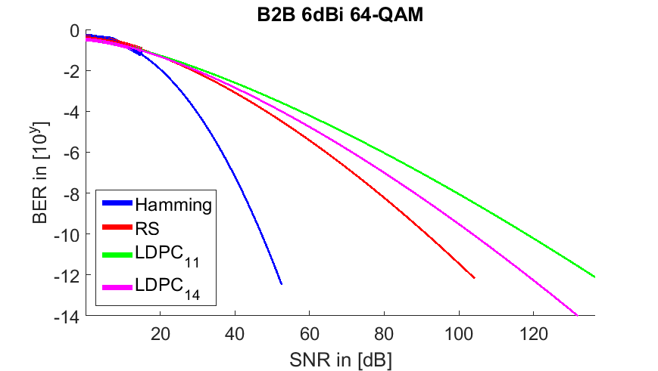
Intra-Device: 6dBi
Alexander Fricke (TU Braunschweig)

Slide 16
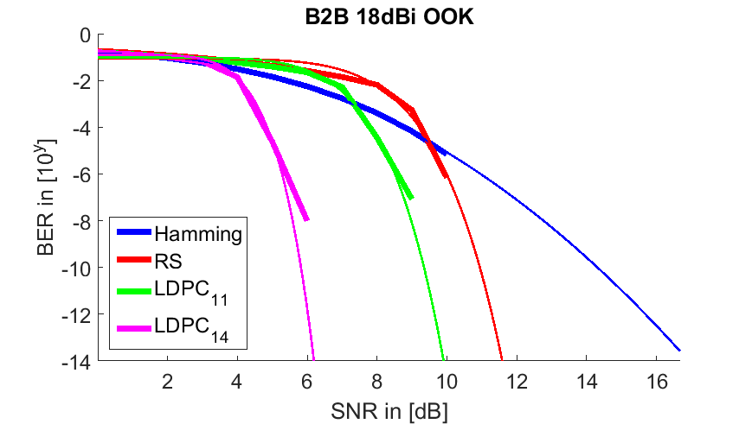
Intra-Device: 18dBi
Alexander Fricke (TU Braunschweig)

Slide 17
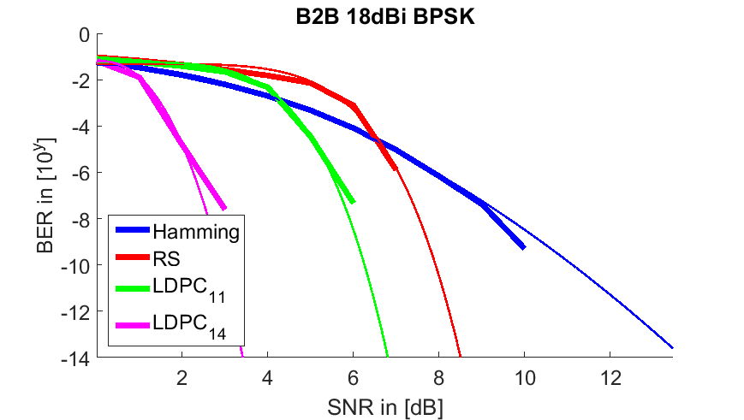
Intra-Device: 18dBi
Alexander Fricke (TU Braunschweig)

Slide 18
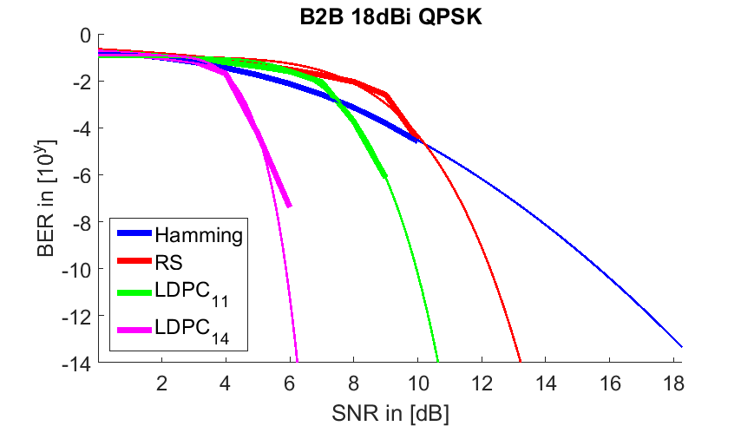
Intra-Device: 18dBi
Alexander Fricke (TU Braunschweig)

Slide 19
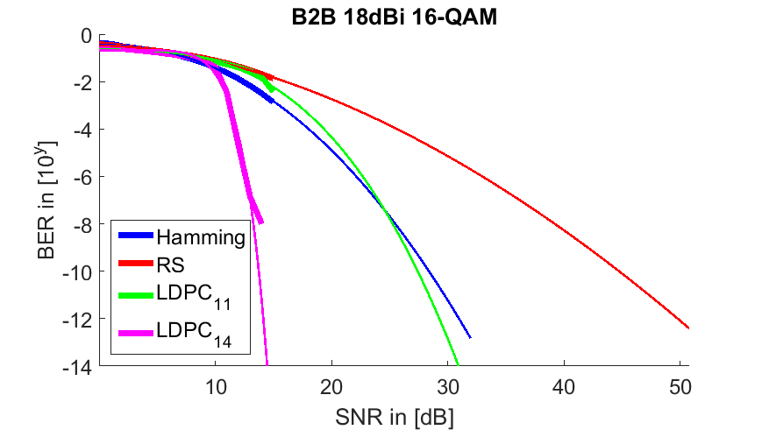
Intra-Device: 18dBi
Alexander Fricke (TU Braunschweig)

Slide 20
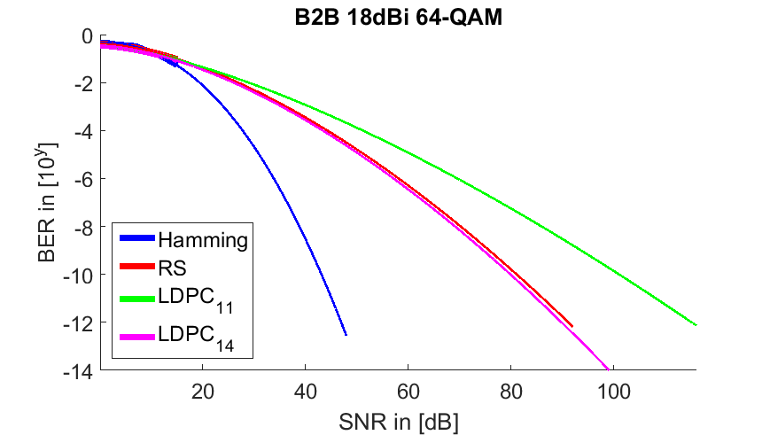
Intra-Device: 18dBi
Alexander Fricke (TU Braunschweig)

Slide 21
Backhaul/Fronthaul: AWGN
Alexander Fricke (TU Braunschweig)

Slide 22
Backhaul/Fronthaul: AWGN
Alexander Fricke (TU Braunschweig)

Slide 23
Backhaul/Fronthaul: AWGN
Alexander Fricke (TU Braunschweig)

Slide 24
Backhaul/Fronthaul: AWGN
Alexander Fricke (TU Braunschweig)

Slide 25
Backhaul/Fronthaul: AWGN
Alexander Fricke (TU Braunschweig)

Slide 26
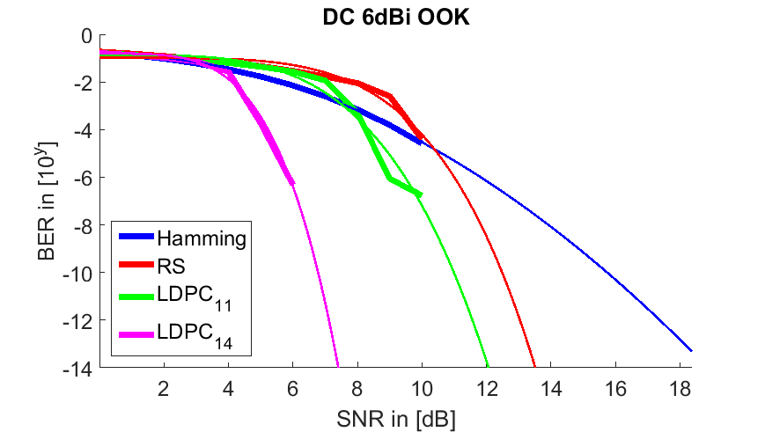
Data Center: 6dBi
Alexander Fricke (TU Braunschweig)

Slide 27
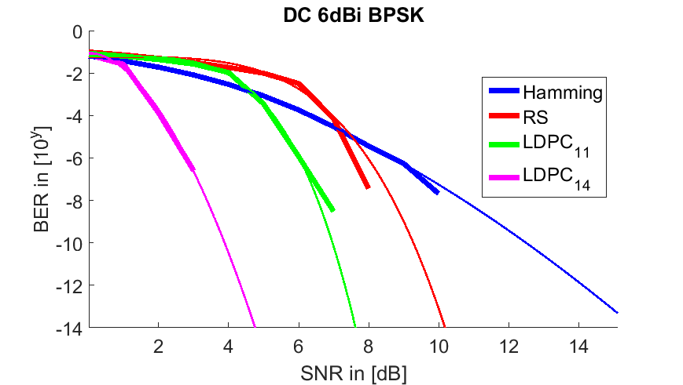
Data Center: 6dBi
Alexander Fricke (TU Braunschweig)

Slide 28
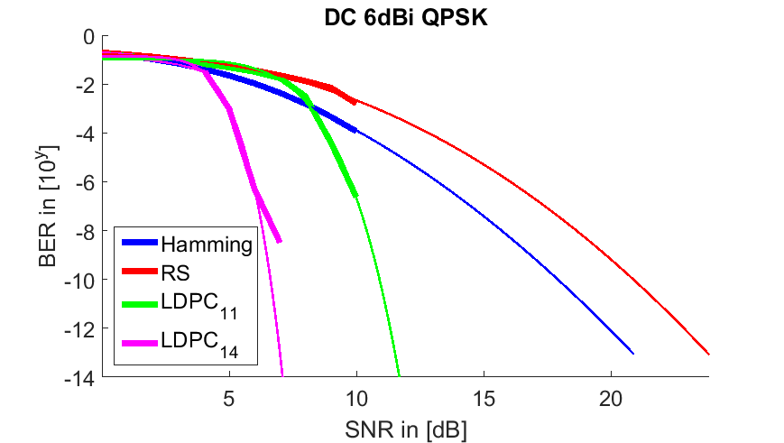
Data Center: 6dBi
Alexander Fricke (TU Braunschweig)

Slide 29


Data Center: 6dBi
Alexander Fricke (TU Braunschweig)

Slide 30
Data Center: 6dBi
Alexander Fricke (TU Braunschweig)

Slide 31
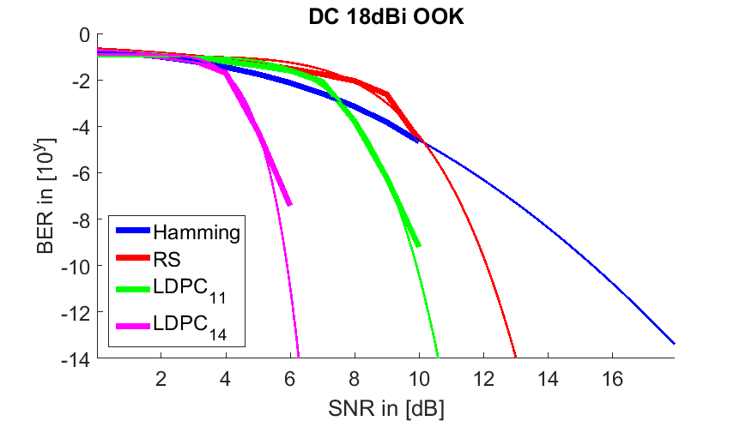
Data Center: 18dBi
Alexander Fricke (TU Braunschweig)

Slide 32
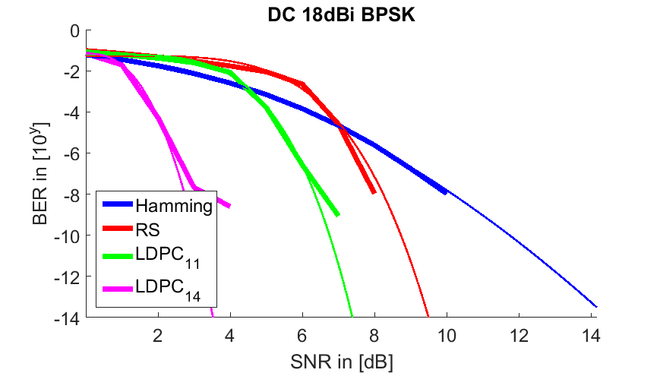
Data Center: 18dBi
Alexander Fricke (TU Braunschweig)

Slide 33
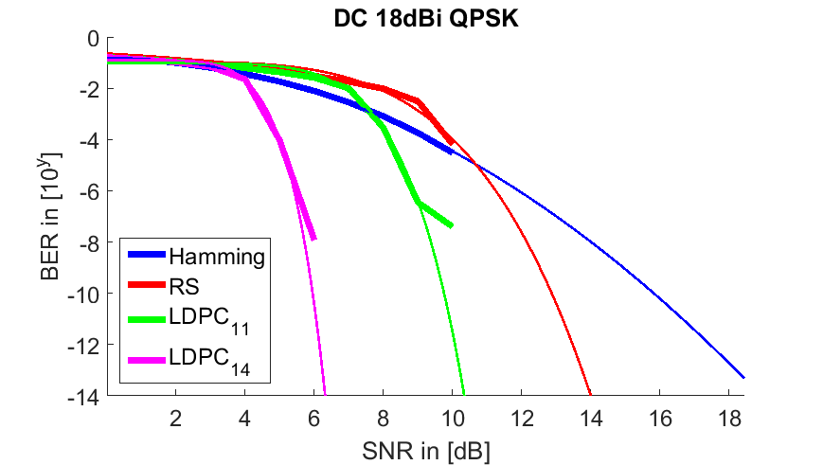
Data Center: 18dBi
Alexander Fricke (TU Braunschweig)

Slide 34
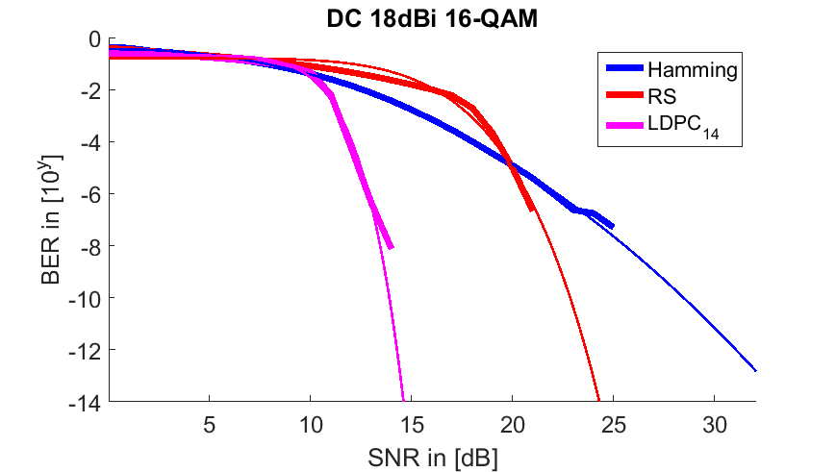
Data Center: 18dBi
Alexander Fricke (TU Braunschweig)

Slide 35
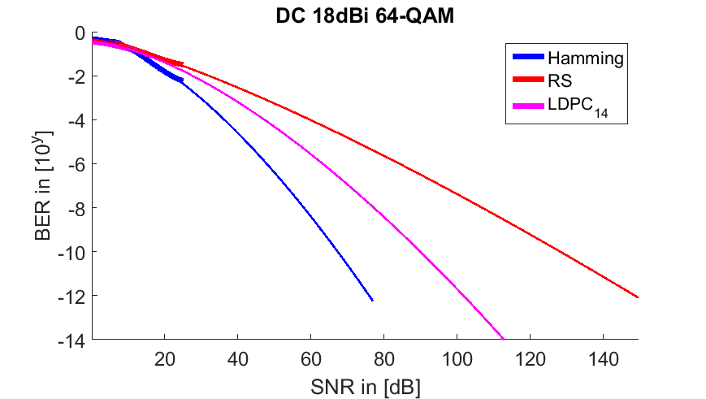
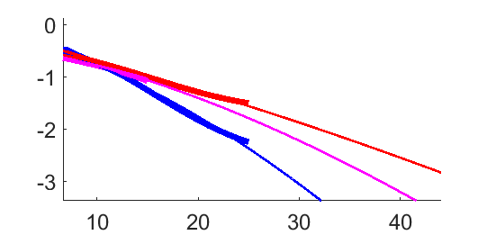
Data Center: 18dBi
Alexander Fricke (TU Braunschweig)

Slide 36
Impact of ISI
    The FEC simulations have so far not shown any error floor
    Since at most 10⁹ bits have been simulated so far, the SNR-BER curves have been extrapolated to allow an estimate of the SNR required to reach the target BER of 10⁻¹²
    Error floors may appear due to intersymbol interference (ISI)
    As a rough estimate to check whether ISI may become an issue the RMS delay spread for each scenario is calculated
    In order to calculate the RMS delay spread, noise clipping has to be applied, i.e. multipath signals with an amplitude of less than 30dB below the respective main signal are disregarded. Hence, the delay spread becomes a function of the SNR
    If the RMS delay spread is much smaller than the symbol duration (chip duration), ISI may be neglected
    The chip duration lies between ~0.023ns (bandwidth of 69.120 GHz) and ~0.568 ns (bandwidth of 2.160 GHz)
Alexander Fricke (TU Braunschweig)

Slide 37
ISI Impact Estimation
Alexander Fricke (TU Braunschweig)

Slide 38
ISI Impact Estimation
Alexander Fricke (TU Braunschweig)

Slide 39
ISI Impact Estimation
Alexander Fricke (TU Braunschweig)

Slide 40
Conclusion on Preliminary Results
    The simulation results show that a BER of 10-12 can be achieved in most cases for a SNR in the order of 4-10 dB for OOK, BPSK and QPSK
    First results for 16-QAM and 64-QAM show that it might be difficult to achieve the target BER for reasonable SNR. More simulations are needed to confirm this
    The RMS delay spread is significantly below the chip duration for SN < 15 dB if antennas with 18dBi gain are assumed
    In the intra-device case, when using antennas with a gain of 6 dBi, ISI may become a critical issue
Alexander Fricke (TU Braunschweig)

Slide 41
Thank You for Your Attention

