Slide 1
Project: IEEE P802.15 Working Group for Wireless Personal Area Networks (WPANs)
Submission Title: Some thoughts on naming conventions in TG3d
Date Submitted: 15 September 2016
Source: Thomas Kürner (TU Braunschweig)
Address Schleinitzstr. 22, D-38092 Braunschweig, Germany
Voice:+495313912416, FAX: +495313915192, E-Mail: kuerner@ifn.ing.tu-bs.de
Re: 15-16-0595-00-003d-proposal-for-ieee802-15-3d-thz-phy
Abstract: This document discusses naming conventions wrt to the THz, parinet and HRCP nature of TG3d
Purpose: To be considered in TG3d baseline document
Notice: This document has been prepared to assist the IEEE P802.15. It is offered as a basis for discussion and is not binding on the contributing individual(s) or organization(s). The material in this document is subject to change in form and content after further study. The contributor(s) reserve(s) the right to add, amend or withdraw material contained herein.
Release: The contributor acknowledges and accepts that this contribution becomes the property of IEEE and may be made publicly available by P802.15.

Slide 2
Scope of TG3d
Within TG3d a new PHY operating at 252 to 325 GHz is developed for switched point-to-point links
The amendment developed inTG3d distinguishes from the baseline standard by introducing
  a PHY for new frequency range -> THz PHY
  the concept of point-to-point links, where only two devices are involved. This is the same concept as introduced by the parallel running project TG3e and is called there a pairnet

Slide 3
Scope of TG3e
Within TG3e a new PHY, but still operating at 60 GHz is developed for High-Rate Close proximity (HRCP) applications.
HRCP also involves only two devices. Therefore the concept of pairnet is introduced.
HRCP devices are always operating in a pairnet.

Slide 4
Commonalities and Differences between TG3d and TG3e
Commonalities: In both cases the devices are always operated as pairnet
Differences: TG3d operatores at the 300 GHz band (THz) and TG3e operates at the 60 GHz band.
Partly commonalities/partly differences: Some applications in TG3d are HRCP applications, soem are not (see next slide)

Slide 5
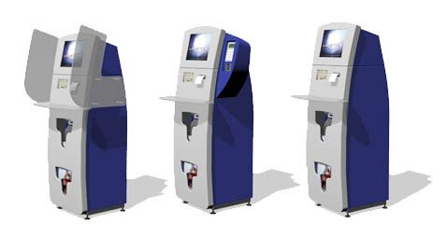
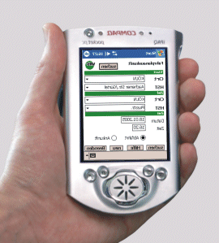
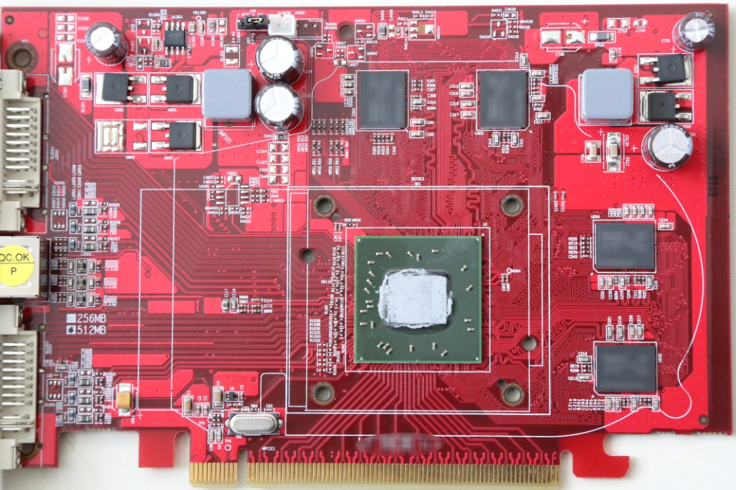
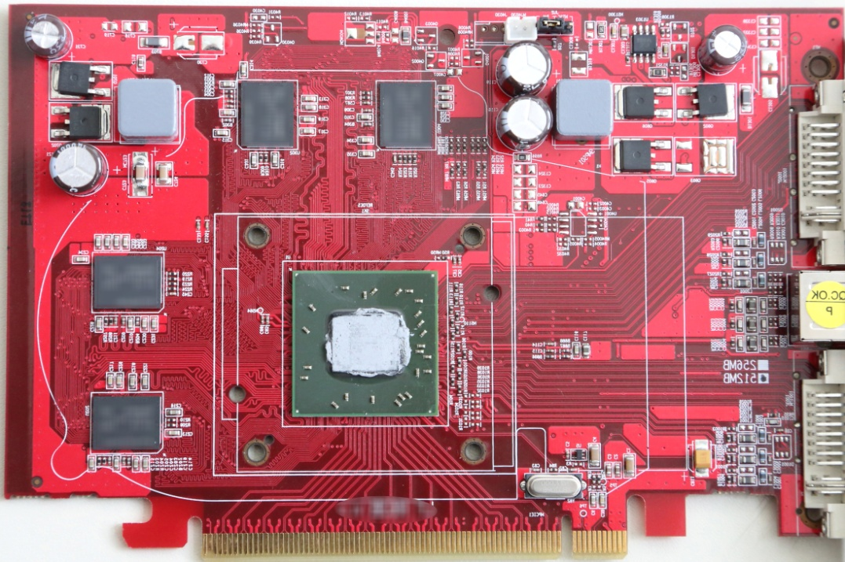
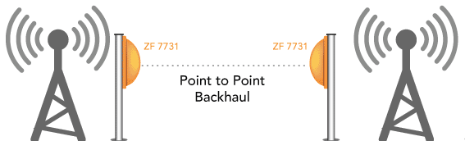
HRCP and non-HRCP applications are considered in TG3d
10...100 Gbit/s
10...100 Gbit/s
HRCP
Kiosk downloads
Intra-Device Communication
10..100 Gbit/s
10...100 Gbit/s
Non-HRCP
Backhaul/Fronthaul links
Wireless Links in Data Centers

Slide 6
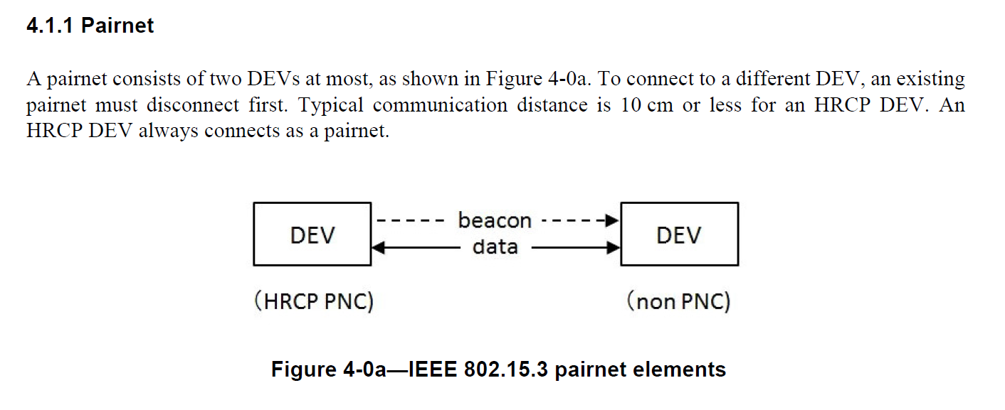
Oberservations made in P802.15.3e D04
The terms pairnet and HRCP are sometimes used as „synonym“. It is not always clear, which elements are due to the HRCP nature and which features are due to the parinet nature.
Example: The HRCP PNC is rather a pairnet coordinator

Slide 7
Proposal for the naming conventions (1/2)
Throughout both amendments a clear distinction has to be made:
  The term THz PHY should be used, whenever the feature is a special case that applies for the 300 GHz band and the corresponding THz PHY.
  The term HRCP PHY should be used, whenever the feature is a special case that applies for specific HRCP PHY (oeprating at 60 GHz).
  The term pairnet should be used, whenever it is a special case for pairnets in general and not restricted to HRCP only
  The term HRCP should be used, whenever it is a special case for HRCP applications only.

Slide 8
Proposal for the naming conventions (2/2)
  The term THz pairnet should be used, whenever the feature is a special case that applies for a pairnet and the THz PHY only.
  The term THz HRCP should be used, whenever the feature is a special case that applies for the combination of an HRCP and the THz PHY only.
  The term THz non-HRCP pairnet should be used, whenever the feature is a special case that applies for the combination a THz pairnet and non-HRCP only.

Slide 9
Overview of Features adressed and names (to be) used in TG3d and TG3e
future
3??
HRCP
PHY
3d
THz PHY
PHY
3e
Pairnet
Piconet
Pairnet/ Piconet
HRCP/
Non-HRCP
HRCP
Non-HRCP

