Slide 1
Project: IEEE P802.15 Working Group for Wireless Personal Area Networks (WPANs)
Submission Title: [L2R interface considerations for TG12]
Date Submitted: [14 Sept 2016]
Source: [Charles Perkins] Company [Futurewei]
Address [Saratoga, CA, USA]
Voice:[+1-408-330-4586], E-Mail:[charliep@computer.org]
Re: [L2R functional module interfaces]
Abstract: [Interface considerations for TG12 support of L2R, architectural discussion]
Purpose: []
Notice: This document has been prepared to assist the IEEE P802.15. It is offered as a basis for discussion and is not binding on the contributing individual(s) or organization(s). The material in this document is subject to change in form and content after further study. The contributor(s) reserve(s) the right to add, amend or withdraw material contained herein.
Release: The contributor acknowledges and accepts that this contribution becomes the property of IEEE and may be made publicly available by P802.15.

Slide 2
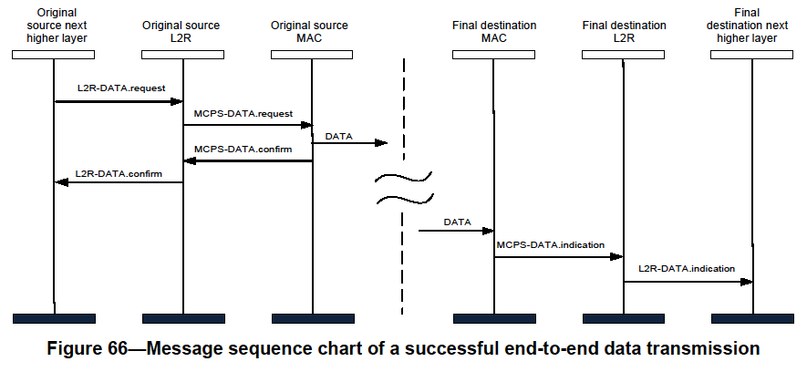
802.15.10 Functional Decomposition
The Data SAP and the MCPS-SAP are used for Multicast as indicated in Figure 19 and Figure 66
The MGMT SAP and the MLME-SAP are used as indicated in Figures 3 through 13

Slide 3
PHY and DLL Functional Decomposition
IPv
6
Network
Other Networks
Other Applications
L
a
y
e
r
3
EPD
a
=
0
x
86
DD
n
NWK
d
-
SAP
APP
-
IPv
SAP
6
-
6
SAP
LON
-
SAP
a
P
b
A
o
S
v
-
Protocol Discrimination Entity
e
(
PDE
)
-
Mandatory
H
-
O
L
6
802
.
1
XH
-
SAP
6
topH
-
SAP
MGMTH
-
SAP
H
-
6
LoWPAN
KMPH
SAP
-
SAP
L
2
RH
-
SAP
RNGH
-
-
SAP
Optional
2
-
1
Management
.
KMP
802
.
5
1
X
6
top
L
2
R
Protocols
Ranging
Other Protocol
(
s
1
)
.
-
Optional
-
-
Optional
-
-
Optional
-
-
Optional
-
-
Optional
2
-
-
Mandatory
0
-
8
6
LOM
-
SAP
L
2
RM
-
SAP
MGMTM
-
SAP
RNGM
-
802
SAP
.
1
XM
-
SAP
6
topM
-
SAP
M
-
KMPM
SAP
-
SAP
L
Fragmentation
a
-
Optional
-
y
Multiplexed MAC Interface
e
(
MMI
)
-
Mandatory
802
-
r
.
15
.
9
6
lowpan
2
MCPS
-
SAP
MLME
-
SAP
Beacon
-
enabled modes
Nonbeacon
-
enabled modes
Generic
LECIM
(
GTS
)
DSME
TSCH
SUN
TVWS
(
RFID
RCC
Generic
lp
-
wan
C
-
)
Optional
-
-
Optional
-
-
Optional
-
-
Optional
-
-
Optional
-
-
Optional
-
-
Optional
-
-
Optional
A
-
-
Optional
M
-
MAC optional behaviors
Association
Security
Promiscuous
Ranging
Low Energy
Priority
Metrics
Channel Hopping
I
.
E
.
4
s
TRLE
.
5
1
.
2
PD
-
SAP
PLME
-
0
SAP
8
Modulation type
O
L
-
QPSK
BPSK
FSK
MSK
OFDM
CSS
UWB
-
HRP
UWB
-
LRP
ASK
a
Y
-
y
Optional
-
-
Optional
-
-
Optional
-
-
Optional
-
-
Optional
-
-
Optional
-
-
Optional
-
-
Optional
-
-
Optional
H
-
e
P
r
1
PHY optional behaviors
Data Whitener
FEC
PSDU FRAK
Slide 3
Notes:
September 16
Page 3

Slide 4
What’s in L2R?
How to invoke L2R (definition of primitives)
Definition of L2R protocol elements (IEs)
Definition of L2R configuration parameters (cfg_tables: L2IB, …)

Slide 5
Mesh L2R Primitives
mesh discovery and management
  L2RLME-PAN-SCAN.{request (14), confirm, indication}
  L2RLME-MESH-START.{request (18), confirm}
  L2RLME-MESH-STOP.{request, confirm}
  L2RLME-JOIN-MESH.{request (9), confirm}
  L2RLME-MESH-DISCOVERY.{request (5), confirm}
  L2RLME-MESH-SELECT.{request (3), confirm}
  L2RLME-LEAVE-MESH.{request (4), confirm}
  L2RLME-DISCONNECT-MESH.indication (2)
  L2RLME-INTERMEDIATE-ADDR-LIST.indication (3)
  L2RLME-NOTIFY.indication (3)

Slide 6
Other L2R Primitives
short address assignment / management
  L2RLME-AA-RQ.{request (3), confirm (4), indication (5)}
  L2RLME-AA-RP.{request, confirm}
  L2RLME-ARLS.{request, confirm, indication}
multicast management
  L2RLME-MULTICAST-SUBSCRIPTION.{request (4), confirm}
data-plane support
  L2R-DATA.{request (21), confirm, indication (15)}
  L2R-MC-DATA.{request (7), confirm, indication}

Slide 7
Protocol operations to MAC/PHY
Topology control and mesh parameter dissemination
  Beacon configuration to include TC IE
  TC IE, RA IE
Neighbor list management (NLM IE)
Support for source routing (# addresses fields)
Support for peer-to-peer routing (P2P-RQ/RP IEs)
Small scale PAN support (SRA and SLR IEs)
Address allocation support (AA-RQ, AA-RP, A-RLS)
Data plane optimization, acknowledgement, configuration (L2R Routing IE , DCat IE, E2E ACK IE)

Slide 8
Configuration tables (many parameters)
24 L2IB attributes (Table 57)
6 elements of a L2R mesh descriptor (Table 58)
L2R Broadcast Security attributes (Table 59 — many)
L2R Unicast Security attributes (Table 62 — many)

Slide 9
L2IB configuration parameters
l2rMeshDescriptorList
l2rSwitchMesh
l2rMeshIdMeshRoot
l2rIntervalUnit
l2rRaIeInterval
l2rNlmIeInterval
l2rTcIeInterval
l2rRaIeInterval
l2rNlmIeInterval
l2rTcIeTxAddrFrequency
l2rMaxMissedTcIe
l2rNlmIeAcceptance
l2rMeshSelection
l2rMeshRecordMode
l2rNeighborRecord
l2rRvsUnsupported
l2rMaxScanRetry
l2rDcatMaxLength
l2rDefaultTtl
l2rDefaultRl
l2rMcBcJitterNeighborMagnitude
l2rMcbcJitterBaseValue
l2rAaWaitTime
l2rPmax
l2rPmin
l2rP2PRouteDiscoveryTimeout

Slide 10
View of L2R optional functional block
Northbound Interface
short address
multicast management
mesh discovery and management
data-plane support
L2RH-SAP
802.15.12 Management Interface (?)
L2R
L2IB
(Optional)
….
L2RM-SAP
Topology control. mesh parameters
Address allocation
Neighbor list management
source routing
Data Plane
SSPAN
P2P routing
Southbound Interface

Slide 11
802.15.10 “inside” 802.15.12 (?)
L2RH-SAP
Data
MGMT
L
2
R
MLME
-
MCPS
SAP
Data
MGMT
-
SAP
L2IB
L
2
R
….
Higher Layer
Data
MGMT
MLME
-
MCPS
SAP
-
L
2
R
SAP
MLME
-
MCPS
SAP
-
SAP
MCPS
-
SAP
MLME
-
SAP
IEEE
802
.
15
.
4
MAC
L2RM-SAP
PD
-
SAP
PLME
-
SAP
IEEE
802
.
15
.
4
PHY
(
s
)

