Slide 1
Project: IEEE P802.15 Working Group for Wireless Personal Area Networks (WPANs)
Submission Title: [Proposed resolution to comments on MCS indication]
Date Submitted: [21 September 2016]
Source: [Ken Hiraga⁽¹⁾, Keiji Akiyama, Jae Seung Lee, Itaru Maekawa, Makoto Noda, Ko Togashi, (representative contributors), all contributors are listed in “Contributors” slide]
Company: [ETRI, JRC, NTT¹, Sony, Toshiba]
Address¹: [Hirarinooka 1-1, Yokosuka Japan]
E-Mail¹: [hiraga.ken@lab.ntt.co.jp (all contributors are listed in “Contributors” slide)]
Re:[15-16-0585-00-003e consolidated sponsor ballot comments]
Abstract: A proposed resolution to Comment #i-201, #i-202, #i-203, and #i-27.
Purpose: For a comment resolution to Comment #i-27, #i-201, #i-202, and #i-203, we propose to add a missing table and explain the function and the purpose of the primitive to resolve these comments.
Notice: This document has been prepared to assist the IEEE P802.15. It is offered as a basis for discussion and is not binding on the contributing individual(s) or organization(s). The material in this document is subject to change in form and content after further study. The contributor(s) reserve(s) the right to add, amend or withdraw material contained herein.
Release: The contributors acknowledge and accept that this contribution becomes the property of IEEE and may be made publicly available by P802.15.

Slide 2
Contributors
Name | Affiliation | Email
Jae Seung Lee | ETRI | jasonlee@etri.re.kr
Moon-Sik Lee | ETRI | moonsiklee@etri.re.kr
Itaru Maekawa | Japan Radio Co., Ltd. | maekawa.itaru@jrc.co.jp
Doohwan Lee | NTT Corporation | lee.doohwan@lab.ntt.co.jp
Ken Hiraga | NTT Corporation | hiraga.ken@lab.ntt.co.jp
Keitarou Kondou | Sony Corporation | Keitarou.Kondou@jp.sony.com
Hiroyuki Matsumura | Sony Corporation | Hiroyuki.Matsumura@jp.sony.com
Makoto Noda | Sony Corporation | MakotoB.Noda at jp.sony.com
Masashi Shinagawa | Sony Corporation | Masashi.Shinagawa@jp.sony.com
Ko Togashi | Toshiba Corporation | ko.togashi@toshiba.co.jp
Kiyoshi Toshimitsu | Toshiba Corporation | kiyoshi.toshimitsu@toshiba.co.jp
Thomas Kürner | TU-Braunschweig | Kuerner@ifn.ing.tu-bs.de

Slide 3
Comments and proposed resolutions
CID | Page | Sub-clause | Line # | Comment | Proposed Change | E/T | Must Be Satisfied? | Proposed resolution
i-201 | 18 | 5.3.19 | 14 | If the goal is to indicate the current MCS and channel, then this should be done with the MAC-HRCP-DATA primitives as these are associated with data frames. However, it is not clear what the upper layer will do with the MCS as this is a PHY specific item. Part of the MAC's purpose is to abstract the PHY to the upper layers. | Delete 5.3.19 and its associated subclauses. |  | Yes | Accepted
i-202 | 18 | 5.3.19.1 | 30 | The semantics have one primitive, Timeout, which is not defined anywhere in the draft. | Delete 5.3.19 and its associated subclauses. |  | Yes | Accepted
i-203 | 18 | 5.3.19.2 | 47 | The text states that the primitive parameters are defined in Table 5-27a, but that table does not exist in the current draft | Delete 5.3.19 and its associated subclauses. |  | Yes | Accepted
i-27 |  | 5.3.19.2 |  | There is no Table 5-27a. (only reference to this table) | Create and insert table, presented in page 7 of 15-16-0326r01. | T | Yes | Revised

Slide 4
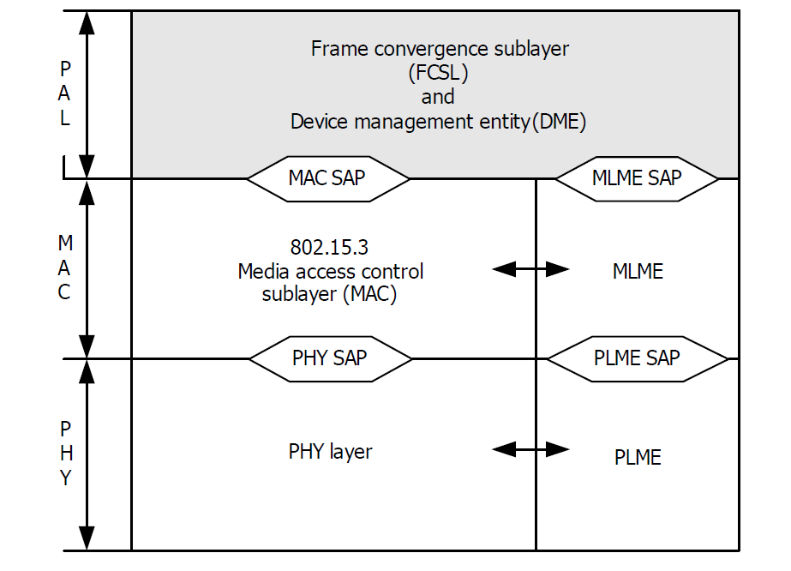
Comment #i-201
Accept
In current draft, the MCS information indicated by MLME-MCS primitive is intended to be used in the upper layer of the transmitter of the transmitted frame.
As commented, this function can be provided by MAC-HRCP-DATA primitives which reports at MAC SAP. MAC-HRCP-DATA.confirm primitive is used to report the result of a request to transfer an MSDU from one MAC entity to another MAC entity or entities.
Hence we propose to delete MLME-MCS primitives and modify MAC-HRCP-DATA.confirm primitive.
MLME-MCS.request
Ask the current MCS and frequency channel
Remove these primitives shown in 5.3.19.
MLME-MCS.confirm
Information of the MCS identifier of this frame
MAC-HRCP-DATA.request
MAC-HRCP-DATA.confirm
Modify this primitive
PHY frame

Slide 5
Comment #i-201
Accept
Proposed resolution to this comment
  Delete 5.3.19 and its associated subclauses (5.3.19.1 and 5.3.19.2) along with the proposed resolution.
  Modify MAC-HRCP-DATA.comfirm primitives described in 5.5.8.
    Primitive parameters which indicatie MCS information are added.
    Add a description that function is optional only applicable to HRCP-SC-PHY, not applicable to HRCP-OOK-PHY.

Slide 6
Comment #i-201
Accept
Answer to “What will the upper layer will do?”
Usage examples:
  Along with MCS used for frame transmission, the downloading kiosk can choose the compression size of movie file which will be provided to user.
  In order to limit communication area, the kiosk uses another antenna and transmits interference signals to limit communication range. The power level of the interfering signal will be set along with MCS of the transmitted frame.

Slide 7
Comment #i-202 and #i-203
Accept
Proposed change from D04:
Delete 5.3.19 and its associated subclauses.

Slide 8
Proposed resolution to #i-27
Revise
Insert the following text in red at 5.5.8:
5.5.8 MAC-HRCP-DATA.confirm
This primitive is used to report the result of a request to transfer an MSDU from one MAC entity to another
MAC entity or entities. This primitive is only generated if the ConfirmRequested parameter in the MAC-
HRCP-DATA.request with the same RequestID value is ALWAYS or is ON_ERROR and the ResultCode
is FAILURE.
MCSIdentifier and ChIdentifier parameters are used to indicate the current MCS identifier and frequency channel used in the transmitted frame to the upper layer. These two parameters are only applicable for HRCP SC PHY.
The semantics of this primitive are:
MAC-HRCP-DATA.confirm (
RequestID,
TransmitDelay,
MCSIdentifier
ChIdentifier
ResultCode,
ReasonCode
)
The primitive parameters are defined in Table 5-31.

Slide 9
Proposed resolution to #i-27
Insert the following row in red at the end of Table 5-31:
Table 5-31—MAC-ISOCH-DATA, MAC-ASYNC-DATA and MAC-HRCP-DATA primitive parameters
Name | Type | Valid range | Description
LogicalChannel | Enumeration | CH0, CH1 | LogicalChannel value is available for use by the Higher Layer Protocol user and is therefore out of scope of this specification. This parameter is valid only for MAC-HRCP-DATA primitives.
MCSIdentifier | Enumeration | Any valid MCS identifier, as defined in Table 11a-6. | MCS used in the transmitted PHY frame. Only applicable for HRCP SC PHY.
ChIdentifier | Enumeration | Any valid combinations of channel, as defined in figure 6-88c | The frequency channel used in the transmitted PHY frame. Only applicable for HRCP SC PHY.

