Slide 1
Project: IEEE P802.15 Working Group for Wireless Personal Area Networks (WPANs)
Submission Title: [Proposed resolution to comments on MCS indication]
Date Submitted: [14 September 2016]
Source: [Ken Hiraga⁽¹⁾, Keiji Akiyama, Jae Seung Lee, Itaru Maekawa, Makoto Noda, Ko Togashi, (representative contributors), all contributors are listed in “Contributors” slide]
Company: [ETRI, JRC, NTT¹, Sony, Toshiba]
Address¹: [Hirarinooka 1-1, Yokosuka Japan]
E-Mail¹: [hiraga.ken@lab.ntt.co.jp (all contributors are listed in “Contributors” slide)]
Re:[15-16-0585-00-003e consolidated sponsor ballot comments]
Abstract: A proposed resolution to Comment #i-27, #i-201, #i-202, and #i-203.
Purpose: For a comment resolution to Comment #i-27, #i-201, #i-202, and #i-203, we propose to add a missing table and explain the function and the purpose of the primitive to resolve these comments.
Notice: This document has been prepared to assist the IEEE P802.15. It is offered as a basis for discussion and is not binding on the contributing individual(s) or organization(s). The material in this document is subject to change in form and content after further study. The contributor(s) reserve(s) the right to add, amend or withdraw material contained herein.
Release: The contributors acknowledge and accept that this contribution becomes the property of IEEE and may be made publicly available by P802.15.

Slide 2
Contributors
Name | Affiliation | Email
Jae Seung Lee | ETRI | jasonlee@etri.re.kr
Moon-Sik Lee | ETRI | moonsiklee@etri.re.kr
Itaru Maekawa | Japan Radio Co., Ltd. | maekawa.itaru@jrc.co.jp
Doohwan Lee | NTT Corporation | lee.doohwan@lab.ntt.co.jp
Ken Hiraga | NTT Corporation | hiraga.ken@lab.ntt.co.jp
Keitarou Kondou | Sony Corporation | Keitarou.Kondou@jp.sony.com
Hiroyuki Matsumura | Sony Corporation | Hiroyuki.Matsumura@jp.sony.com
Makoto Noda | Sony Corporation | MakotoB.Noda at jp.sony.com
Masashi Shinagawa | Sony Corporation | Masashi.Shinagawa@jp.sony.com
Ko Togashi | Toshiba Corporation | ko.togashi@toshiba.co.jp
Kiyoshi Toshimitsu | Toshiba Corporation | kiyoshi.toshimitsu@toshiba.co.jp

Slide 3
Comments to be resolved
CID | Page | Sub-clause | Line # | Comment | Proposed Change | E/T | Must Be Satisfied? | Proposed resolution
i-201 | 18 | 5.3.19 | 14 | If the goal is to indicate the current MCS and channel, then this should be done with the MAC-HRCP-DATA primitives as these are associated with data frames. However, it is not clear what the upper layer will do with the MCS as this is a PHY specific item. Part of the MAC's purpose is to abstract the PHY to the upper layers. | Delete 5.3.19 and its associated subclauses. |  | Yes | Reject
i-202 | 18 | 5.3.19.1 | 30 | The semantics have one primitive, Timeout, which is not defined anywhere in the draft. | Delete 5.3.19 and its associated subclauses. |  | Yes | Revise
i-203 | 18 | 5.3.19.2 | 47 | The text states that the primitive parameters are defined in Table 5-27a, but that table does not exist in the current draft | Delete 5.3.19 and its associated subclauses. |  | Yes | Revise
i-27 |  | 5.3.19.2 |  | There is no Table 5-27a. (only reference to this table) | Create and insert table, presented in page 7 of 15-16-0326r01. | T | Yes | Accept

Slide 4
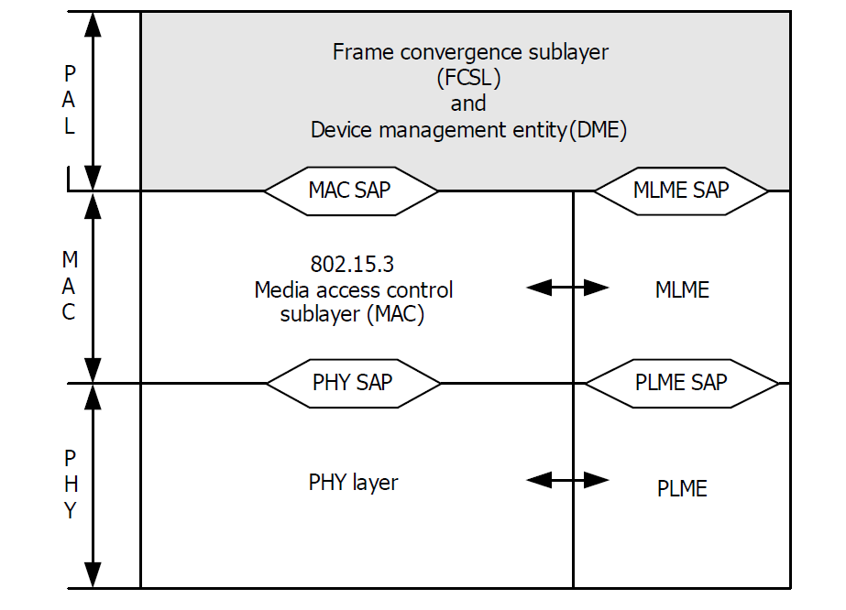
Comment # i-201
The MCS information indicated by this primitive is used in the upper layer of the transmitter of the transmitted frame.
So we think that this function cannot be provided by MAC-HRCP-DATA primitives which reports at MAC SAP in the receiver.
HRCP-DEV #1
Transmitter of the frame
MLME-MCS.request
Ask the current MCS and frequency channel
HRCP-DEV #2
Receiver of the frame
MLME-MCS.confirm
Information of the MCS identifier of this frame
MAC-HRCP-DATA.confirm
PHY frame

Slide 5
Comment # i-201
What will the upper layer will do?
Usage examples:
Along with MCS used for frame transmission, the downloading kiosk can choose the compression size of movie file which will be provided to user.
In order to limit communication area, the kiosk uses another antenna and transmits interference signals to limit communication range. The power level of the interfering signal will be set along with MCS of the transmitted frame.

Slide 6
Comment #i-202
Proposed change from D04:
In 5.3.19.1, Change sentence as shown below in red.
5.3.19.1 MLME-MCS.request
This primitive requests reports of MCS identifier to MLME.
The semantics of this primitive are as follows:
MLME-MCS.request (
Timeout
)
The primitive parameter is defined same as in Table 5-27. The primitive has no parameters.

Slide 7
CID #i-203 and #i-27
Insert the missing table after 5.3.19.2
Table 5-27a. MLME-MCS primitive parameters
Name | Type | Valid range | Description
MCSIdentifier | Enumeration | Any valid MCS identifier, as defined in Table 11a-6. | MCS used in the transmitted PHY frame.
ChIdentifier | Enumeration | Any valid combinations of channel, as defined in figure 6-88c | The frequency channel used in the transmitted PHY frame.
Result Code | Enumeration | SUCCESS, FAILURE | Indicates the result of the MLME request.

