Slide 1
Project: IEEE P802.15 Working Group for Wireless Personal Area Networks (WPANs)
Submission Title: Final Proposal for THz PHY in IEEE 802.15.3 - Explanations
Date Submitted: 7 November 2016
Source: Thomas Kürner (TU Braunschweig) on behalf of TU Braunschweig, NICT, University of Hiroshima, University of Glasgow
Address Schleinitzstr. 22, D-38092 Braunschweig, Germany
Voice:+495313912416, FAX: +495313915192, E-Mail: kuerner@ifn.ing.tu-bs.de
Re: 15-16-0595-00-003d-proposal-for-ieee802-15-3d-thz-phy
Abstract: Explanations on the final TG3d proposal from TU Braunschweig, NICT, University of Hiroshima, University of Glasgow
Purpose: To be considered in TG3d baseline document
Notice: This document has been prepared to assist the IEEE P802.15. It is offered as a basis for discussion and is not binding on the contributing individual(s) or organization(s). The material in this document is subject to change in form and content after further study. The contributor(s) reserve(s) the right to add, amend or withdraw material contained herein.
Release: The contributor acknowledges and accepts that this contribution becomes the property of IEEE and may be made publicly available by P802.15.

Slide 2
Final Proposal for a THz PHY in IEEE 802.15.3 - Explanations
This document provides some further explanations to 15-16- 0595-00-003d-proposal-for-ieee802-15-3d-thz-phy
The document is an evolution of the preliminary proposals presented in
  15-16-0481-01-003d_preliminray_proposal_3d
  15-16-0482-01-003d-preliminary-proposal-for-tg3d-cfp
  15-16-0510-00-003d-Thoughts_towards_a_baseline_3d
The explanations wrt RF channelization are presented in 15-16-0592-00-003d-proposal-for-ieee802-15-3d-channel-assignment-plans

Slide 3
List of Contributors
Thomas Kürner (TU Braunschweig)
Iwao Hosako (NICT)
Sebastian Rey (TU Braunschweig)
Bile Peng (TU Braunschweig)
Alexander Fricke (TU Braunschweig)
Akifumi Kasamatsu (NICT)
Norihiko Sekine (NICT)
Hiroyo Ogawa (NICT)
Minoru Fujishima (Hiroshima University)
Anthony Kelly (University of Glasgow)
This preliminary proposal is partially originating from the H2020-iBrow-project (www.ibrow-project.eu)

Slide 4
Outline
Applications and Requirements for a 802.15.3d
THz PHY
Baseline for the final proposal
Modulation Schemes
Forward Error Correction
Data Rates
Link Budget
Transmit PSD Mask
Required Changes for the MAC
Options to draft section on THz OOK PHY mode
Criteria from TRD
Issues for further studies
t

Slide 5
Applications for a 802.15.3d THz PHY

Slide 6
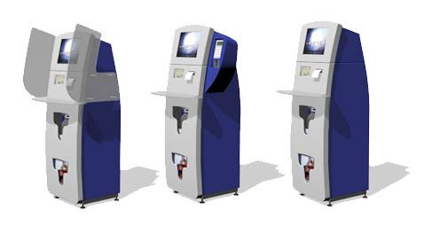
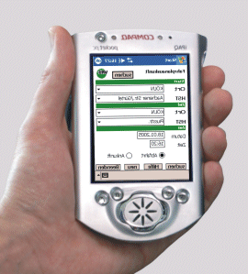
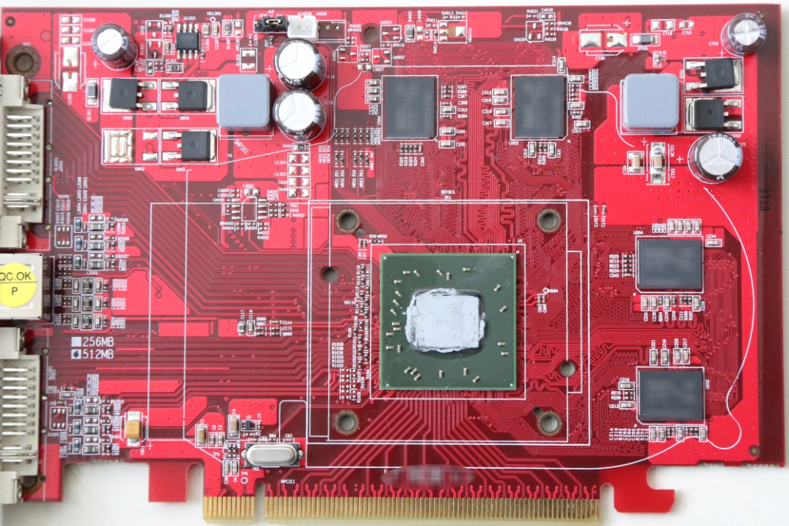
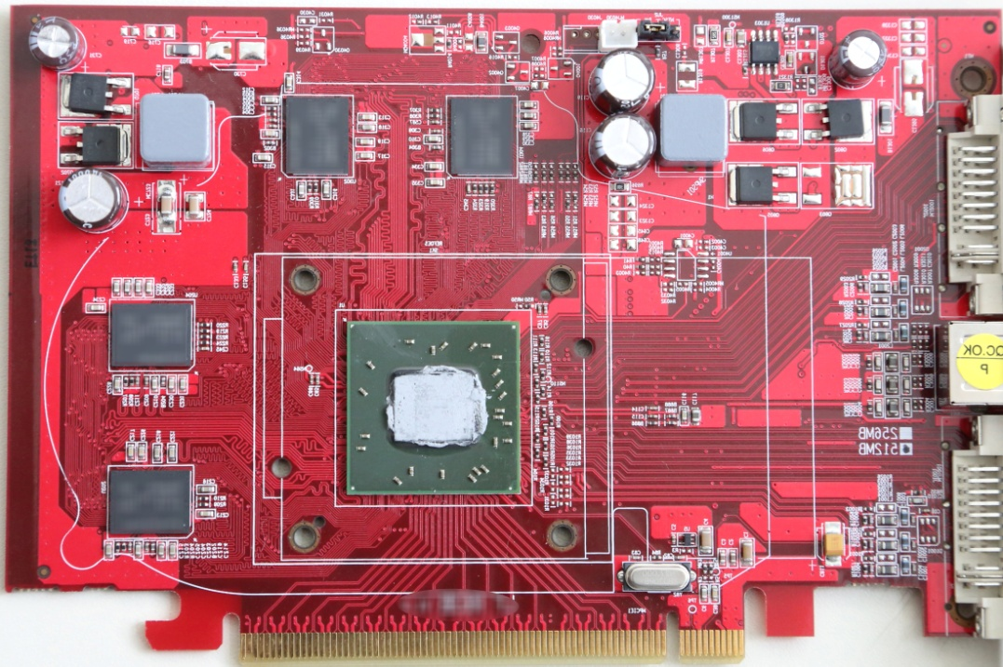
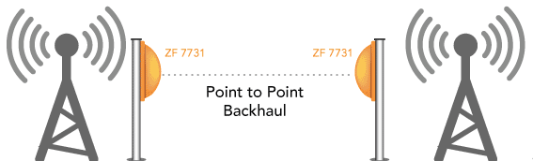
Applications for switched point-to-point links
10...100 Gbit/s
10...100 Gbit/s
Kiosk downloads
Intra-Device Communication
10..100 Gbit/s
10...100 Gbit/s
Backhaul/Fronthaul links
Wireless Links in Data Centers

Slide 7
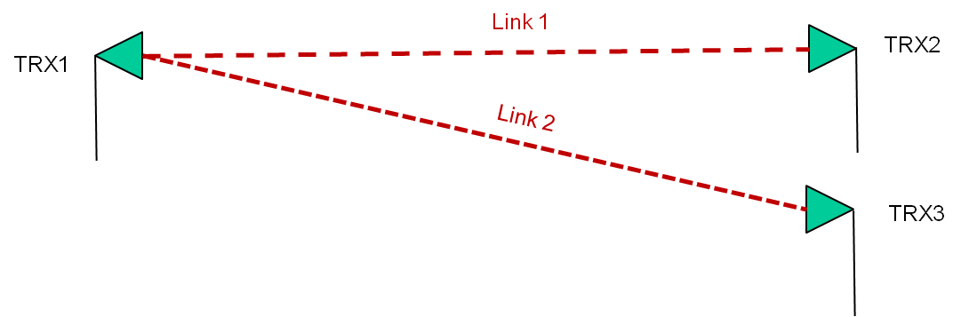
Common Characteristics of all four Applications
It can be assumed that a-priori knowledge of the locations of Tx and Rx is available.
As a consequence the efforts for device discovery and beam tracking may be reduced.
Only two DEVs are involved in communications. However links may be switched between different DEVs
The point-to-point nature with the application of highly directive antennas may yield less complex channels and less complex interference situations

Slide 8
Baseline for the preliminary proposal

Slide 9
Frequency Range and RF Channelization
This proposal defines a PHY for the frequency range 252 – 325 GHz (called the THz PHY)
The links using the THz PHY are called THz links
The THz PHY may use larger bandwidth as used in the millimeter wave PHY defined in IEEE 802.15.3RevA. This will allow the use of less complex modulation schemes.

Slide 10
Features defined in IEEE P802.15.3e (HRCP)
The applications Kiosk Downloading and Intra-Device Communications have some similarities to the applications currently considered in IEEE P802.15.3e
Some features developed in IEEE P802.15.3e may also be applied in conjunction with the THz PHY.
The corresponding links will be called THz HRCP
This proposal also inherits the concept of pairnet as defined in IEEE P802.15.3e.
For non-HRCP THz links the beacon may be not switched off after establishing the connection.

Slide 11
Modulation and Coding Schemes
In order to enable the reuse of implementations based on IEEE P802.15.3RevA and IEEE P802.15.3e the modulation and coding schemes defined in the corresponding standards should be adopted as much as possible.
However, other – more simple – coding schemes are defined in this proposal as well. This will be possible due to the less complex situation wrt channel properties and interference and will reduce complexity

Slide 12
MODULATION SCHEMES

Slide 13
PHY Modes
A compliant THz PHY shall implement at least one of the following PHY modes:
  Single carrier mode PHY
    π/2-shift BPSK
    π/2-shift QPSK
    π/2-PSK
    π/2-APSK
    16-QAM
    64-QAM
    A final decision, which modulation schemes are optional/required is for furthr discussion
  b) On-off keying mode PHY
  Clarification: OOK Phy and SC Phy are two alternatives. A device has to support only one of these.

Slide 14
Reasoning for Modulation Schemes of the SC mode PHY – 1 –
π/2-shift BPSK
  Compatible to existing standard
π/2-shift QPSK
  Reasonable data rate
  Compatible to existing standard
  64 Gbit/s demonstrated e.g. in TERAPAN project (I. Kallfass et al, “Towards MMIC-Based 300GHz Indoor Wireless Communication Systems,” IEICE Trans. Electron, vol. E98.C, no. 12, pp. 1081–1090, 2015.)

Slide 15
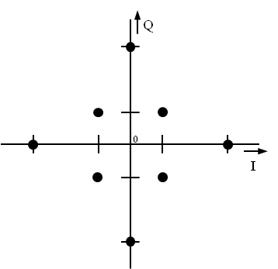
Reasoning for Modulation Schemes of the SC mode PHY – 2 –
π/2-8-PSK
  Works for systems with limited linearity.
  30 Gbit/s demonstrated in Millilink project at 240 GHz (J. Antes et al, Transmission of an 8-PSK modulated 30 Gbit/s signal using an MMIC-based 240 GHz wireless link. IEEE MTT-S International Microwave Symposium Digest (IMS), 2013.)
π/2-8-APSK
  Works for systems with limited linearity but in comparison is more robust to phase noise than 8-PSK.

Slide 16
Reasoning for Modulation Schemes of the SC mode PHY – 3 –
16 QAM
  100 Gbit/s demonstrated at 240 GHz with an optical transmitter and an electronic receiver (S. Koenig et al, 100 Gbit/s Wireless Link with mm-Wave Photonics. Anaheim, California: Optical Society of America, 2013.)
64 QAM
  Example of QAM in 300 GHz band with Si-CMOS devices] - 32 QAM: 17.5 Gbit/s/ch (@ channel width = 5 GHz, 6 channels) ref. IEEE ISSCC2016, Digest pp. 342-343
If a higher order QAM (64 QAM) is supported than the 16 QAM (not 8-PSK or 8-APSK) has to be supported.

Slide 17
Reasoning for OOK Phy
Enables an easier receiver architecture because no coherent modulation is used.
All-electronic solutions at 300 GHz with OOK are currently developed within the iBROW project (www.ibrow-project.eu) based on Resonant Tunnelling Diode (RTD) technology

Slide 18
Reasoning for OOK Phy
Simple modulation scheme trades spectral efficiency for simplicity and therefore cost
RTD based devices with integrated antennas are being developed in Japan, several European groups and in particular the I-BROW project
Systems demonstrated up to and beyond 300GHz
Potentially very low cost technology

Slide 19
OOK based RTD communications
Oscillators up to 1.92 THz have been demonstrated. [T. Maekawa, H. Kanaya, S. Suzuki, and M. Asada, Appl. Phys. Express, 9, 024101 (2016).]
Wireless data transmission of 30 Gb/s at 490 GHz. [N. Oshima, H. Hashimoto, D. Horikawa, S. Suzuki, and M. Asada, IEEE International Microwave Symposium,San Francisco, THIF2, May 2016.]
Receiver functionality has been demonstrated at 300GHz. [T. Shiode, T. Mukai, M. Kawamura, and T. Nagatsuma, “Giga-bit wireless communication at 300 GHz using resonant tunneling diode detector,” in Proc. Asia-Pacific Microw. Conf. (APMC2011), pp. 1122-1125, Dec. 2011. ]
iBROW is developing systems for 10Gbit/s at 300GHz

Slide 20
Forward error correction

Slide 21
A couple of FEC defined in IEEE P802.15.3-2016 and IEEE P802.15.3e – D04
The following FEC shall be reused:
  Rate 14/15 LDPC (1440,1344)
  Rate 11/15 LDPC (1440,1056)
  RS (255,239) in GF(2⁸)
In addition also more simple Haming-Code may be considered
Current working assumption is that the LDPC codes are used for SC-PHY and RS-Codes are used for the OOK-PHY

Slide 22
Simpler FEC schemes
Due to the extremely high data rate, a simpler FEC with less decoding complexity is of great advantage in hardware realization.
The performance of a (7,4) Hamming code in an AWGN-channel is depicted in the figure on the right.
See also: Doc. IEEE 802.15-13-0406-00

Slide 23
Status of Evaluation
Perfomance evaulations for the proposed modulation and coding schemes are currently being done using the channel models defined in the CMD.
Some first results are presented in doc. 16/0746r1 Preliminary Performance of FEC Schemes in TG3d Channels

Slide 24
Data Rates

Slide 25
Excerpt of Data Rates for SC-PHY at the higher end of the Bandwidth
MCS identifier | bandwidth (GHz) | modulation | FEC rate | data rate (Gb/s) w/ PW | data rate (Gb/s) w/o PW
71 | 25,92 | 64-QAM | 14/15 | 123,6480 | 108,1920
72 | 51,84 | BPSK | 11/15 | 32,3840 | 28,3360
73 | 51,84 | BPSK | 14/15 | 41,2160 | 36,0640
74 | 51,84 | QPSK | 11/15 | 64,7680 | 56,6720
75 | 51,84 | QPSK | 14/15 | 82,4320 | 72,1280
76 | 51,84 | 8-PSK | 11/15 | 97,1520 | 85,0080
77 | 51,84 | 8-PSK | 14/15 | 123,6480 | 108,1920
78 | 51,84 | 8-APSK | 11/15 | 97,1520 | 85,0080
79 | 51,84 | 8-APSK | 14/15 | 123,6480 | 108,1920
80 | 51,84 | 16QAM | 11/15 | 129,5360 | 113,3440
81 | 51,84 | 16-QAM | 14/15 | 164,8640 | 144,2560
82 | 51,84 | 64-QAM | 11/15 | 194,3040 | 170,0160
83 | 51,84 | 64-QAM | 14/15 | 247,2960 | 216,3840

Slide 26
Data Rates for OOK-PHY
(complete table)
MCS identifier | bandwidth (GHz) | Spreading Factor L_{SF} | FEC rate | data rate (Gb/s) w/ PW | data rate (Gb/s) w/o PW
0 | 2.16 | 1 | 224/240 | 1,64266667 | 1,43733333
1 | 4.32 | 1 | 224/240 | 3,28533333 | 2,87466667
2 | 8.64 | 1 | 224/240 | 6,57066667 | 5,74933333
3 | 12.96 | 1 | 224/240 | 9,856 | 8,624
4 | 17.28 | 1 | 224/240 | 13,1413333 | 11,4986667
5 | 25.92 | 1 | 224/240 | 19,712 | 17,248
6 | 51.84 | 1 | 224/240 | 39,424 | 34,496

Slide 27
Link Budget

Slide 28
Link Budget – 1 –
Based on:
I. Kallfass et al, “Towards MMIC-Based 300GHz Indoor Wireless Communication Systems,” IEICE Trans. Electron, vol. E98.C, no. 12, pp. 1081–1090, 2015.
Tx Power: -4.0 dBm
(Bandwidth 64 GHz)
Rx noise figure 6.7 dB
Thermal noise for a bandwidth of 51.840 GHz:
-66.9 dBm

Slide 29
Link Budget – 2 –
Assuming:
  Tx Power: -4.0 dBm
  Bandwidth 50.84 GHz
  Rx noise figure 6.7 dB
For an SNR of 10 dB with only free space path loss:
Covers the whole range of applications with different antennas.
Distance [m] | 0.1 | 1 | 10 | 100 | 1,000
Required Gain per Antenna [dBi] | 6.9 | 16.9 | 26.9 | 36.9 | 48.9

Slide 30
TransMIt PSD MASK

Slide 31
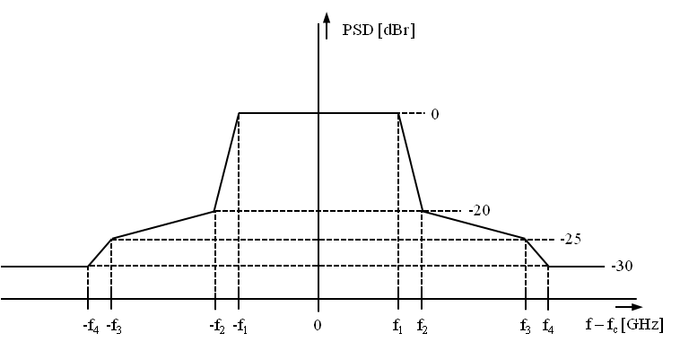
Definition of a Generic PSD Mask
For each of the seven defined bandwidths a separate PSD mask is required
This proposal follows the concept in TG3e to define a generic mask with bandwidth-specific parameters

Slide 32
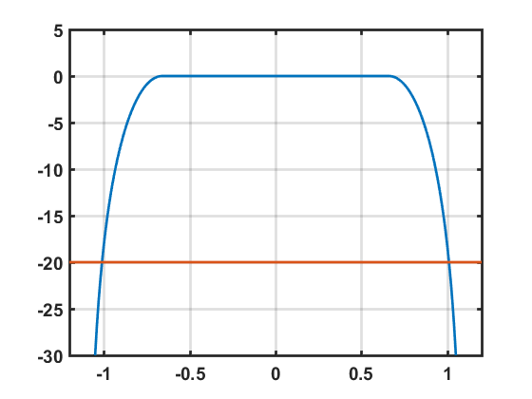

Definition of a Generic PSD Mask
With the given chip rate, the attenuation is at -20 dB for f₂= bandwidth/2 for a raised cosine filter.
With this filter f₁ is defined by $f=\frac{1+β}{2T}$; with chip duration T and roll off factor $β$
For $β=0.25$
PSD [dBr]
f-f_{c} [GHz]

Slide 33
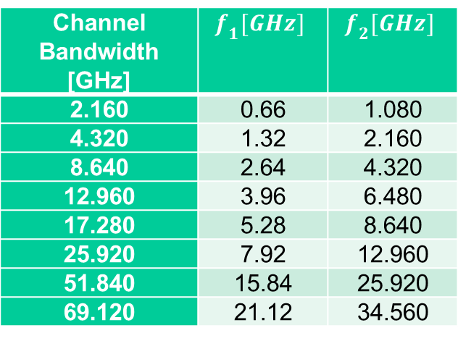
Suggested Frequencies
Channel Bandwidth [GHz] | $$f_{1}[GHz]$$ | $$f_{2}[GHz]$$
2.160 | 0.66 | 1.080
4.320 | 1.32 | 2.160
8.640 | 2.64 | 4.320
12.960 | 3.96 | 6.480
17.280 | 5.28 | 8.640
25.920 | 7.92 | 12.960
51.840 | 15.84 | 25.920
69.120 | 21.12 | 34.560

Slide 34
Required Changes for the MAC

Slide 35
Required Changes for the MAC
The PAR allows changes of the MAC only to the extent, that the new PHY can be supported.
The corresponding parts, that need to be changed are in chapter 6.
Most of the details to be changed are for further studies
On the following slide a proposal for the THz DEV capability field is made

Slide 36
DEV Capability Field (equivalent to figure 6-88b in draft 802.15.3e-D04
Bits b0-b23 are identical to the draft of 802.15.3e-D04
Bits | Capability | meaning
b24-b29 | SC supported MCS | b24: SC π/2-shift BPSK supported b25: SC π/2-shift QPSK supported b26: SC π/2-shift 8-PSK supported b27: SC π/2-shift 8-APSK supported b28: SC 16-QAM supported b29: SC 64-QAM supported
b30 | OOK spreading | b30: OOK spreading used
b31 | Reserved
b31-b37 | Channel bandwidth supported | b31: 2.16 GHz b32: 4.32 GHz b33: 8.64 GHz b34: 12.96 GHz b35: 17.28 GHz b36: 25.92 GHz b37: 51.84 GHz
b38 | Reserved
b39-b70 | Spectrum part supported | Spectrum parts given in the smallest granularity of 2.16 GHz; spectrum range corresponds to the spectrum ranges defined by the spectrum ranges of CHNL_ID 1 to 32) b(38+ CHNL_ID) Note: in the final draft the spectrum may be given in absolute numbers here
B71 | Reserved

Slide 37
Example for configuration of the Spectrum part supported“ in the DEV Capability Field
BW(GHz)
Ch 1
Ch 2
Ch 3
Ch 4
Ch 5
Ch 6
Ch 7
Ch 8
Ch 9
Ch 10
Ch 11
Ch 12
Ch 13
Ch 14
Ch 15
Ch 16
Ch 17
Ch 18
Ch 19
Ch 20
Ch 21
Ch 22
Ch 23
Ch 24
Ch 25
Ch 26
Ch 27
Ch 28
Ch 29
Ch 30
Ch 31
Ch 32
f _{GHz}
2.16
4.32
Ch 33
Ch 34
Ch 35
Ch 36
Ch 37
Ch 38
Ch 39
Ch 40
Ch 41
Ch 42
Ch 43
Ch 44
Ch 45
Ch 46
Ch 47
Ch 48
f _{GHz}
8.64
Ch 49
Ch 50
Ch 51
Ch 52
Ch 53
Ch 54
Ch 55
Ch 56
f _{GHz}
12.96
Ch 57
Ch 58
Ch 59
Ch 60
Ch 61
f _{GHz}
17.28
Ch 62
Ch 63
Ch 64
Ch 65
f _{GHz}
25.92
Ch 66
Ch 67
f _{GHz}
51.84
Ch 68
f _{GHz}
250
255
260
265
270
275
280
285
290
295
300
305
310
315
320
252.72
304.56
321.84

Slide 38
Options to draft section on THz OOK PHY mode

Slide 39
Current Status of Clause 11b.3
The OOK-PHY is described in clause 11b.3 of the proposal
Currently the proposal includes only proposals on the modulation and coding scheme
The remaining part of clause 11b.3 is for further discussion. Two options are proposed:
  option1: to follow the structure of 11a.3 (HRCP-OOK)
  option 2: to follow largely the structure of 11b.2 (THz-SC PHY)

Slide 40
Fullfillment of Criteria from TRD

Slide 41
TRD Criteria
Section in TRD | Grade of Fullfillment
8. Data rates | Data rates fulfilled (Table 11b-1); BER need to be checked by simulations
9. Transmission range | Fullfilled ,see slide 31
10. Operational Freqeuncy Bands | Fulfilled, see Table 11b-1
11. Regulatory Requirements | To be provided once all transmitter characteristiscs are fixed
12. Media Access Mechanism | Existing Mechanism from 802.15.3-2016 and P802.15.3e will be inherited
16. Security Mechanism | Existing Mechanism from 802.15.3-2016 and P802.15.3e will be inherited
17. Size and Power | To be provided based on ongoing research projects

Slide 42
ISSUES FOR FuRTHER STUDIES

Slide 43
List of open Issues for further studies
The following essential issues need to be resolved before the draft standard can be completed:
  PSD Mask: Definition of parameters in Table 11b-3
  FEC: Simulations using models from CMD and based on the achieved results selection of final schemes
  Transmitter and receiver characteristics: EVM requirements and reference sensitivity levels have to be defined
  MAC: All required changes to the MAC have to be identified (chapter 6)
  OOK: Decision on the structure of clause on OOK-mode

