Slide 1
Project: IEEE P802.15 Working Group for Wireless Personal Area Networks (WPANs)
Submission Title: [TG12 ULI Report for Sept 2016 Session]
Date Submitted: [12 Sept 2016]
Source: [Patrick Kinney] Company [Kinney Consulting LLC]
Address [Chicago area, IL, USA]
Voice:[+1.847.960.3715], E-Mail:[pat.kinney@ieee.org]
Re: [TG12 Report for Sept 2016 Session.]
Abstract: [Report for the Sept Session]
Purpose: []
Notice: This document has been prepared to assist the IEEE P802.15. It is offered as a basis for discussion and is not binding on the contributing individual(s) or organization(s). The material in this document is subject to change in form and content after further study. The contributor(s) reserve(s) the right to add, amend or withdraw material contained herein.
Release: The contributor acknowledges and accepts that this contribution becomes the property of IEEE and may be made publicly available by P802.15.

Slide 2
Instructions for the WG Chair
The IEEE-SA strongly recommends that at each WG meeting the chair or a designee:
Show slides #1 through #4 of this presentation
Advise the WG attendees that:
The IEEE’s patent policy is described in Clause 6 of the IEEE-SA Standards Board Bylaws;
Early identification of patent claims which may be essential for the use of standards under development is strongly encouraged;
There may be Essential Patent Claims of which the IEEE is not aware. Additionally, neither the IEEE, the WG, nor the WG chair can ensure the accuracy or completeness of any assurance or whether any such assurance is, in fact, of a Patent Claim that is essential for the use of the standard under development.
Instruct the WG Secretary to record in the minutes of the relevant WG meeting:
That the foregoing information was provided and that slides 1 through 4 (and this slide 0, if applicable) were shown;
That the chair or designee provided an opportunity for participants to identify patent claim(s)/patent application claim(s) and/or the holder of patent claim(s)/patent application claim(s) of which the participant is personally aware and that may be essential for the use of that standard
Any responses that were given, specifically the patent claim(s)/patent application claim(s) and/or the holder of the patent claim(s)/patent application claim(s) that were identified (if any) and by whom.
The WG Chair shall ensure that a request is made to any identified holders of potential essential patent claim(s) to complete and submit a Letter of Assurance.
It is recommended that the WG chair review the guidance in IEEE-SA Standards Board Operations Manual 6.3.5 and in FAQs 14 and 15 on inclusion of potential Essential Patent Claims by incorporation or by reference.
Note: WG includes Working Groups, Task Groups, and other standards-developing committees with a PAR approved by the IEEE-SA Standards Board.

Slide 3
Participants, Patents, and Duty to Inform
All participants in this meeting have certain obligations under the IEEE-SA Patent Policy.
Participants [Note: Quoted text excerpted from IEEE-SA Standards Board Bylaws subclause 6.2]:
“Shall inform the IEEE (or cause the IEEE to be informed)” of the identity of each “holder of any potential Essential Patent Claims of which they are personally aware” if the claims are owned or controlled by the participant or the entity the participant is from, employed by, or otherwise represents
“Should inform the IEEE (or cause the IEEE to be informed)” of the identity of “any other holders of potential Essential Patent Claims” (that is, third parties that are not affiliated with the participant, with the participant’s employer, or with anyone else that the participant is from or otherwise represents)
The above does not apply if the patent claim is already the subject of an Accepted Letter of Assurance that applies to the proposed standard(s) under consideration by this group
Early identification of holders of potential Essential Patent Claims is strongly encouraged
No duty to perform a patent search
Slide #1

Slide 4
Patent Related Links
All participants should be familiar with their obligations under the IEEE-SA Policies & Procedures for standards development.
Patent Policy is stated in these sources:
IEEE-SA Standards Boards Bylaws
http://standards.ieee.org/develop/policies/bylaws/sect6-7.html#6
IEEE-SA Standards Board Operations Manual
http://standards.ieee.org/develop/policies/opman/sect6.html#6.3
Material about the patent policy is available at
http://standards.ieee.org/about/sasb/patcom/materials.html
If you have questions, contact the IEEE-SA Standards Board Patent Committee Administrator at patcom@ieee.org or visit http://standards.ieee.org/about/sasb/patcom/index.html
This slide set is available at https://development.standards.ieee.org/myproject/Public/mytools/mob/slideset.ppt
Slide #2

Slide 5
Call for Potentially Essential Patents
If anyone in this meeting is personally aware of the holder of any patent claims that are potentially essential to implementation of the proposed standard(s) under consideration by this group and that are not already the subject of an Accepted Letter of Assurance:
Either speak up now or
Provide the chair of this group with the identity of the holder(s) of any and all such claims as soon as possible or
Cause an LOA to be submitted
Slide #3

Slide 6
TG12 Officers
Chair Pat Kinney
Vice Chair Charlie Perkins
Slide 6
Notes:
September 16
Page 6

Slide 7
TG12 Meeting Goals (15-16-602-00)
Monday 12 Sept, AM2: Opening report, Agenda, Functional decomposition review
Tuesday 13 Sept, AM1: Discussion on PDE and MMI
Wednesday 14 Sept, PM1: Overview discussion on how each functional block should operate, assignment of functional blocks not already assigned
Wednesday 14 Sept, PM2: Discussion on management protocols functional block with focus on MAC&PHY configuration
Thursday 15 Sept, AM2: Discussion on discovery, compression of higher layer headers and EtherType, recap on week’s efforts, define the next steps, timetable for completion, phone calls
Slide 7
Notes:
September 16
Page 7

Slide 8
TG12 Meeting
Monday 12 Sept, PM1: Opening report, Agenda, Functional decomposition review
Approve Agenda 15-16-0602-00
Approve Minutes from previous session 15-16-0539-00
Review strategy for moving forward
Functional Decomposition Review
Slide 8
Notes:
September 16
Page 8

Slide 9
Strategy for moving forward
Next Steps
Define the Protocol Discrimination Entity (PDE).
Define how the Multiplexed MAC interface (MMI) works using the Multiplexed data service as a baseline.
Define how the management protocols work
PHY configuration
MAC configuration
Define how KMP should work within 15.12.
Define the KMP SAPs using 802.1X as an example
Define how 6LoWPAN should work within 15.12.
Define the 6LO SAPs using IPv6 as an example
Define how L2R should work within 15.12.
Define the L2R SAPs using both an endpoint and router as examples
Define how Ranging should work within 15.12
Define the RNG SAPs using RFID as example
Define ULI frame mechanism (ULI IE/Payload).
Unique identification of ULI presence
Compression of higher layer stack and EtherType
Other components?
Slide 9
Notes:
September 16
Page 9

Slide 10
802.15.12 Functional Decomposition
Slide 10
Notes:
September 16
Page 10

Slide 11
PHY and DLL Functional Decomposition
Slide 11
Notes:
September 16
Page 11

Slide 12
Example of Options Used for Secured SUN FSK Device
Slide 12
Notes:
September 16
Page 12

Slide 13
Example of Options Used for LECIM O-QPSK Device
Slide 13
Notes:
September 16
Page 13

Slide 14
Example of Options Used for 6tisch O-QPSK Device
Slide 14
Notes:
September 16
Page 14

Slide 15
802.15.12 Protocol Discrimination Entity (PDE)
Purpose:
Directs and optionally modifies information from protocol SAP to the appropriate higher layer SAP or to another protocol SAP
Overview
For frames going to the higher layer, the PDE determines the appropriate SAP for delivery, as determined by the ULI header, removes the ULI header, reconstitutes the appropriate header, and then directs the datagram to the SAP
For datagrams coming from a higher layer, the PDE determines the SAP to which the datagram is to be sent based upon the configuration of the device as set by the Management Protocols entity, and forwards it to the appropriate SAP.
Note: review how CoMI and CoAP send their management information to the correct device/SAP. Note: ask RAC for EtherType assignment for 802.15.12.

Slide 16
802.15.12 Multiplexed MAC interface (MMI)
Purpose
Directs and may modify information from a protocol SAP to the appropriate MAC SAP or another protocol SAP
Overview
Provides multiplex and fragmentation service to the packets sent by the ULI functions and send them to either the MCPS-SAP, the MLME-SAP, or to another function within the ULI. The process of sending the packets includes formatting the ULI IE or prepending the appropriate headers into the payload of the frame for transmission.
The interface between the MMI and the ULI functions includes the Multiplex ID and the payload to be sent or the payload received.
The mechanism for the MMI, i.e. the ability to send the data to the proper SAP, will be similar to the mechanism defined in IEEE 802.15.9 for the multiplexed data service

Slide 17
802.15.12 Optional Protocols
802.1X provides authentication, authorization, and cryptographic key agreement mechanisms to support secure communication between end stations connected to 802 networks.
802.15.9 (KMP) provides a methodology to enable key management by providing a transport for key management protocols outside the application layers. Additionally, provides a fragmentation and multiplexing layer for those packets so they can be delivered over smaller MAC layer frames and multiplexed on the recipient end to the right processing service.
6LoWPAN provides the function of MAC frame modification into a frame format for transmission of IPv6 packets and the method of forming IPv6 link-local addresses and statelessly autoconfigured addresses on IEEE 802.15.4 networks. Additional functions include a header compression scheme using shared context and provisions for packet delivery in IEEE 802.15.4 meshes.

Slide 18
802.15.12 Optional Protocols
6tisch functions as an abstraction of an IP link over the TSCH mode of the MAC sublayer by providing network formation and maintenance, multi-hop topology, assign time source neighbor, resource management, dataflow control, scheduling mechanisms, and security.
802.15.10 (L2R) provides the following functions: topology construction, L2R mesh discovery/join/update/recovery, hop-by-hop retransmission, unicast/multicast/broadcast routing, data concatenation, short address assignment, and security
Ranging: provides calls for ranging packets and ranging metrics, and provides a higher layer application such as a location solver with the raw data from the MAC/PHY or with a ranging estimate derived from the aforementioned raw data.
Generic: the generic protocol block allows an upper layer application to either access the MAC SAPs or to access a protocol block’s SAP using the MMI data service.

Slide 19
802.15.12 Mandatory Protocol
Management protocol
The management protocol block has three primary functions:
it provides configuration parameters to the MAC and PHY using configuration data received from a higher layer
it provides configuration parameters to other protocol blocks received from a higher layer or stored in the management protocol block
it provides network device monitoring or management. The monitoring function provides device monitoring metrics to a higher layer application using either the 802.15.4 primitives or a well-known interface such as the Yang modeling interface. The management function uses data collected from the device to optimize the device’s configuration for better spectral use.

Slide 20
Management Protocol Configuration Parameters via MGMT SAP - MAC
Operational | Op enumerations
Device Type | FFD, RFD, RFD-TX, RFD-RX
PAN | Set-up, discovery
Slide 20
Notes:
September 16
Page 20

Slide 21
Management Protocol Configuration Parameters via MGMT SAP - MAC
Optional Modes | Configuration set-up
Generic (GTS) [beacon-enabled] | Superframe
DSME | Superframe
TSCH | Slotframe
SUN
TVWS
LECIM (lp-wan)
RFID
RCC
Generic [non-beacon-enabled]
Slide 21
Notes:
September 16
Page 21

Slide 22
Management Protocol Configuration Parameters via MGMT SAP - MAC
Option behaviors | Option details
Association
Security | Integrity, Encryption
Promiscuous
Ranging
Low Energy | CSL, RIT, IRIT
Priority
Metrics | MAC Metrics IE/All MAC Metrics IE
Channel Hopping | Channel hopping IE, macHoppingSequenceLength, macHoppingSequenceList, macHoppingSequenceId, macNumberofChannels, macPhyConfiguration, macExtendedBitmap
IEs | Header, Payload
TRLE
Spectrum Tracking
Slide 22
Notes:
September 16
Page 22

Slide 23
Management Protocol Configuration Parameters via MGMT SAP
PHY Parameters | PHY Parameters - detail
Channel | phyCurrentChannel = Number: phyCurrentPage
Modulation type | O-QPSK, BPSK, FSK, MSK, OFDM, CSS, UWB-HR, UWB-LR, ASK
Preamble | Code/repetition: phyFskPreambleLength, SecondaryFskPreambleLength
FCS size | 2, or 4
Packet Length | aMaxPhyPacketSize = 127, or 2047, or phyLecimDsssPsduSize
Bandwidth
Data Rate (kb/s) | 2.4, 4.8, 6.25, 9.6, 10, 12.5, 16, 19.2, 20, 25, 31.25, 32, 36, 38.4, 40, 50, 100, 110, 150, 156, 200, 234, 250, 300, 312, 468, 600, 624, 800, 850, 936, 1000, 1404, 1562.5, 1638, 2000, 3125, 6250, 6810, 27240
Transmit power level | phyTxPower
CCA | 1, 2, 3, 4, 5, 6, : aCcatime/phyCCADuration
FEC | Off/On, rate, code, interleaving: phyFskFecEnabled, phyFskFecInterleavingRsc, phyFskFecScheme/phyTvwsFskFecScheme, phyLecimFecTailBitingEnabled
SFD | Size/value: phySunFskSfd, phyTvwsSfdLength, phyLecimDsssSfdPresent, SecondaryFskSfd
Slide 23
Notes:
September 16
Page 23

Slide 24
Management Protocol Configuration Parameters via MGMT SAP
PHY Parameters (cont’d) | PHY Parameters - detail
TX<->RX | aTurnaroundTime
ED threshold
Spreading factor
DSSS code
Data whitening
Common signaling mode
Slide 24
Notes:
September 16
Page 24

Slide 25
802.15.12 Discovery Techniques
Dedicated IEs
Reserved for use with devices using 15.4e-2012, or 15.4-2015
Payload IE, reserved for 15.12, sent out with defined discovery payload
Devices not understanding this IE will reject the IE with no ill effects
Devices with 802.15.12 ULI will receive the IE and respond appropriately
Payload encrypted with well known key
Reserved for use with devices using older firmware (< 2011), i.e. no IEs
Defined discovery payload is sent using security with a well known key
Devices not knowing this key will reject packet with no ill effects
Devices with 802.15.12 ULI will decrypt payload and respond appropriately
Slide 25
Notes:
September 16
Page 25

Slide 26
Frame Composition
Slide 26
Notes:
September 16
Page 26

Slide 27
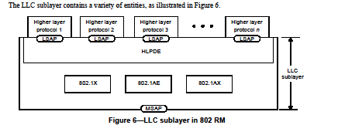
802-2014 Reference Model
Slide 27
Notes:
September 16
Page 27

Slide 28
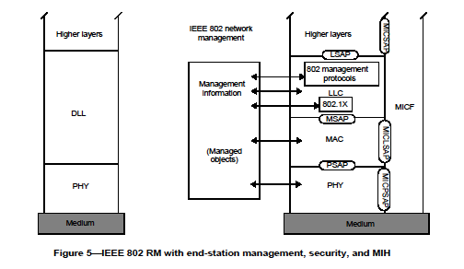
802-2014 Reference Model
Slide 28
Notes:
September 16
Page 28

Slide 29
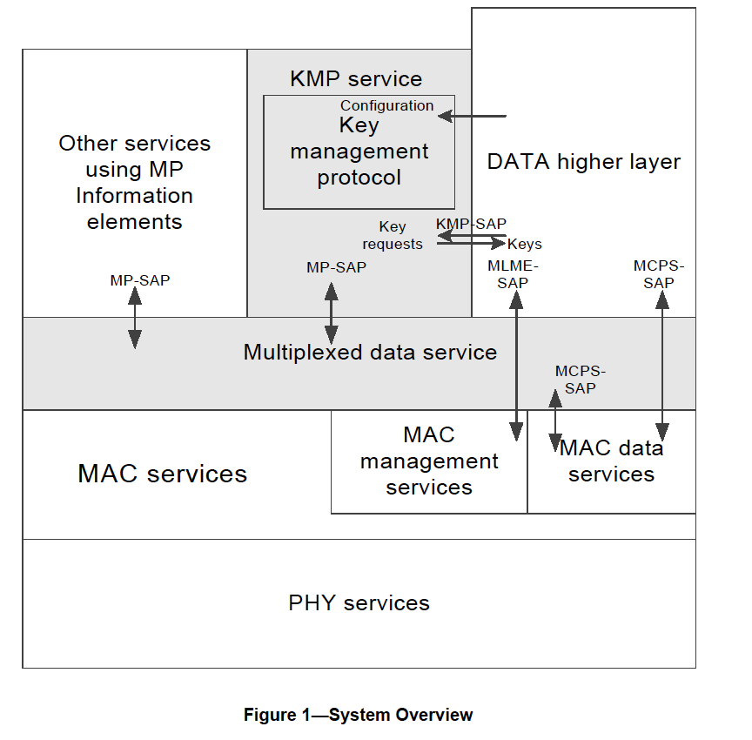
802.15.9 Functional Decomposition

Slide 30
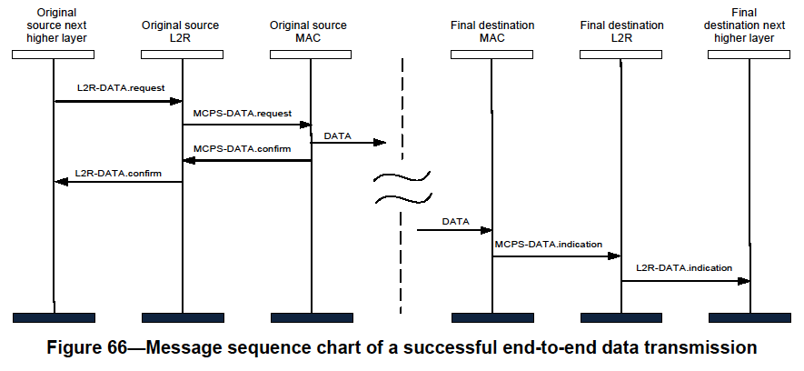
802.15.10 Functional Decomposition
The Data SAP and the MCPS-SAP are used for Multicast as indicated in Figure 19 and Figure 66
The MGMT SAP and the MLME-SAP are used as indicated in Figures 3 through 13

Slide 31
Deliverables
Deliverables
Management SAP
Configuration Management
Dynamic PHY management
B Rolfe to provide
Network
Set-Up
MAC
Set-Up
PHY
Set-Up
Security
Set-Up
TSCH set-up
P Kinney to provide
Channel Hopping
Yang Modeling
L2 Routing
C Perkins to provide
Data SAP
Protocol Differentiation
EtherType
Security
KMP (802.15.9)
ETSI TS102887-2
802.1x
Internet Key Exchange (IKE)
Dragonfly
PANA
Vendor specific
MAC Resource Management
Priority
GTS management
TSCH Operation
P Kinney to provide
Fragmentation
Adaptive
PHY (PSDU)
UpperLayer
802.15.9
6LoWPAN
Location awareness
Ranging
B Verso to provide
Slide 31
Notes:
September 16
Page 31

Slide 32
Deliverables
Management SAP
Configuration Management
PHY
Set-Up
Channel
Center frequency
Channel number
Regional band
Bandwidth
Modulation
Channel page
Preamble
Code
Repetition
FCS size
Packet Length
Data Rate
Transmit Power level
Data Whitening
Common Signalling Mode
ED Threshold
Spreading Factor
DSSS code
CCA
Mode
duration
FEC?
Rate
Coding
Interleaving
SFD
Size
value
Slide 32
Notes:
September 16
Page 32

Slide 33
Deliverables
Management SAP
Configuration Management
MAC
Set-Up
FFD?
Beacon-enabled?
DSME?
Seong-Soon Joo to provide
Superframe parameters
Low Energy?
Parameters
Channel Hopping?
parameters
Association?
Fast?
Synchronization
Superframe
TSCH
ACK required?
Promiscuous mode?
Ask Packet Sniffer vendors or chipset vendors
Device Announcement
UL IEs?
parameters
Slide 33
Notes:
September 16
Page 33

Slide 34
Deliverables
Management SAP
Configuration Management
Network
Set-Up
PAN Coordinator?
Beacon-enabled?
Low Energy?
Association?
Fast?
Permit to Join?
Criteria to accept
Short Address?
Assignment
Channel Scan
Slide 34
Notes:
September 16
Page 34

Slide 35
Future Efforts
Functional Block Technical Details
HLPDE P Kinney
MMI P Kinney
Management Protocol H Yokota
6LoWPAN
KMP
802.1X
L2R C Perkins
6tisch
Ranging B Verso
Functional Block Overview
How do they work?
What functions do they include?
How do the SAPs work?
What primitives are required?
What parameters are required?
Slide 35
Notes:
September 16
Page 35

Slide 36
Meeting Accomplishments
Discussion on the concepts necessary for 802.15.12
L2R Protocol Block function defined
Ranging Protocol Block function defined
Management Protocol Block requirements defined
MAC/PHY configuration
Protocol block configuration
Device Monitoring and Management
Consensus on asking IETF for use cases
Consensus on investigating 802.11 emulation mode for device monitoring
MMI multiplex mechanism defined
Discussion on the architecture for 802.15.12
Consensus on MAC/PHY model
Consensus on TG12 schedule
Slide 36
Notes:
September 16
Page 36

Slide 37
Schedule
TASK | Start | Completed
TG12 | May, 2016 | Mar, 2019
Concept and Architecture | May, 2016 | Nov, 2016
Baseline definition | Nov, 2016 | May, 2017
Draft | May, 2017 | Sept, 2017
TG Comment Collection | Sept, 2017 | Nov, 2017
WG Letter Ballot | Dec, 2017 | July, 2018
Sponsor Ballot | Aug, 2018 | Jan, 2019
NesCom | Jan, 2019 | Mar, 2019
IEEE-SA Publication | Mar, 2019 | June, 2019
Slide 37
Notes:
September 16
Page 37

