Slide 1
Project: IEEE P802.15 Working Group for Wireless Personal Area Networks (WPANs)
Submission Title: [Comment resolution for i-024 and i-151 – rev 01]
Date Submitted: [12 September, 2016]
Source: [Kiyoshi Toshimitsu⁽¹⁾, Ko Togashi, Ken Hiraga, Jae Seung Lee, Itaru Maekawa, Keitarou Kondou , all contributors are listed in “Contributors” slide]
Company [Toshiba¹, ETRI, JRC, NTT, Sony]
Address [1-1 Shibaura 1-chome, Minato-ku, Tokyo, Japan]
E-Mail:[kiyoshi.toshimitsu@toshiba.co.jp]
Abstract: [This document describes about PPSP and PPPP.]
Purpose: [To propose a full set of specifications for TG 3e]
Notice: This document has been prepared to assist the IEEE P802.15. It is offered as a basis for discussion and is not binding on the contributing individual(s) or organization(s). The material in this document is subject to change in form and content after further study. The contributor(s) reserve(s) the right to add, amend or withdraw material contained herein.
Release: The contributor acknowledges and accepts that this contribution becomes the property of IEEE and may be made publicly available by P802.15.

Slide 2
Contributors
Name | Affiliation | Email
Jae Seung Lee | ETRI | jasonlee at etri.re.kr
Itaru Maekawa | Japan Radio Co., Ltd. | maekawa.itaru at jrc.co.jp
Ken Hiraga | NTT Corporation | hiraga.ken at lab.ntt.co.jp
Keitarou Kondou | Sony Corporation | Keitarou.Kondou at jp.sony.com
Ko Togashi | Toshiba Corporation | ko.togashi at toshiba.co.jp
Kiyoshi Toshimitsu | Toshiba Corporation | kiyoshi.toshimitsu at toshiba.co.jp

Slide 3
Comment i-24
The title of Figure 4-2a is inappropriate. In Section 7.4.4, PPAP is defined as occurring after Association, which is not correct.
Comment i-151
In Figure 4-2a, having "- Stop Beacon" and "- Send Association Response instead" in the "Associated Phase" part of the figure is very confusing since they are actually a part of the unassociated phase.
Resolution : Accept
Resolution summary for i-024
1. Define PPSP and PPPP.
2. Delete three terms: PPAP, Associated Phase, Unassociated Phase
3. Update Figure 4-2a to reflect the changes.

Slide 4
Definition of PPSP and PPPP
3.1 definition
Change to:
point-to-point setup period: Setup period for HRCP association.
Point-to-point paired period: Paired period after HRCP association is established.
3.2 Acronyms and abbreviations
Change to:
PPSP: point-to-point setup period
PPPP: point-to-point paired period

Slide 5
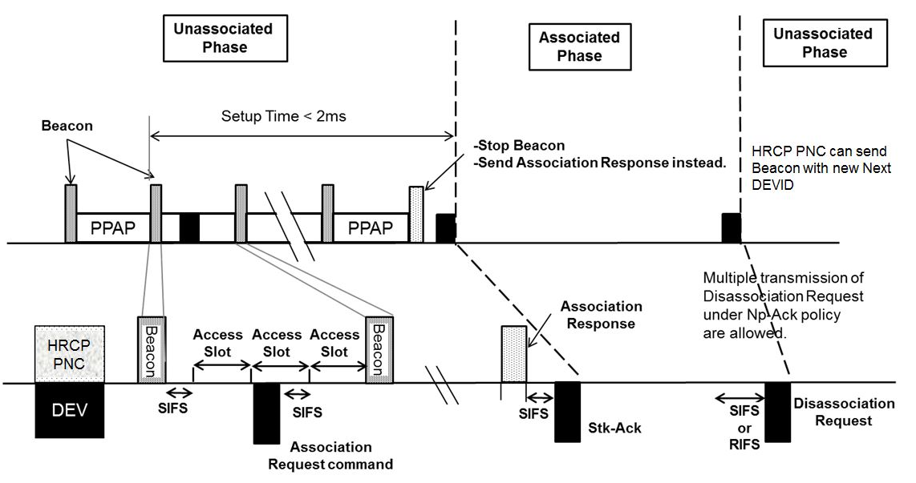
Figure 4-2a—Original version
Figure 4-2a—One cycle of PPAP

Slide 6
Figure 4-2a—Proposed Change (New version)
PPSP
PPPP
Setup Time < 2ms
Beacon
Stop beacon
Send Association Response
command instead
HRCP PNC can send
beacon with new Next
DEVID
Multiple transmission of
Disassociation Request
command under
No-ACK policy
are allowed
Association
Response command
HRCP
PNC
Beacon
Access Slot
Beacon
DEV
SIFS
SIFS
SIFS
SIFS
or
RIFS
Association
Request command
Stk-ACK
Disassociation
Request command
Figure 4-2a—One session of HRCP

Slide 7
Association details (1)
4.3.6 The IEEE802.15.3 superframe
Change
The Superframe structure for HRCP is shown in Figure 4-2a. Carrier sensing is not required during point-to-point setup period(PPSP) and point-to point paired period (PPPP). Access method of point-to-point access period (PPAP) during PPSP the Associated Phase is different from that during PPPPthe Unassociated Phase.
a) Point-to-point setup period (PPSP)
All frames shall be transmitted using an MCS from the mandatory MCS set during PPSP the Unassociated Phase. The superframe duration during PPSP in unassociated phase equals the interval between transmission start times of beacons with the same PHY mode and is indicated by the pairnet Synchronization Parameters field in the beacon frame.
b) Point-to-point paired period (PPPP)
The superframe in PPPPassociated phase starts from the transmission start time of the Association Response command that replaces the beacon.

Slide 8
Association details (2)
4.3.7.2 Channel time management for pairnets
Change
There is one method for communicating data between DEVs that form a pairnet. Data exchanges are achieved during a PPPP, which is described in 7.4.4.
6.2.1.2 Frame type field
Change
Stk-ACK frames with no data which are sent in response to data frames in PPPP are treated as data frames.
6.3.1.1a Non-secure Beacon frame for pairnets
Change
The Superframe Duration field contains the duration of the current superframe in PPSP unassociated phase.

Slide 9
Association details (3)
7.3a.1 Association
Change
Before an HRCP DEV has completed the association process, all frames sent to the HRCP PNC byfrom the HRCP DEV shall be exchanged in the Access Slots in PPSP of the superframe.
Change
7.4.4 PPPP after association
Stk-ACK is used for data frame acknowledgement in PPPP and is indicated in the MAC header and may be piggybacked with the data payload. The PPPP has two phases, synchronous phase and asynchronous phase.
7.9.2a Stk-ACK
Stk-ACK is commonly used for acknowledgement in PPPP.

Slide 10
Association details (4)
11a.2.3.1 PHY preamble
Change
A PHY-long preamble shall be used during PPSP Unassociated Phase and a PHY-short preamble shall be used during PPPPAssociated Phase.

