Slide 1
Project: IEEE P802.15 Working Group for Wireless Personal Area Networks (WPANs)
Submission Title: [Comment resolution for i-024 and i-151]
Date Submitted: [12 September, 2016]
Source: [Kiyoshi Toshimitsu⁽¹⁾,Ko Togashi, Ken Hiraga, Jae Seung Lee, Itaru Maekawa, Makoto Noda(representative contributors), all contributors are listed in “Contributors” slide]
Company [Toshiba¹, ETRI, JRC, NTT, Sony]
Address [1-1 Shibaura 1-chome, Minato-ku, Tokyo, Japan]
E-Mail:[kiyoshi.toshimitsu@toshiba.co.jp]
Abstract: [This document describes about PPSP and PPPP.]
Purpose: [To propose a full set of specifications for TG 3e]
Notice: This document has been prepared to assist the IEEE P802.15. It is offered as a basis for discussion and is not binding on the contributing individual(s) or organization(s). The material in this document is subject to change in form and content after further study. The contributor(s) reserve(s) the right to add, amend or withdraw material contained herein.
Release: The contributor acknowledges and accepts that this contribution becomes the property of IEEE and may be made publicly available by P802.15.

Slide 2
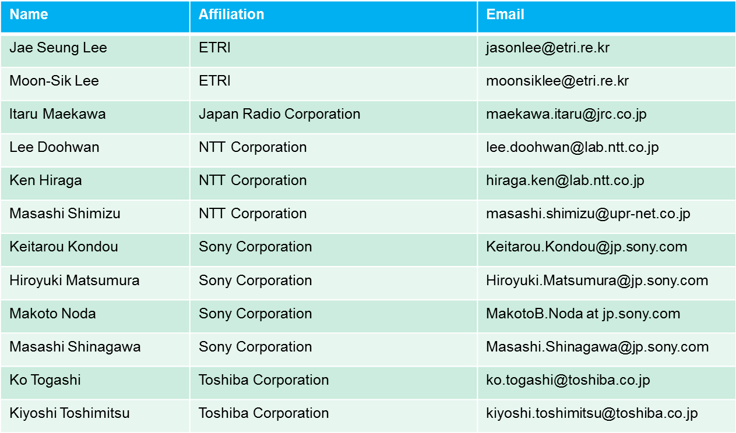
Contributors

Slide 3
Comment i-24
The title of Figure 4-2a is inappropriate. In Section 7.4.4, PPAP is defined as occurring after Association, which is not correct.
Comment i-151
In Figure 4-2a, having "- Stop Beacon" and "- Send Association Response instead" in the "Associated Phase" part of the figure is very confusing since they are actually a part of the unassociated phase.
Proposed change for i-024
Change title of Figure 4-2a to "One session of HRCP".
Divide PPAP into PPSP (P2P setup) and PPPP (P2P paired) periods.
In 7.6 Synchronization, rewrite PPAP as "PPSP and PPPP are ...".
In 7.9.2a, change "PPAP" to "PPPP". Replace all occurrences throughout the document.
Proposed change for i-151
Move them to the "Unassociated Phase" part of the figure
Resolution : Accept

Slide 4
3.1 Definition
Point-to-point setup period: Setup period for HRCP association.
Point-to-point paired period: Paired period after HRCP association is established.
3.2 Acronyms and abbreviations
PPSP: point-to-point setup period
PPPP: point-to-point paired period

Slide 5
PPSP
PPPP
Setup Time < 2ms
Beacon
Stop beacon
Send association response instead
HRCP PNC can send
beacon with new Next
DEVID
Multiple transmission of
Disassociation Request
under No-Ack policy
are allowed
Association
Response command
HRCP
PNC
Beacon
Access Slot
Beacon
DEV
SIFS
SIFS
SIFS
SIFS
or
RIFS
Association
Request command
Stk-Ack
Disassociation
Request command
Figure 4-2a—One session of HRCP

