Slide 1
Project: IEEE P802.15 Working Group for Wireless Personal Area Networks (WPANs)
Submission Title: [Comment resolution for i-022]
Date Submitted: [12 September, 2016]
Source: [Kiyoshi Toshimitsu⁽¹⁾,Ko Togashi, Ken Hiraga, Jae Seung Lee, Itaru Maekawa, Makoto Noda(representative contributors), all contributors are listed in “Contributors” slide]
Company [Toshiba¹, ETRI, JRC, NTT, Sony]
Address [1-1 Shibaura 1-chome, Minato-ku, Tokyo, Japan]
E-Mail:[kiyoshi.toshimitsu@toshiba.co.jp]
Abstract: [This document presents MLME-SCAN request.]
Purpose: [To propose a full set of specifications for TG 3e]
Notice: This document has been prepared to assist the IEEE P802.15. It is offered as a basis for discussion and is not binding on the contributing individual(s) or organization(s). The material in this document is subject to change in form and content after further study. The contributor(s) reserve(s) the right to add, amend or withdraw material contained herein.
Release: The contributor acknowledges and accepts that this contribution becomes the property of IEEE and may be made publicly available by P802.15.

Slide 2
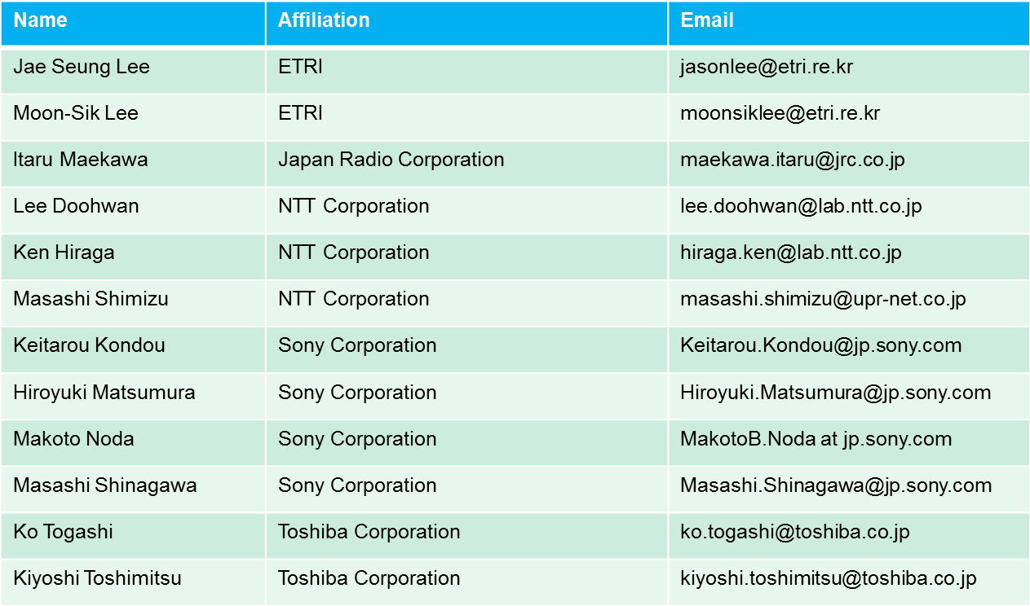
Contributors

Slide 3
■ Comment (i-022)
When MLME-SCAN.request is received, MLME-SCAN.confirm is sent after waiting for timeout. For HRCP operation, however, this report should be sent immediately upon discovery of the other device.
Proposed Change
Add a command in MLME-SCAN.request ("scan mode“ ). When this is "true", send a confirm immediately, without waiting for timeout.
Resolution : Revised
MLME-SCAN.indication should be sent upon discovery of the other device instead of MLME-SCAN.confirm.

Slide 4
■ Resolution
5.3.2 Scanning for piconets
Change Table 5-5 (the entire table is not shown)as indicated:
Table 5-5—MLME-SCAN primitive parameters
Name | type | Valid range | Description
ScanMode | enumeration | IMMEDIATE, TIMEOUT | Indicate the scan mode for HRCP

Slide 5
5.3.2.3 MLME-SCAN.indication
Change the second paragraph as indicated:
The primitive parameters are defined in Table 5-5. For an HRCP DEV, only pairnets will be reported immediately if the ScanMode parameter is set to IMMEDIATE. If the ScanMode parameter is set to TIMEOUT, the result will be reported after the SCAN Timeout timer expires.

