Slide 1
Project: IEEE P802.15 Working Group for Wireless Personal Area Networks (WPANs)
Submission Title: [Comment resolution for i-16]
Date Submitted: [12 September, 2016]
Source: [Kiyoshi Toshimitsu⁽¹⁾,Ko Togashi, Ken Hiraga, Jae Seung Lee, Itaru Maekawa, Makoto Noda(representative contributors), all contributors are listed in “Contributors” slide]
Company [Toshiba¹, ETRI, JRC, NTT, Sony]
Address [1-1 Shibaura 1-chome, Minato-ku, Tokyo, Japan]
E-Mail:[kiyoshi.toshimitsu@toshiba.co.jp]
Abstract: [This document presents recovery proses of HRCP Association Response Command.]
Purpose: [To propose a full set of specifications for TG 3e]
Notice: This document has been prepared to assist the IEEE P802.15. It is offered as a basis for discussion and is not binding on the contributing individual(s) or organization(s). The material in this document is subject to change in form and content after further study. The contributor(s) reserve(s) the right to add, amend or withdraw material contained herein.
Release: The contributor acknowledges and accepts that this contribution becomes the property of IEEE and may be made publicly available by P802.15.

Slide 2
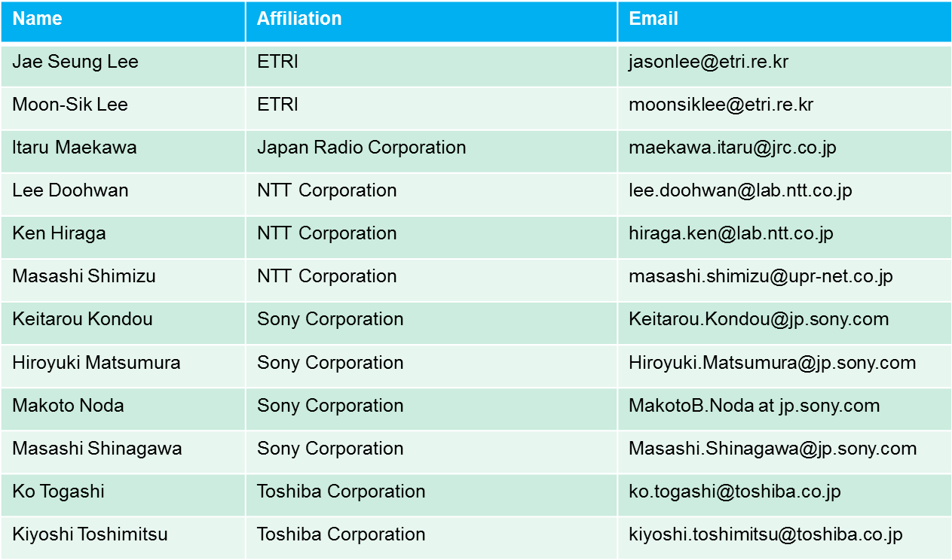
Contributors

Slide 3
Comment
Stk-ACK cannot be returned under conditions depicted in Fig.7-20c. Since the Dev does not receive the Association response from the PNC, it has insufficient information to send the Stk-Ack.
Proposed change
Need a new process to Resend Association Response in this case.
Resolution : Accept

Slide 4
Problem
Since the DEV cannot be sure that it has associated until it has properly received the Association Response command, it cannot send out a Stk-ACK response before then. Therefore, the original sequence depicted in Figure 7-20d is not possible.
DEV does not receive Association Response,
due to MAC Header Error.
PNC sends Stk-ACK. Last Received Sequence
Number is not incremented and stays at 0
retransmit
HRCP
PNC
Association
Resp.(SN=0)
RIFS
Stk-
ACK
Association
Resp.(SN=0)
(Error)
Stk-
ACK
DEV
SIFS
SIFS
Last Received Sequence Number
is set to 0x3FF (no packet has been
received yet by the DEV)
Original Figure 7-20d

Slide 5
Resolutions
Change Figure 7-20d (including title) as follows:
Delete Figures 7-20e and 7-20f
Figure 7-20e and 7-20f since these two cases do not exist (DEV cannot know DEVID before association is established).
DEV does not receive Association Response
due to MAC Header Error, or
b) HRCP PNC does not receive Stk-ACK
PNC resends Association Response
(retransmit)
HRCP
PNC
Association
Resp.(SN=0)
RIFS
Association
Resp.(SN=0)
Data
(Error)
Stk-
ACK
DEV
SIFS
SIFS
Last Received
Sequence Number = 0
Figure 7-20d Recovery of Association Response

Slide 6
7.3a.1 Association
Delete bottom part of page 54 / line 60 as follows:
,and resend the Association Response after a RIFS period, as shown Figure 7-20d and Figure 7-20e. For the case of …. The HRCP PNC then transmits …..The last correctly received…….to 0x3FF.

Slide 7
Replace with new Figure 7-20c as follows (removing the original incorrect figure).
HRCP
PNC
Association
Resp.(SN=0)
Data
DEV
SIFS
Figure 7-20c Association correctly completed (Case 2)

