Slide 1
Project: IEEE P802.15 Working Group for Wireless Personal Area Networks (WPANs)
Submission Title: [Liaison Report on 802.11 for July 2016]
Date Submitted: [28, July, 2016 ]
Source: [Al Petrick 802.11] Company [Jones-Petrick and Associates]
Address [Orlando, Florida, 32832]
Voice:[321-235-3269], FAX: [], E-Mail:[al@jpasoc.com ]
Re: [Liaison Report on 802.11 for July, 2016]
[If this is a response to a Call for Contributions, cite the name and date of the Call for Contributions to which this document responds, as well as the relevant item number in the Call for Contributions.]
[Note: Contributions that are not responsive to this section of the template, and contributions which do
not address the topic under which they are submitted, may be refused or consigned to the “General Contributions” area.]
Abstract: [Liaison Report on 802.11 for July, 2016.]
Purpose: [Informative]
Notice: This document has been prepared to assist the IEEE P802.15. It is offered as a basis for discussion and is not binding on the contributing individual(s) or organization(s). The material in this document is subject to change in form and content after further study. The contributor(s) reserve(s) the right to add, amend or withdraw material contained herein.
Release: The contributor acknowledges and accepts that this contribution becomes the property of IEEE and may be made publicly available by P802.15.
NOTE: Update all red fields replacing with your information; they are required. This is a manual update in appropriate
fields. All Blue fields are informational and are to be deleted. Black stays. After updating delete this box/paragraph.

Slide 2
802.11 Liaison Report
Manchester Grand Hyatt
San Diego, CA July 2016

Slide 3
IEEE 802.11 Revisions
802.11
-2003
802.11
-2007
802.11
-2012
802.11
-2016 (TBC)
MAC
11k
RRM
11s
Mesh
11aa
Video Transport
11e
QoS
IEEE
Std
802.11
-1997
11h
DFS & TPC
11u
WIEN
11v
Network
Management
11ae
QoS Mgt Frames
11d
Intl roaming
11i
Security
11z
TDLS
11w
Management
Frame
Security
11f
Inter AP
11r
Fast Roam
11n
High
Throughput
(>100 Mbps)
11af
TV Whitespace
11a
54 Mbps
5GHz
11j
JP bands
11ac -VHT
>1 Gbps @ 5GHz
11b
11 Mbps
2.4GHz
11g
54 Mbps
2.4GHz
11p
WAVE
11y
Contention
Based
Protocol
11ad - VHT
>1 Gbps @ 60GHz
MAC
&
PHY
Notes:
doc.: IEEE 802.11-11/0483r0
May 2011
Bruce Kraemer (Marvell)
Page 3

Slide 4
IEEE 802.11 Standards Pipeline
MAC
802.11
-2016
802.11
-2012
802.11aq
PAD
802.11aa
Video Transport
802.11ak
GLK
802.11ae
QoS Mgt Frames
802.11ai
FILS
WUR SG
Wake-up
Radio
802.11az
NGP
WNG
802.11ax
HEW
802.11ah
< 1Ghz
802.11af
TVWS
802.11ac
VHT 5GHz
802.11ay
NG60
802.11ad
VHT 60 GHz
802.11aj
CMMW
MAC & PHY
Discussion Topics
TIG/Study
groups
TG without
Approved draft
WG
Letter Ballot
Sponsor
Ballot
Published
Amendment
Published
Standard
4
Notes:
doc.: IEEE 802.11-11/0483r0
May 2011
Bruce Kraemer (Marvell)
Page 4

Slide 5
802.11 Task Groups in Comment Resolution
Task Group | Ballot | Draft | Comments | Resolved | Plans | Closing Report
TGax | Internal WG | D0.1 | ~1000 | 500 | Continue resolving comments Sept 2016 working on D0.3 | 16/1051
TGai | SB recir | D7.0 | 6 | 6 | Recirculation | 16/1034
TGaq | LB221 | D5.0 | 65 | ALL | Recirculation | 16/1047
TGmc | SB recir | D6.0 |  |  | Recirculation planned D7.0 Revcom approval Dec 2016
TGah |  | D7.0 |  |  | RevCom expected Dec 2016, pending 802.11ai/mc – Recir-D9.0 | 16/1039
TGak | - | D2.0 | - | - | --------- | -

Slide 6
802.11WNG (Wireless Next Generation)
Presentations reviewed
“P802.1CM Time-Sensitive Networking for Fronthaul” - János Farkas (Ericsson)
https://mentor.ieee.org/802.11/dcn/16/11-16-1003-00-0wng-p802-1cm-time-sensitive-networking-for-fronthaul.pptx
“History and Implementation of the IEEE 802 Security Architecture”, Meareg Abreha (Addis Ababa University – IEEE 802 student paper award winner)
https://mentor.ieee.org/802.11/dcn/16/11-16-0940-01-0wng-history-and-implementation-of-the-ieee-802-security-architecture.pptx
Introduction to SOMA” Junghoon Suh (Huawei)
https://mentor.ieee.org/802.11/dcn/16/11-16-0943-00-0wng-introduction-to-soma.pptx
“Student Measurements of 802.11 behavior in different environments”, Jim Lansford (Qualcomm/University of Colorado - Boulder)
https://mentor.ieee.org/802.11/dcn/16/11-16-0977-00-0wng-measurements-of-802-11-behavior-in-different-environments.ppt
Closing report: 16/1050

Slide 7
WUR – SG (Wake-Up Receiver)
Goal
Focus is on low power performance – 2.4 GHz, 5GHz
Started work on PAR / CSD
4 presentations – PAR
1 presentation – CSD
Reviewed 6 technical presentations
Power Savings, Security, Roaming
Performance metrics

Slide 8
802.11ax (High Efficiency WLAN)
90 technical submissions
Many of the submissions address comments on D0.1 from internal review
Approved 230 comments (internal review) technical draft
Editor to begin updating Draft 0.3
Plans for September 2016
Continue updating Draft 0.3
Decide of draft is ready for D1.0 WG letter.
Closing report: 16/1051

Slide 9
802.11ay (Next Generation 60 GHz (20Gb/s)
20 technical submissions
Channel models, Specification Framework Document, and Technologies
Current status
Channel model proposal under review
Evaluation methodology approved
Plans for September 2016
Continued working on Specification Framework Document
Closing report: 16/1035

Slide 10
802.11az (Next Generation Positioning)
High Rate PHY 2.4 GHz, 5 GHz, 60 GHz
Continued working on Functional Requirements Document
Reviewed proposals on
Security, Channel Sounding, and Functional Requirements
Plans for September 2016
Continue reviewing technical proposals and updating Functional Requirements document
Closing report: 16/751r0

Slide 11
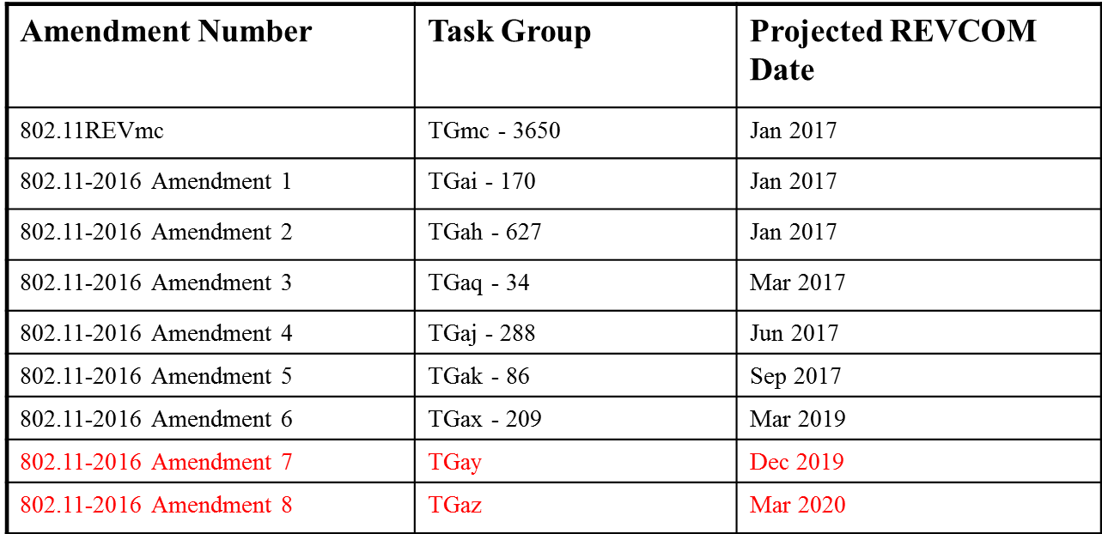
Projected Completion of 802.11 Amendments
Editors Report: Doc 16/934r2

Slide 12
Questions???

