Slide 1
Project: IEEE P802.15 Working Group for Wireless Personal Area Networks (WPANs)
Submission Title: [A KR-EU Joint Research Project Relevant to HRRC – 5G CHAMPION]
Date Submitted: [26 July, 2016]
Source: [Junhyeong Kim, Bing Hui, Hee-Sang Chung and Il Gyu Kim] Company [ETRI]
Address [218 Gajeong-ro, Yuseong-gu, Daejeon, 34129, KOREA]
Voice:[+82-42-860-6239], FAX: [+82-42-861-1966], E-Mail:[jhkim41jf@etri.re.kr]
Abstract: [This document presents performance evaluation results of a prototype of a millimeter-wave-based communication system in tunnel environments]
Purpose: [For discussion]
Notice: This document has been prepared to assist the IEEE P802.15. It is offered as a basis for discussion and is not binding on the contributing individual(s) or organization(s). The material in this document is subject to change in form and content after further study. The contributor(s) reserve(s) the right to add, amend or withdraw material contained herein.
Release: The contributor acknowledges and accepts that this contribution becomes the property of IEEE and may be made publicly available by P802.15.

Slide 2
Contents
Background
Overview
Main Research Topics
Plan for PoC and Demonstration
Plan for Standardization

Slide 3
Background
Usage scenarios of future 5G have been defined by the ITU for IMT2020 and beyond^{[1]}
Enhanced Mobile Broadband
Ultra-reliable and low latency communications
Massive MTC
Usage scenarios of IMT for 2020 and beyond
Enhancement of key capabilities from IMT-Advanced to IMT-2020

Slide 4
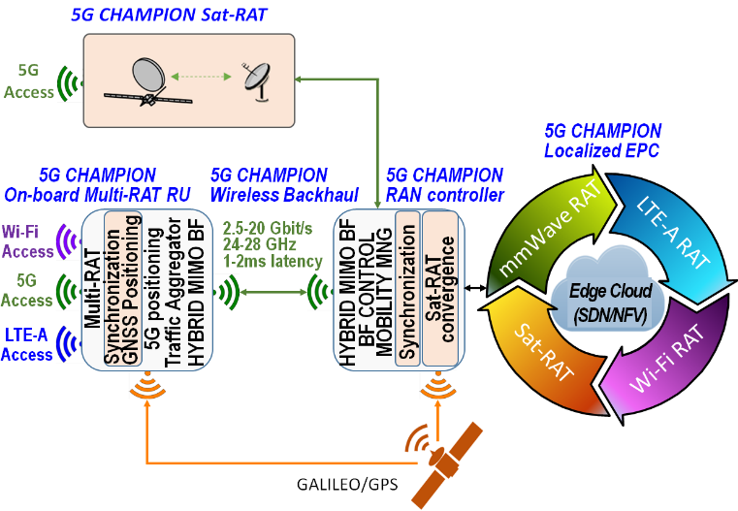
Overview
Project Title : 5GCHAMPION
5G Communication with a Heterogeneous, Agile Mobile network in the PyeongChang wInter Olympic competitioN
5GCHAMPION Project Duration
2016.6.1. ~ 2018.5.31. (24 months)
5GCHAMPION Project Objective
5GCHAMPION project aims at the first 5G system proof-of-concept (PoC) in conjunction with the 2018 Korean Winter Olympics
5GCHAMPION Concept
A system to support various 5G use cases and all new and legacy access networks
Key Building Block of 5GCHAMPION System
mmWave access and backhaul network
sub 6 GHz direct 5G satellite narrowband access, positioning
a flexible and evolved packet core network managed by SDN interface

Slide 5
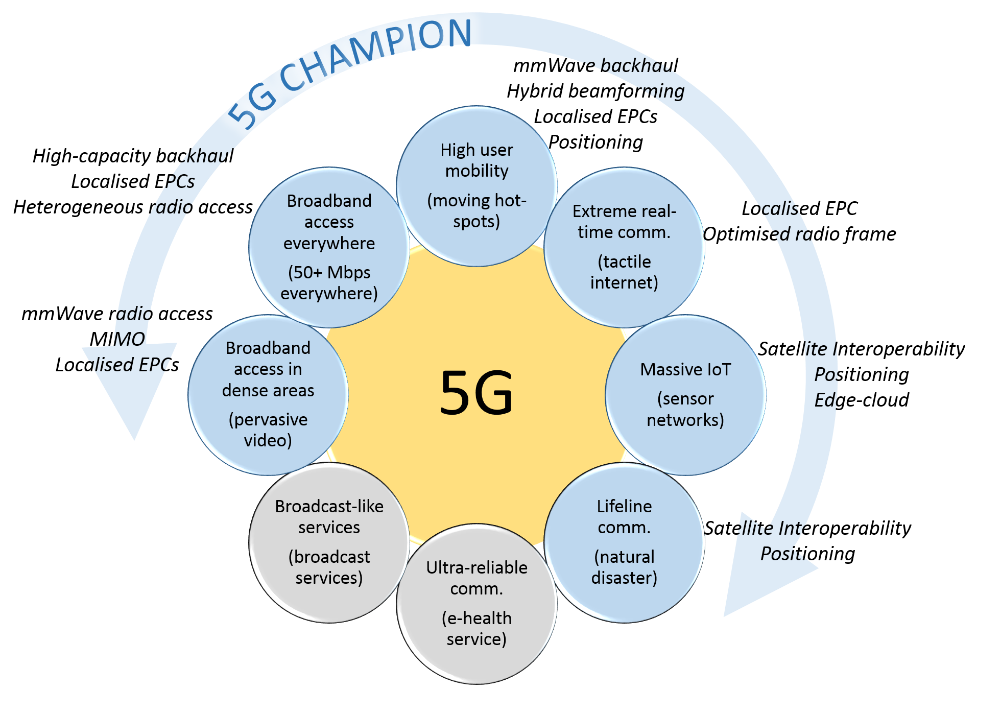
Overview
Potential use-cases covered by 5GCHAMPION

Slide 6
Overview
Key Technological Objectives of 5G CHAMPION
 | KPIs | Remarks
1 | Provide up to 20 Gbps user data rate over a mmWave indoor link | 20 Gbps
2 | Provide a mmWave high capacity backhaul link with 2.5 Gbps maximum data-rate using 400 MHz ~ 1 GHz bandwidth in the 24-29.19 GHz band | 2.5 Gbps
3 | Provide in the high mobility scenario a user-experience of 100 Mbps | 100 Mbps
4 | Provide a seamless access to satellite communications for 5G devices including narrowband IoT service to 5G UE ‘as is’ via a satellite component | support
5 | Demonstrate 1~2 ms latency over the 5G wireless backhaul link | 1~2 msec
6 | Demonstrate an agile management of the core network functionality and services through an SDN/NFV evolved packet core | support
7 | Ubiquitous (indoor-outdoor) location accuracy < 1 m | Less than 1 m
8 | Improved multi-link connectivity supporting simultaneous or adaptively selecting wireless backhaul to several entry points into the network | support

Slide 7
Overview
Additionally, 5G CHAMPION Participants Will
Contribute to Global 5G standardization
Contribute to regulations activities for a unified approach of spectrum allocations
Join forces and create a long lasting synergy for 5G research, innovation and commercialization
Participant (KR) | Participant Organization Name | Country
ETRI (Coordinator) | Electronics and Telecommunications Research Institute | South Korea
SMRT | Seoul Metropolitan Rapid Transit | South Korea
SKT | South Korea Telecom | South Korea
HFR | - | South Korea
CL | Clever Logic | South Korea
SNU | Seoul National University | South Korea
DKU | Dankook University | South Korea
HU | Hanyang University | South Korea
KT | Korea Telecom | South Korea
ELU | Eluon | South Korea
INS | InSoft | South Korea
MOB | Mobigen | South Korea
GIST | Gwangju Institute of Science and Technology | South Korea
Participant (EU) | Participant Organization Name | Country
CEA (Coordinator) | Commissariat à l’énergie atomique et aux énergies alternatives | France
Nokia | Nokia | Finland
INTEL | INTEL Deutschland GmbH | Germany
TASF | Thales Alenia Space – France | France
UOULU | University of Oulu | Finland
HHI | Fraunhofer Heinrich Hertz Institute | Germany
TPZF | Telespazio | France
iMINDs | iMINDs | Belgium

Slide 8
Main Research Topics
Work Package (WP) Construction and Research Tasks
 | WP Title | Detailed Research Tasks
WP1 | Project Management
WP2 | System Architecture, Scenarios, Use cases and Requirements
WP3 | mmWave backhauling & fronthauling | Advanced Antenna Arrays and RF front-end platform for mmWave Backhauling & Fronthauling Algorithms for backhauling & fronthauling Implementation and testing of the mmWave backhaul/fronthaul transceiver platform Mobility management
WP4 | Core Network | Design, implementation, deployment and integration of the Mobile Core TestBed Design & implementation and Standard Definition of the Distributed Mobile Core Mobility Management and Integrated Orchestration Design & implementation of the Mobile Core Virtual Network Functions
WP5 | Satellite access & positioning | 5G Mobile/Satellite Convergence High precision/integrity ubiquitous GNSS based LBS and timing
WP6 | Integration of 5GCHAMPION PoC and the Olympics 2018 Demo | Integration of access and backhaul components to proof-of-concept system Integration of NFV/SDN/EPC to proof-of-concept system Integration of satellite access & positioning to proof-of-concept system System level testing of “proof of concept” phase1 in Oulu 5GTN and Korean side and System level testing of “proof of concept” phase2 in Korean Olympics 2018
WP7 | Dissemination and standardization

Slide 9
Main Research Topics
5G CHAMPION focuses on 5G Key enabling technologies
Satellite MTC
mmWave for high speed mobility
Development of mmWave mobile backhaul links using analog and hybrid analog-digital beamforming
Interconnected core networks and MANO
Localization
A new indoor-outdoor positioning solution relying on the interoperability between GNSS and mmW 5G technology
Software Reconfigurability
Network Functions Virtualization (NFV)

Slide 10
Main Research Topics
More specifically, the following research topics of WP3, highly relevant to IG HRRC, are our main concerns
Implementation of mmWave (24~28 GHz) wireless transceiver for high capacity backhaul/fronthaul links
Investigation and development of advanced antenna solutions, mmWave RF front-end platform architecture, and transceiver algorithms
Analog and hybrid analog-digital beamforming
MIMO using polarized antennas
Investigation of novel channel models for dynamic mmWave backhaul/fronthaul channel
Advanced algorithms and solutions to support mobility management in high-speed moving hot spot scenarios
Neighbor cell search/measurement
Effective handover algorithm

Slide 11
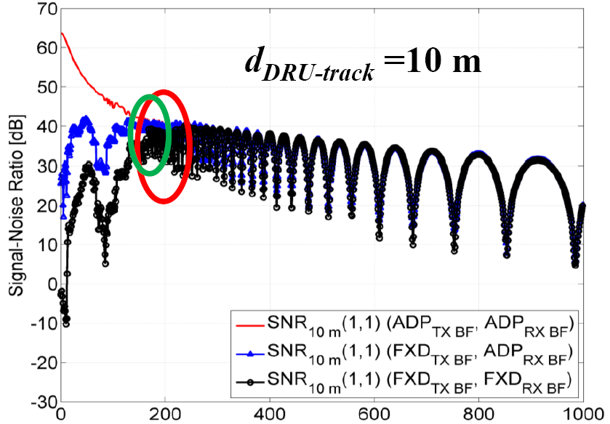
Main Research Topics
Advanced MIMO and beamforming (BF) techniques for high-speed train (HST) communication using millimeter-wave
Polarized MIMO technologies
Due to relatively low multi-path and high LOS in this case
Adaptive BF is the main concern in the case of the train with relatively low velocity
Adaptive BF is necessary for the train running along the curved track while fixed BF is enough for the train running along the straight line^{[2][3]}
In the curved track, trains are most likely to run at low speeds

Slide 12
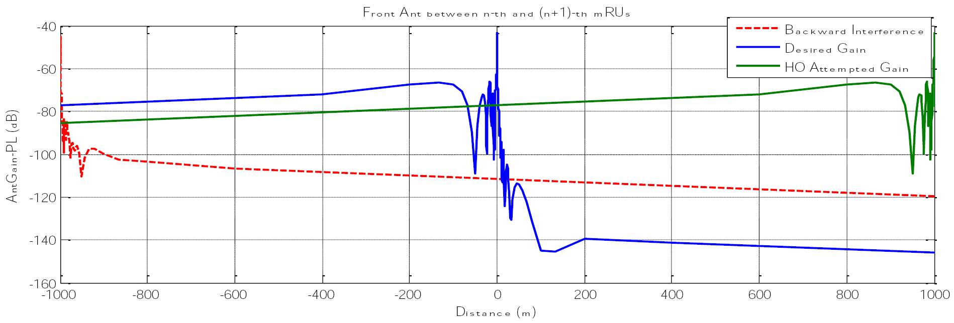
Main Research Topics
Effective cell search and handover Algorithm for high-speed rail communications
Signal characteristics in the high-speed rail communication network^{[4]}
Blue : signal strength of serving cell
Green : signal strength of target(handover) cell

Slide 13
Plan for PoC and Demonstration
The 5G CHAMPION PoC includes
mmWave radio access for the wireless backhaul
Heterogeneous access
Localized EPCs (Evolved Packet Cores)
Additionally, 5G CHAMPION demonstrates the capability of interoperability with satellite systems
5GCHAMPION will provide a fully integrated and operational 5G prototype to the 2018 Olympic Games in PyeongChang, Korea
Provide UHD video streaming and/or immersive video conference from Finland to Korea and vice versa

Slide 14
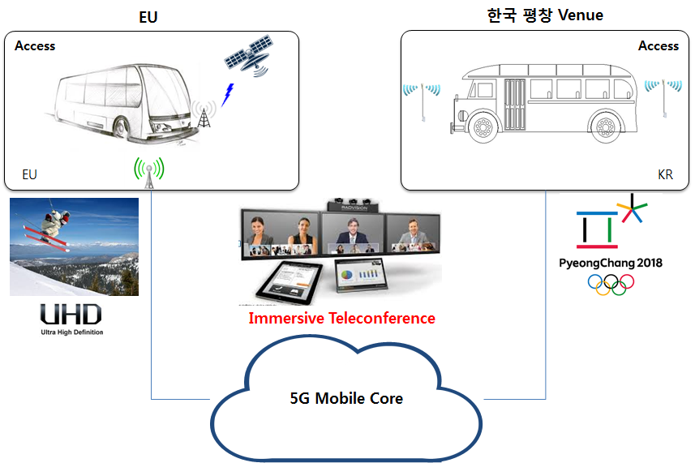
Plan for PoC and Demonstration
Immersive Teleconference Service
This use case connects EU and Korea’s passengers in the buses of each side
The 5G mobile access and core network provides stable and high quality A/V experience to the end users in the bus running at high-speed
Sharing real-time video of the PyeongChang Olympic venue with passengers of EU access will be another applicable use case of this use
EU (Finland)
KR (PyeongChang Olympic Venue)

Slide 15
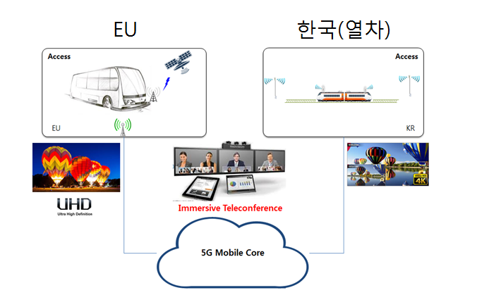
Plan for PoC and Demonstration
UHD CDN Service
Conveying this information to mobile platforms in Europe(bus) and Korea(train)
This demonstration will directly relate:
mmWave backhauling
Provisioning & orchestration tailor-made for UHD CDN service over the DECs
CDN service request routing between VECs along with load balancing & highly scalable facilities based on real-time monitoring information
EU (bus)
KR (train)

Slide 16
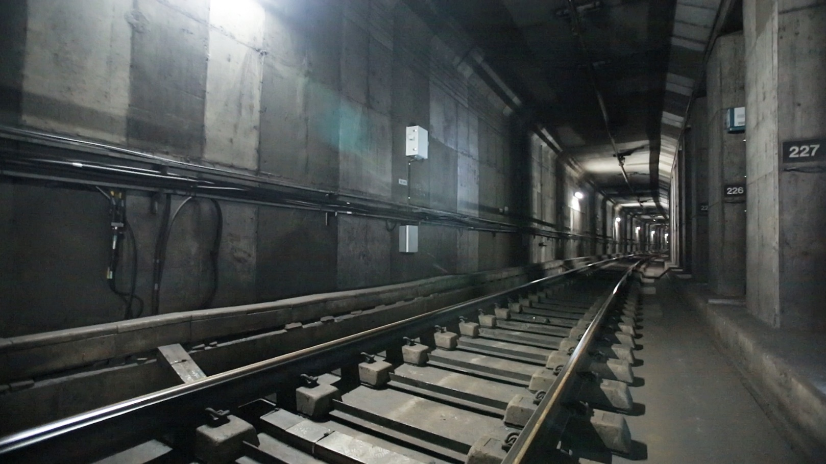
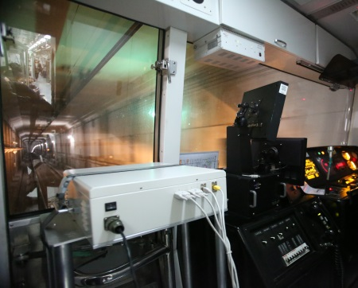
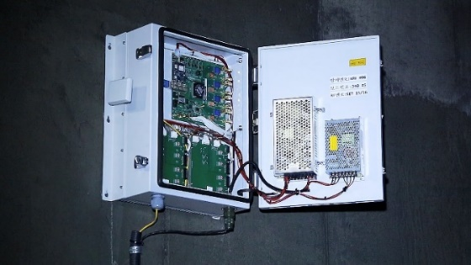
Plan for PoC and Demonstration
The PoC system would be the upgraded version of the existing MHN system for moving subway capable of achieving a peak data rate of over 400Mbps^{[5]}
MHN : Mobile Hotspot Network
mRU : MHN Radio Unit
mTE : MHN Terminal Equipment
mTE
mRU

Slide 17
Plan for Standardization
IEEE 802.15 IG HRRC
Interest Group for High Rate Rail Communications, chaired by ETRI
Consideration of the transition from the IG to Study Group when enough interest has been identified
3GPP
ETRI introduced some high speed(HS) deployment scenarios in 5G
3GPP TSG RAN Ad Hoc Meeting #70bis
Currently RAN1 discuss about evaluation parameters for HS deployment scenarios
Option 1) Around 4GHz, Option 2) Around 30 GHz
ETRI has proposed evaluation parameters on Option 2) in RAN1
Contributing to SA5 on 5G Management architecture
ITU-T FG IMT-2020
ETSI NFV ISG

Slide 18
References
[1] | Recommendation ITU-R M.2083-0, “IMT Vision – Framework and overall objectives of the future development of IMT for 2020 and beyond”
[2] | J. Kim, H. S. Chung, I. G. Kim, H. Lee and M. S. Lee, "A study on millimeter-wave beamforming for high-speed train communication," Information and Communication Technology Convergence (ICTC), 2015 International Conference on, Jeju, 2015, pp. 1190-1193.
[3] | IEEE 802.15-15-0837-01-hrrc, “Ray-tracing based Study on Mobile Channel in Typical Urban Environment with Various Beamforming Strategies at 32 GHz”
[4] | IEEE 802.15-15-0839-00-hrrc, “Handover Strategy for High-speed Rail Communications”
[5] | IEEE 802.15-16-0185-01-hrrc, “Performance Evaluation of Millimeter-wave-based Communication System in Subway Tunnels”

Slide 19
Thank you

