Slide 1
Project: IEEE P802.15 Working Group for Wireless Personal Area Networks (WPANs)
Submission Title: [Doppler Mitigation for High-speed Rail Communications]
Date Submitted: [28 July, 2016]
Source: [Bing Hui, Junhyeong Kim, Hee-Sang Chung, and IlGyu Kim] Company [ETRI]
Address [218 Gajeong-ro, Yuseong-gu, Daejeon, 34129, KOREA]
Voice:[+82-42-860-5324], FAX: [+82-42-860-6732], E-Mail:[huibing@etri.re.kr]
Abstract: []
Purpose: [For discussion]
Notice: This document has been prepared to assist the IEEE P802.15. It is offered as a basis for discussion and is not binding on the contributing individual(s) or organization(s). The material in this document is subject to change in form and content after further study. The contributor(s) reserve(s) the right to add, amend or withdraw material contained herein.
Release: The contributor acknowledges and accepts that this contribution becomes the property of IEEE and may be made publicly available by P802.15.

Slide 2
Doppler Mitigation for High-speed Rail Communications

Slide 3
Outline
Background
Unidirectional Network Deployment
Channel Model
Doppler Mitigation for HSR Communications
Discussions

Slide 4
Background
Problems of OFDM based Systems for HSR Communications
  OFDM is sensitive to ICI
    Restraining Inter-Carrier Interference (ICI), estimating and compensating frequency shift are vital technologies.
  mmWave introduces much high Doppler shift
  Doubled Doppler Spread in TDD UL
    UE estimates the DL carrier frequency and use it as the central frequency for UL transmission.
    The Doppler frequency spread and the oscillator frequency offset cannot be distinguished by UE.
    The Doppler spread in DL will be accumulated in the UL reception.
    Therefore, totally doubled Doppler frequency spread will be received by UL receiver.

Slide 5
Background
Conventional Doppler Compensation Method
  AOA & velocity estimation based Doppler compensation
    Multi-tap in time-domain & complex
    Not accurate & not suitable for OFDM
  Correlation based methods
    Computationally high
    Need a significant load of measurements
  Not suitable for HSR communications
    Channel varies fast
    Doppler effect is severe.

Slide 6
Unidirectional Network Deployment
Mobile Hotspot Network (MHN) System Architecture
  Mobile wireless backhaul supporting very high traffic volume on new frontier bands (mmWave)
    Backhaul link : use mmWave
    Access link inside vehicle : use sub 6GHz (Wi-Fi or Small cell)
Inter-mDU
Mobility Controller
Public Core
Network
mGW
mDU
mDU
mGW: MHN Gateway
mDU: MHN Digital Unit
mRU: MHN Radio Unit
mTE: MHN Terminal Equipment
Intra-mDU
Mobility Controller
Access Link: WiFi
(sub-6 GHz Inside Vehicle)
Backhaul Link: mmWave
(31.5~31.75 GHz)
mTE
…
…
mRU
mRU
mRU
mRU
1 Km Distance

Slide 7
Unidirectional Network Deployment
Wireless Backhaul Connections
Fig. DU-RUs connections
Fig. Double TE antennas case
Fig. Single TE antenna case

Slide 8

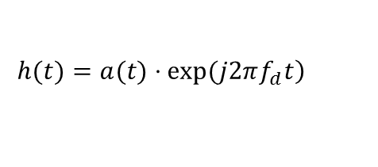
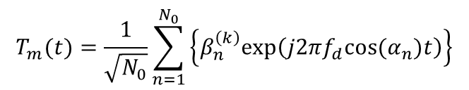
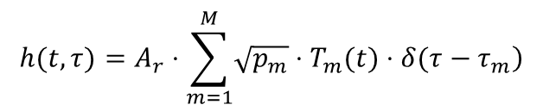
Channel Model
Multipath multi-tap channel (TDL model)
Weight for WSSUS model
Simplified Channel w. Doppler
$$h(t,τ)=A_{r}⋅\sum_{m=1}^{M}{\left.\sqrt{p_{m}}⋅T_{m}(t)⋅δ(τ−τ_{m}\right)}$$
$$T_{m}(t)=\frac{1}{\sqrt{N_{0}}}\sum_{n=1}^{N_{0}}{\left\{β_{n}^{\left(k\right)}exp\left(j{2πf}_{d}cos(α_{n})t\right)\right\}}$$
$$\left.h(t)=a(t)⋅exp(j2πf_{d}t\right)$$
Doppler Shift $f_{d}=\frac{vf0⋅cosθ}{c}$

Slide 9
Doppler Mitigation Method
Channel Behaviors of both Links
  Forward link
  Backward link
Received Signals

Slide 10
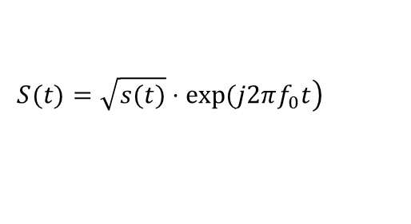
Doppler Mitigation Method
Transmitted OFDM Symbols
Received Symbol
$$\left.S(t)=\sqrt{s(t)}⋅exp(j2πf_{0}t\right)$$
Fig. Block Diagram of the Receiver

Slide 11
Doppler Mitigation Method
System Parameters
Parameter Setup
Frequency | 32 GHz
Antenna Configuration | 1 Head Ant. + 1 Tail Ant. / Single Ant.
Antenna Height | 6.5 m for RU, 3 m for TE
Antenna Setup | Directional Ant. / Omni-directional Ant.
Length of Train | 200 m
Distance | 1 km
Speed | 100 m/s (360 km/h)

Slide 12
Doppler Mitigation Method
Maximum Doppler Shift Performance
  Assume the fixed highest mobility
  Suitable for time-varying mobility and better performance can be achieved.
  Fig. Residual Doppler shift after DL reception
  Fig. Residual Doppler shift before UL transmission

Slide 13
Discussions
Pros
  Efficiently remove Doppler effect for most of the cases without the necessity of estimating Doppler spread
    In most of the cases (90% in the shown example), the residual Doppler shift is 0 Hz.
    Time-domain pilot density can be reduced since the residual Doppler shift is 0 Hz with high probability. Even though the peaks of residual Doppler shift exist, the handover should be performed at the exact time of peak residual Doppler, therefore the influence of peak residual Doppler shift to the data transmission and reception is limited.
  Reduce residual Doppler shift
    Especially for UL, residual Doppler shift in DL can be reduced by half for UL transmission due to the doubled carrier frequency after multiplication of the two received signals (two antennas on the train)
  Robust to the time-varying mobility
    Since the head antenna and the tail antenna always have the same mobility with the opposite direction, the residual Doppler shift will be 0 Hz no matter how the mobility varies with the time.
  Complexity reduction of automatic frequency control (AFC)
    Since the frequency offset after implementing the invented Doppler mitigation method is dramatically reduced, an AFC with relatively low computational complexity may be enough to further compensate the remaining frequency offset.
Cons
  2 receive antennas are required.
  X2 interface is necessary among DUs for UL case.
  IF processing may be necessary.

