Slide 1
Project: IEEE P802.15 Working Group for Wireless Personal Area Networks (WPANs)
Submission Title: [Transmit spectral mask modification ]
Date Submitted: [31 May, 2016]
Source: [Itaru Maekawa and Jun Kobayashi] Company [Japan Radio Co., Ltd.]
Address [Mitaka, Tokyo, Japan]
Voice: [+81.422.45.9228], E-Mail: [Maekawa.Itaru@jrc.co.jp, kobayashi.jun@jrc.co.jp]
Abstract: [This document presents a modified transmit spectral mask for TG3e.]
Purpose: [Transmit spectral mask modification - CID 1068 and 1069.]
Notice: This document has been prepared to assist the IEEE P802.15. It is offered as a basis for discussion and is not binding on the contributing individual(s) or organization(s). The material in this document is subject to change in form and content after further study. The contributor(s) reserve(s) the right to add, amend or withdraw material contained herein.
Release: The contributor acknowledges and accepts that this contribution becomes the property of IEEE and may be made publicly available by P802.15.

Slide 2
Summary
A modified spectral mask for TG3e is presented.
Power efficiency will be improved by employing the proposed mask.
This proposed transmit spectral mask does not violate the radio regulations of any country.
Any degradation of SNR at the adjacent channels due to this mask change is negligible, since the maximum allowable leakage power will only increase by less than 0.2dB.

Slide 3
Motivation for a modified transmit spectral mask
In Figure 1, the spectrum of the transmit signal with a two-times oversampling DAC is compared with the current mask. To reduce unwanted aliasing without degrading SNR, the slope of anti-aliasing needs to be steep as shown below. A high-order passive filter can be used to achieve such a purpose; however, insertion loss caused by the on-chip inductor will be large.
Wide bandwidth
Anti-aliasing filter response
Shape slope
Figure 1 Unfiltered two-times oversampled DAC output

Slide 4
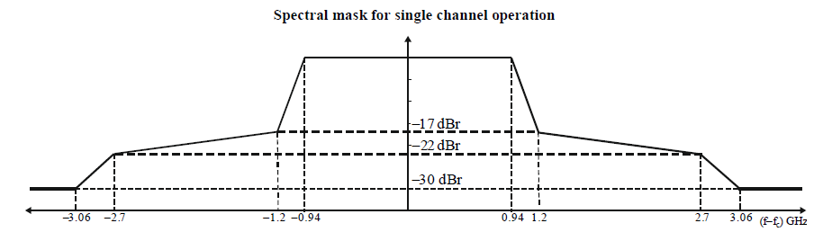
Current transmit spectral mask for a single channel
Figure 2 Current transmit spectral mask for single-channel operation

Slide 5
Proposed transmit spectral mask for a single channel operation
PSD (dBr)
-17dBr
-22dBr
-30dBr
-3.3
-3.06
-1.2
0.94
3.3
-0.94
1.2
3.06
(f-fc) GHz
Figure 3 Proposed spectral mask

Slide 6
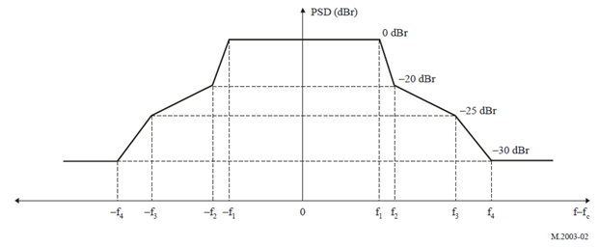
Current transmit spectral mask for channel-bonded case
Figure 4 Current transmit spectral mask for channel-bonded case
Table 1 Current spectral mask parameters for channel-bonded case
Channel bonding | f1 (GHz) | f2 (GHz) | f3 (GHz) | f4 (GHz)
Two-bonded channel transmission | 2.100 | 2.160 | 3.000 | 4.000
Three-bonded channel transmission | 3.150 | 3.240 | 4.500 | 6.000
Four-bonded channel transmission | 4.200 | 4.320 | 6.000 | 8.000

Slide 7
Proposed transmit spectral mask for channel-bonded operation
PSD (dBr)
-17dBr
-30dBr
-f3
-f2
-f1
f1
f2
f3
(f-fc) GHz
Figure 5 Proposed spectral mask for channel-bonded operation
Table.2 Proposed spectral mask parameters for channel-bonded operation
Channel bonded case | f1 (GHz) | f2 (GHz) | f3 (GHz)
Two-channel bonded transmission | 1.880 | 2.400 | 4.000
Three-channel bonded transmission | 2.820 | 3.600 | 6.000
Four-channel bonded transmission | 3.760 | 4.800 | 8.000

Slide 8
Filter power consumption
The integrated anti-aliasing filter for the transmitter is commonly realized as either an active or passive filter. High-order passive filters cause a large insertion loss as mentioned before. However, power consumption of an active anti-aliasing filter is too large for a ultra-short range (up to 10 cm) wireless system, whose output power is typically -5dBm (0.3 mW) [1]. The total power efficiency of the system is hard to be optimize.
Table 3 Filter power consumption
Filter Architecture | Power Consumption/channel (mW) | Ref
Gm-C | 70 to 150 | [2], [3]
Passive | 0

Slide 9
Simulated EVM and filtered DAC output for a single channel operation
Figure 6 shows the Tx EVM as a function of filter order for 4 different cutoff frequencies. This simulation does not consider the contribution of aliasing effect. Figure 7 shows the filtered DAC output for 4 different cutoff frequencies.
LPF: 3rd order Butterworth
EVM degraded
by amplitude distortion
EVM degraded
by group delay
Figure 6 Simulated EVM vs filter order and cutoff frequency
Figure 7 Filtered DAC output and filter cutoff frequency
The 3rd order LPF (cutoff freq.=1.8GHz) achieves a small SNR degradation and low insertion loss. but, the transmit spectrum exceeds the current spectral mask for a single channel.

Slide 10
Proposed transmit spectral mask for a single channel and filtered DAC output
LPF 3rd order butterworth
Margin
Figure 8 Proposed transmit spectral mask and filtered DAC output

Slide 11
Proposed transmit spectral mask for bonded channel and filtered DAC output
The slope between f₁ offset and f₂ offset is the same as that of the current mask for single channel operation.
Slope is same as for single channel operation
f₀
f₁
f₂
f₃
Fig.9 Proposed spectral mask for 2-channel bonding and filtered DAC output

Slide 12
Summary of 60 GHz radio regulations
Table 4 Radio regulations
Country | Frequency (GHz) |  | Antenna gain | Antenna power Or Conducted Power | EIRP | Occupied bandwidth (GHz) | Allowable value of unwanted emission intensity | Ref
Japan | 57～66 |  | 47 dBi max. | 10dBm max | Not specified | 9 | Less than 55.62GHz -30dBm/MHz max Over 55.62GHz less than 57GHz -26dBm/MHz max Over 66GHz less than 67.5GHz -26dBm/MHz max Over 67.5GHz -30dBm/MHz max | [4]
 |  |  | 10dBi or over | Over 10dBm less than 24dBm | 40 dBm max
United States | 57-64 | Outdoor | less than 51 dBi | Not Specified | EIRP = 82 dBm -2*(51 - Antenna gain) | Not specified | 40GHz-200GHz 90pW/cm^2 @3m (EIRP =-10dBm) *2 | [5]
 |  |  | 51 dBi or over | Not Specified | EIRP = 82 dBm
 |  | Indoor | less than 27 dBi | 27 dBm max *1 | 40 dBm | Not specified
Europe | 57-66 |  | Not specified | Not specified | 40 dBm max | Not specified | 1GHz-130GHz -30 dBm/MHz | [6]
China | 59-64 |  | 34dBi max | 10dBm max | 44 dBm max | Not specified | 40 GHz or Over -20dBm /MHz | [7]

Slide 13
The proposed transmit spectral mask for a single channel and
unwanted emission intensity
Transmit power of ultra short range system is typically -5dBm. The proposed transmit spectral mask does not infringe on any country’s regulatory requirements.
Figure 10 Proposed mask and allowed unwanted emission intensity

Slide 14
The proposed transmit spectral mask for channel bonding and
un-wanted emission intensity
Transmit power of ultra short range system is typically -5dBm. The proposed transmit spectral mask does not infringe on any country’s regulatory requirements.
Figure 11 Proposed mask for channel bonding and allowed unwanted emission intensity

Slide 15
Adjacent channel leakage power of proposed spectral mask
for a single channel
The difference in leakage power to an adjacent channel (D/U ratio=0 dB) for the case of the current mask and proposed mask is less than 0.2dB. The effect on the SNR of adjacent channels is negligible.
Lower
Adjacent
Channel
Reference
Channel
Upper
Adjacent
Channel
Leakage
Figure 12 Adjacent channels and leakage power

Slide 16
References
[1] 15-15-0109-07-003e, “TG3e Technical Guidance Document “
[2] S.Pavan and Y.Tsividis, “High Frequency Continuous Time Filters in Digital CMOS Processes,” Kluwer, Boston, 2000.
[3] A.Siligarls, et al., “A 65-nm CMOS Fully Integrated Transceiver Module for 60-GHz Wireless HD Applications,” IEEE ISSCC, pp.162-163, Feb.2011.
[4] Japan Regulations for enforcement of the radio law 6-4-2 Specified Low Power Radio Station 59-66 GHz Band.
[5] Part 15 Rules for Unlicensed Operation in the 57-64 GHz Band DA/FCC: FCC-13-112.
[6] ETSI EN 302 567 V1.2.1.
[7] 信无函[2005]423 号.

Slide 17
END

