Slide 1
doc.: IEEE 802.15-16- 0412 -00-007a
Project: IEEE P802.15 Working Group for Wireless Personal Area Networks (WPANs)
Submission Title: Kookmin Simplified Screen modes on PHY C of D0
Date Submitted: May 2016
Source: Trang Nguyen, Nam Tuan Le, Yeong Min Jang [Kookmin University]
Contact: +82-2-910-5068 E-Mail: yjang@kookmin.ac.kr
Re:
Abstract: This is an idea how to simplify Kookmin Screen Modes (both visible modes and invisible modes) to be on PHY C of D0
Purpose: D0 Input
Notice: This document has been prepared to assist the IEEE P802.15. It is offered as a basis for discussion and is not binding on the contributing individual(s) or organization(s). The material in this document is subject to change in form and content after further study. The contributor(s) reserve(s) the right to add, amend or withdraw material contained herein.
Release: The contributor acknowledges and accepts that this contribution becomes the property of IEEE and may be made publicly available by P802.15.
Submission

Slide 2
doc.: IEEE 802.15-16- 0412 -00-007a
Content
Operations of Kookmin Screen Modes
  Visible Screen Mode key-technologies Summary
  Invisible Screen Mode key-technologies Summary
Simplified Modes on a table (Screen modes)
Discussion
Submission

Slide 3
doc.: IEEE 802.15-16- 0412 -00-007a
Operation of Kookmin Screen Modes
Submission

Slide 4
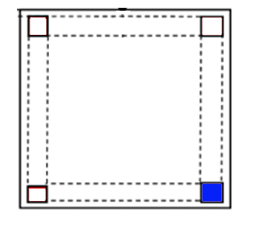
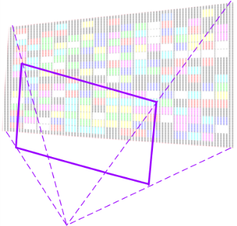
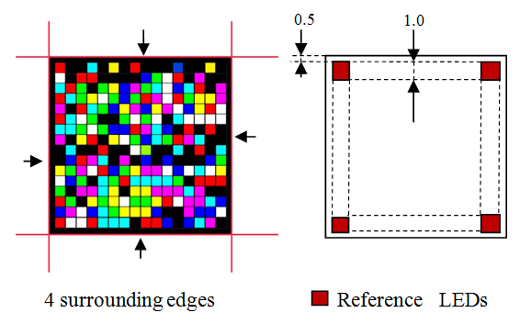
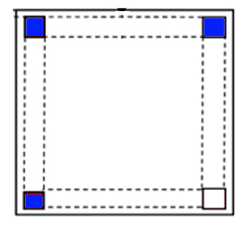
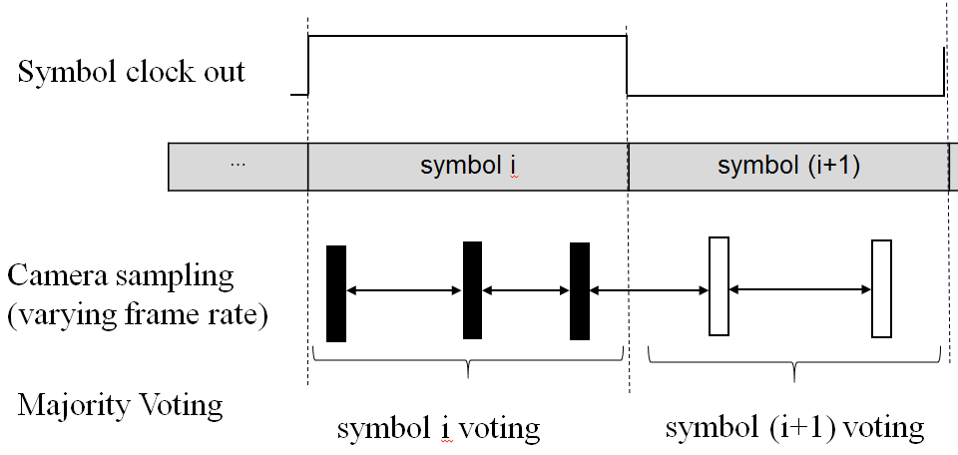
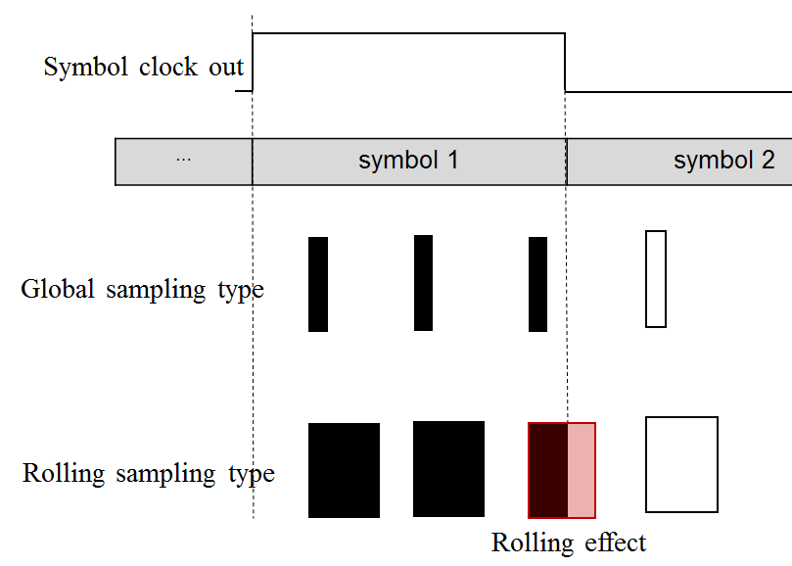
doc.: IEEE 802.15-16- 0412 -00-007a
Kookmin 2D code - key technologies (doc. 16- 0012r1)
Code
Area
Code
Area
360º Rotation using Phases Difference
Perspective Distortion Mitigation using Defined Matrix
Real-time Detection using Hough Transform
Asynchronous Communications using clock transmission
Rolling Effect Detection & Removal using reference LEDs
Submission

Slide 5
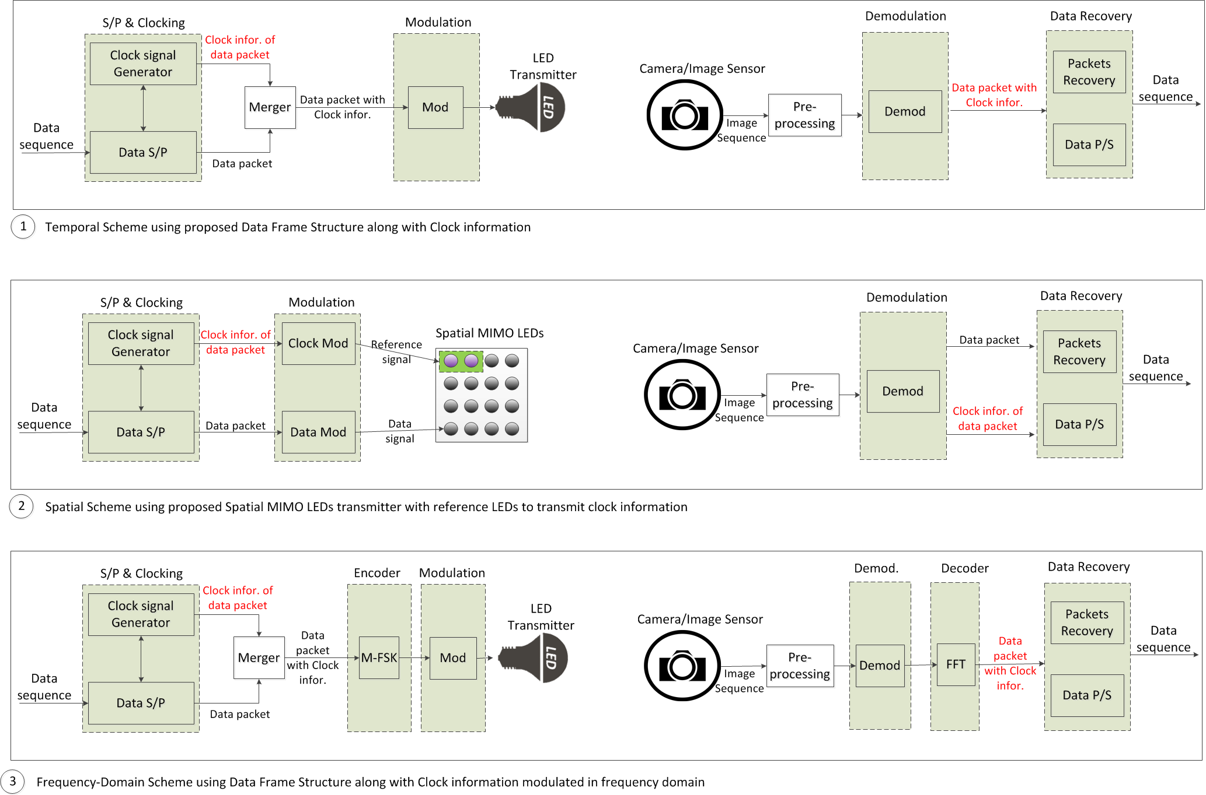
doc.: IEEE 802.15-16- 0412 -00-007a
Kookmin key-technologies (doc. 16- 0011r1)
Submission

Slide 6
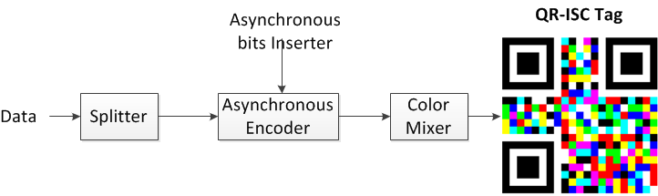
doc.: IEEE 802.15-16- 0412 -00-007a
Kookmin key-technologies
2D Visible Code
Reference LEDs: Spatial Approach
(doc. 16- 0012r1)
Temporal Approach
(doc. 16- 0012r1)
Both are applied for Invisible Screen Mode!
Submission

Slide 7
doc.: IEEE 802.15-16- 0412 -00-007a
Kookmin key-technologies
2D Invisible Code
Reference LEDs: Spatial Approach
(doc. 16- 0283r3)
Temporal Approach
(exactly similar in principle to QR-ISC)
2D Invisible Generator
2D Invisible Code
Submission

Slide 8
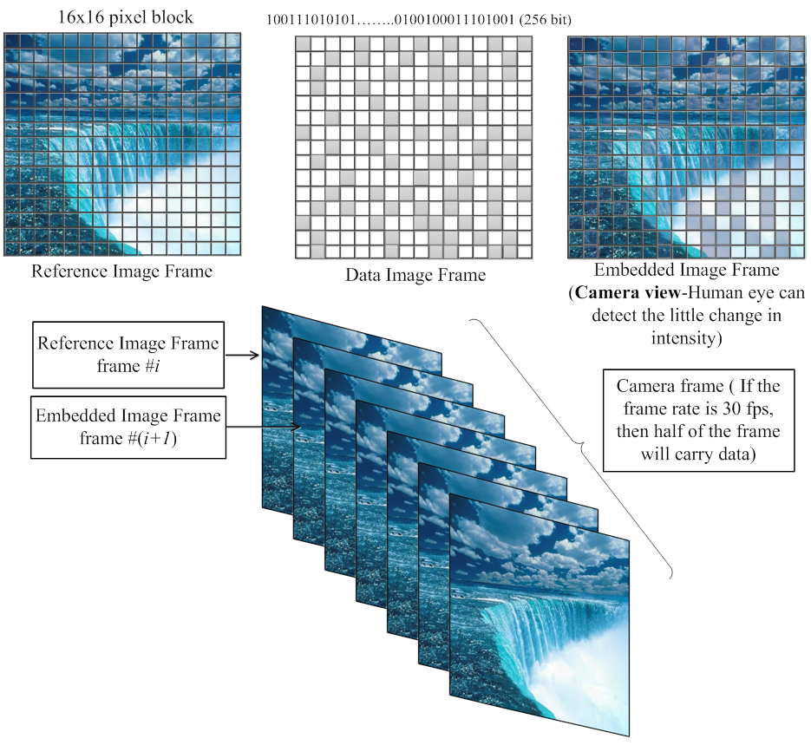
doc.: IEEE 802.15-16- 0412 -00-007a
Kookmin Invisible code key-technologies
Code
Area
Code
Area
360º Rotation
Rolling Effect Detection & Removal using reference LEDs
Asynchronous Communications using clock transmission
Invisible Generator
(doc. 16- 0283r3)
Submission

Slide 9
doc.: IEEE 802.15-16- 0412 -00-007a
Simplified Screen Modes
Submission

Slide 10
doc.: IEEE 802.15-16- 0412 -00-007a
Tables (doc. 16- 0389r3)
PHY C Operating Modes (Visible Screen Modes)
 |  | FEC
Modulation | RLL code | Outer code | Inner code | Data Rate
2D-sequential code | None | Repeat code (symbol/sec) | Code rate = data / (data +clock information) = N/(N+4) Spatial coding | (symbol rate) x (#_data LEDs)
4 color 2D-sequential code |  |  |  | (symbol rate) x 2.(#_data LEDs)
8 color 2D-sequential code |  |  |  | (symbol rate) x 3.(#_data LEDs)
QR-ISC code |  |  |  | R_{QR code} - (clock transmission)
PHY C Operating Modes (Invisible Screen Modes)
Modulation (m:n) | RLL Code | Optical Clock Rate | FEC |  | Data Rate (bits) m x n x 15 x RS_option x CC_option
 |  |  | Outer code (RS) | Inner code (CC)
2D-invisible sequential code 4:3 | None | 30Hz | RS_option | CC_option | 180 x RS_option x CC_option
2D-invisible sequential code 16:10 | None | 30Hz | RS_option | CC_option | 2400 x RS_option x CC_option
2D-invisible sequential code 8:5 | None | 30Hz | RS_option | CC_option | 600 x RS_option x CC_option
2D-invisible sequential code 16:9 | None | 30Hz | RS_option | CC_option | 2160 x RS_option x CC_option
2D-invisible sequential code 8:3 | None | 30Hz | RS_option | CC_option | 360 x RS_option x CC_option
Submission

Slide 11
doc.: IEEE 802.15-16- 0412 -00-007a
Simplified Table – Kookmin PHY C Screen modes
PHY C Operating Modes (Kookmin Screen Modes)
Modulation | RLL code | Optical Clock Rate | FEC |  | Data Rate
 |  |  | Outer code | Inner code
2D-sequential color code (2D Visible Spatial Approach) | None | 10 Hz | Repeat code (symbol/sec) | Code rate = data / (data +clock information) = N/(N+4) Spatial coding | (symbol rate) x (#_data LEDs) x log₂(#_of_colors)
QR-ISC code (2D Visible Temporal Approach) |  |  |  |  | R_{QR code} – OH_{clock information}
Invisible Mode (m:n) (Spatial / Temporal Approach) | None | 10 Hz | Repeat code (symbol/sec) RS_option | CC_option | (m x n) x (symbol rate) x RS_option x CC_option
Submission

