Slide 1
Project: IEEE P802.15 Working Group for Wireless Personal Area Networks (WPANs)
Submission Title: ULP TASK Performance Evaluation
Date Submitted: May 19, 2015
Source: [Kiran Bynam], [Chandrashekhar Thejaswi PS], [Jinesh Nair]
        [Youngsoo Kim], [Changsoon Park], [Young-Jun Hong]
Abstract: This presentation presents the recently published 15.4q (Ultra Low Power). It describes the benefits of the TASK-PHY and performance evaluation
Purpose: This presentation is to provide an analysis of the TG4q TASK PHY
Notice: This document has been prepared to assist the IEEE P802.15. It is offered as a basis for discussion and is not binding on the contributing individual(s) or organization(s). The material in this document is subject to change in form and content after further study. The contributor(s) reserve(s) the right to add, amend or withdraw material contained herein.
Release: The contributor acknowledges and accepts that this contribution becomes the property of IEEE and may be made publicly available by P802.15.

Slide 2
Contents
Introduction
  Requirements
  TASK PHY features and benefits
  Power consumption Figures
Performance Evaluation
  Comparison between BT LE and 802.15.4q TASK
  Comparison between the 802.15.4 and 802.15.4q TASK
Summary

Slide 3
Application Requirements
Market Sector | Data Rate (Kbps) | Range (m) | Number of Nodes | Reliability | Form Factor | Duty Cycle | Payload Size | Mobility | Battery Life
Smart Utility (Gas/Water) | 100 | 30 | 1000s | High | -- | Low | Small | No | Years
Building Automation | 1000 | 30 | 100s | High | S, M | Mid | Mid | No | Years
Medical / Health Care | 1000 | 10 | 10s | High | Small | High | Small-Mid | Yes | Days-Mos
Retail Service | 100 | 30 | 100s | High | Small | Mid-High | Mid-Large | Yes | Years
Telecom Service | 1000 | 10 | 10s | High | Small | High | Mid-Large | Yes | Days
Industrial Monitoring | 100 | 100 | 100s | High | -- | Mid-High | Small-Mid | No | Years
Environment Monitoring | 100 | 100 | 100s | High | -- | Low | Small | No | Years
Energy-Harvesting Sensor | 100 | 10 | 10s | Low | -- | Low | Small | -- | Years
Smart Active Label | 100 | 30 | 1000s | High | Small | Low | Small | Yes | Days-Mos
Shelf Label/ Inventory Tracking | 1000 | 30 | 1000s | High | Small | Low | Mid-Large | - | Months-years

Slide 4
Technical Requirements
In addition to 802.15.4 requirements, following were added to technical guidance document
  Less than 15 mW Power consumption
  Range of 30 m to be demonstrated in AWGN environment

Slide 5
TASK PHY
TASK PHY block diagram & description
Data rates support
Preamble description
Dual RX mode support: coherent & non-coherent

Slide 6
TASK PHY Block Diagram and Data Rates
MCS Identifier | Modulation format | Coding format | Chip rate (Mcps) | M (Bits/data symbol) | L (Chips/ data symbol) | Code rate | Data rate (kbps)
0 | 1/1-TASK | BCH | 1 | 1 | 1 | 51/63 | 809.52
1 | 2/4-TASK | BCH with interleaving | 1 | 2 | 4 | 51/63 | 404.76
2 | 3/8-TASK | BCH with interleaving | 1 | 3 | 8 | 51/63 | 303.57
3 | 5/32-TASK | BCH with interleaving | 1 | 5 | 32 | 51/63 | 126.48

Slide 7
Benefits of TASK Modulation
  Best suited for non-coherent mode of operation
  enables low power implementation at the receivers
  decodable simultaneously at the coherent receiver also.
  Spreading to enable robustness, data rate scalability and low-complex designs.
  Spreading sequences with good correlation properties:
  sequences with good correlation properties both in coherent (with ternary alphabet) and non-coherent (unipolar binary) modes.
  performance similar to the best-known sequences in the respective domains.
  (W-H codes in coherent mode and OOC in non-coherent mode)
  Benefits at the transmitter:
  Low power consumption due to duty-cycling
  Low complexity implementation.
  Benefits at the receiver:
  Non-coherent receiver
  based on Super-regenerative reception (SRR) principle
  eliminates need of mixers, and the demodulation is based on simple envelope detection.
  2. Reduction in power consumption due to duty-cycling.

Slide 8
Power Consumption
TX Component | Power (µW) @ -5 dBm
Power Amplifier | 3640
VCO | 1070
Frequency Synthesizer | 1850
Digital Baseband | 380
Total | 6940
RX Component | Power (µW)
LNA+SRO | 638
ED+VGA | 33
ADC (8 bit) | 7.5
Frequency Synthesizer | 1850
Digital Baseband | 1050
Total | 3578.5
Total Power consumption less than 5 mW for Receiver
Total Power consumption of transmitter less than 7 mW @ -5 dBm EIRP

Slide 9
Comparison between BT LE and
IEEE 802.15.4q TASK

Slide 10
Energy Analysis Overall Approach
Protocol for transmission of a single packet from sensor to node is analyzed for BT LE and 802.15.4q TASK
  A generic Power Consumption Model is derived
Power Consumption Tables for BT LE and 802.15.4q TASK are presented for various states
Energy Utility Models derived for BT LE and 802.15.4q TASK from the generic power consumption model
  Model capturing Energy Utility (bits/Joule) as a function of number transmission bytes
  Includes impact of connection establishment
  Multiple packet transmission
Performance comparison results
  Energy Utility vs number of transmission bytes
  Application Scenario comparisons

Slide 11
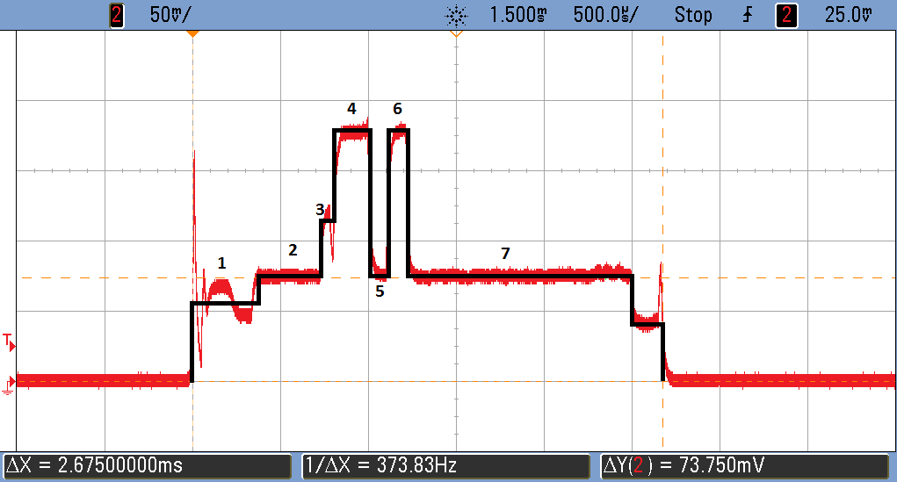
Bluetooth Low Energy: TI CC2541 Current Waveform
RX Active
TX Active
Spike from voltage regulator wake-up
Pre-RX
Pre-processing
RX-to-TX
Post-processing
Wake-up
Pre-sleep
Sleeping
Sleeping
Reference: Texas Instruments Application Note, “Measuring Bluetooth Low Energy Power Consumption”, 2012.

Slide 12
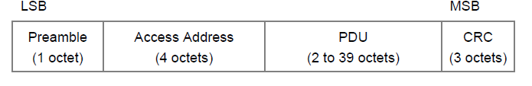
Bluetooth Low Energy: Acknowledged Transmission
PHY Overhead: 8 Byte
MAC Overhead: 12 Byte
Data: 27 Byte
Packet
Overhead
8+12 Byte
Maximum
Payload Size
27 Byte
ACK Size
8+2 Byte
TX/RX Turnaround Time
150 us
Inter-Frame Spacing
150 us
Data Frame
ACK Frame
Data Frame
Minimum Data Frame Interval 756 us
Throughput 285.7 kbps
PHY Overhead: 8 Byte
MAC Overhead: 12 Byte
Data: 27 Byte
ACK: 2 Byte

Slide 13
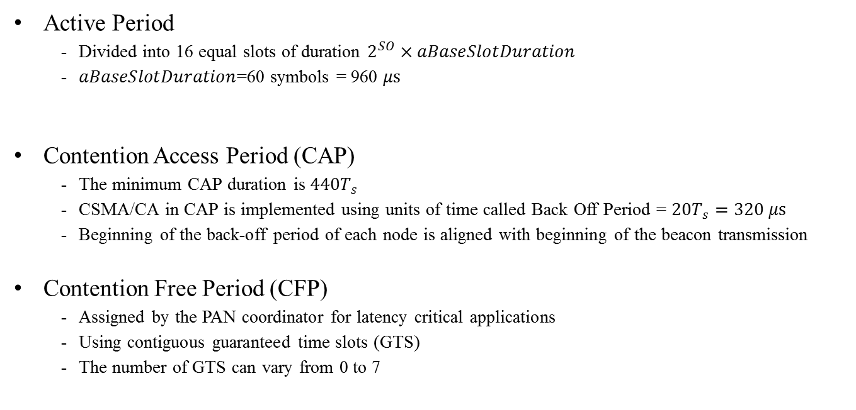
802.15.4 - MAC: Overview
Active Period
  Divided into 16 equal slots of duration $2^{SO}×aBaseSlotDuration$
  $aBaseSlotDuration$=60 symbols = 960 $μs$
Contention Access Period (CAP)
  The minimum CAP duration is $440T_{s}$
  CSMA/CA in CAP is implemented using units of time called Back Off Period = ${20T}_{s}=320 μs$
  Beginning of the back-off period of each node is aligned with beginning of the beacon transmission
Contention Free Period (CFP)
  Assigned by the PAN coordinator for latency critical applications
  Using contiguous guaranteed time slots (GTS)
  The number of GTS can vary from 0 to 7

Slide 14
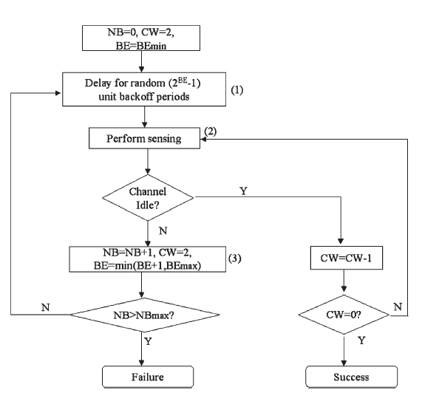
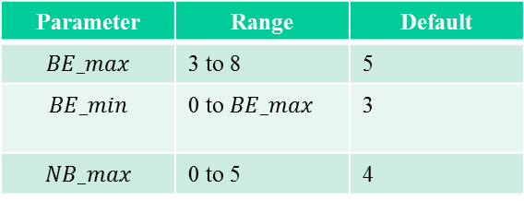
802.15.4 - MAC: Overview
Brief working
  NB: number of times CSMA/CA was required to back-off while attempting current transmission
  CW: Number of back-off periods that need to be clear of channel activity before transmission can start
  BE: is the back off exponent related to the maximum number of back-off periods that a node will wait before attempting to access the channel
Parameter | Range | Default
$$BE_max$$ | 3 to 8 | 5
$$BE_min$$ | 0 to $BE_max$ | 3
$$NB_max$$ | 0 to 5 | 4

Slide 15
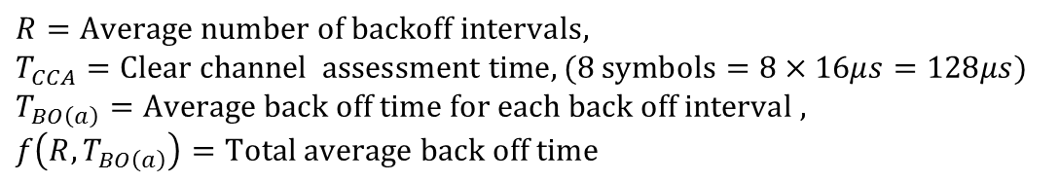
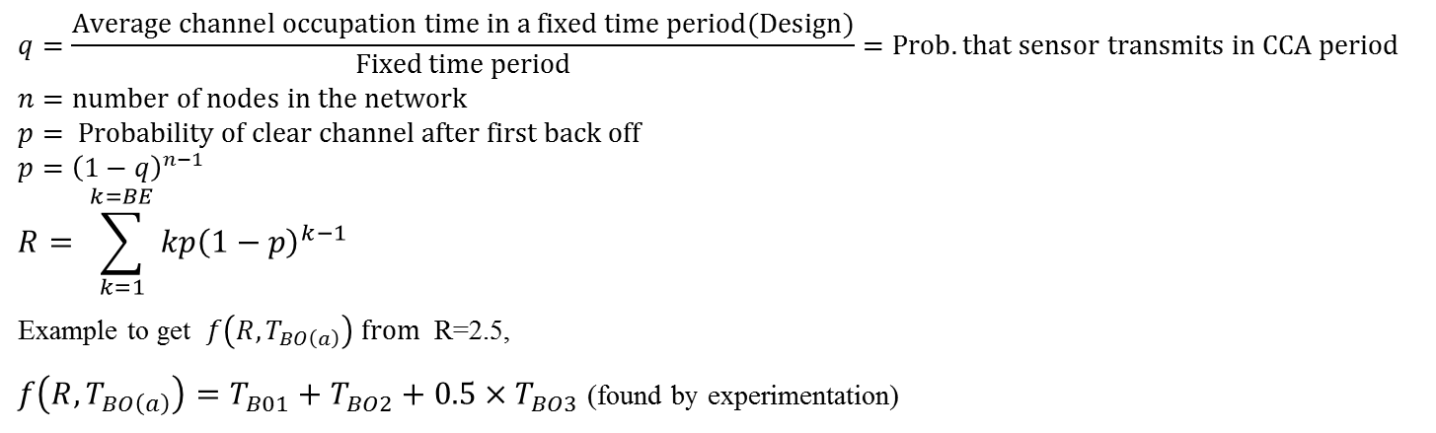

Average Time for Channel Access
$$D_{csma}=RT_{CCA}+f(R,T_{BO\left(a\right)})$$
$$R=Average number of backoff intervals,$$
$$T_{CCA}=Clear channel assessment time, (8 symbols=8×16μs=128μs)$$
$$T_{BO\left(a\right)}=Average back off time for each back off interval ,$$
$$f\left(R,T_{BO\left(a\right)}\right)=Total average back off time$$
$$q=\frac{Average channel occupation time in a fixed time period(Design)}{Fixed time period}=Prob. that sensor transmits in CCA period$$
$$n=number of nodes in the network$$
$$p= Probability of clear channel after first back off$$
$$p={\left(1−q\right)}^{n−1}$$
$$R= \sum_{k=1}^{k=BE}{kp{\left(1−p\right)}^{k−1}}$$
Example to get $f\left(R,T_{BO\left(a\right)}\right) from$ R=2.5,
$f\left(R,T_{BO\left(a\right)}\right)=T_{B01}+T_{BO2}+0.5×T_{BO3}$ (found by experimentation)

Slide 16
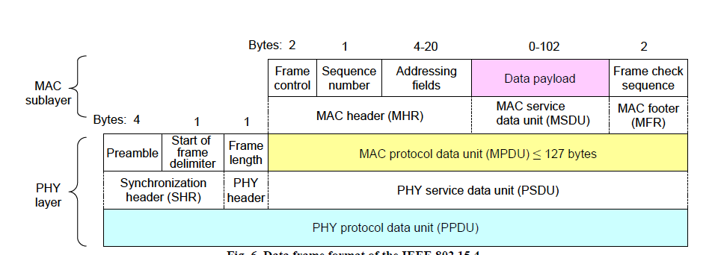
802.15.4 - MAC: Acknowledged Transmission
PHY Overhead: 6 Byte
MAC Overhead: 9 Byte
Data: 118 Byte
Packet
Overhead
6+9 Byte
Maximum
Payload Size
118 Byte
ACK Size
6+5 Byte
Inter-Frame Spacing
640 us
TX/RX Turnaround Time
192 us
Data Frame
ACK Frame
Data Frame
Minimum Data Frame Interval 5440 us
Throughput 173.5 kbps
PHY Overhead: 6 Byte
MAC Overhead: 9 Byte
Data: 118 Byte
ACK: 5 Byte

Slide 17
Generic Power Consumption Model
Receiver
Transmitter
Assumption: C1 = 10960 [cycle] (340 us @ 32 MHz)
Assumption: C2 = 12800 [cycle], C3 = 32 [us/Byte] (1280 us @ 32 MHz, 27 Byte)
Processor Bounded Task
Processor Bounded Task
Memory Bounded Task
C1 [cycle] / clock frequency [Hz]
C2 [cycle] / clock frequency [Hz] + C3 [us/Byte] * MSDU [Byte]
Data Frame
ACK Frame
Pre-RX
RX-TX
Wake-up
Pre-sleep
Pre-processing
Post-processing
Processor Bounded Task
Memory Bounded Task
Processor Bounded Task
C2 [cycle]/ clock frequency [Hz] + C3 [us/Byte] * MSDU [Byte]
C1 [cycle] / clock frequency [Hz]
Data Frame
ACK Frame
Pre-TX
TX-RX
Wake-up
Pre-sleep
Pre-processing
Post-processing

Slide 18
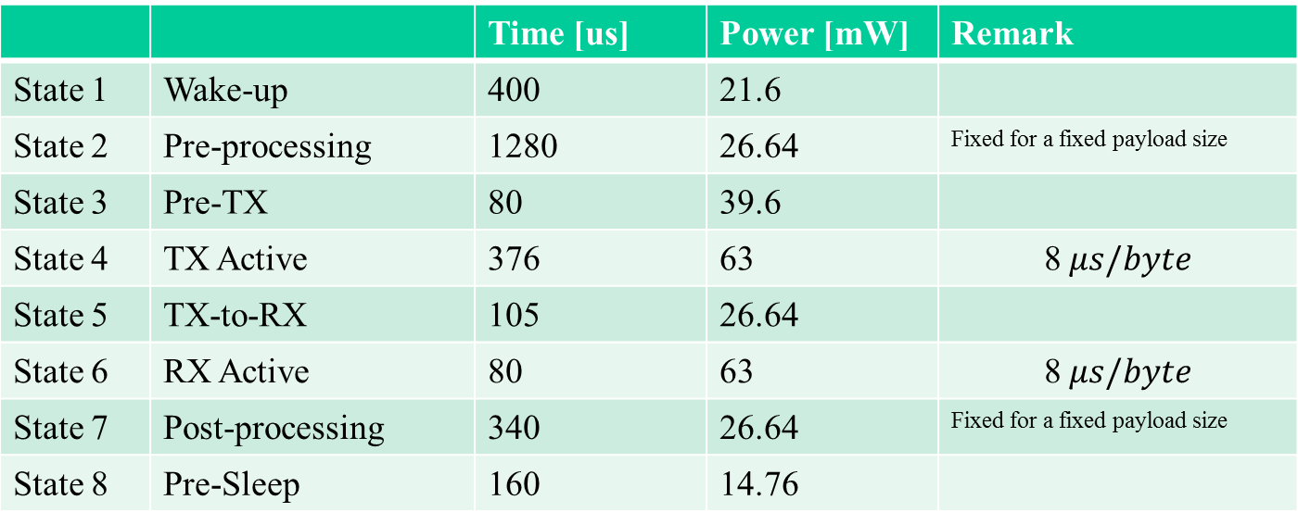
BT LE Power Model: Transmitter
 |  | Time [us] | Power [mW] | Remark
State 1 | Wake-up | 400 | 21.6
State 2 | Pre-processing | 1280 | 26.64 | Fixed for a fixed payload size
State 3 | Pre-TX | 80 | 39.6
State 4 | TX Active | 376 | 63 | $$\text{8} μs/byte$$
State 5 | TX-to-RX | 105 | 26.64
State 6 | RX Active | 80 | 63 | $$\text{8} μs/byte$$
State 7 | Post-processing | 340 | 26.64 | Fixed for a fixed payload size
State 8 | Pre-Sleep | 160 | 14.76
Data Frame: 376 us (20+27B)
ACK Frame: 80 us (10B)
 |  | Current [mA]
State 9 | Sleep | 0.001
Modified from Reference: Texas Instruments Application Note, “Measuring Bluetooth Low Energy Power Consumption”, 2012.

Slide 19
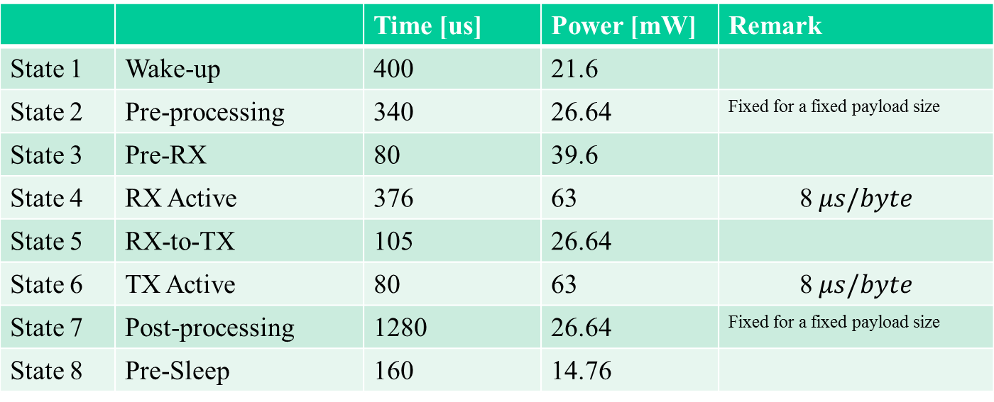
BT LE Power Model: Receiver
 |  | Time [us] | Power [mW] | Remark
State 1 | Wake-up | 400 | 21.6
State 2 | Pre-processing | 340 | 26.64 | Fixed for a fixed payload size
State 3 | Pre-RX | 80 | 39.6
State 4 | RX Active | 376 | 63 | $$\text{8} μs/byte$$
State 5 | RX-to-TX | 105 | 26.64
State 6 | TX Active | 80 | 63 | $$\text{8} μs/byte$$
State 7 | Post-processing | 1280 | 26.64 | Fixed for a fixed payload size
State 8 | Pre-Sleep | 160 | 14.76
Data Frame: 376 us (20+27B)
ACK Frame: 80 us (10B)
 |  | Current [mA]
State 9 | Sleep | 0.001
Modified from Reference: Texas Instruments Application Note, “Measuring Bluetooth Low Energy Power Consumption”, 2012.

Slide 20
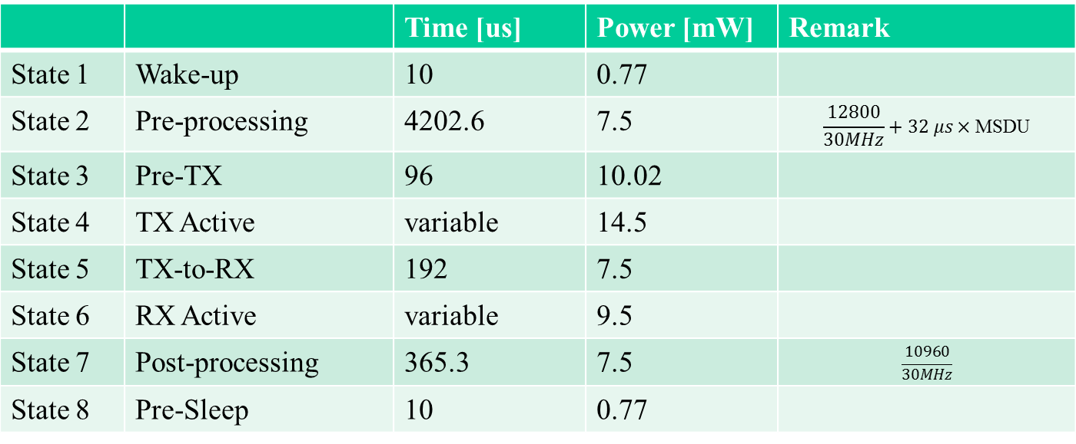
IEEE 802.15.4q TASK Power Model: Transmitter
 |  | Time [us] | Power [mW] | Remark
State 1 | Wake-up | 10 | 0.77
State 2 | Pre-processing | 4202.6 | 7.5 | $$\frac{12800}{30MHz}+32 μs×\text{MSDU}$$
State 3 | Pre-TX | 96 | 10.02
State 4 | TX Active | variable | 14.5
State 5 | TX-to-RX | 192 | 7.5
State 6 | RX Active | variable | 9.5
State 7 | Post-processing | 365.3 | 7.5 | $$\frac{10960}{30MHz}$$
State 8 | Pre-Sleep | 10 | 0.77
MCU 30 MHz
MSDU 118 B
 |  | Current [mA]
State 9 | Sleep | 0.001

Slide 21
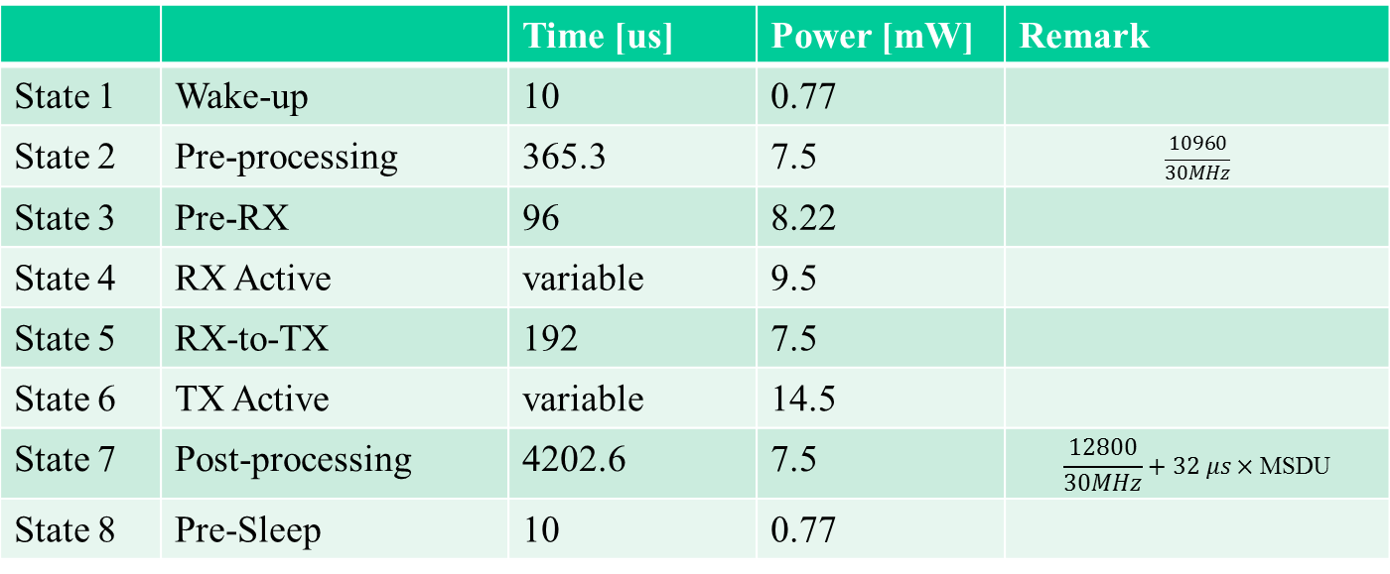
IEEE 802.15.4q TASK Power Model: Receiver
 |  | Time [us] | Power [mW] | Remark
State 1 | Wake-up | 10 | 0.77
State 2 | Pre-processing | 365.3 | 7.5 | $$\frac{10960}{30MHz}$$
State 3 | Pre-RX | 96 | 8.22
State 4 | RX Active | variable | 9.5
State 5 | RX-to-TX | 192 | 7.5
State 6 | TX Active | variable | 14.5
State 7 | Post-processing | 4202.6 | 7.5 | $$\frac{12800}{30MHz}+32 μs×\text{MSDU}$$
State 8 | Pre-Sleep | 10 | 0.77
MCU 30 MHz
MSDU 118 B
 |  | Current [mA]
State 9 | Sleep | 0.001

Slide 22









BT LE: MAC Mechanism
Connection Establishment
Connected Communication
Scanner
Advertiser
Scanner/Master
Advertiser/Slave
ADV
$$t_{anchor}$$
EVENT_1
ADV
$$T_{a}$$
$d_{IFS}$
$d_{IFS}$
ACK
$$T_{c}$$
CON_REQ
$$d_{two}+1.25ms$$
EVENT_2
$d_{IFS}$
ACK
EVENT_1
$d_{IFS}$
$$d_{tw}$$
ACK
EVENT_3
$d_{IFS}$
ACK

Slide 23
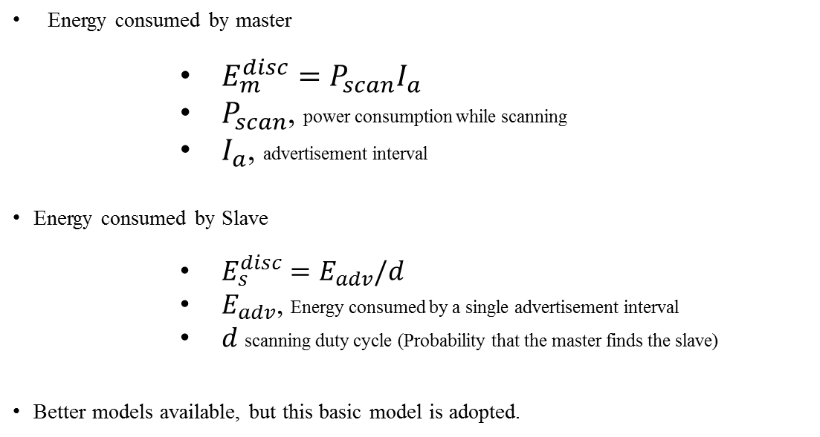
BT LE: Energy Model for Point to Point Link
Non-Connected communication
Energy consumed by master
      $E_{m}^{disc}=P_{scan}I_{a}$
      $P_{scan}$, power consumption while scanning
      $I_{a}$, advertisement interval
Energy consumed by Slave
      $E_{s}^{disc}=E_{adv}/d$
      $E_{adv}$, Energy consumed by a single advertisement interval
      $d$scanning duty cycle (Probability that the master finds the slave)
Better models available, but this basic model is adopted.

Slide 24
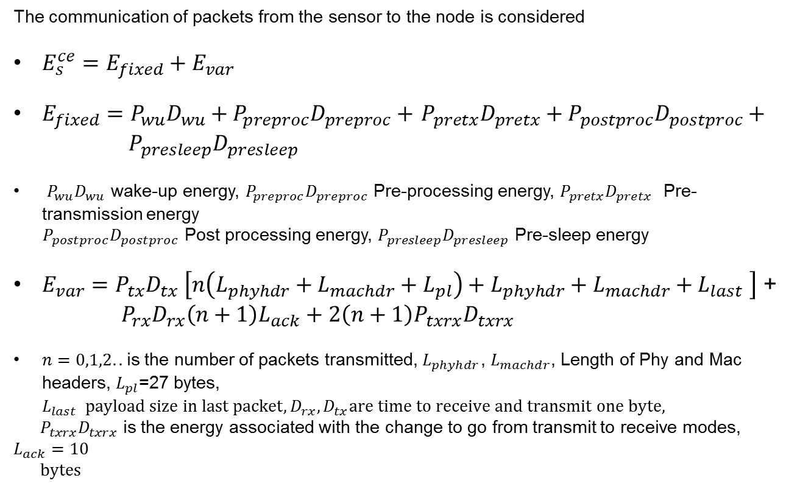
BT LE: Energy Model for Point to Point Link
Connected communication
The communication of packets from the sensor to the node is considered
$E_{s}^{ce}=E_{fixed}+E_{var}$
$E_{fixed}=P_{wu}D_{wu}+$ $P_{preproc}D_{preproc}+$ $P_{pretx}D_{pretx}+$ $P_{postproc}D_{postproc}+ { P}_{presleep}D_{presleep}$
$P_{wu}D_{wu}$ wake-up energy, $P_{preproc}D_{preproc}$ Pre-processing energy, $P_{pretx}D_{pretx}$ Pre-transmission energy
$P_{postproc}D_{postproc}$ Post processing energy, $P_{presleep}D_{presleep}$ Pre-sleep energy
$E_{var}=P_{tx}D_{tx} \left[n\left(L_{phyhdr}+L_{machdr}+L_{pl}\right)+{L_{phyhdr}+L_{machdr}+L}_{last} \right]$ +
$P_{rx}D_{rx}\left(n+1\right)L_{ack}+2\left(n+1\right)P_{txrx}D_{txrx}$
$n=0,1,2..$is the number of packets transmitted, $L_{phyhdr}$, $L_{machdr}$, Length of Phy and Mac headers, $L_{pl}$=27 bytes, $L_{last} payload size in last packet, D_{rx}, D_{tx}are time to receive and transmit one byte,$
$P_{txrx}D_{txrx}$ is the energy associated with the change to go from transmit to receive modes, $L_{ack}=10$
$bytes$

Slide 25
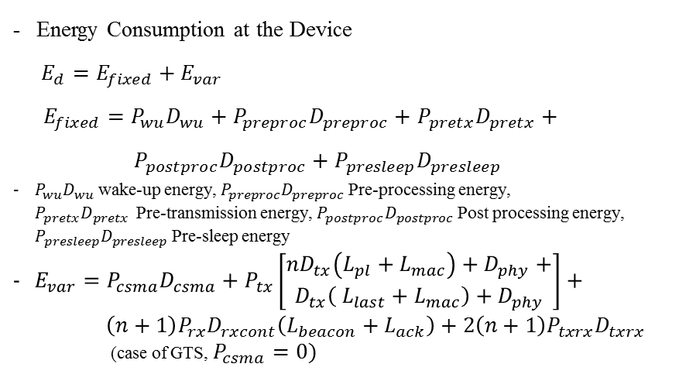
802.15.4 - MAC: MAC Mechanism and Energy Model for Beacon Enabled Mode (Uplink)
Coordinator
Device
Uplink (Direct) Communication
Energy Consumption at the Device
$E_{d}=E_{fixed}+E_{var}$
$E_{fixed}=P_{wu}D_{wu}+$ $P_{preproc}D_{preproc}+$ $P_{pretx}D_{pretx}+$
$P_{postproc}D_{postproc}+P_{presleep}D_{presleep}$
$P_{wu}D_{wu}$ wake-up energy, $P_{preproc}D_{preproc}$ Pre-processing energy,
$P_{pretx}D_{pretx}$ Pre-transmission energy, $P_{postproc}D_{postproc}$ Post processing energy, $P_{presleep}D_{presleep}$ Pre-sleep energy
$E_{var}=P_{csma}D_{csma}+P_{tx}\left[\begin{aligned}nD_{tx}\left(L_{pl}+L_{mac}\right)+D_{phy}+ \\ D_{tx}\left( L_{last}+L_{mac}\right)+D_{phy}\end{aligned}\right]+$
$\left(n+1\right)P_{rx}D_{rxcont}\left(L_{beacon}+L_{ack}\right)+2\left(n+1\right)P_{txrx}D_{txrx}$
(case of GTS, $P_{csma}=0)$
Beacon
Data
(CAP/GTS)
ACK (Optional)
$n=0,1,2..$is the number of packets transmitted, $P_{txrx}D_{txrx}$ is the energy associated with the change to go from transmit to receive mode, $L_{mac}$, $D_{phy}$, Length of MAC headers and duration of PHY headers, $L_{pl}$ payload bytes, $L_{ack}=10 bytes , L_{beacon}=28 bytes, L_{last} payload size in last packet,D_{rx}, D_{tx}are time to receive and transmit one byte$

Slide 26
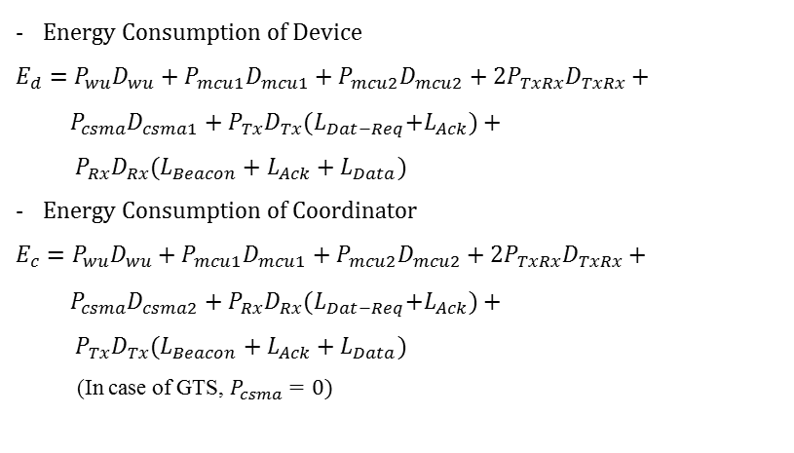
802.15.4 - MAC: MAC Mechanism and Energy Model for Beacon Enabled Mode (Downlink)
Coordinator
Device
Downlink (Indirect) Communication:
Beacon
Energy Consumption of Device
$$E_{d}=P_{wu}D_{wu}+P_{mcu1}D_{mcu1}+P_{mcu2}D_{mcu2}+2P_{TxRx}D_{TxRx}+$$
${ P}_{csma}D_{csma1}+P_{Tx}D_{Tx}{(L}_{Dat−Req}+L_{Ack})+$
$${ P}_{Rx}D_{Rx}(L_{Beacon}+L_{Ack}+L_{Data})$$
Energy Consumption of Coordinator
$$E_{c}=P_{wu}D_{wu}+P_{mcu1}D_{mcu1}+P_{mcu2}D_{mcu2}+2P_{TxRx}D_{TxRx}+$$
${ P}_{csma}D_{csma2}+P_{Rx}D_{Rx}{(L}_{Dat−Req}+L_{Ack})+$
$${ P}_{Tx}D_{Tx}(L_{Beacon}+L_{Ack}+L_{Data})$$
(In case of GTS, $P_{csma}=0)$
DATA_REQ
(CAP)
ACK
Data
CAP/GTS
ACK
$P_{wu}D_{wu}$= Wake up energy, $P_{mcu1}D_{mcu1}$= Pre-processing energy, $P_{mcu2}D_{mcu2}$= Post-processing energy
$P_{csma}D_{csma}$=Energy associated with channel access in CAP, $P_{Tx}{, P}_{Rx}=$Transmitter Power, Receiver Power
$D_{Tx}$, $D_{Rx}$ Transmitter and receiver time in seconds/byte, $L_{Data}$, $L_{Beacon},L_{Ack}$ is length in bytes for Data, Ack, beacon packets

Slide 27
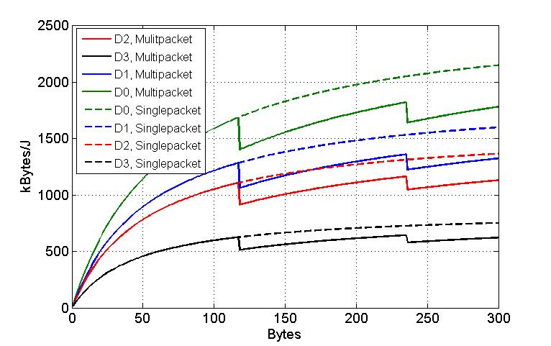
Performance Comparisons
Parameter | Value
Number of retransmissions | 1
Multi-rate PHY modes | D0: 1/1-TASK, D1: 2/4-TASK, D2: 3/8-TASK, D3: 5/32-TASK BT LE: 1 Mbps
Size of packets | [1-256] bytes
Energy utility as a function of packet data size for 802.15.4q TASK and BT LE
Based on active power consumption, the energy utility of 802.15.4q TASK is far superior
Energy utility as a function of packet data size for 802.15.4q TASK PHY: D0, D1, D2, D3
For data beyond 127 bytes, multi-packet transmission and single packet of sizes beyond 127 packets are considered.

Slide 28
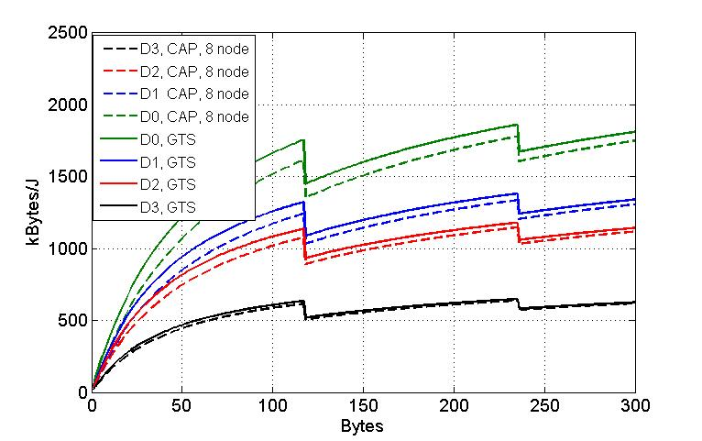
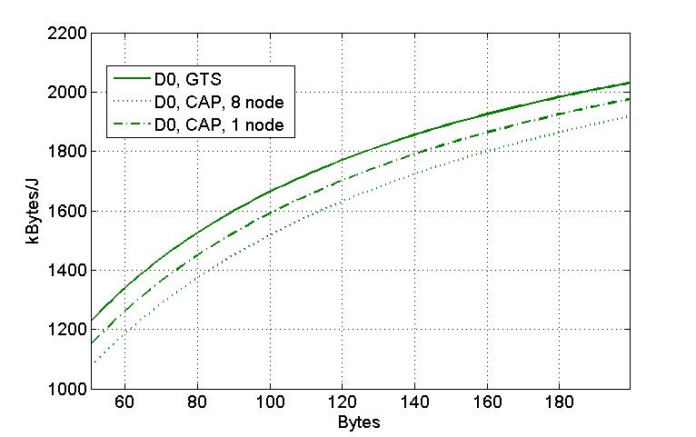
Performance comparisons : CAP and GTS
Parameter | Value
Number of retransmissions | 1
Multi-rate PHY modes | D0: 1/1-TASK, D1: 2/4-TASK, D2: 3/8-TASK, D3: 5/32-TASK BT LE: 1 Mbps
Size of packets | [1-256] bytes
As expected marginal gains are observed with GTS as $P_{csma}=0$

Slide 29
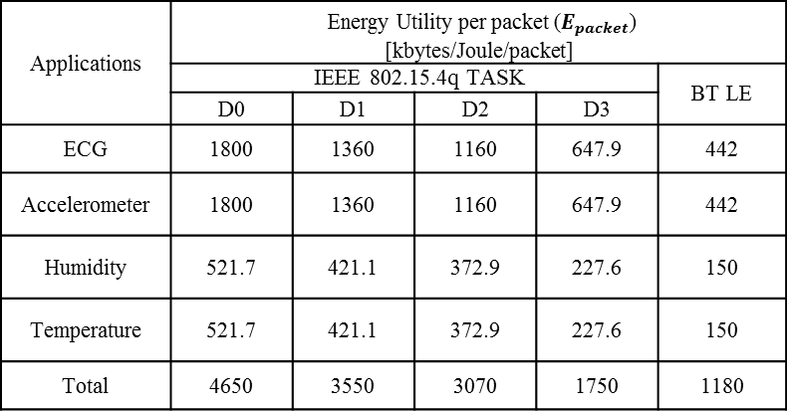
Application Scenarios: CAP and GTS
Applications | Packet Size (Bytes) | Packets/Sec/device | Data Rate (kbps) | Mode
ECG | 127 | 4 | 4.064 | CFP
Accelerometer | 127 | 8 | 8.128 | CFP
Humidity | 16 | 2 | 0.256 | CAP
Temperature | 16 | 1 | 0.128 | CAP
Energy utility per packet
[kByte/J/packet]
Applications | Energy Utility per packet ($E_{packet}$) [kbytes/Joule/packet]
 | IEEE 802.15.4q TASK |  |  |  | BT LE
 | D0 | D1 | D2 | D3
ECG | 1800 | 1360 | 1160 | 647.9 | 442
Accelerometer | 1800 | 1360 | 1160 | 647.9 | 442
Humidity | 521.7 | 421.1 | 372.9 | 227.6 | 150
Temperature | 521.7 | 421.1 | 372.9 | 227.6 | 150
Total | 4650 | 3550 | 3070 | 1750 | 1180

Slide 30
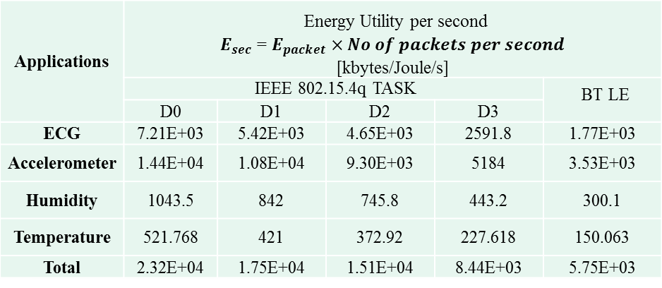
Application Scenarios (with CAP and GTS)
Applications | Energy Utility per second $E_{sec}$ = $E_{packet}×No of packets per second$ [kbytes/Joule/s]
 | IEEE 802.15.4q TASK |  |  |  | BT LE
 | D0 | D1 | D2 | D3
ECG | 7.21E+03 | 5.42E+03 | 4.65E+03 | 2591.8 | 1.77E+03
Accelerometer | 1.44E+04 | 1.08E+04 | 9.30E+03 | 5184 | 3.53E+03
Humidity | 1043.5 | 842 | 745.8 | 443.2 | 300.1
Temperature | 521.768 | 421 | 372.92 | 227.618 | 150.063
Total | 2.32E+04 | 1.75E+04 | 1.51E+04 | 8.44E+03 | 5.75E+03
kByte/J/sec

Slide 31
Summary
BT LE and 802.15.4q TASK power models are derived
  Energy utilization based on the active power consumption
  Power consumption figures are obtained from paper, TI-CC-2541 and ULP prototypes
  802.15.4q applicable for multiple rates
  Sensor to master data transfer considered
Results for BT LE and 802.15.4q TASK are compared
  Energy utilization of IEEE 802.15.4q TASK is more superior than BT LE for higher data rates
  There is a value in extending packet sizes beyond 127 bytes to 255 bytes

Slide 32
Comparison of IEEE 802.15.4 and 802.15.4q TASK – OPNET simulation

Slide 33

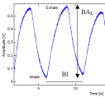


IEEE 802.15.4q TASK: Protocol Stack
New IEEE 802.15.4q TASK can support the legacy combination of IEEE 802.15.4b MAC and ZigBee stack.
ECG (Ectrocardiography)
PPG (Photoplethysmography)
IMP (Body Impedance)
Application
IEEE 802.15.4b MAC
IEEE 802.15.4q TASK PHY

Slide 34
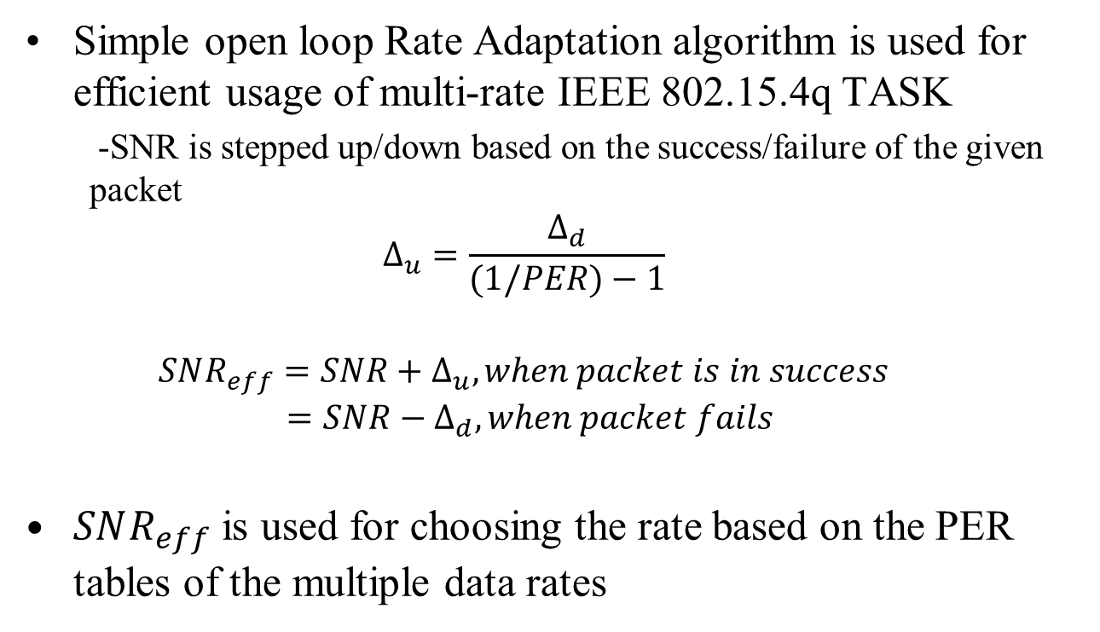
Using Variable Data Rate: Rate Adaptation
Simple open loop Rate Adaptation algorithm is used for efficient usage of multi-rate IEEE 802.15.4q TASK
  -SNR is stepped up/down based on the success/failure of the given packet
  $$Δ_{u}=\frac{Δ_{d}}{(1/PER)−1}$$
  $$SNR_{eff}=SNR+Δ_{u}, when packet is in success=SNR−Δ_{d}, when packet fails$$
$SNR_{eff}$ is used for choosing the rate based on the PER tables of the multiple data rates

Slide 35
RA algorithm: OPNET Simulation
Simulation Assumptions
  TX Power for 15.4 OQPSK is 10 mW
  RX Power for 15.4 OQPSK is 20 mW
  TX Power for 15.4q TASK is 10 mW
  RX Power for 15.4q TASK is 5 mW
  EIRP for all sensors is -10 dBm
  EIRP of coordinator is 0 dBm
  Single tap, Pedestrian channel at 3 kmph is observed.
  Various packet sizes from 30 to 120 bytes considered
  Number of nodes in network varied between 1 , 4 and 8 for CAP mode
  Simulation done for BO-4 and SO-4

Slide 36
Results of RA algorithm for GTS
Power
[watt]
Power
[watt]
Receiver Energy comprises mainly of Beacon and ACK components.
Transmitter Energy comprises of actual transmitted packets.
Gain in TX energy is mainly due to use of Rate adaptation and RX Energy is mainly due to ULP front end (SRR).

Slide 37
Results of RA algorithm for CAP
Power
[watt]
Power
[watt]
Power
[watt]
Observations
CAP energy consumption is very high when number of nodes is increased in the network
RA algorithm with multiple rate reduces the congestion by taking advantage of higher rate when encountering good SNR

Slide 38
Mobile Health Care Application
Node description | Number of nodes | Packet Size (Bytes) | Packets/Sec/device | Data Rate (kbps) | Mode | Total packets/3minute
ECG | 3 | 127 | 4 | 4.064 | CFP | ~1900
Accelerometer | 2 | 127 | 8 | 8.128 | CFP | ~2500
Humidity, Temperature, | 2 | 16 | 2 | 0.256 | CAP | ~500
PPG | 1 | 127 | 3 | 3.048 | CFP | ~650
Practical application of mobile health is simulated
Assumptions for simulation are same
Coordinator is placed in Mobile interacting with several health monitoring sensors
All the above applications are run for 3 minutes for benchmarking energy consumption

Slide 39
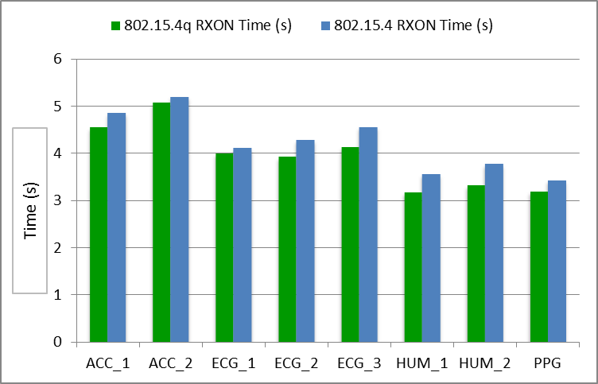
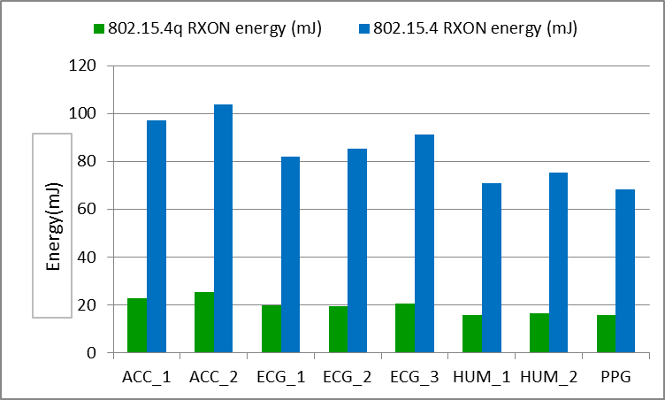
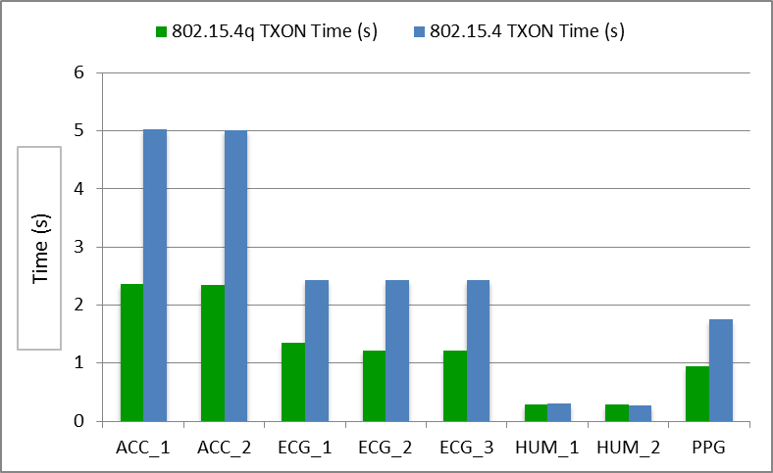
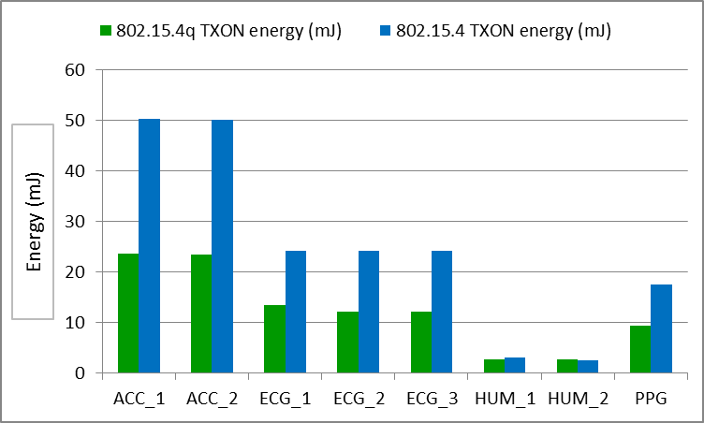
Results of Mobile Health Care Application
RX gain is mainly originated from ULP front-end (4 times)
TX gain is mainly originated from Rate Adaptation (2 times)
RX Active Time and Energy comparison
TX Active Time and Energy comparison

Slide 40
Summary
Demonstrate more than 100% of active energy efficiency improvement by 802.15.4q TASK with Rate Adaptation
CCA being impacted and gaining by 4 times by using multi rate 802.15.4q TASK in efficiency , less retransmissions and non-coherent receivers
TX Energy gains mainly due to decreased retransmissions and RX Energy gains are obtained by using ULP transceiver

