Slide 1
Project: IEEE P802.15 Working Group for Wireless Personal Area Networks (WPANs)
Submission Title: [Liaison Report on 802.11 for May 2016]
Date Submitted: [19 March, 2016 ]
Source: [Al Petrick 802.11] Company [Jones-Petrick and Associates]
Address [Orlando, Florida, 32832]
Voice:[321-235-3269], FAX: [], E-Mail:[al@jpasoc.com ]
Re: [Liaison Report on 802.11 for May, 2016]
[If this is a response to a Call for Contributions, cite the name and date of the Call for Contributions to which this document responds, as well as the relevant item number in the Call for Contributions.]
[Note: Contributions that are not responsive to this section of the template, and contributions which do
not address the topic under which they are submitted, may be refused or consigned to the “General Contributions” area.]
Abstract: [Liaison Report on 802.11 for May, 2016.]
Purpose: [Informative]
Notice: This document has been prepared to assist the IEEE P802.15. It is offered as a basis for discussion and is not binding on the contributing individual(s) or organization(s). The material in this document is subject to change in form and content after further study. The contributor(s) reserve(s) the right to add, amend or withdraw material contained herein.
Release: The contributor acknowledges and accepts that this contribution becomes the property of IEEE and may be made publicly available by P802.15.
NOTE: Update all red fields replacing with your information; they are required. This is a manual update in appropriate
fields. All Blue fields are informational and are to be deleted. Black stays. After updating delete this box/paragraph.

Slide 2
802.11 Liaison Report
Hilton Waikoloa Village, HI, USA
May 2016

Slide 3
802.11 Task Groups in Comment Resolution
Task Group | Ballot | Draft | Comments | Resolved | Plans | Closing Report
TGax | Internal WG | D0.1 |  | 200 PHY | Resolve comments July 2016 | 16/739r0
TGai | SB #
TGaq | LB2xx
TGaj | LB2xx | D2.0 | ?? | ?? | ??
TGmc | ?? | ?? | ?? | ?? | ??
TGah | SP#3 | D8.0 | 2 | ALL | Prepare documents for EC and RevCom | 16/742r0
TGak | ?? | ?? | ?? | ?? | ??

Slide 4
802.11ax
(High Efficiency WLAN)
70 technical submissions
  Many of the submissions were related to the Specification Framework Document
Approved 200 comments (internal review) technical draft 0.1 addressing the PHY layer
Text revisions in May / June will be included in Draft 0.2
Plans for July 2016
  Continue reviewing comments and update Draft 0.2
Closing report: 16/739r0

Slide 5
802.11ah
TGah has completed all comment resolution of the 3rd Sponsor Recirculation Ballot for Draft 8.0
Plans for July 2016
  Prepare documents for ExCom and RevCom approval
Closing report: 16/0742r0

Slide 6
802.11az
(Next Generation Positioning)
High Rate PHY 2.4 GHz, 5 GHz, 60 GHz
Approved working draft Functional Requirement Document.
Motioned 17 functional requirements on accuracy/coverage and scalability sections.
Plans for July 2016
  Begin reviewing initial technical submissions, channel models and protocols
Closing report: 16/508r0

Slide 7
LRLP - TIG
(Long Range Low Power)
2 Technical presentations
  Wearable Device Use Cases and Requirements for LRLP
  Considerations on Long Range
Next steps
  TIG decided Wake-Up Receiver (WUR) was sufficient for Low-Power 802.11 and mechanisms for Long Ranger were not required
  WNG strawpoll and WG approved starting a study group to address WUR and create a PAR and 5C.
Closing report: 16-0519r0

Slide 8
802.11WNG
(Wireless Next Generation)
Reconfirmation
Lei Wang (Marvell) was reconfirmed as vice-chair by unanimous consent
Presentations at March 2016 meeting
  “Li-Fi presentation and demo,” Nikola Serafimovski (PureLiFi)
    https://mentor.ieee.org/802.11/dcn/16/11-16-0708-01-0wng-lifi-presentation-and-demo.pptx
  “Proposal for LP-WUR Study Group,” Minyoung Park (Intel)
    https://mentor.ieee.org/802.11/dcn/16/11-16-0605-03-0wng-proposal-for-lp-wur-study-group.pptx
  “Discussion of 802.11 inputs to 5G EC SC,” Joseph Levy (InterDigital)
    https://mentor.ieee.org/802.11/dcn/16/11-16-0651-03-0000-802-11-discussion-of-inputs-to-802-ec-5g-sc.pptx
Minutes
  https://mentor.ieee.org/802.11/dcn/16/11-16-0706-00-0wng-wng-meeting-minutes-of-2016-may-waikoloa.docx
Closing report: 16/0727r0

Slide 9
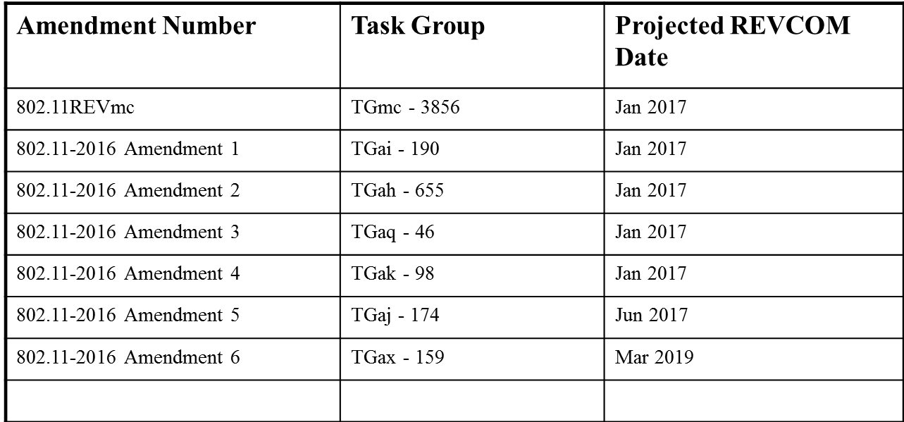
Projected Completion of 802.11 Amendments
Editors Report: Doc 16/603r2

Slide 10
Questions???

