Slide 1
Project: IEEE P802.15 Working Group for Wireless Personal Area Networks (WPANs)
Submission Title: [Proposed resolution to cid#1064]
Date Submitted: [17 May 2016]
Source: [Ken Hiraga and Hideki Toshinaga]
Company: [NTT]
Address¹: [Hirarinooka 1-1, Yokosuka Japan]
E-Mail¹: [hiraga.ken@lab.ntt.co.jp (all contributors are listed in “Contributors” slide)]
Re:[15-16-0371r00 lb119_consolidated_comments]
Abstract: A proposed resolution to CID#1064. This presents a MLME function related to the MCS information.
Purpose: For a comment resolution to CID#1064,
Notice: This document has been prepared to assist the IEEE P802.15. It is offered as a basis for discussion and is not binding on the contributing individual(s) or organization(s). The material in this document is subject to change in form and content after further study. The contributor(s) reserve(s) the right to add, amend or withdraw material contained herein.
Release: The contributors acknowledge and accept that this contribution becomes the property of IEEE and may be made publicly available by P802.15.

Slide 2
Comment to be resolved
CID | Page | Sub-clause | Line # | Comment | Proposed Change | E/T | Must Be Satisfied? | Resolution Stats
1064 |  | n/a | n/a | Define method to send MCS info to the upper layer or set MCS from the upper layer. | As commented. | T | Yes

Slide 3
Function to confirm the MCS
(1) Decide the compression rate
In content downloading.
(2) Limit the communication area by controlling RF power
The kiosk decides what files should be transferred by estimating required transmission time.
Kiosk
Application
Kiosk
Application
A content stored in various compression rate
[Example]
High quality: 500 MB
Medium quality:100 MB
Low quality: 20 MB
Indication
MCS
Frequency channel aggregation
Indication
MCS
Frequency channel aggregation
Set RF power to limit transmission area size
15.3e MLME
15.3e MAC
15.3e MLME
RF module

Slide 4
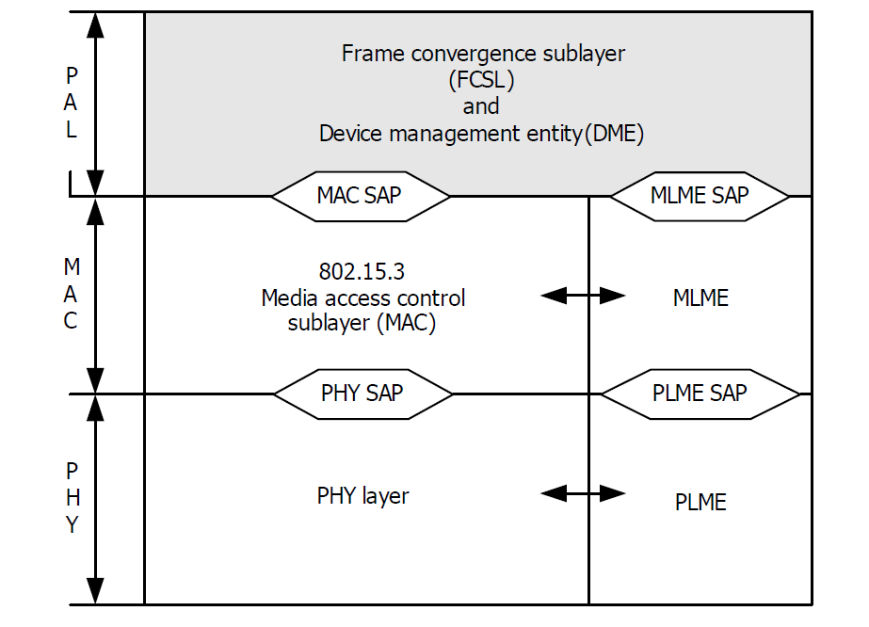

A new MLME primitive
We propose to add a new MLME primitive that indicates the current MCS identifier used in the frame to the upper layer.
HRCP-DEV #1 (PPC)
MLME-MCS.request
Ask the current MCS and frequency channel
HRCP-DEV #2 (non-PPC)
MLME-MCS.confirm
Information of the MCS identifier A
Used frequency channel P and Q
PHY frame( MCS identifier = A
at frequency channel P and Q)

Slide 5
Proposed text
Insert the following subclause, after subclause 5.3.18.
5.3.19 MCS indication to the upper layer
This function is only applicable for HRCP SC PHY. These primitives are used to indicate the current MCS identifier and frequency channel used in the transmitted frame to the upper layer.
5.3.19.1 MLME-MCS.request
This primitive requests reports of MCS identifier to MLME.
The semantics of this primitive are:
MLME-MCS.request (
Timeout
)
The primitive has no parameters.
5.3.19.2 MLME-MCS.confirm
This primitive indicates the MCS identifier and frequency channel where the frame will be transmitted.
The semantics of this primitive are:
MLME-MCS.confirm (
MCSIdentifier
ChIdentifier
ResultCode
)
The primitive parameters are defined in Table 5-27a.

