Slide 1
Project: IEEE P802.15 Working Group for Wireless Personal Area Networks (WPANs)
Submission Title: [Introduction of MAC related proposals]
Date Submitted: [16 May, 2016]
Source: [Li Qiang, Jiang Tong, Dong Chen] Company [Huawei]
Address [Huawei Building, No.3 Xinxi Road, Haidian, Beijing, China]
Voice:[86-15801539749], FAX: [+86-10-82882144], E-Mail:[john.liqiang@huawei.com]
Re: []
Abstract: [In this contribution, we analyze the benefits of joint operation of RF and VLC. The potential standard impacts are further presented.]
Purpose: [Contribution to IEEE 802.15.7r1 Optical Wireless Communication]
Notice: This document has been prepared to assist the IEEE P802.15. It is offered as a basis for discussion and is not binding on the contributing individual(s) or organization(s). The material in this document is subject to change in form and content after further study. The contributor(s) reserve(s) the right to add, amend or withdraw material contained herein.
Release: The contributor acknowledges and accepts that this contribution becomes the property of IEEE and may be made publicly available by P802.15.

Slide 2
Introduction of MAC related proposals
Li Qiang, Jiang Tong, Dong Chen
Huawei

Slide 3
Potential enhancements for 802.15.7-2011
Support for coordinated network
Support for RF+VLC
Support of QoS
Support of dynamic link adaptation
Support of handover
Support of interference coordination
Resolve hidden node issues in the uplink

Slide 4
Supported topologies
RF + VLC

Slide 5
Superframe structure
BP: beacon period
CAP: Contention access period
CFP: Contention free period

Slide 6
Beacon period
For P2P and star topologies, beacon period is just a beacon
For coordinated network
  Neighbor VPANs are time aligned
  Proposal: TDM of beacons from neighboring VPANs to reduce the interference

Slide 7
CAP: contention access period
Uplink hidden node problems: devices can not see each other, so CSMA/CA does not work
Proposal: use RTS and CTS to solve the issue. Introduce RTS CTS frames in the specs

Slide 8
CAP: contention access period
Bandwidth clarification: Devices in a VPAN may have different modulation bandwidth for uplink transmissions. But in CAP, the coordinator does not know which device is transmitting.
Proposals
  Proposal1: inform the coordinator about the requested BW in RTS frames. RTS frame itself is always transmitted in minimal bandwidth. BW used for data transmission is confirmed in CTS
  Proposal2: split the CAP into different regions. Each region is used for TX of one predefined BW
5MHz
10MHz

Slide 9
CFP: contention free period
Proposal: enhance current CFP operations with QoS support. Introduce flow request / flow maintenance / flow termination commands

Slide 10
VPAN establishment
current 15.7, a coordinator need to perform channel scanning first. Then it selects a VPAN ID and then start the VPAN.
Issue: a coordinator may not be able to see neighboring VPANs
Proposal: besides the active scan and passive scan supported in 15.7-2011, scan-over-backhaul is supported. Primitives are need to hand the scan request to the next higher layer.
Scan-over-backhaul request
Scan-over-backhaul response

Slide 11
Association procedures
Issue: for coordinated network, superframe boundaries are aligned. There could be conflicts in beacon transmissions from neighboring VPANs even with TDM of beacons. For example only three beacon slots are assigned in beacon period while there are four neighboring VPANs.
Proposal: if a device can not detect any beacons for a [TBD] ms, it send a “additional beacon request”. The coordinators that received the request allocated a GTS in CFP to transmit an “additional beacon frame” to allow the device to obtain system information.

Slide 12
VPAN ID confliction resolution
Current 15.7: a device report a “VPAN ID conflict notification command” to the associated coordinator if VPAN ID confliction is detected. Then the coordinator performs a channel scan and choose a new VPAN ID.
Issue: the coordinator may not be able to see the neighboring VPANs by scanning
Proposal: the coordinator may send “neighboring VPAN report request command” to its served devices. The devices feedback “neighboring VPAN report response command” to report the VPAN ID of neighbors

Slide 13
CSI feedback
Current 15.7: current specs do not support CSI feedback
Proposal1: link adaptation subfield is imbedded in the MAC header. A device can request another device to feedback CSI by setting “MCS request” to be ‘1’. A recommended MCS level is feedback in the “MCS feedback” field
CSI feedback for bit-loading and MIMO are FFS
Bits: 0 | 1-3 | 4-6 | 7-10
MCS request | MCS sequence index | Feedback sequence index | MCS feedback

Slide 14
Handover
Current 15.7: current specs do not support handover
Proposal1: handover initiated by device
Proposal2: handover initiated by global-controller

Slide 15
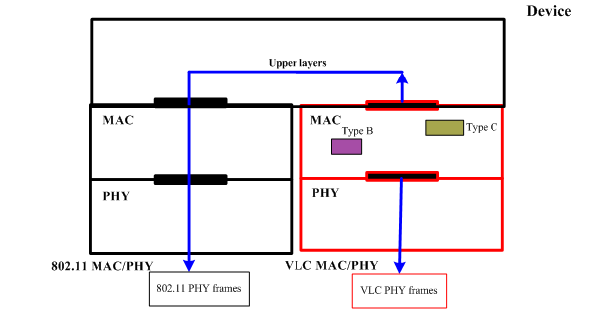
RF DL + VLC UL
Current 15.7: current specs do not support RF DL + VLC UL
Proposal1: specify primitives to hand uplink frames destined for the coordinator (such as association request) to the next higher layer
Using RF link to transmit a uplink command frame
Original procedure for a device to transmit a uplink command frame

Slide 16
Summary
Modifications to current 802.15.7
  Beacon frame: indicate whether RTS/CTS is used; configuration of CAP, CFP etc,
  Introduce reassocaition request/response command (for handover)
  Introduce additional beacon request command (if beacons from neighbor VPANs collide constantly)
  Introduce scan-over-backhaul request / response command
  Introduce neighbor-VPAN status report request / response command
  Introduce flow establishment / maintenance / termination commands
  Introduce RTS/CTS frames
  Related primitives are specified
  Primitives that support RF DL + VLC UL

