Slide 1
Project: IEEE P802.15 Working Group for Wireless Personal Area Networks (WPANs)
Submission Title: [PHY proposal for existing Sub 1-GHz bands in 15.4]
Date Submitted: [15 May, 2016]
Source: [Kunal Shah] Company [Silver Spring Networks]
[] Company []
Address []
Voice: [], E-Mail:[kshah @ silverspringnet.com]
Re: []
Abstract: [PHY proposal to support Sub 1-GHz band]
Purpose: [To be considered in the PHY amendment as part of 802.15.4v]
Notice: This document has been prepared to assist the IEEE P802.15. It is offered as a basis for discussion and is not binding on the contributing individual(s) or organization(s). The material in this document is subject to change in form and content after further study. The contributor(s) reserve(s) the right to add, amend or withdraw material contained herein.
Release: The contributor acknowledges and accepts that this contribution becomes the property of IEEE and may be made publicly available by P802.15.

Slide 2
May 2016
Background
Scope of the project:
“This amendment defines changes to the IEEE Std 802.15.4-2015 PHY clauses enabling the use of the 870-876 MHz & 915-921 MHz bands in Europe, the 902-928 MHz band in Mexico, the 902-907.5 MHz & 915-928 MHz bands in Brazil, the 915-928 MHz band in Australia/ New Zealand and Asian regional frequency bands that are not in IEEE Std 802.15.4-2015. This amendment also changes the channel parameters for the 470-510 MHz band in China and the 863-870 MHz band in Europe for SUN PHYs, and aligns these channel parameters with regional requirements. The amendment includes channel access and/or timing changes to the MAC necessary for conformance to regional requirements
for these bands.”

Slide 3
Purpose and Objective
PHY parameters as specified in 15.4 can not be operational per regional requirements
Specify operational PHY parameters for existing 15.4 regions

Slide 4
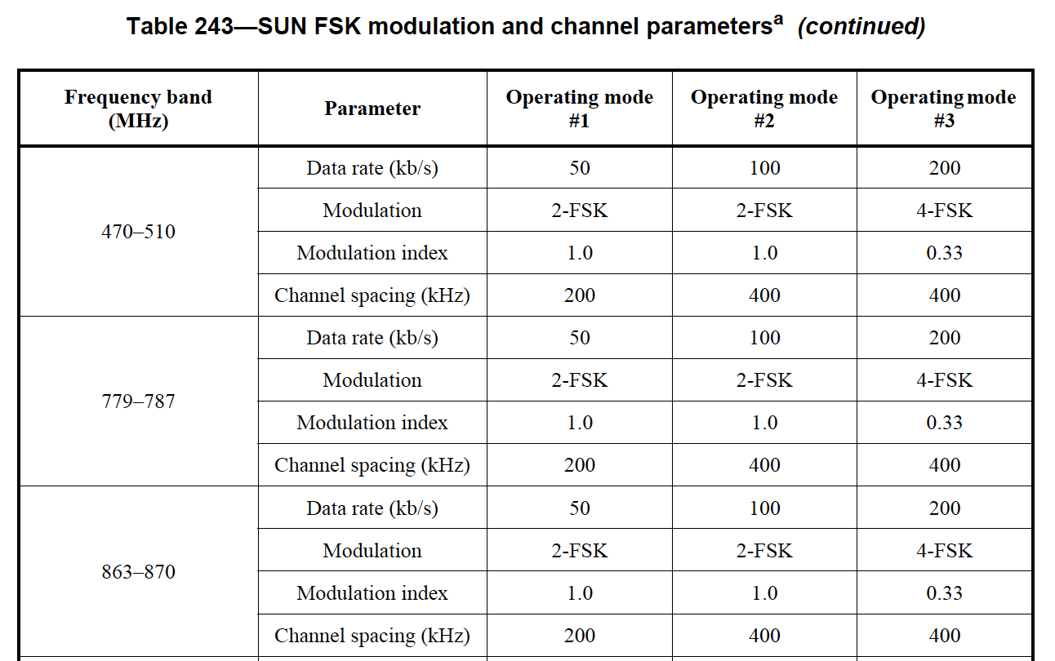
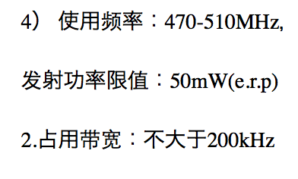
Technical Details (Chinese Band)

Slide 5
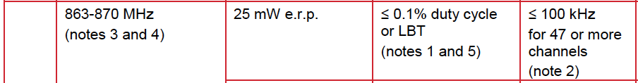
Technical Details (European Band)

Slide 6
Modulation and Channel Parameters (SUN FSK)
Frequency band (MHz) | Parameter | Operating Mode #1 | Operating Mode #2 | Operating Mode #3 | Operating Mode #4
470-510 (China) | Data Rate (kbps) | 50 | 100 | 150 | 100
 | Modulation | 2-FSK | 2-FSK | 2-FSK | 4-FSK
 | Modulation Index | 1.0 | 0.5 | 0.5 | 0.33
 | Channel spacing (kHz) | 200 | 200 | 200 | 200
863 - 870 (Europe) | Data Rate (kbps) | 50 | 100 | 150 | 100
 | Modulation | 2-FSK | 2-FSK | 2-FSK | 4-FSK
 | Modulation Index | 0.5 | 0.5 | 0.5 | 0.33
 | Channel spacing (kHz)* | 100 | 200 | 200 | 200
* Channel spacing requirements per ERC Rec 70-03 [CEPT]

Slide 7
Modulation and Channel Parameters for
Chinese and European band
Modulation | Support for OFDM Option 4 as per sub-clause 21 (SUN OFDM PHY)
SUN OFDM Optional Mode | Data rates supported (kb/s): 50, 100, 150, 200, 300 Channel Spacing (kHz): 200 Nominal bandwidth (kHz): 156
Modulation | Support for SUN O-QPSK
SUN O-QPSK Optional Mode | Rate Mode: 0,1,2,3 Data rates supported (kb/s): 6.25, 12.5, 25, 50 Chip rate (kchip/s): 100

Slide 8
Modulation and Channel Parameters (Contd..)
Summary
  SUN FSK (Mandatory Mode)
    50 kbps (Mandatory data rate)
    100 kbps and 150 kbps (Optional data rate)
  SUN OFDM 4 (Optional Mode)
    50, 100, 150, 200, and 300 kbps (Optional data rates)
  SUN O-QPSK (Optional Mode)
    6.25, 12.5, 25 and 50 kbps
All additional PHY parameters shall be as per existing SUN FSK, SUN OFDM and SUN O-QPSK

Slide 9
Reference
May 2016
IEEE Std. 802.15.4-2015, Part 15.4: Low-Rate Wireless Personal Area Networks (LR-WPANs)
IEEE Std. 802.15.4g-2012, Part 15.4: Low-Rate Wireless Personal Area Networks (LR-WPANs) - Amendment 3: Physical Layer (PHY) Specifications for Low-Data-Rate, Wireless, Smart Metering Utility Networks, March 2012.
  https://standards.ieee.org/findstds/standard/802.15.4g-2012.html
Slide 9
Notes:
doc.: IEEE 802.15-<doc#>
<month year>
<author>, <company>
Page 9

