Slide 1
Project: IEEE P802.15 Working Group for Wireless Personal Area Networks (WPANs)
Submission Title: [TG12 ULI Report for May 2016 Session]
Date Submitted: [15 May 2016]
Source: [Patrick Kinney] Company [Kinney Consulting LLC]
Address [Chicago area, IL, USA]
Voice:[+1.847.960.3715], E-Mail:[pat.kinney@ieee.org]
Re: [TG12 Report for May 2016 Session.]
Abstract: [Report for the May Session]
Purpose: []
Notice: This document has been prepared to assist the IEEE P802.15. It is offered as a basis for discussion and is not binding on the contributing individual(s) or organization(s). The material in this document is subject to change in form and content after further study. The contributor(s) reserve(s) the right to add, amend or withdraw material contained herein.
Release: The contributor acknowledges and accepts that this contribution becomes the property of IEEE and may be made publicly available by P802.15.

Slide 2
TG12 Meeting Goals
Monday, 16 May, PM1
  Opening report, approve agenda
  TG Officer nomination procedure, collection of verbal nominations
  ULI PAR review and presentation(s)
  ULI presentation(s), discussion on schedule, deliverables, and liaisons
Tuesday, 17 May, PM2
    ULI presentation(s), discussion on schedule, deliverables, and liaisons
Wednesday 18 May, AM1:
    Vote on TG officers
    Continued discussion on schedule, deliverables, and liaisons
Wednesday 18 May, PM1:
  Discussion on related standards/Alliances/Consortiums, protocols, etc and possibilities of leveraging them
Thursday 19 May, AM1
  Discuss strategy (i.e. how to best move ahead), agree on next steps
Slide 2
Notes:
May 16
Page 2

Slide 3
Instructions for the WG Chair
The IEEE-SA strongly recommends that at each WG meeting the chair or a designee:
  Show slides #1 through #4 of this presentation
  Advise the WG attendees that:
    The IEEE’s patent policy is described in Clause 6 of the IEEE-SA Standards Board Bylaws;
    Early identification of patent claims which may be essential for the use of standards under development is strongly encouraged;
    There may be Essential Patent Claims of which the IEEE is not aware. Additionally, neither the IEEE, the WG, nor the WG chair can ensure the accuracy or completeness of any assurance or whether any such assurance is, in fact, of a Patent Claim that is essential for the use of the standard under development.
  Instruct the WG Secretary to record in the minutes of the relevant WG meeting:
    That the foregoing information was provided and that slides 1 through 4 (and this slide 0, if applicable) were shown;
    That the chair or designee provided an opportunity for participants to identify patent claim(s)/patent application claim(s) and/or the holder of patent claim(s)/patent application claim(s) of which the participant is personally aware and that may be essential for the use of that standard
    Any responses that were given, specifically the patent claim(s)/patent application claim(s) and/or the holder of the patent claim(s)/patent application claim(s) that were identified (if any) and by whom.
  The WG Chair shall ensure that a request is made to any identified holders of potential essential patent claim(s) to complete and submit a Letter of Assurance.
  It is recommended that the WG chair review the guidance in IEEE-SA Standards Board Operations Manual 6.3.5 and in FAQs 14 and 15 on inclusion of potential Essential Patent Claims by incorporation or by reference.
  Note: WG includes Working Groups, Task Groups, and other standards-developing committees with a PAR approved by the IEEE-SA Standards Board.

Slide 4
Participants, Patents, and Duty to Inform
All participants in this meeting have certain obligations under the IEEE-SA Patent Policy.
  Participants [Note: Quoted text excerpted from IEEE-SA Standards Board Bylaws subclause 6.2]:
    “Shall inform the IEEE (or cause the IEEE to be informed)” of the identity of each “holder of any potential Essential Patent Claims of which they are personally aware” if the claims are owned or controlled by the participant or the entity the participant is from, employed by, or otherwise represents
    “Should inform the IEEE (or cause the IEEE to be informed)” of the identity of “any other holders of potential Essential Patent Claims” (that is, third parties that are not affiliated with the participant, with the participant’s employer, or with anyone else that the participant is from or otherwise represents)
  The above does not apply if the patent claim is already the subject of an Accepted Letter of Assurance that applies to the proposed standard(s) under consideration by this group
  Early identification of holders of potential Essential Patent Claims is strongly encouraged
  No duty to perform a patent search
Slide #1

Slide 5
Patent Related Links
  All participants should be familiar with their obligations under the IEEE-SA Policies & Procedures for standards development.
  Patent Policy is stated in these sources:
  IEEE-SA Standards Boards Bylaws
  http://standards.ieee.org/develop/policies/bylaws/sect6-7.html#6
  IEEE-SA Standards Board Operations Manual
  http://standards.ieee.org/develop/policies/opman/sect6.html#6.3
  Material about the patent policy is available at
  http://standards.ieee.org/about/sasb/patcom/materials.html
If you have questions, contact the IEEE-SA Standards Board Patent Committee Administrator at patcom@ieee.org or visit http://standards.ieee.org/about/sasb/patcom/index.html
This slide set is available at https://development.standards.ieee.org/myproject/Public/mytools/mob/slideset.ppt
Slide #2

Slide 6
Call for Potentially Essential Patents
If anyone in this meeting is personally aware of the holder of any patent claims that are potentially essential to implementation of the proposed standard(s) under consideration by this group and that are not already the subject of an Accepted Letter of Assurance:
  Either speak up now or
  Provide the chair of this group with the identity of the holder(s) of any and all such claims as soon as possible or
  Cause an LOA to be submitted
Slide #3

Slide 7
    Schedule, Deliverables, and Liaisons
Deliverables
Management SAP
  Configuration Management
    Dynamic PHY management
      B Rolfe to provide
    Network
      Set-Up
    MAC
      Set-Up
    PHY
      Set-Up
    Security
      Set-Up
    TSCH set-up
      P Kinney to provide
    Channel Hopping
  Yang Modeling
  L2 Routing
    C Perkins to provide
Data SAP
  Protocol Differentiation
    EtherType
  Security
    KMP (802.15.9)
      ETSI TS102887-2
      802.1x
      Internet Key Exchange (IKE)
      Dragonfly
      PANA
      Vendor specific
  MAC Resource Management
    Priority
    GTS management
  TSCH Operation
    P Kinney to provide
  Fragmentation
    Adaptive
    PHY (PSDU)
    UpperLayer
      KMP
      6LoWPAN
  Location awareness
    Ranging
    B Verso to provide
Liaisons
802.1
802.11
TG4s
WiSUN
Thread
IETF
  6tisch
  6lo
Slide 7
Notes:
May 16
Page 7

Slide 8
    Schedule, Deliverables, and Liaisons
Deliverables
Management SAP
  Configuration Management
    PHY
      Set-Up
        Channel
          Center frequency
          Channel number
          Regional band
        Bandwidth
        Modulation
          Channel page
        Preamble
          Code
          Repetition
        FCS size
        Packet Length
        Data Rate
        Transmit Power level
        Data Whitening
        Common Signalling Mode
        ED Threshold
        Spreading Factor
        DSSS code
        CCA
          Mode
          duration
        FEC?
          Rate
          Coding
          Interleaving
        SFD
          Size
          value
Slide 8
Notes:
May 16
Page 8

Slide 9
    Schedule, Deliverables, and Liaisons
Deliverables
Management SAP
  Configuration Management
    MAC
      Set-Up
        FFD?
        Beacon-enabled?
          DSME?
            Seong-Soon Joo to provide
          Superframe parameters
        Low Energy?
          Parameters
        Channel Hopping?
          parameters
        Association?
          Fast?
        Synchronization
          Superframe
          TSCH
        ACK required?
        Promiscuous mode?
          Ask Packet Sniffer vendors or chipset vendors
        Device Announcement
        UL IEs?
          parameters
Slide 9
Notes:
May 16
Page 9

Slide 10
    Schedule, Deliverables, and Liaisons
Deliverables
Management SAP
  Configuration Management
    Network
      Set-Up
        PAN Coordinator?
          Beacon-enabled?
          Low Energy?
          Association?
            Fast?
            Permit to Join?
              Criteria to accept
          Short Address?
            Assignment
        Channel Scan
Slide 10
Notes:
May 16
Page 10

Slide 11
    Schedule, Deliverables, and Liaisons
Deliverables
Management SAP
  Configuration Management
    6top set-up
    6SF set-up
    TSCH set-up
      TSCH Synchronization IE
      Channel Hopping IE
      TSCH timeslot IE
      TSCH Slotframe and Link IE
      Set Join Metric
      Set macLinkTimekeeping
Slide 11
Notes:
May 16
Page 11

Slide 12
    Schedule, Deliverables, and Liaisons
TASK | Start | Completed
TG12 | May, 2016 | November, 2018
RFP | May, 2016 | July, 2016
Baseline definition | July, 2016 | Sept, 2016
Draft | Sept, 2016 | March, 2017
TG Comment Collection | April, 2017 | May, 2017
WG Letter Ballot | June, 2017 | January, 2018
Sponsor Ballot | January, 2018 | July, 2018
NesCom | July, 2018 | September, 2018
IEEE-SA Publication | September, 2018 | November, 2018
Slide 12
Notes:
May 16
Page 12

Slide 13
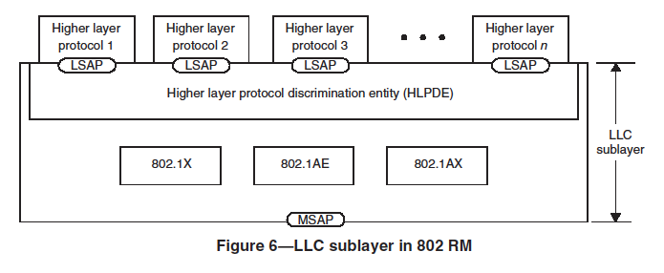
802 LLC SubLayer
Slide 13
Notes:
May 16
Page 13

Slide 14
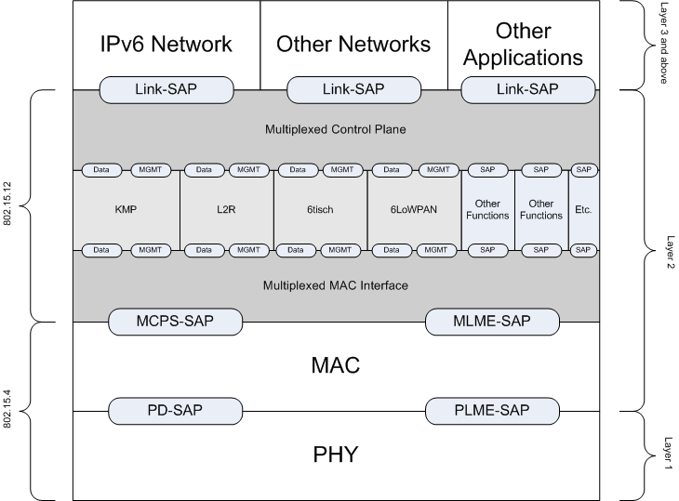
802.15.12 Functional Decomposition
Slide 14
Notes:
May 16
Page 14

Slide 15
Discuss strategy
(i.e. how to best move ahead)
Next Steps:
Define how KMP should work within 15.12
  What does Link SAP look like?
  Define the Multiplexed MAC interface leveraging 15.9
Define how 6LoWPAN should work within 15.12
  Define the Link SAP using IPv6, et al as examples
Define Generic PHY configuration using multiplexed MAC interface
  Defined objects mapped to MLME SAP
Define Generic MAC Configuration using multiplexed MAC Interface
Slide 15
Notes:
May 16
Page 15

Slide 16
TG12 Officers
Chair Pat Kinney
Vice Chair Charlie Perkins
Slide 16
Notes:
May 16
Page 16

Slide 17
Meeting Accomplishments
  Officers affirmed:
    Chair: Pat Kinney
    Vice Chair: Charlie Perkins
  Deliverables
    Definition started
  Schedule
    Generic schedule defined
  Liaisons
    List has been started
  Strategy
    Defined
Slide 17
Notes:
May 16
Page 17

