Slide 1
Project: IEEE P802.15 Working Group for Wireless Personal Area Networks (WPANs)
Submission Title: [Resolution for comment about relaxing regulations]
Date Submitted: [21 Apr 2016]
Source: [Keitarou Kondou]
Company: [Sony Semiconductor Solutions Corporation]
Address¹: [4-14-1 Asahi-cho, Atsugi-shi, Kanagawa 243-0014]
E-Mail¹: [Keitarou.Kondou@jp.sony.com]
Re: [In response to 15-16-0162-04-003e-lb114-consolidated-comments]
Abstract: [This document presents a resolution for comment about relaxing clock accuracy and receiver maximum input level in 15-16-0162-04-003e-lb114-consolidated-comments.]
Purpose: [Resolving the comment #46, #48]
Notice: This document has been prepared to assist the IEEE P802.15. It is offered as a basis for discussion and is not binding on the contributing individual(s) or organization(s). The material in this document is subject to change in form and content after further study. The contributor(s) reserve(s) the right to add, amend or withdraw material contained herein.
Release: The contributors acknowledge and accept that this contribution becomes the property of IEEE and may be made publicly available by P802.15.

Slide 2
Comment #46 and the resolution
CID | Page | Sub-clause | Line # | Comment | Proposed Change
46 | 100 | 11a.2.4.2 |  | Can we relax this spec e.g. up to 30*10^(-6)? | Discuss and change.
Accepted, and Change the spec up to ±30 × 10⁻⁶.
See next page for the reason.

Slide 3
Evaluation
Same channel model and RF parameters are used for simulation as those employed in SC-PHY proposal document 15-15/662r0.
FER and required SNR for the criteria is evaluated as a function of frequency offset.

Slide 4
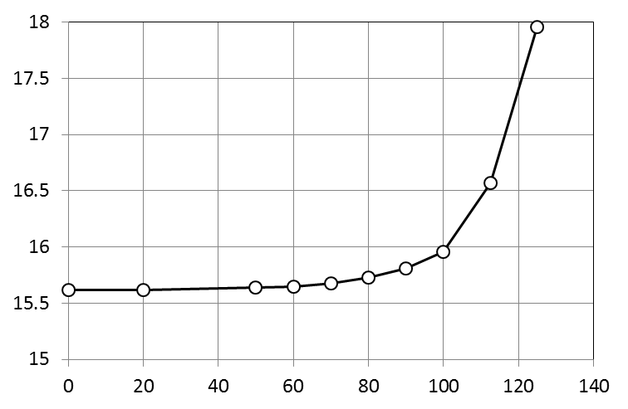
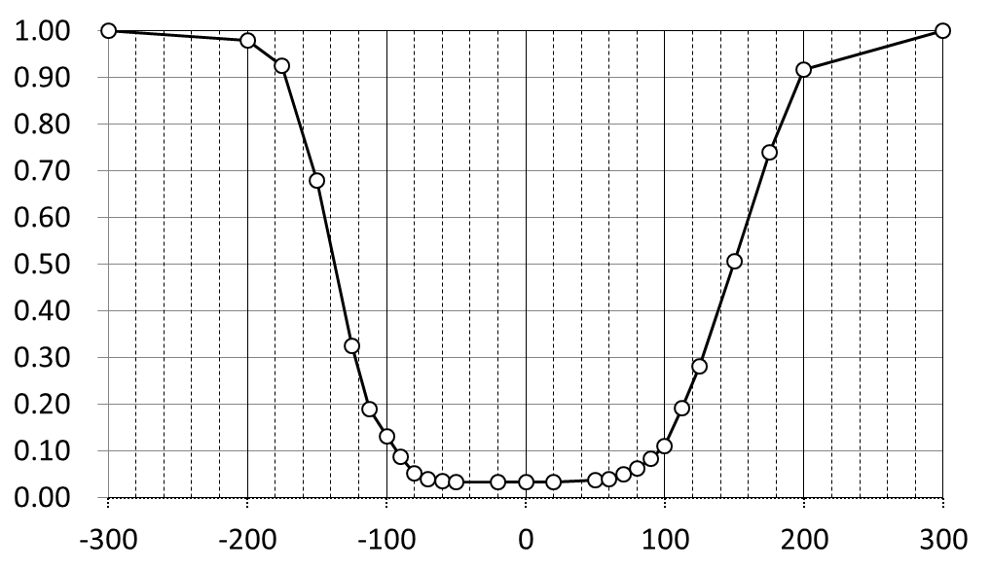
Result
Changing the spec from ±25 × 10⁻⁶ to ±30 × 10⁻⁶ is acceptable, because we still have margin if we have relaxed the spec.
Frame-error rate
±60 ppm
Required SNR (dB)
Frequency offset (ppm)
Frequency offset (ppm)
FER@SNR 15.8 dB as a function of freq. offset
Required SNR for obtaining 8% of FER

Slide 5
Comment #46 and the resolution
CID | Page | Sub-clause | Line # | Comment | Proposed Change
48 | 101 | 11a.2.5.2 |  | Receiver maximum input level should be relaxed. | Specs should be revised considering usage scenario and process potential for advanced CMOS circuit.
Accepted, and Change the receiver maximum input level from −10 dBm to −30 dBm to obtain enough back-off at the receiver. Further, make this restriction for mandatory MCSs only because higher modulation may require more relaxed maximum input power.
See next page for evaluation.

Slide 6
RF Rx Power, P_{RFRx}(x), measurement setup
measurement setup No.1: to determine P_{Rxant} (Rx antenna power)
G_{hornant}
L_{Rx}
SG
adapter
Horn Ant
15dBi
9cm
Horn Ant
15dBi
adapter
SA
x
P_{Rxant}(x)
P_{SA1}(x)
measurement setup No.2: to determine P_{RFRx} (RF Rx power)
G_{Rxant}
SG
adapter
Horn Ant
15dBi
9cm
6dBi
Ant
RF Rx
BB Rx
x
P_{Rxant}(x)
P_{RFRx}(x)
P_{BBRx}(x)
$$eq1:P_{Rxant}(x) =P_{SA1}(x)−(G_{hornant}−L_{Rx})$$
x | SG output power
P_{RxANT}(x) | Rx antenna power(calculated by eq1)
P_{SA1}(x) | SA measured power(measured)
G_{hornant} | Horn Ant. Gain (15dBi**)
L_{Rx} | loss from horn ant to SA (3.7dB*)
G_{Rxant} | Rx ant gain w/ impl. loss (4.1dBi**)
P_{RFRx}(x) | RF Rx Power (calculated by eq2)
P_{BBRx}(x) | BB Rx input power (measured)
$${eq2: P}_{RFRx}\left(x\right)=P_{RxAnt}\left(x\right)−G_{Rxant}$$
*measured by VNA
**from antenna spec
SG freq : 60.508359375GHz

Slide 7
Result
By changing the receiver maximum input level to −30dBm, enough back-off level of 12dB is achieved in the current RF devices.
Psat -7.6dBm
12dB
back-off
BB Rx power (P_{BBRx}) (dBm)
−29.5dBm input
RF Rx Power(P_{RFRx}) (dBm)

Slide 8
END

