Slide 1
Project: IEEE P802.15 Working Group for Wireless Personal Area Networks (WPANs)
Submission Title: [Liaison Report on 802.11 for March 2016]
Date Submitted: [16 March, 2016 ]
Source: [Al Petrick 802.11] Company [Jones-Petrick and Associates]
Address [Orlando, Florida, 32832]
Voice:[321-235-3269], FAX: [], E-Mail:[al@jpasoc.com ]
Re: [Liaison Report on 802.11 for March, 2016]
[If this is a response to a Call for Contributions, cite the name and date of the Call for Contributions to which this document responds, as well as the relevant item number in the Call for Contributions.]
[Note: Contributions that are not responsive to this section of the template, and contributions which do
not address the topic under which they are submitted, may be refused or consigned to the “General Contributions” area.]
Abstract: [Liaison Report on 802.11 for March, 2016.]
Purpose: [Informative]
Notice: This document has been prepared to assist the IEEE P802.15. It is offered as a basis for discussion and is not binding on the contributing individual(s) or organization(s). The material in this document is subject to change in form and content after further study. The contributor(s) reserve(s) the right to add, amend or withdraw material contained herein.
Release: The contributor acknowledges and accepts that this contribution becomes the property of IEEE and may be made publicly available by P802.15.
NOTE: Update all red fields replacing with your information; they are required. This is a manual update in appropriate
fields. All Blue fields are informational and are to be deleted. Black stays. After updating delete this box/paragraph.

Slide 2
802.11 Liaison Report
Macau, China
March 2016

Slide 3
802.11 Task Groups in Comment Resolution
Task Group | Ballot | Draft | Comments | Resolved | Plans | Closing Report
TGai | SB #1 | D6.3 | 760 | ALL | Recirculation | 11-16-0179r0
TGaq | LB216 | D3.0 | 400 | ALL | Issue Recirculation D4.0 March 2016 | 11-16-0462r0
TGaj | LB217 | D1.0 | 240 | 58 remaining | 2nd Recirculation D2.0 May 2016 | 11-16-0473-r0
TGmc | SB Rec #1 Closes 1/26 | D5.0 | ?? | ?? | ?? | ??
TGah | SP#3 | D6.0 |  |  | Comments resolve Recirculation D7.0 March 2016 | 11-16-0463r0
TGak | LB218 | D1.0 | 346 | ALL | Resolved 141 comments May 2016 resolved | 11-16-0478r0

Slide 4
802.11ax (High Efficiency WLAN)
45 technical submissions.
12 PHY submissions
18 MAC Submissions
06 MU Submissions
07 SR submissions
05 submissions addressing TG issues
21 day comment period on draft D0.1 (16/0024r1)
WG Letter Ballot draft D1.0 – July 2016
List of submissions: https://mentor.ieee.org/802.11/dcn/16/11-16-0235-07-00ax-tgax-march-2016-meeting-agenda.pptx
Closing report: 16/0475r0

Slide 5
802.11ay
Enhanced throughput (20Gb/s) above 45 GHz (Millimeter Wave)
28 technical submissions
Channel models, Use-Cases
Specification Framework Document
Closing report: 16/0464r0

Slide 6
802.11az (Next Generation Positioning)
High Rate PHY 2.4 GHz, 5 GHz, 60 GHz
Approved a working Functional Requirements Document
Approved Specification Framework Document template
Updated use cases
Plans for May
Updated channel models
Reviewed technical approaches
Closing report: 16/479r0

Slide 7
LRLP - TIG (Long Range Low Power)
9 Technical presentations
Low power wake-up receiver
Packet identity considerations
Range and power requirements for indoor use-cases
Updated LRLP report to WG
Extend TIG through the next plenary
Gain consensus on scope, differentiators and technical approaches
Closing report: 16-0467r0

Slide 8
IEEE 802.11 JTC1 SC
Reviewed status of PSDO pipeline
IEEE 802 has pushed 18 standards completely through the PSDO ratification process
IEEE 802 has 11 standards pending
SC6 meeting in March 2016
IEEE 802 do did not attend!!
A new SG on Low Power Wide Area Networking was created
Next SC6 meeting planned early 2017 in Tunisia
Closing report: 16/0481r0

Slide 9
802.11WNG (Wireless Next Generation
Presentations – March 2016
“LiFi – Use of visible light communications for 802.11”, Nikola Serafimovski (PureLiFi)
https://mentor.ieee.org/802.11/dcn/16/11-16-0436-00-0wng-lifi-concept-use-cases-and-progress.pptx
“802.11 and LWA: Perspectives from 3GPP” – Richard Burbridge (3GPP RAN2 chair), Sasha Sirotkin (LWA WI Rapporteur), and Philippe Reininger (3GPP RAN3 chair)
https://mentor.ieee.org/802.11/dcn/16/11-16-0351-01-0000-liaison-from-3gpp-on-lwa-and-lwip.pptx
Closing report 16/0474r0

Slide 10
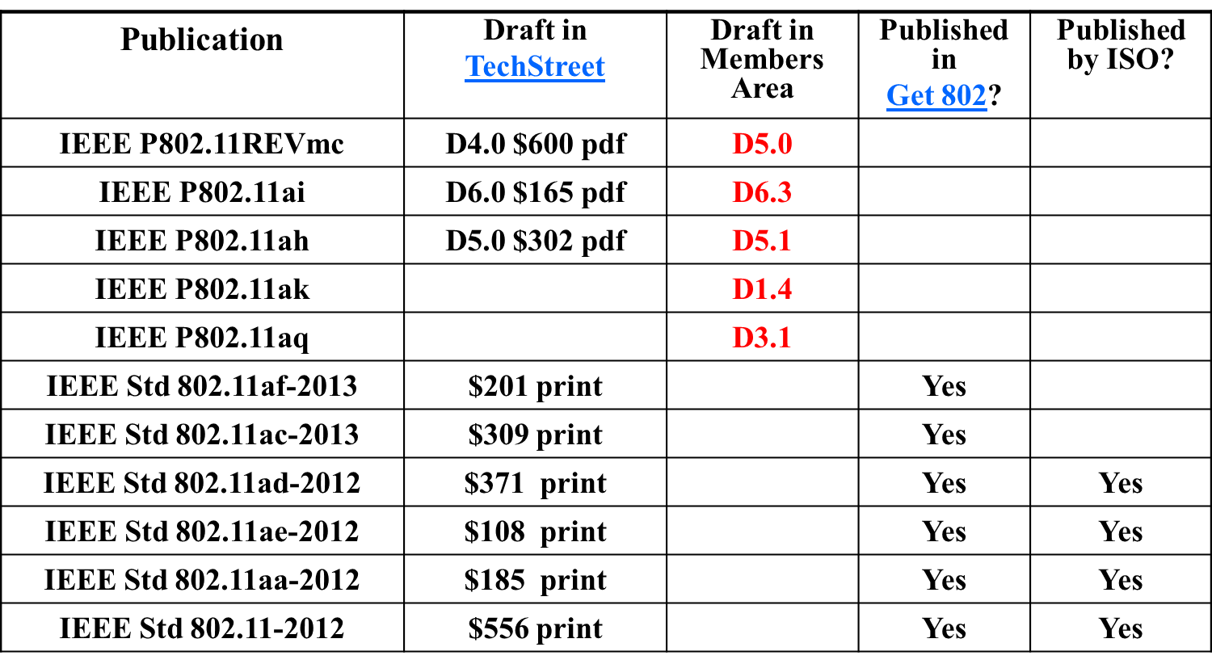
Available 802.11 - Drafts

Slide 11
Questions???

