Slide 1
Project: IEEE P802.15 Working Group for Wireless Personal Area Networks (WPANs)
Submission Title: [Resolution on comments #9, #13, #23, #33 and #34 for MAC selection]
Date Submitted: [14 March 2016]
Source: [Keiji Akiyama and Keitarou Kondou]
Company: [Sony Corporation]
Address: [1-7-1 Konan, Minato-ku, Tokyo 108-0075]
E-Mail: [Keiji.Akiyama at jp.sony.com, Keitarou.Kondou at jp.sony.com]
Re: [In response to 15-16-0162-01-003e-lb114-consolidated-comments]
Abstract: [This document presents a resolution on comments #9, #13, #23, #33 and #34 for MAC part in 15-16-0162-01-003e-lb114-consolidated-comments.]
Purpose: [Resolving the comments #9, #13, #23, #33 and #34]
Notice: This document has been prepared to assist the IEEE P802.15. It is offered as a basis for discussion and is not binding on the contributing individual(s) or organization(s). The material in this document is subject to change in form and content after further study. The contributor(s) reserve(s) the right to add, amend or withdraw material contained herein.
Release: The contributors acknowledge and accept that this contribution becomes the property of IEEE and may be made publicly available by P802.15.

Slide 2
CID9
CID | Comment | Proposed Change | E/T | Must Be Satisfied? (enter Yes or No) | Resolution Status
9 | Define method to send MCS info to the upper layer | Confirm why MLME channel status request has disappeared (6.3.18) | T | Yes | Accepted
In 802.15.3b, MLME-Channel-Status had removed.
  In slide 3
Why removed?
  Searching Mentor…
  05/0074r0 presents that MLME-Channel-Status removed in DF8 by following reason (In slide 4)
  I could not find any comment being the origin of above modification.

Slide 3
802.15.3 MLME
802.15.3 |  | 802.15.3b |  | 802.15.3c |  | Rollup
MLME-RESET |  | MLME-RESET |  | MLME-RESET |  | MLME-RESET
MLME-SCAN |  | MLME-SCAN |  | MLME-SCAN |  | MLME-SCAN
MLME-START |  | MLME-START |  | MLME-START |  | MLME-START
MLME-START-DEPENDENT |  | MLME-STOP |  | MLME-STOP |  | MLME-STOP
MLME-SYNCH |  | MLME-ASSOCIATE |  | MLME-ASSOCIATE |  | MLME-ASSOCIATE
MLME-ATP-EXPIRED |  | MLME-DISASSOCIATE |  | MLME-DISASSOCIATE |  | MLME-DISASSOCIATE
MLME-ASSOCIATE |  | MLME-MEMBERSHIP-UPDATE |  | MLME-MEMBERSHIP-UPDATE |  | MLME-MEMBERSHIP-UPDATE
MLME-DEV-ASSOCIATION-INFO |  | MLME-SECURITY-ERROR |  | MLME-SECURITY-ERROR |  | MLME-SECURITY-ERROR
MLME-DISASSOCIATE |  | MLME-SECURITY-MESSAGE |  | MLME-SECURITY-MESSAGE |  | MLME-SECURITY-MESSAGE
MLME-REQUEST-KEY |  | MLME-PNC-HANDOVER |  | MLME-PNC-HANDOVER |  | MLME-PNC-HANDOVER
MLME-DISTRIBUTE-KEY |  | MLME-NEW-PNC |  | MLME-NEW-PNC |  | MLME-NEW-PNC
MLME-MEMBERSHIP-UPDATE |  | MLME-DEV-INFO |  | MLME-DEV-INFO |  | MLME-DEV-INFO
MLME-SECURITY-ERROR |  | MLME-SECURITY-INFO |  | MLME-SECURITY-INFO |  | MLME-SECURITY-INFO
MLME-SECURITY-MESSAGE |  | MLME-APPLICATION-SPECIFIC |  | MLME-APPLICATION-SPECIFIC |  | MLME-APPLICATION-SPECIFIC
MLME-PNC-HANDOVER |  | MLME-ANNOUNCE-SERVICE |  | MLME-ANNOUNCE-SERVICE |  | MLME-ANNOUNCE-SERVICE
MLME-NEW-PNC |  | MLME-PICONET-SERVICES |  | MLME-PICONET-SERVICES |  | MLME-PICONET-SERVICES
MLME-PNC-INFO |  | MLME-CREATE-STREAM |  | MLME-CREATE-STREAM |  | MLME-CREATE-STREAM
MLME-SECURITY-INFO |  | MLME-MODIFY-STREAM |  | MLME-MODIFY-STREAM |  | MLME-MODIFY-STREAM
MLME-CREATE-ASIE |  | MLME-TERMINATE-STREAM |  | MLME-TERMINATE-STREAM |  | MLME-TERMINATE-STREAM
MLME-RECEIVE-ASIE |  | MLME-BSID-CHANGE |  | MLME-BSID-CHANGE |  | MLME-BSID-CHANGE
MLME-PROBE |  | MLME-PICONET-PARM-CHANGE |  | MLME-PICONET-PARM-CHANGE |  | MLME-PICONET-PARM-CHANGE
MLME-ANNOUNCE |  | MLME-PS-SET-INFORMATION |  | MLME-PS-SET-INFORMATION |  | MLME-PS-SET-INFORMATION
MLME-PICONET-SERVICES |  | MLME-SPS-CONFIGURE |  | MLME-SPS-CONFIGURE |  | MLME-SPS-CONFIGURE
MLME-CREATE-STREAM |  | MLME-PM-MODE-CHANGE |  | MLME-PM-MODE-CHANGE |  | MLME-PM-MODE-CHANGE
MLME-MODIFY-STREAM |  | MLME-MONITOR-PM-MODE |  | MLME-MONITOR-PM-MODE |  | MLME-MONITOR-PM-MODE
MLME-TERMINATE-STREAM |  | MLME-MULTICAST-CONFIGURATION |  | MLME-MULTICAST-CONFIGURATION |  | MLME-MULTICAST-CONFIGURATION
MLME-MULTICAST-RX-SETUP |  | MLME-MULTICAST-RX-SETUP |  | MLME-MULTICAST-RX-SETUP |  | MLME-MULTICAST-RX-SETUP
MLME-CHANNEL-STATUS |  | MLME-BEACON-EVENT |  | MLME-BEACON-EVENT |  | MLME-BEACON-EVENT
MLME-REMOTE-SCAN |  |  |  | MLME-TXDIV |  | MLME-TXDIV
MLME-PICONET-PARM-CHANGE
MLME-TX-POWER-CHANGE |  |  |  |  |  | Remained
MLME-PS-SET-INFORMATION |  |  |  |  |  | Disappeared in next Rev.
MLME-SPS-CONFIGURE |  |  |  |  |  | Newly added in current Rev.
MLME-PM-MODE-CHANGE
MLME-PM-MODE-ACTIVE

Slide 4
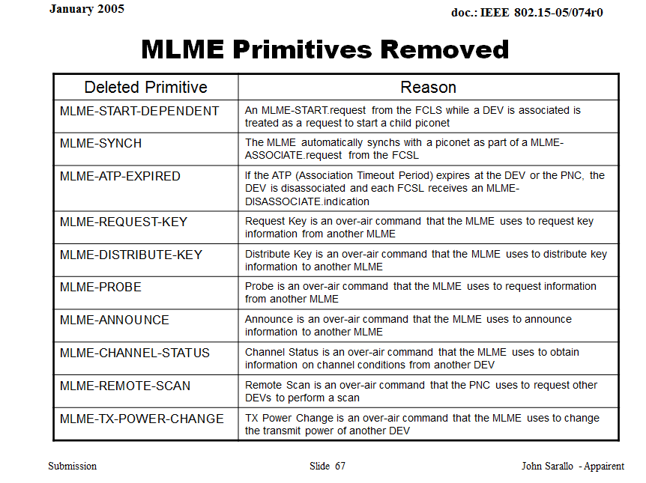

Slide 5
Next Action
Create more MLME primitives?
Prepare for new command?

Slide 6
CID13
CID | Comment | Proposed Change | E/T | Must Be Satisfied? (enter Yes or No) | Resolution Status
13 | Beacon and Unassociated Phase should use mandatory MCS | As commented | T | Yes | Accepted
Proposed text
  Insert following text in section 7.3a.1, Page 56, after Line 26.
  “All beacon and command frames that sent in unassociated phase described in Figure 4-2a shall use mandatory MCSs defined in section 11a.”

Slide 7
CID23
CID | Comment | Proposed Change | E/T | Must Be Satisfied? (enter Yes or No) | Resolution Status
23 | It is desirable to add description such as "HRCP Pair Capability shall be included in IEs field of Association Response command". | Add the description "HRCP Pair Capability shall be included in IEs field of Association Response command" or equivalent. | T | Yes | Accepted
This comment shall be rejected: proposed change is already included in current draft..
6.4.11c HRCP Pair Capability IE
  The HRCP Pair Capability IE Content field shall be formatted as illustrated in Figure 6-88k. The HRCP Pair Capability IE shall be included in each Association Response command frame. This capability indicates the communication parameter to be used in the current session that was decided by the PPC to satisfy both PPC and DEV capabilities.

Slide 8
CID33
CID | Comment | Proposed Change | E/T | Must Be Satisfied? (enter Yes or No) | Resolution Status | Resolution Detail
33 | Isn't a mechanism to select the logical channel for the higher layer needed (embedded in the frame format) to deliver data properly to the higher layer? | Consider whether such a mechanism is required. | T | Yes | Accepted | Add new text describing logical channel mechanism
Add new 1 bit for MAC header to distinguish the logical channel. Modify Figure 6-6a, Page.31, Line 7.
Add 1 parameter to indicate the logical channel in MAC-HRCP-DATA primitives.
  Changes will also included in resolution of CID32.

Slide 9
CID33(cont’d)
Modifed Figure 6-6a, Page 31, Line 7
Bits: b0-b2 | b3-b5 | b6 | b7-b8 | b9 | b10-b15
Protocol Version | Frame Type | SEC | ACK Policy | Logical Channel | Reserved
Figure 6-6a—Frame control field format for HRCP
Insert the following section after 6.2.1.4a, Page 32 , Line 12
6.2.1.8 Logical Channel
Logical Channel is available for use by the Higher Layer Protocol User and therefore out of scope from this specification. The value of this field set to 0 for CH0 of Logical Channel, otherwise 1. All MSDUs in the MAC frame shall send in same Logical Channel.

Slide 10
CID34
CID | Comment | Proposed Change | E/T | Must Be Satisfied? (enter Yes or No) | Resolution Status | Resolution Detail
34 | What is the "Unique ID"? This sentence refers to 6.4.7 but the subclause 6.4.7 which exists in the baseline (roll-up) version doesn't mention unique ID. | Define "Unique ID" in 6.4.7 | T | Yes | Revised | Change "Unique ID" to the proper term. Check with James Gilb.
I had check with TG3m chair, James Gilb. His answer was as follows;
  “In the current revision draft, the field name was changed to "Unique ID"due to a comment from the IEEE Standards Association RegistrationAuthority Committee (IEEE SA RAC). My comment was that the amendment should match the revision.”
In current revision of rollup (802.15.3RevA-D02CMP.pdf), there is right description about Unique ID in section 6.4.7.
Therefore, 3e draft should refer the relevant section of rollup. No change is required in current 3e draft.
This comment should be rejected.

Slide 11
Summary
Resolutions are provided for comments #13, #23, #33 and #34
The comment #9 regarding MLME-Channel-Status is remained for further discussion.

Slide 12
END

