Slide 1
Project: IEEE P802.15 Working Group for Wireless Personal Area Networks (WPANs)
Submission Title: [Resolution on comment #20,22 and 30]
Date Submitted: [16 March 2016]
Source: [Itaru Maekawa] Company [Japan Radio Co.,Ltd.]
Address [Mitaka, Tokyo, Japan]
Voice: [+81.422.45.9228], E-Mail: [Maekawa.Itaru@jrc.co.jp]
Re: [In response to 15-16-0162-01-003e-lb114-consolidated-comments]
Abstract: [This document presents a resolution on comment #20,22 and 30 in 15-16-0162-01-003e-lb114-consolidated-comments.]
Purpose: [Resolving the comment #22,24 and 30]
Notice: This document has been prepared to assist the IEEE P802.15. It is offered as a basis for discussion and is not binding on the contributing individual(s) or organization(s). The material in this document is subject to change in form and content after further study. The contributor(s) reserve(s) the right to add, amend or withdraw material contained herein.
Release: The contributor acknowledges and accepts that this contribution becomes the property of IEEE and may be made publicly available by P802.15.

Slide 2
Comment and the resolution
Comment #22
Page | Sub-clause | Line # |  | Proposed Change
42 | 6.4.11a | 4 | How does the LLPS mode work when the LLPS Capable flag is set in a) PPC Capability IE or b) DEV Capability IE? | Add detail description to enable LLPC mode.

Slide 3
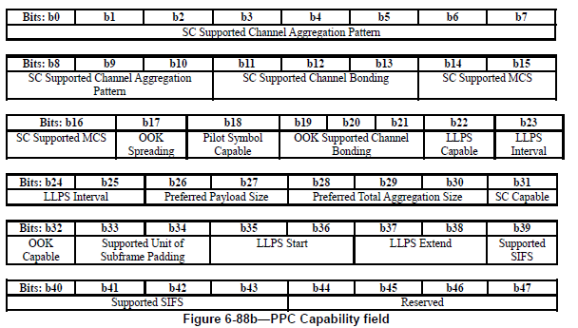
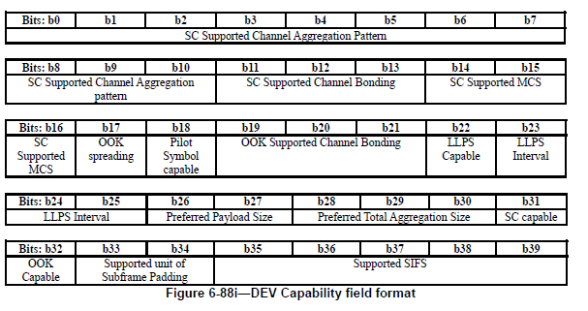
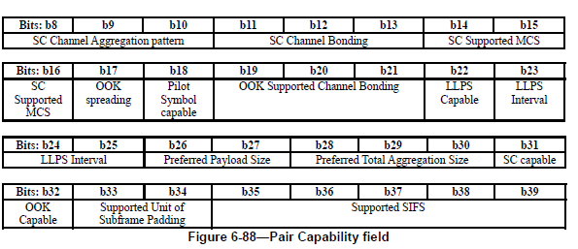
Capability field in D01
Figure 6-88b—PPC Capability field
-It is not clear in D01, who decides LLPS parameters.
-LLPS Parameters should be specified by Coordinator because coordinator know higher layer application.

Slide 4
Figure 6-88b—PPC Capability field
Resolution
Accept the comment and change the text and Figure as follows
-6-88b(PPC Capability): Re-order capability field alignment.
-6-88i(DEV Capability): Use common definition with 6-88b then change LLPS parameters fields to “reserved”
-6-88(Pair Capability): Use common definition with 6-88b.
-P44
-P47 :Delete following sentences
-P48 :Add following sentences

Slide 5
Comment and the resolution
Comment #24
Page | Sub-clause | Line # |  | Proposed Change
64 | 7.14a | 16 | Is it possible to issue a sleep request from either PPC or DEV? | Make clear the start condition and definition of the HRCP DEV.

Slide 6
Figure 6-88b—PPC Capability field
Resolution
Accept the comment and revice the text as follows

Slide 7
Comment and the resolution
Comment #30
Page | Sub-clause | Line # |  | Proposed Change
61 | 7.8.3 | 9 | It appears redundant to send empty data frames to adjust the subframe number and subframe length. There should be a better way to do this. | Clarify meaning.
Resolution
1)Delete paragraph.
2)In Fig 7-54a and 7-54b, Change "More fragment flag is set to 1 to indicate the corresponding subframe is not a final frame of fragmentation." to "Last fragment flag is set to 1 to indicate the corresponding subframe is a final frame of fragmentation."
Change "More fragment" to "Last fragment" in all other appropriate locations in the draft. (in 6.3.4a.1 as well)
3)Add new text to explain the size requirement for each subframe. A MPDU which is not a last fragment of an original MSDU, shall have a payload with the length of the Preferred Payload Size.

Slide 8
Resolution #1
-Delete paragraph on P61 ,line 9-12
“To avoid buffer overflow, before starting real data transmission, the originating and target DEV may exchange empty data frame with the preferred total aggregation size properly configured as defined in 6.4.11 to inform each other the available receiving buffer size. This information is used by the DEVs to adjust the subframe number and subframe length when sending real data.”

Slide 9
Resolution #2
-Change “More Fragment” to “Last Fragment” on Page 61 line 7 to 8.
-Change as follows on Page 39

Slide 10
Resolution #3
MSDU#3
MSDU#2
MSDU#1
Fragmentation
Fragmentation
Payload#5
(Fragment#2)
Payload#4
(Fragment#1)
Payload#3
(Fragment#2)
Payload#2
(Fragment#1)
Payload#1
MAC Header
Last fragment=1
FCS
Payload#1
HCS
MAC
Subheader#1
Last fragment flag is set to 1 to indicate the corresponding subframe is a final frame of fragmentation.
Last fragment=0
Subframe#1
FCS
Payload#2
HCS
MAC
Subheader#2
Last fragment=1
Subframe#2
FCS
Payload#3
HCS
MAC
Subheader#3
Payload# and Payload length are shown in Sub Header
Last fragment=0
Subframe#3
FCS
Payload#4
HCS
MAC
Subheader#4
Number of subframes and Ack information are shown in MAC Header
Subframe#4
Subframe
#n
Subframe
#4
Subframe
#3
Subframe
#2
Subframe
#1
HCS
MAC Header
PHY Header
m+n
m+4
m+3
m+2
m+1
Sequence Number

Slide 11
MSDU#3
MSDU#2
MSDU#1
Defragmentation
Defragmentation
Payload#5
(Fragment#2)
Payload#4
(Fragment#1)
Payload#3
(Fragment#2)
Payload#2
(Fragment#1)
Payload#1
MAC Header
Last fragment=1
FCS
Payload#1
HCS
MAC
Subheader#1
Last fragment flag is set to 1 to indicate the corresponding subframe is a final frame of fragmentation.
Last fragment=0
Subframe#1
FCS
Payload#2
HCS
MAC
Subheader#2
Last fragment=1
Subframe#2
FCS
Payload#3
HCS
MAC
Subheader#3
Payload# and Payload length are shown in Sub Header
Last fragment=0
Subframe#3
FCS
Payload#4
HCS
MAC
Subheader#4
Number of subframes and Ack information are shown in MAC Header
Subframe#4
Subframe
#n
Subframe
#4
Subframe
#3
Subframe
#2
Subframe
#1
HCS
MAC Header
PHY Header
m+n
m+4
m+3
m+2
m+1
Sequence Number

Slide 12
Resolution #3
-Add following sentence on Page 60.

