Slide 1
Project: IEEE P802.15 Working Group for Wireless Personal Area Networks (WPANs)
Submission Title: Issues to add new PHYs to existing 15.7 standard
Date Submitted: Mar. 16, 2016
Source: Soo-Young Chang (SYCA) and Jaesang Cha (SNUST)
Company: SYCA and SNUST
Address:
Voice: 530 574 2741 FAX: E-Mail: sychang@ecs.csus.edu
Re: CFP of 15.7r1
Abstract: Some issues to add new PHYs to the existing 15.7 standard
Purpose: to suggest some critical issues to add new PHYs to the existing 15.7 standard
Notice: This document has been prepared to assist the IEEE P802.15. It is offered as a basis for discussion and is not binding on the contributing individual(s) or organization(s). The material in this document is subject to change in form and content after further study. The contributor(s) reserve(s) the right to add, amend or withdraw material contained herein.
Release: The contributor acknowledges and accepts that this contribution becomes the property of IEEE and may be made publicly available by P802.15.
Slide 1

Slide 2
INTRODUCTION
To investigate whether there are any critical issues to add new PHYs to the Existing 15.7 standard.
  The existing 15.7 was reviewed.
  Some critical issues are found, which should be discussed before preparing draft texts for added PHYs in this group.

Slide 3
PHY LAYER OF EXISTING 15.7
4.4.1 PHY layer
The PHY layer supports multiple PHY types.
a) PHY I: This PHY type is intended for outdoor usage with low data rate applications. This mode uses on-off keying (OOK) and variable pulse position modulation (VPPM) with data rates in the tens to hundreds of kb/s, as defined in Table 73.
b) PHY II: This PHY type is intended for indoor usage with moderate data rate applications. This mode uses OOK and VPPM with data rates in the tens of Mb/s, as defined in Table 74.
c) PHY III: This PHY type is intended for applications using color shift keying (CSK) that have multiple light sources and detectors. This mode uses CSK with data rates in the tens of Mb/s, as defined in Table 75.

Slide 4
MANDATORY OPERATING MODES FROM EXISITING 15.7
8.2 Operating modes
A compliant IEEE 802.15.7 PHY shall implement at least one of the PHY I or PHY II mandatory modes (as defined in 10 and 11) given in Table 73 and Table 74. A device implementing the PHY III mode in Table 75 shall also implement PHY II mode for co-existence as summarized in 4.4.1.2.
→ Existing PHY I and PHY II are mandatory while other PHYs are all optional?
→ needs to be discussed

Slide 5
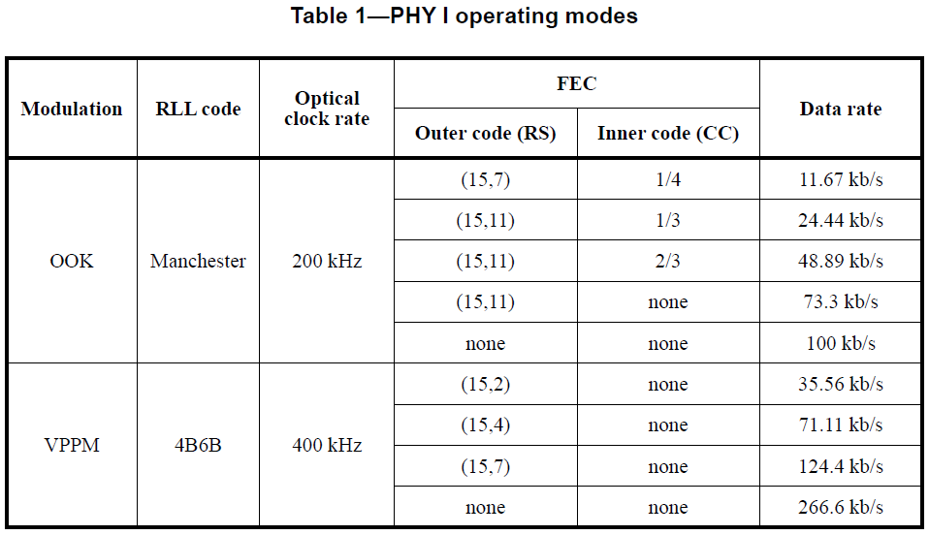
PHY I: MANDATORY OPERATING MODE
10. PHY I specifications
PHY I is targeted towards applications requiring low data rates as shown in Table 73. For PHY I, the PHY header shall be sent at 11.67 kb/s if the 200 kHz optical clock rate is selected or at 35.56 kb/s if the 400 kHz optical clock rate is selected. Support for 11.67 kb/s at 200 kHz optical clock is mandatory.

Slide 6
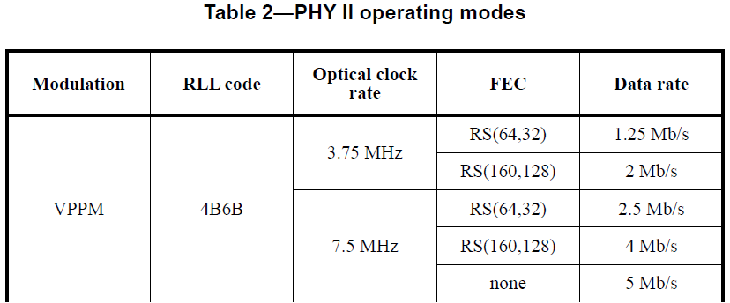
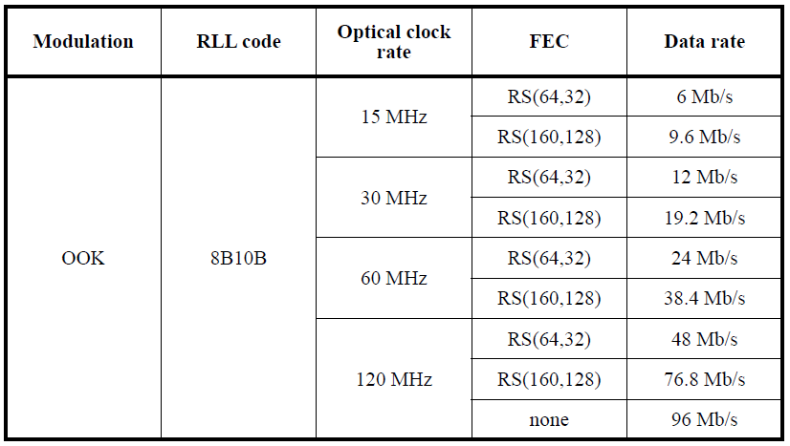
PHY II: MANDATORY OPERATING MODE
11. PHY II specifications
PHY II is targeted towards applications requiring high data rates, as shown in Table 74. For PHY II, the PHY header shall be sent at one of the following data rates: 1.25 Mb/s, 2.5 Mb/s, 6 Mb/s, 12 Mb/s, 24 Mb/s or 48 Mb/s, depending on the selected optical clock rate. Support for 1.25 Mb/s at an optical clock of 3.75 MHz is mandatory.

Slide 7
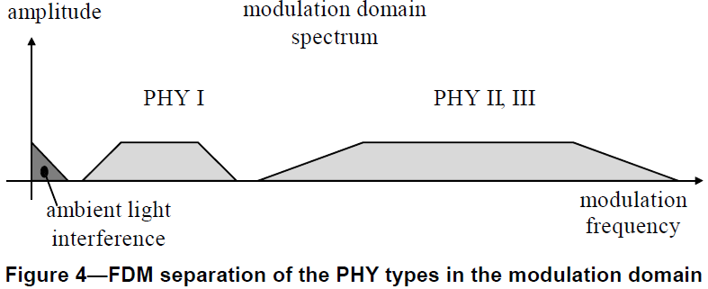
WAVELENGTH BAND PLAN (1)
4.4.1.2 Interoperability and co-existence between PHY types
The PHY types co-exist but do not interoperate. PHY I and PHY II occupy different spectral regions in the modulation domain spectrum, which enables frequency division multiplexing (FDM) as a co-existence mechanism, as shown in Figure 4.

Slide 8
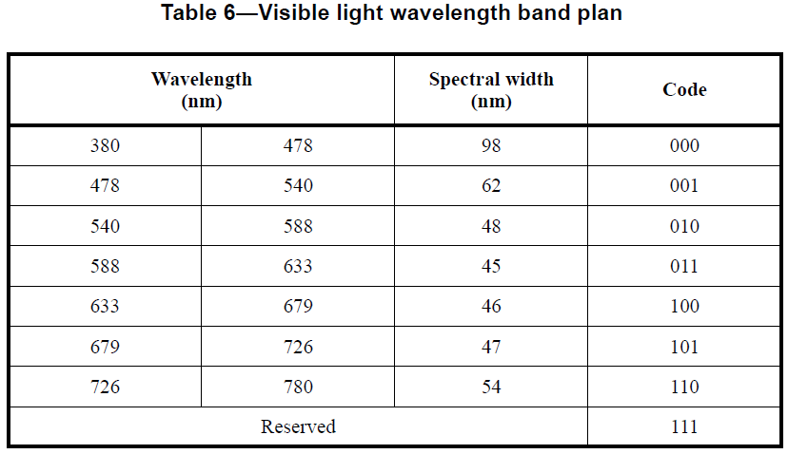
WAVELENGTH BAND PLAN (2)
8.3.1 Wavelength band plan
A compliant device shall operate with peak radiated energy within the visible light spectrum defined as being from 380 nm to 780 nm. A compliant device shall operate in one or several visible light frequency bands as summarized in Table 6.
The codes in Table 6 are used to indicate the wavelengths containing the spectral peak for the transmitted frame and are indicated in the PHY header. This information may be used by the receiver for optimizing its performance.

Slide 9
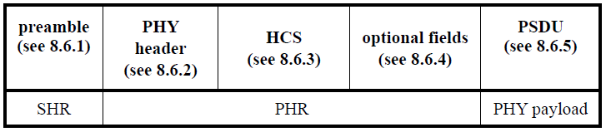
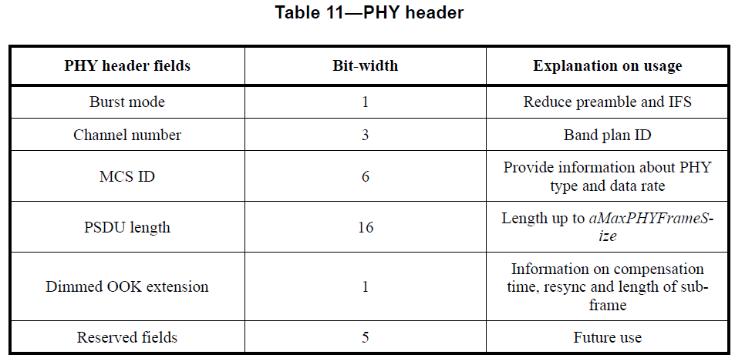
PHY HEADER
Figure 8—Format of the PPDU

Slide 10
ISSUES TO BE CONSIDERED FOR NEW PHYS
PHY I and PHY II are mandatory while other new PHYs are optional?
  PHY 1: outdoor usage with low rate
  PHY 2: indoor usage with moderate rate
  → Need to check whether each proposal can be realized with none of the above existing PHYs.
The 15.7r1 group needs to modify the existing 15.7 for all PHYs to be mandatory?
  For all new PHYs to be operated independantly without having any mandatory existing PHYs.
  For all requirements from 15.7r1 TCD to be satisfied.

