Slide 1
Project: IEEE P802.15 Working Group for Wireless Personal Area Networks (WPANs)
Submission Title: [Resolution on comment #11 for preamble selection]
Date Submitted: [14 March 2016]
Source: [Keitarou Kondou]
Company: [Sony Corporation]
Address¹: [1-7-1 Konan, Minato-ku, Tokyo 108-0075]
E-Mail¹: [Keitarou.Kondou@jp.sony.com]
Re: [In response to 15-16-0162-01-003e-lb114-consolidated-comments]
Abstract: [This document presents a resolution on comment #11 for MIMO preamble in 15-16-0162-01-003e-lb114-consolidated-comments.]
Purpose: [Resolving the comment #11]
Notice: This document has been prepared to assist the IEEE P802.15. It is offered as a basis for discussion and is not binding on the contributing individual(s) or organization(s). The material in this document is subject to change in form and content after further study. The contributor(s) reserve(s) the right to add, amend or withdraw material contained herein.
Release: The contributors acknowledge and accept that this contribution becomes the property of IEEE and may be made publicly available by P802.15.

Slide 2
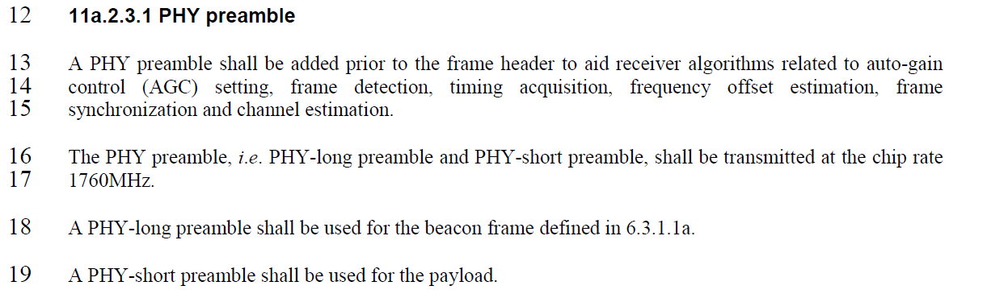
Comment and the current draft (D01)
Comment #11
Page | Sub-clause | Line # | Comment | Proposed Change | Resolution Detail
93 | 11a.2.3.1 | 19 | Use of preamble, payload, and command frame are confusing | Delete "a PHY short preamble shall be used for the payload" | Change as proposed and explain how to choose preamble type.
Current draft description

Slide 3
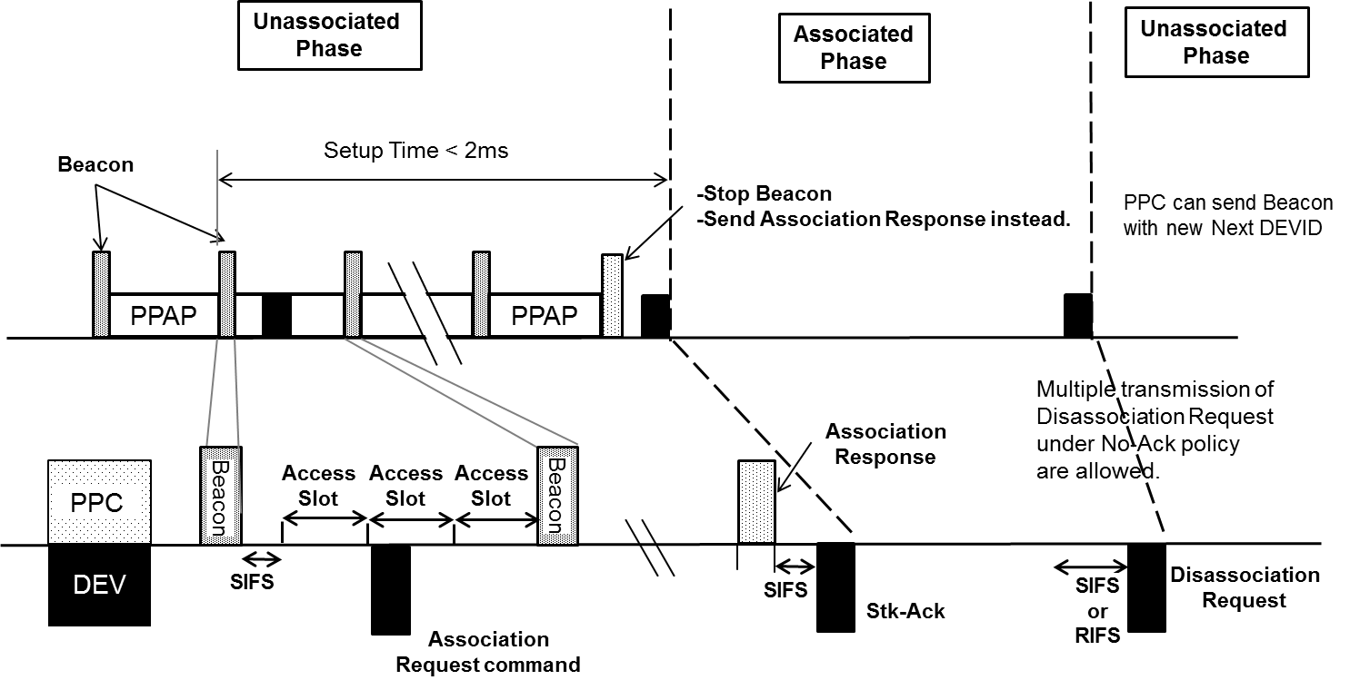
Resolution
Accept the comment and change the text to
“A PHY-long preamble shall be used during Unassociated Phase and a PHY-short preamble shall be used in Associated Phase.”
Figure 4-2a – One cycle of PPAP

Slide 4
END

