Slide 1
doc.: IEEE 15-16-0229-01-007a
Project: IEEE P802.15 Working Group for Wireless Personal Area Networks (WPANs)
Submission Title: China Telecom PHY proposal for PAPM and MPPM
Date Submitted: March 2016
Source: Yu Zeng [China Telecom]
Contact: +86-10-50902080 E-Mail: zengyu@ctbri.com.cn
Re:
Abstract: This is a PHY proposal for using unified PAPM.
Purpose: Call for Proposal Response
Notice: This document has been prepared to assist the IEEE P802.15. It is offered as a basis for discussion and is not binding on the contributing individual(s) or organization(s). The material in this document is subject to change in form and content after further study. The contributor(s) reserve(s) the right to add, amend or withdraw material contained herein.
Release: The contributor acknowledges and accepts that this contribution becomes the property of IEEE and may be made publicly available by P802.15.
Submission

Slide 2
doc.: IEEE 15-16-0229-01-007a
Content
Current 802.15.7 PHY specs
Proposed Modulation Schemes
  M-n-PAPM
Conclusion
Submission

Slide 3
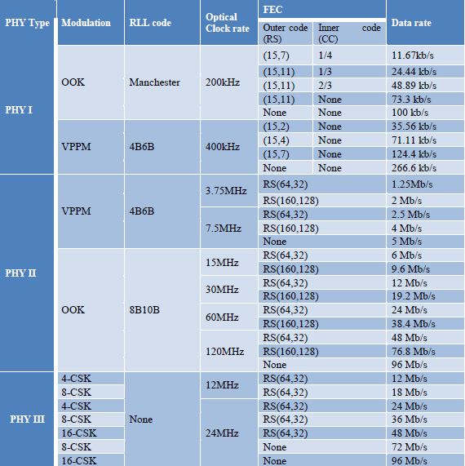
doc.: IEEE 15-16-0229-01-007a
Current 802.15.7 PHY specs
Modulation Schemes include OOK, VPPM and CSK
Modulation schemes fixed according to different PHY
Submission

Slide 4
doc.: IEEE 15-16-0229-01-007a
Proposed Modulation Schemes
Submission

Slide 5
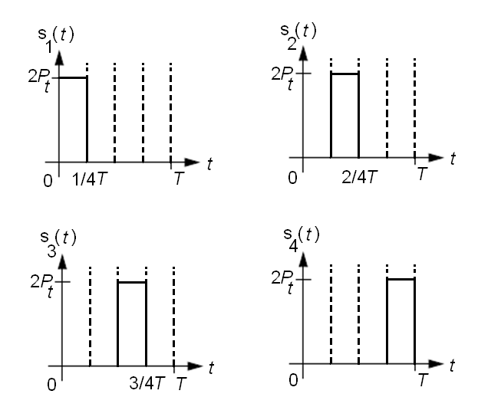
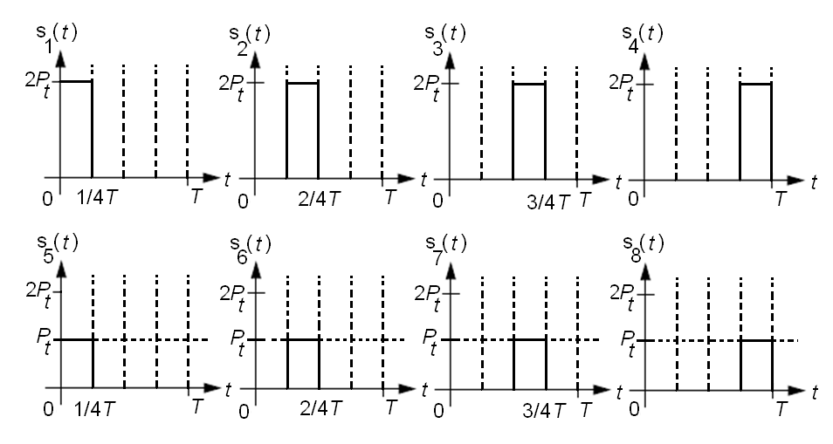
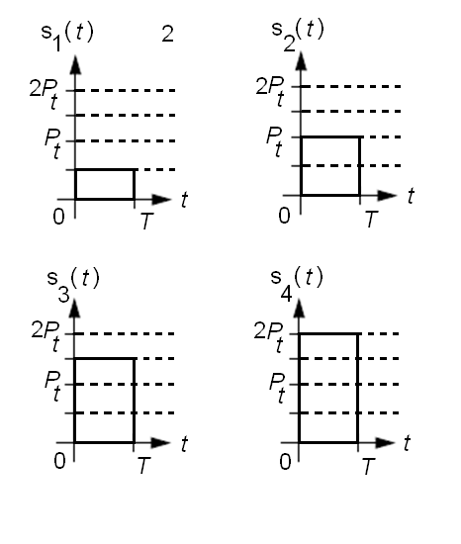
doc.: IEEE 15-16-0229-01-007a
PAPM(Pulse Amplitude and Pulse Position Modulation)
The amplitude and position can be defined according to application scenarios.
Time Waveform of 4-PPM
Time Waveform of 2-4-PAPM
Time Waveform of 4-PAM
Submission

Slide 6
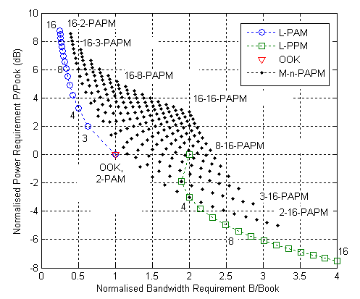
doc.: IEEE 15-16-0229-01-007a
PAPM(Pulse Amplitude and Pulse Position Modulation)
The M-n-PAPM refer to M level amplitude and n-PPM, by select different combination of M and n, the M-n-PAPM scheme can be obtained. When M = 1, the 1-n-PAPM becomes n-PPM, and when n=1, the M-1-PAPM becomes M-PAM
Submission

Slide 7
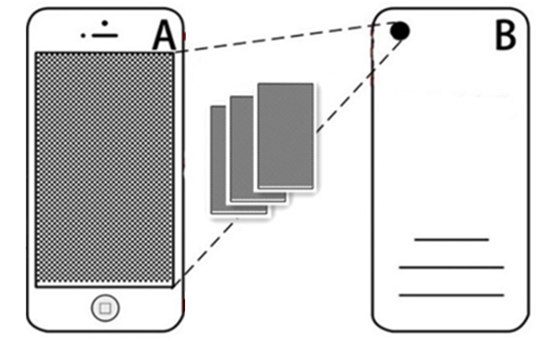
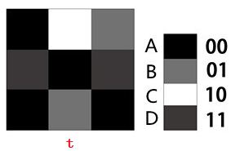
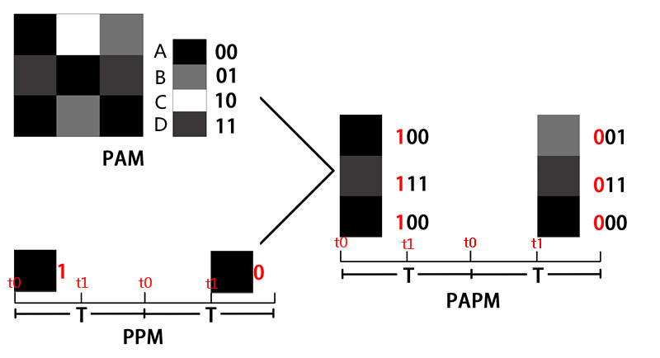
doc.: IEEE 15-16-0229-01-007a
PAPM(Pulse Amplitude and Pulse Position Modulation)
01010101
10101010
01010101
Submission

Slide 8

doc.: IEEE 15-16-0229-01-007a
PAPM(Pulse Amplitude and Pulse Position Modulation)
The proposed M-n-PAPM modulation scheme can provide a unified modulation structure for PHY I and PHY II
Submission

Slide 9
doc.: IEEE 15-16-0229-01-007a
PAPM(Pulse Amplitude and Pulse Position Modulation)
SNR vs BER of M-n-PAPM and PPM
BER vs Data Rate Performance M-n-PAPM Modulation Scheme when background interference changes
Submission

Slide 10
doc.: IEEE 15-16-0229-01-007a
Conclusions
The M-n-PAPM modulation scheme can be used to provide a unified modulation structure for OWC application, and provide a possible solution for software defined modulation module
Link power management can be achieved by actively select proper parameters and combinations of M and n values
Submission

Slide 11
doc.: IEEE 15-16-0229-01-007a
Appendix 1:
Parameters and Geometry for Simulation
Submission

Slide 12
doc.: IEEE 15-16-0229-01-007a
Parameter | Value
Room Dimensions (metre)(length × width × height) | 5×3×2
Coordination System Geometry | X (North to South)Y (East to West)Z (Floor Ceiling)
North (reflectivity) % | 0.58
South | 0.56
West | 0.12
East | 0.30
Ceiling | 0.69
Floor | 0.09
Coordinate (0 0 0) | South East Floor Corner
Transmitter Location (metre) | (3 0.8 2)
Transmitter Elevation and Azimuth (degree) | (-90 0)
Transmitter Lobe Order | 1
Receiver Location (metre) | (2 2 0.8)
Receiver Elevation and Azimuth (degree) | (60 0)
Receiver Area () | 1
Receiver FOV (degree) | 70
Transmitted Optical Power (Watts) | 1
Time Step (ns) | 0.2
Resolution (K=1 bounces) | 30
Resolution (K=2 bounces) | 8
Resolution (K=3 bounces) | 4
Submission

