Slide 1
Project: IEEE P802.15 Working Group for Wireless Personal Area Networks (WPANs)
Submission Title: [Performance Evaluation of Millimeter-wave-based Communication System in Subway Tunnels]
Date Submitted: [13 March, 2016]
Source: [Sung-Woo Choi, Junhyeong Kim, Hee-Sang Chung, Seung Nam Choi, Dae-Soon Cho, Bing Hui, and Il Gyu Kim] Company [ETRI]
Address [218 Gajeong-ro, Yuseong-gu, Daejeon, 34129, KOREA]
Voice:[+82-42-860-6113], FAX: [+82-42-861-1966], E-Mail:[csw9908@etri.re.kr]
Abstract: [This document presents performance evaluation results of a prototype of a millimeter-wave-based communication system in tunnel environments]
Purpose: [For discussion]
Notice: This document has been prepared to assist the IEEE P802.15. It is offered as a basis for discussion and is not binding on the contributing individual(s) or organization(s). The material in this document is subject to change in form and content after further study. The contributor(s) reserve(s) the right to add, amend or withdraw material contained herein.
Release: The contributor acknowledges and accepts that this contribution becomes the property of IEEE and may be made publicly available by P802.15.

Slide 2
Introduction
People want to access Internet every time and every where
Current Wi-Fi service provided in high-speed trains and subways is hard to satisfy onboard passengers’ demand
  Need performance enhancement
Increasing data rate is possible by using abundant spectrum available in millimeter wave
Current ongoing project in ETRI
  Project Name : Mobile Hotspot Network (MHN)
    Development of MHN mobile wireless backhaul system
Objective of this document
  Provide performance evaluation results of a prototype of a mmWave-based communication system in tunnel environments
    Data rate according to distance
    Channel estimation results

Slide 3
Introduction
A Survey on Previous Works
  Generally, radio wave propagation in tunnels depends on frequency, tunnel geometry, and electromagnetic properties of the walls^{[1]}
  The tunnel geometry contains many things like the tunnel cross-sectional dimension, shape, curves
  It has been observed that radio attenuation in a straight tunnel decreases when the carrier frequency and the transverse dimensions increase^{[1][2][3]}
  It is well known that the straight tunnel performs like a good wave guide at high frequencies
[1] A. Hrovat, G. Kandus, and T. Javornik, “A Survey of Radio Propagation Modeling for Tunnels”, IEEE Comm. & Surveys & Tutorials, VOL. 16, NO. 2, pp. 658-669, 2014.
[2] J. Chiba, T. Inaba, Y. Kuwamoto, O. Banno, and R. Sato, “Radio communication in tunnels,” IEEE Trans. Microw. Theory Tech., vol. 26, no. 6, pp. 439–443, 1978.
[3] D. Dudley, M. Lienard, S. Mahmoud, and P. Degauque, “Wireless propagation in tunnels,” IEEE Antennas Propagat. Mag., vol. 49, no. 2, pp. 11–26, 2007.

Slide 4

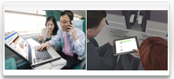
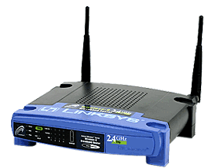


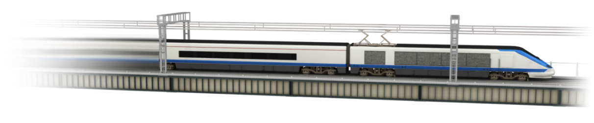



System Architecture
Network Architecture
  Backhaul & user access links
Two-tier network
AP
Backhaul Link
mmWave
Backhaul Link
mmWave
TE
TE
RU
RU
DU
DU : Digital Unit
TE : Terminal Equipment
RU : Radio Unit
GW : Gateway
Public Internet
GW
MHN application for railways

Slide 5
Physical Layer Technology
Millimeter Wave
  Suffering from increased propagation loss and atmospheric loss
    Ex. 20dB increase in propagation loss (comparison between 3 and 30GHz)
  Decreased coverage of cell
  Strong tendency of straightness
  Less multipath components
    Usually under 100 ns
  Have different feature from cellular frequency bands → Need new OFDM specification
MHN Radio Technology
  Modulation : OFDM
  Multiple access : OFDMA

Slide 6
Physical Layer Technology
Physical layer parameters
  Reduced OFDM symbols duration : 6.25us (cf. 71.4us of LTE)
  Reduced slot time : 250 us (cf. 1ms of LTE)
  TDD(mandatory), FDD
Parameters | Value
Size of FFT | 1024
Subcarrier spacing | 180 kHz
Sampling frequency | 184.32 MHz
Cyclic prefix | 0.69 μs
Carrier frequency | 31.5 – 31.75 GHz
Symbol duration | 6.25 μs
Channel coding | Turbo code
Modulation | QPSK, 16QAM, 64QAM
Sub-band bandwidth | 125 MHz
Peak data rate | 250 Mbps per sub-band

Slide 7
Physical Layer Technology
Frame structure

Slide 8
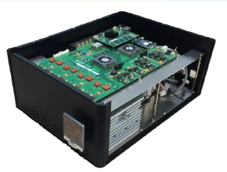
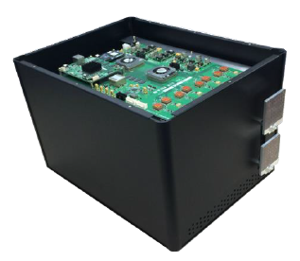
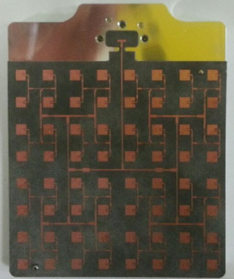
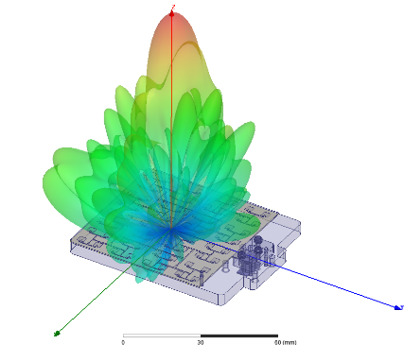
Experimental Environment
System Prototype
  RU-DU (Transmitter) : RF module, BB module, 1 antenna
  TE (Receiver) : RF module, BB module, 2 antenna
  Two sub-bands : 125 MHz x 2
  Max. physical layer data rate : 500 Mbps
RF module
  Power amplifier with a maximum power of 1 watt and 10-dB back-off
  TX antenna input power : 100 mW
  8x8 patch array antenna
  3-dB beamwidth (vertical, horizontal) : 8°
  Antenna gain (TX, RX) : 22 dBi
  Size : 60mm x 76mm
RU-DU
TE

Slide 9
Measuring tools
Functional blocks in TE and DU
RU-DU
TE
Turbo Code
QAM Signal Mapping
Resource Mapping
OFDM Signal Generation
RF
DU
TE
Resource and QAM Demapping
Signal Detection
Channel Estimation
OFDM Demodulation
RF
Turbo Decoding
Sell Searcher
SNR
Freq. response
Time response
BLER Calculation

Slide 10
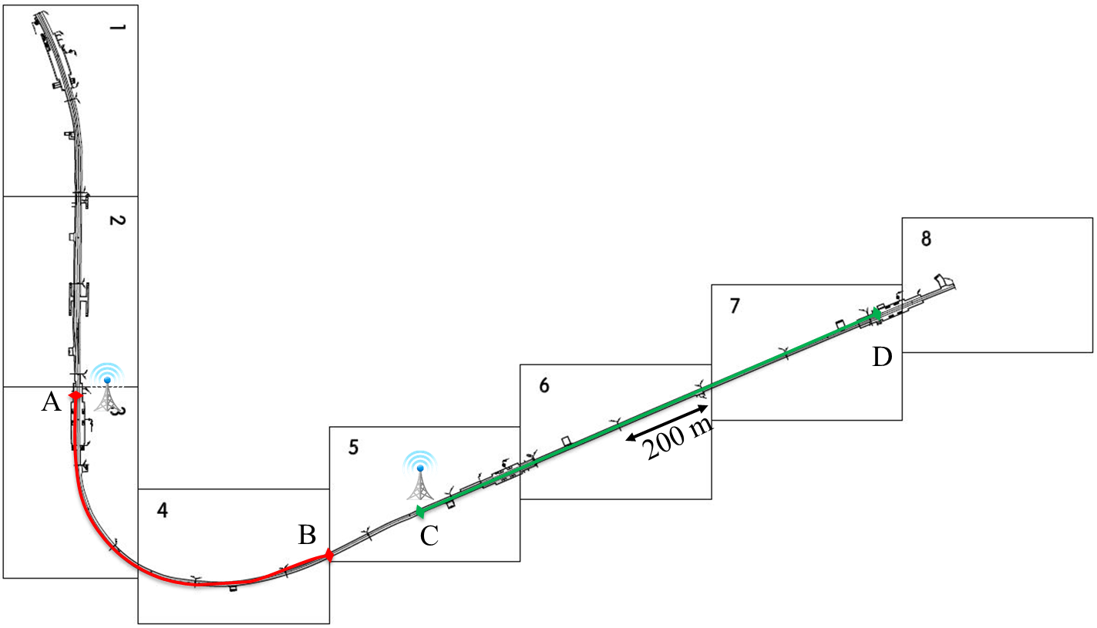
Test site environments
Seoul subway line 8
straight route
(1.1 km)
Songpa
curved route
(600 m)
Jamsil
Seokchon

Slide 11
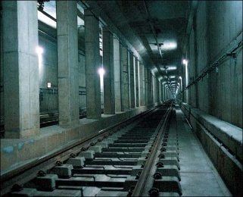
Test site environments
Tunnel structure in Seoul subway line 8
  Box-type tunnels and have two lanes
  Two lanes are separated by pillars in the middle
    Average width : 2 m, Average spacing : 85 cm

Slide 12
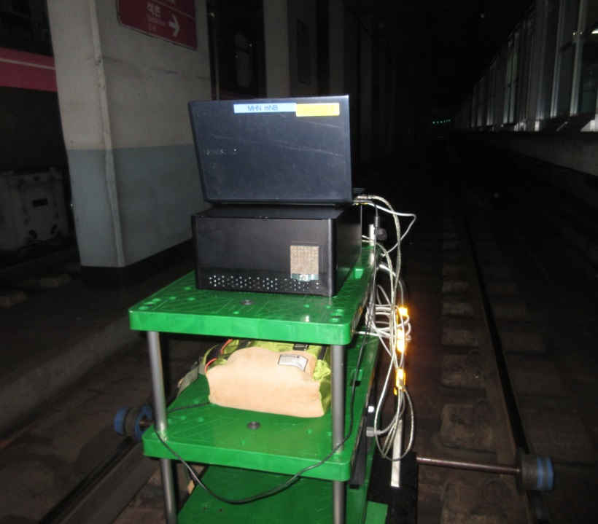
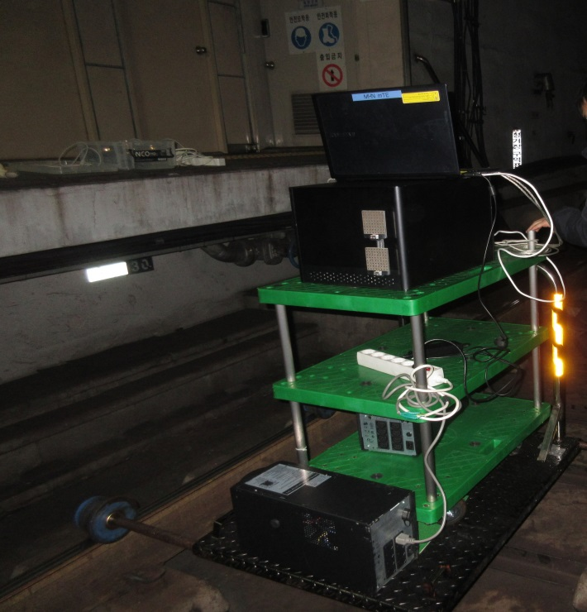
Test site environments
MHN Test beds on Moving Carts
RU/DU
TE

Slide 13
Experimental Results – Curved Route
SNR and data-rate according to distance TX and RX
  MCS 21 : 64 QAM, code rate = 0.58 → 500 Mbps
  MCS 10 : 16 QAM, code rate = 0.32 → 183 Mbps
  MCS 5 : QPSK, code rate = 0.35 → 102 Mbps

Slide 14
Experimental Results – Curved Route
Frequency domain response (at 320 meters)
FA-0, Ant. 0
FA-0, Ant. 1
Green : ABS of ideal channel
Magenta : ABS of measured channel
FA-1, Ant. 0
FA-1, Ant. 1
# of sub-carriers

Slide 15
Experimental Results – Curved Route
Time-domain impulse response (at 320 meters)
  Time domain response : IFFT of channel estimation
Ant. 0
Ant. 1
Delay spread ≤ 60 ns
(OFDM CP length = 0.69 μs = 690 ns)
# of samples
Green : reference
Blue : POW of estimated impulse response

Slide 16
Experimental Results – Curved Route
Frequency response (at 440 meters)
Green : ABS of ideal channel
Magenta : ABS of measured channel

Slide 17
Experimental Results – Straight Route
SNR and data-rate according to distance between TX and RX
500 Mbps

Slide 18
Experimental Results – Straight Route
Frequency domain response (at 1.1 km)
FA-0, Ant. 0
FA-0, Ant. 1
Green : ABS of ideal channel
Magenta : ABS of measured channel
FA-1, Ant. 0
FA-1, Ant. 1

Slide 19
Experimental Results – Straight Route
Time-domain impulse response (at 700 meters)
Second peak
Green : reference timing
Blue : POW of estimated impulse response

Slide 20
Conclusions
We developed a prototype of a millimeter wave-based communication system (MWBCS) for a use in the Railway communication networks (RCNs)
In a curved route, the system could give 500 Mbps of data rate throughout the first 400 m. A data rate of 100 Mbps was possible over 400 ~ 560 m
In the case of a straight route, the prototype is able to achieve 500 Mbps throughout 1.1 km
The tests also gave the channel information like frequency-domain channels and time impulse responses
The time impulse responses clarified that the delay spreads in those tunnels were less than 60 ns for all the measured cases
Furthermore, the results that we obtained from the tests have been used to determine appropriate RU spacing in a system deployment

Slide 21
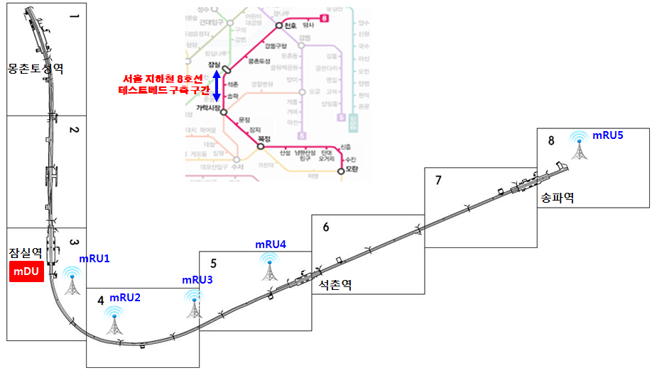
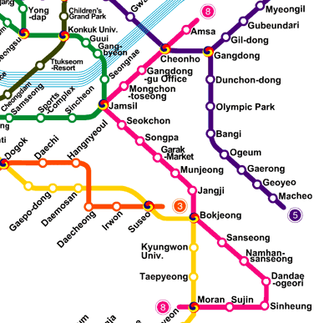
Field Trial of MHN System
MHN Test Bed Installation along Seoul Subway Line 8
mDU : MHN Digital Unit
mTE : MHN Terminal Equipment
mRU : MHN Radio Unit
mGW : MHN Gateway
Songpa
Station
Jamsil Station
Coverage Test : Nov. 10, Nov. 12, 2015
End of Construction : Dec. 4, 2015
Seokchon
Station
Jamsil
Seokchon
Songpa

Slide 22
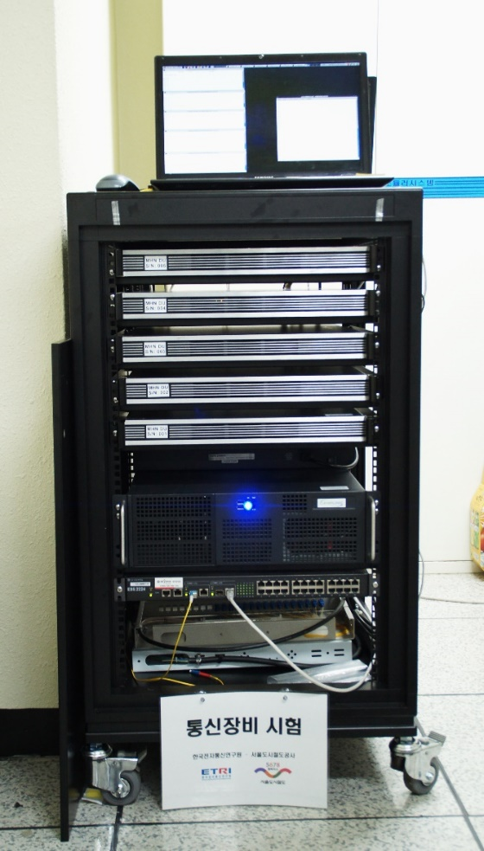
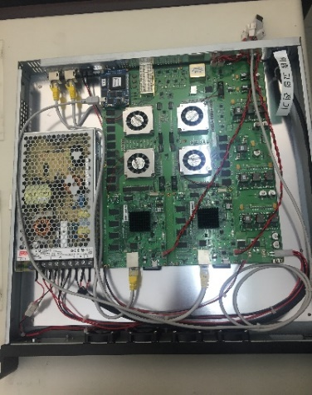
Field Trial of MHN System
Revision of MHN Test Bed
mDU Test Bed at Jamsil Station
mRU of mDU
5 mDUs
Optical Fiber
mTE
MODEMs
(for 2 mRUs)
mGW

Slide 23
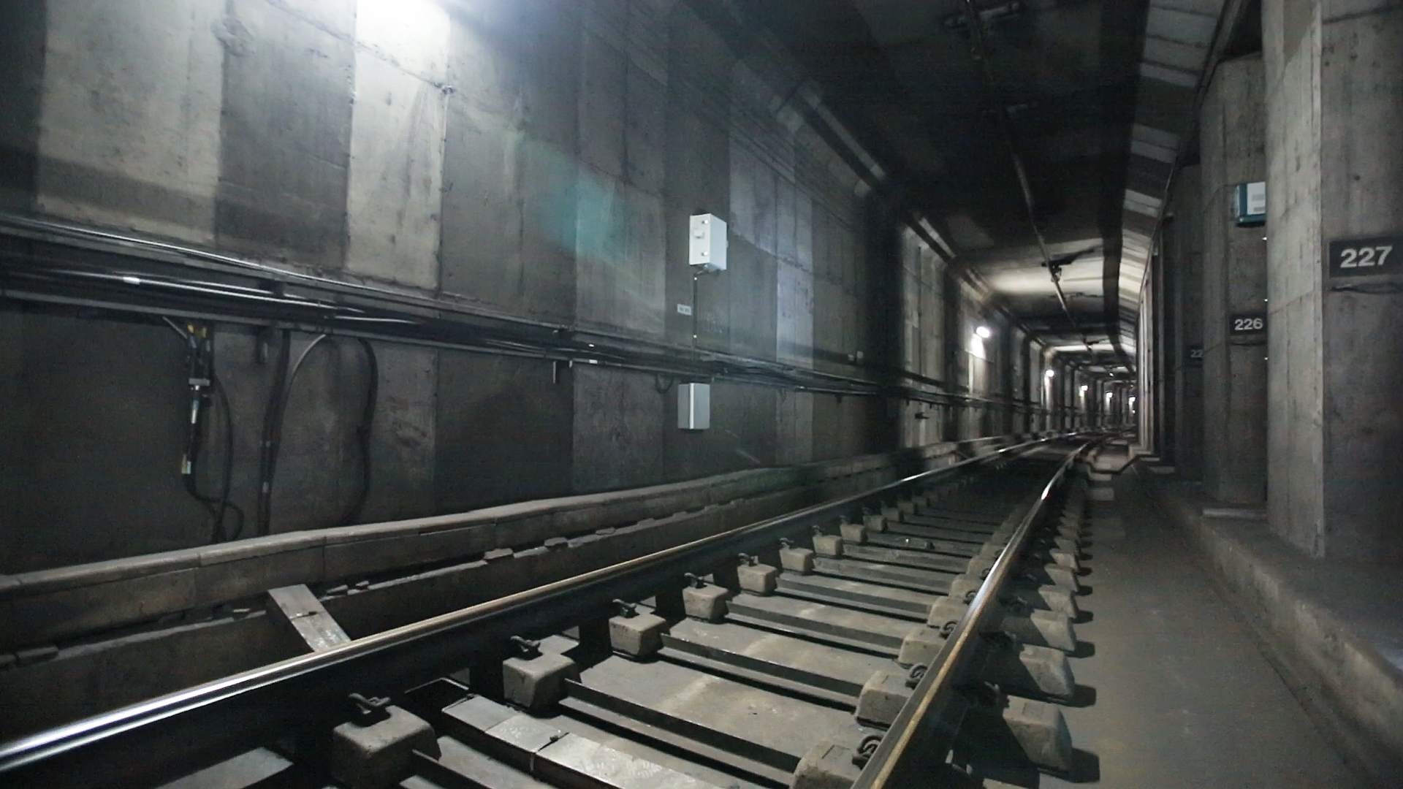
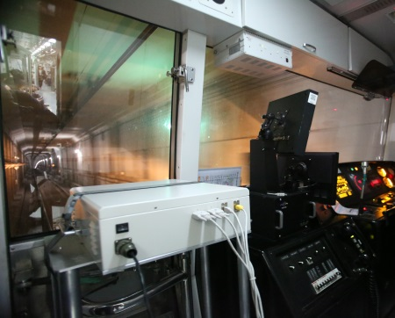
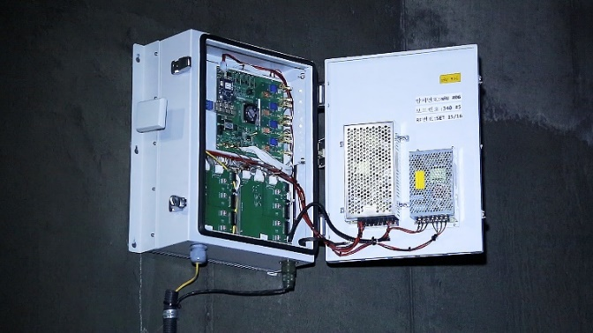
Field Trial of MHN System
mRU & mTE Test Bed Installation
mTE
mRU

Slide 24

Field Trial of MHN System
Performance Evaluation of MHN System for Moving Subway
  Peak data rate of over 400Mbps was achieved

Slide 25
Field Trial of MHN System
Demonstration Video

