Slide 1
16-0178-02-004t
Project: IEEE P802.15 Working Group for Wireless Personal Area Networks (WPANs)
Submission Title: [A Simple System Kept Simple]
Date Submitted: [7 March 2016]
Source: [Ed Callaway] Company [ARM, Inc.]
Address [350 Fairway Drive, Suite 200, Deerfield Beach, Florida, USA 33441-1834]
Voice:[+1-954-608-7537], Fax: [+1-954-333-0193], E-Mail:[ed.callaway@arm.com]
Additional authors:
Paul Gorday, ARM, Inc., paul.Gorday@arm.com;
Henk De Ruijter, SiLabs, Hendricus.DeRuijter@silabs.com
Re: [IEEE 802.15-16-0042-00-004t]
Abstract: [A proposal for IEEE 802.15.4t.]
Purpose: [To initiate discussion of 15.4t technical features.]
Notice: This document has been prepared to assist the IEEE P802.15. It is offered as a basis for discussion and is not binding on the contributing individual(s) or organization(s). The material in this document is subject to change in form and content after further study. The contributor(s) reserve(s) the right to add, amend or withdraw material contained herein.
Release: The contributor acknowledges and accepts that this contribution becomes the property of IEEE and may be made publicly available by P802.15.

Slide 2
A Simple System Kept Simple
16-0178-02-004t
Ed Callaway
ARM, Inc.
ed.callaway@arm.com
+1-954-608-7537

Slide 3
Key PAR Requirements
16-0178-02-004t
Capable of supporting 2 Mb/s data rates;
Utilizing the 2400 - 2483.5 MHz band;
Having backwards-compatibility to, and the same occupied bandwidth as, the present 2450 MHz O-QPSK physical layer; and
Capable of simple implementation.

Slide 4
Observations
16-0178-02-004t
MSK and O-QPSK are very similar, have the same occupied bandwidth, and can be generated from the same circuits
IEEE 802.15.4-2015 has an MSK PHY (§18)
Since MSK bit rate == O-QPSK chip rate (2 Mb/s), no new frequency generation is needed

Slide 5
Gaussian Filtering
16-0178-02-004t
All known implementations of the O-QPSK PHY are using some amount of filtering, e.g., because of in-loop modulation using a PLL.
By defining a Gaussian filter the amount of filtering becomes better defined which may benefit the PSD and the demodulator.

Slide 6
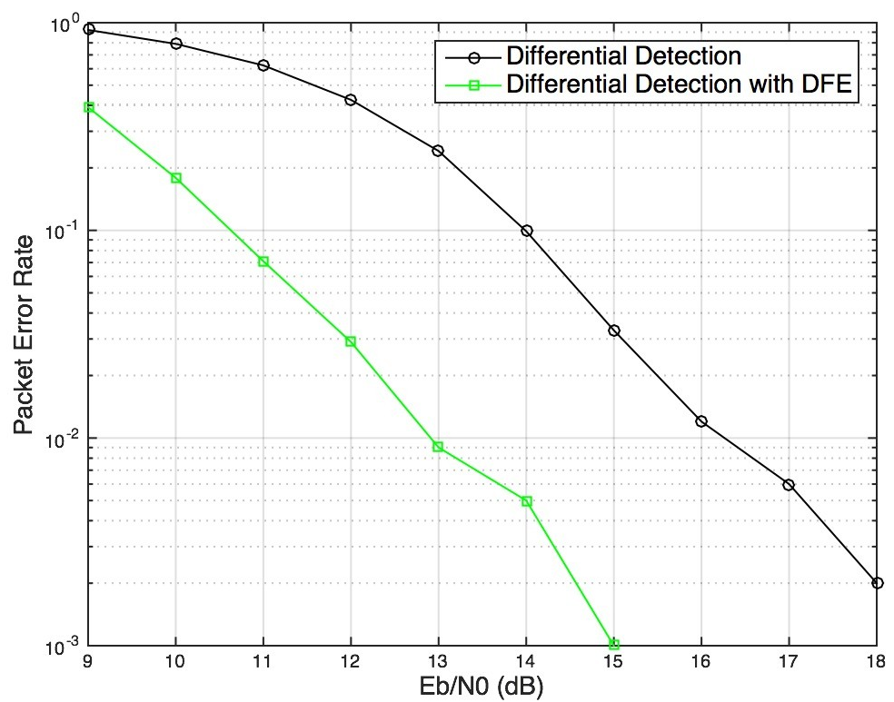
GMSK Sensitivity and Link Margin
16-0178-02-004t
Sensitivity =
kT + nf + E_{b}/N₀ + 10log(R_{b})
= -174 dBm + 10 dB +
12.9 dB + 63 dB
= -88.1 dBm
______________________
10m free space path loss =
20log(4π) + 20log(d/λ)
= 22 dB + 20log(10/0.122)
= 60.2 dB
______________________
Link margin =
-(-88.1 + 60.2) = 27.9 dB
0 dBi antennas
0dBm Tx power

Slide 7
Simple, Straightforward
16-0178-02-004t
All PAR requirements may be met by just six edits to the PHY. . .
  11.1 PHY Constants table: aMaxPHYPacketSize, aTurnaroundTime
  18.1 PPDU Formats (text and figure for new PHR)
  18.2 Data rate (text and Table 18-231)
  18.4.4 Signal modulation (text)
  18.5.2 Transmit PSD mask (Table 18-235)
  18.5.3 Symbol rate (text)
. . . and one to the MAC:
  7.2.10 FCS Field (text)
Draft text available in doc 0179r0
Simple changes should lead to early adoption!

Slide 8
TGD Outline 1
16-0178-02-004t
Mandatory and Optional Features:
Proposals shall clearly stipulate the mandatory and optional behaviors/features.
  As presented in doc 179
Compatibility:
Proposal shall show how it is compatible with the present 2450 MHz O-QPSK physical layer.
  Same chip rate, PSD, adjacent and alternate channel protection; similar modulation
Range:
The proposal shall show the conditions (channel model, antenna, etc.) under which the solution achieves a radio link distance of at least 10m.
  27.9 dB free space link margin at 10m, using 0 dBi antennas, 0 dBm Tx power, 10 dB noise figure
Data Rate:
The proposal shall be capable of supporting a 2 Mb/s data rate.
  As presented in doc 179
Symbol/Chip Rate
The proposer shall specify the symbol/chip rate.
  2 MBaud

Slide 9
TGD Outline 2
16-0178-02-004t
Modulation/ Coding
The proposer shall specify the utilized modulation/coding scheme.
  GMSK
Synchronization and Timing
The proposer shall state the required synchronization and timing accuracy for all types of devices whether or not they are symmetric and any differences between those of the present 2450 MHz O-QPSK physical layer.
  Symmetric; same aTurnAroundTime; same symbol time accuracy (40 ppm)
PHY Frame Structure
The proposer shall specify the PHY frame structure, including preamble length, total frame length, FCS, etc.
  As in document 179.
Transmit Power
The device shall support transmit powers in alignment with the present 2450 MHz O-QPSK physical layer.
  As in document 179.

Slide 10
TGD Outline 3
16-0178-02-004t
Transmit PSD
The proposer should state adjacent channel leakage power ratio (ACL). ACL is defined as the ratio of the power contained in the adjacent channel to the desired channel. Proposals shall have the same occupied bandwidth as, the present 2450 MHz O-QPSK physical layer.
  ACL is -80 dB. Occupied bandwidth is the same as, or less than, the present O-QPSK PHY.
Interference Rejection Capability
The ACR (adjacent channel rejection) and ALCR (alternate channel rejection) shall be stated.
  ACR and ALCR are the same as the present O-QPSK physical layer.
Channel Availability
The proposer shall specify the minimum number of co-located networks supportable without causing any degradation in performance.
  The minimum number of co-located networks is the same as the present O-QPSK physical layer.
Sensitivity
The proposer shall state the sensitivity - defined as the minimum received power to achieve a 1% PER with a 20 octet PSDU.
  -88.1 dBm with 10 dB nf.

Slide 11
TGD Outline 4
16-0178-02-004t
Interoperability
The proposer shall describe the interoperable features of the proposal including any optional behaviors. For instance, it should be made clear whether the data rate can dynamically change.
  The data rate does not dynamically change.
Coexistence Features
The proposal shall state the level of co-existence of the proposed network with other IEEE 802 networks.
  The co-existence of the proposed network may be improved, due to the shorter-duration packets.
Operational Bands
At least the operational band stated in the PAR shall be supported.
  As in document 179.
MAC Layer Changes and Compatibility
The proposal shall state all MAC Layer changes required to support the proposed PHY and their compatibility with the MAC used with the present 2450 MHz O-QPSK physical layer. Ideally the proposal shall include NO (or very minimal) changes to the 802.15.4 MAC operation - for compatibility reasons.
  One change, to support a 4-octet FCS (7.2.10) due to MPDU length increase (2047 octets).

Slide 12
Thank you!
16-0178-02-004t

