Slide 1
16-0178-00-004t
Project: IEEE P802.15 Working Group for Wireless Personal Area Networks (WPANs)
Submission Title: [A Simple System Kept Simple]
Date Submitted: [7 March 2016]
Source: [Ed Callaway] Company [ARM, Inc.]
Address [350 Fairway Drive, Suite 200, Deerfield Beach, Florida, USA 33441-1834]
Voice:[+1-954-608-7537], Fax: [+1-954-333-0193], E-Mail:[ed.callaway@arm.com]
Additional authors:
Paul Gorday, ARM, Inc., paul.Gorday@arm.com;
Henk De Ruijter, SiLabs, Hendricus.DeRuijter@silabs.com
Re: [IEEE 802.15-16-0042-00-004t]
Abstract: [A proposal for IEEE 802.15.4t.]
Purpose: [To initiate discussion of 15.4t technical features.]
Notice: This document has been prepared to assist the IEEE P802.15. It is offered as a basis for discussion and is not binding on the contributing individual(s) or organization(s). The material in this document is subject to change in form and content after further study. The contributor(s) reserve(s) the right to add, amend or withdraw material contained herein.
Release: The contributor acknowledges and accepts that this contribution becomes the property of IEEE and may be made publicly available by P802.15.

Slide 2
A Simple System Kept Simple
16-0178-00-004t
Ed Callaway
ARM, Inc.
ed.callaway@arm.com
+1-954-608-7537

Slide 3
Key PAR Requirements
16-0178-00-004t
Capable of supporting 2 Mb/s data rates;
Utilizing the 2400 - 2483.5 MHz band;
Having backwards-compatibility to, and the same occupied bandwidth as, the present 2450 MHz O-QPSK physical layer; and
Capable of simple implementation.

Slide 4
Observations
16-0178-00-004t
MSK and O-QPSK are very similar, have the same occupied bandwidth, and can be generated from the same circuits
IEEE 802.15.4-2015 has an MSK PHY (§18)
Since MSK bit rate == O-QPSK chip rate (2 Mb/s), no new frequency generation is needed

Slide 5
Gaussian Filtering
16-0178-00-004t
All known implementations of the O-QPSK PHY are using some amount of filtering, e.g., because of in-loop modulation using a PLL.
By defining a Gaussian filter the amount of filtering becomes better defined which may benefit the PSD and the demodulator.

Slide 6
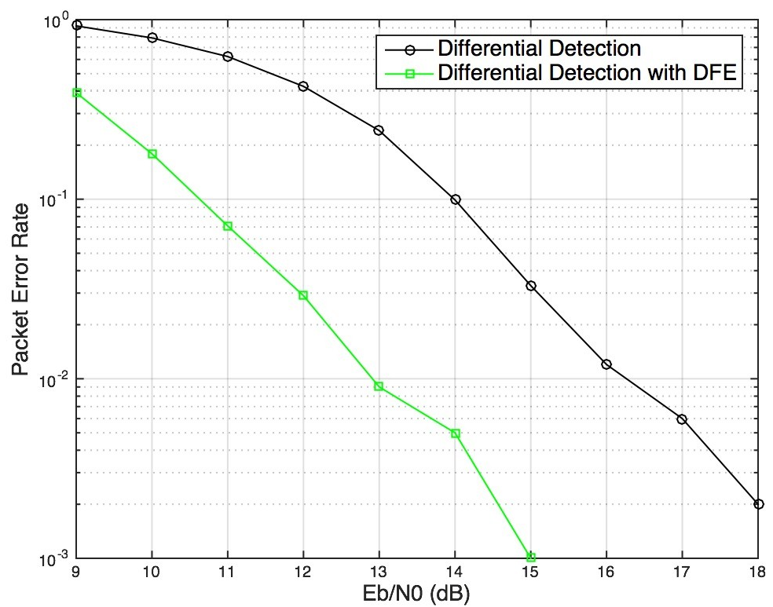
GMSK Sensitivity and Link Margin
16-0178-00-004t
Sensitivity =
kT + nf + E_{b}/N₀ + 10log(R_{b})
= -174 dBm + 10 dB +
12.9 dB + 63 dB
= -88.1 dBm
______________________
10m free space path loss =
20log(4π) + 20log(d/λ)
= 22 dB + 20log(10/0.122)
= 60.2 dB
______________________
Link margin =
-(-88.1 + 60.2) = 27.9 dB

Slide 7
Simple, Straightforward
16-0178-00-004t
All PAR requirements may be met by just six edits to the PHY. . .
11.1 PHY Constants table: aMaxPHYPacketSize, aTurnaroundTime
18.1 PPDU Formats (text and figure for new PHR)
18.2 Data rate (text and Table 18-231)
18.4.4 Signal modulation (text)
18.5.2 Transmit PSD mask (Table 18-235)
18.5.3 Symbol rate (text)
. . . and one to the MAC:
7.2.10 FCS Field (text)
Draft text available in doc 0179r0
Simple changes should lead to early adoption!

Slide 8
Thank you!
16-0178-00-004t

