Slide 1
Project: IEEE P802.15 Working Group for Wireless Personal Area Networks (WPANs)
Submission Title: Kiosk Channel Modeling
Date Submitted: 8 February 2016
Source: Danping He, Beijing Jiaotong University
E-Mail: hedanping1019@163.com
Re: n/a
Abstract: Discussing kiosk application scenarios, ray tracer calibration and preliminary modeling results.
Purpose: Contribution towards developing kiosk channel model for use in TG 3d
Notice: This document has been prepared to assist the IEEE P802.15. It is offered as a basis for discussion and is not binding on the contributing individual(s) or organization(s). The material in this document is subject to change in form and content after further study. The contributor(s) reserve(s) the right to add, amend or withdraw material contained herein.
Release: The contributor acknowledges and accepts that this contribution becomes the property of IEEE and may be made publicly available by P802.15.

Slide 2
Kiosk Channel Modeling
Danping He, Ke Guan, Bo Ai, Zhangdui Zhong
Beijing Jiaotong University
Akifumi Kasamatsu, Hiroyo Ogawa, Iwao Hosako
National Institute of Information and Communications Technology
Dr. Yaita
NTT

Slide 3
Content
Ray Tracer Calibration
Target Scenario Generation
Parameter Extraction and modeling
Channel Realization

Slide 4
1. Ray Tracer Calibration
Calibration Approach
3D ray tracing
Simulation Result
Cost Function
Error calc.
Measurement
Best Parameters per iteration
Mutate Ray Tracing parameters

Slide 5
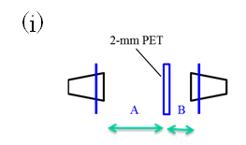
1. Ray Tracer Calibration
Target scenario for calibration:
D=0.5139 m
A=0.3800 m
B=0.0880 m
TX
RX
D
Ray Tracer configuration:
Maximum order of reflected ray: 6
Transmitted loss by PET: A_PET=2.0
Higher order reflection coefficient:
NLOS_Coefficient=0.5
Material
Metal | 1.0 | 1.0E7
PET | 6.4 | 0.1172

Slide 6
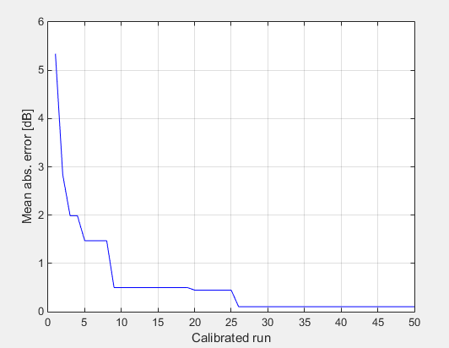
1. Ray Tracer Calibration
Calibrated Result:
Material
Metal | 2.2120 | 4.5209E6
PET | 1.8667 | 0.3953
Progress of the calibration
Transmitted loss by PET: A_PET=1.9890
Higher order reflection coefficient:
NLOS_Coefficient=0.5
Mean abs. error=0.1027 dB

Slide 7
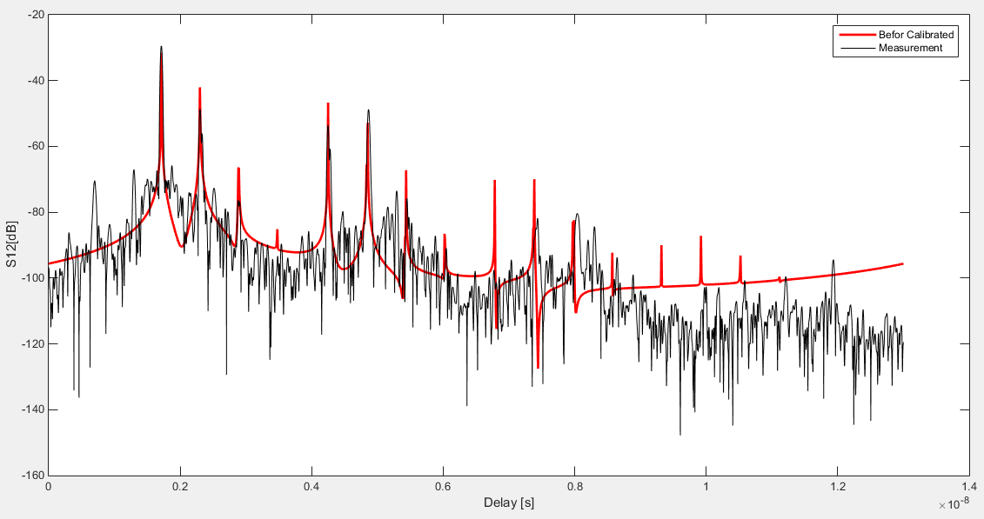
1. Ray Tracer Calibration
Before Calibration

Slide 8
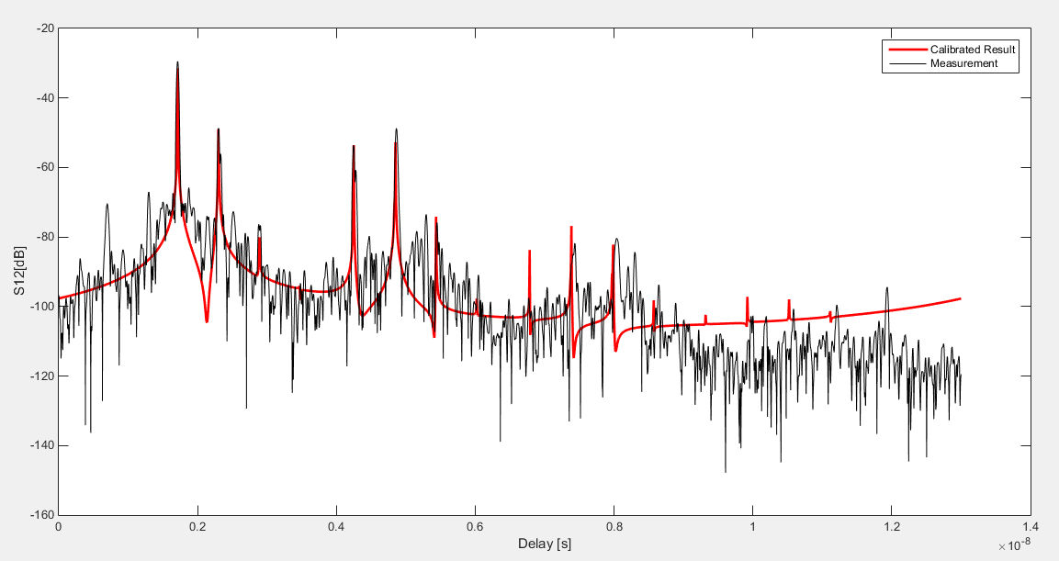
1. Ray Tracer Calibration-After calibration

Slide 9
Content
Ray Tracer Calibration
Target Scenario Generation
Parameter Extraction and modeling
Channel Realization

Slide 10
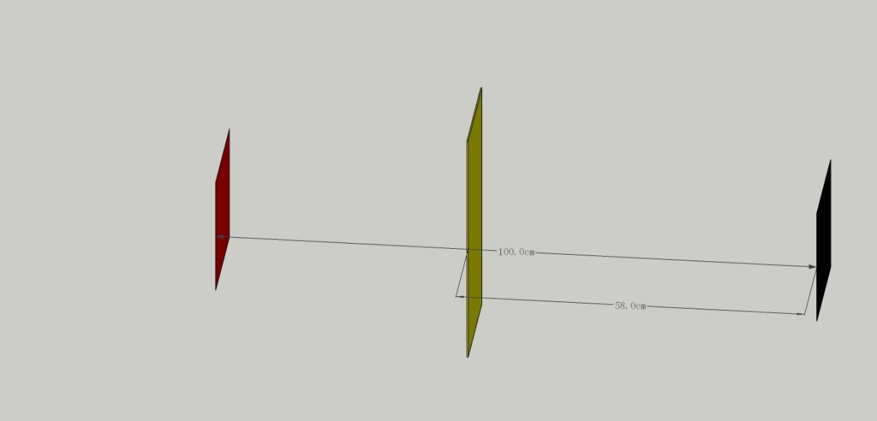
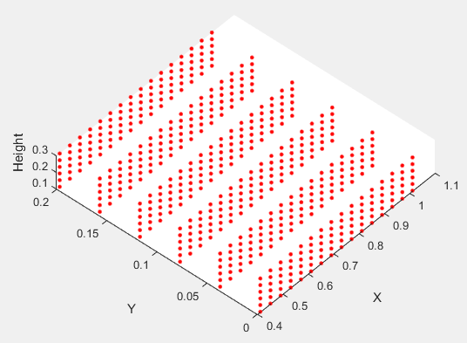
2. Target Scenario Generation
‘All parallel’ Scenario
Height
3D distance between TX and RX ranges from 0.43~1.3m
TX position is fixed
RX and RX metal plate positions vary
Frequency Properties
Y
Fixed
TX
Varies
RX
X
RX positions

Slide 11
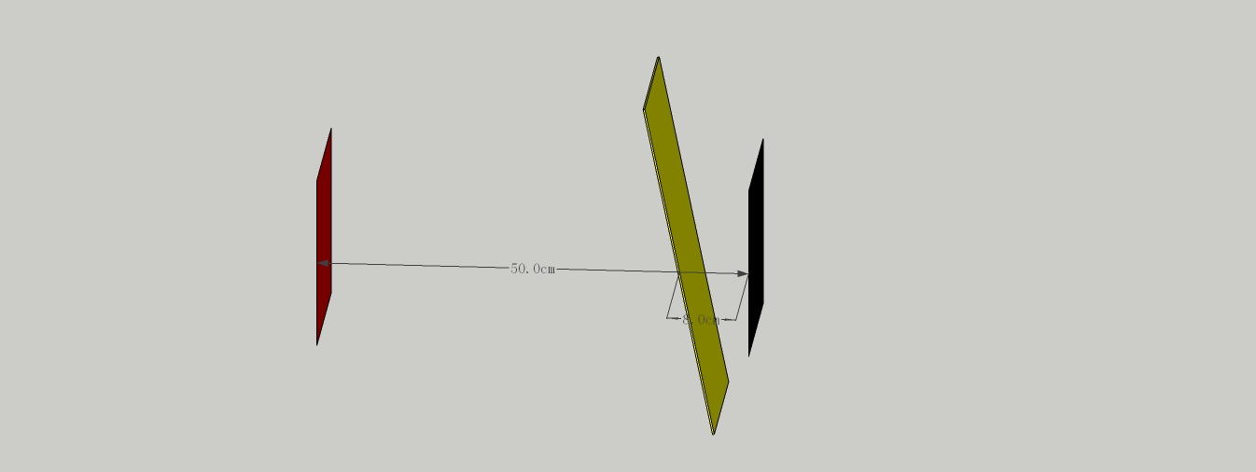
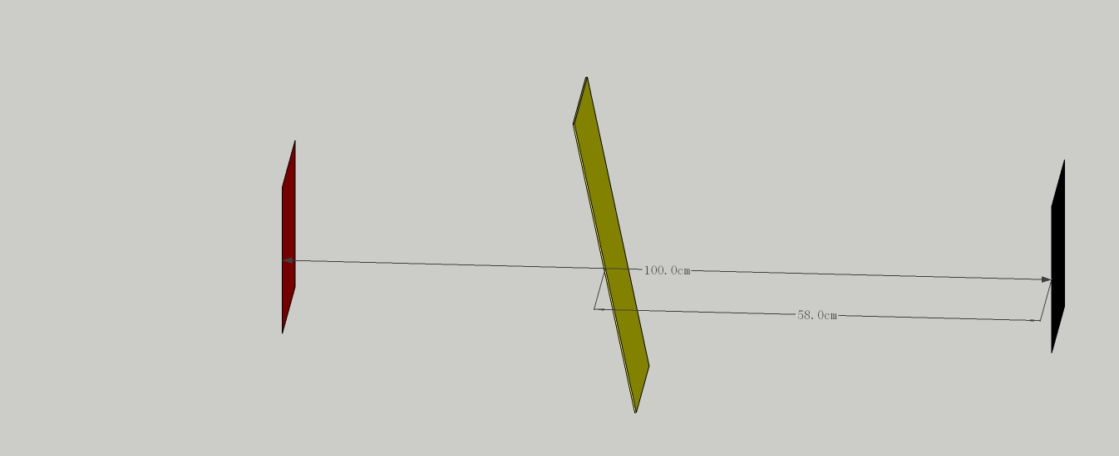
2. Target Scenario Generation
‘PET tilted’ Scenario
PET is tilted
TX and RX points to each other
TX and PET positions are fixed
RX position varies

Slide 12
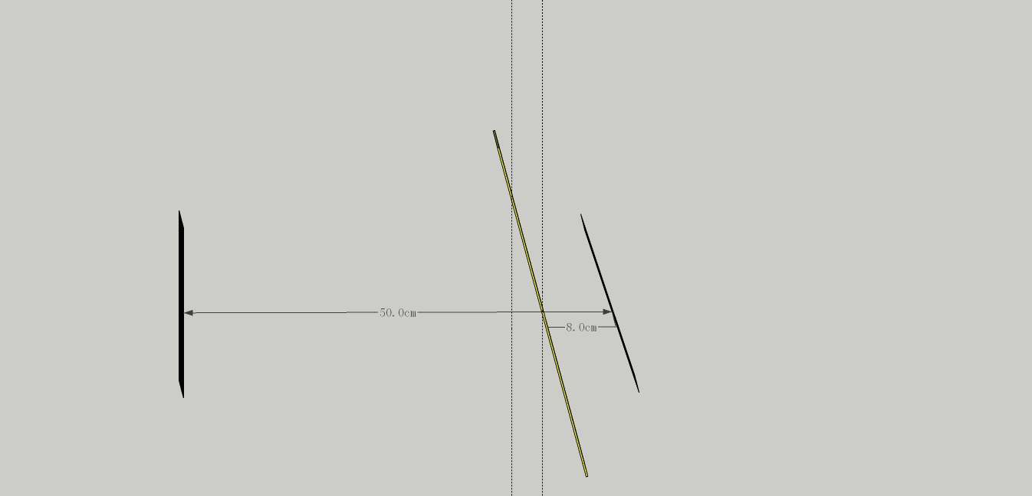
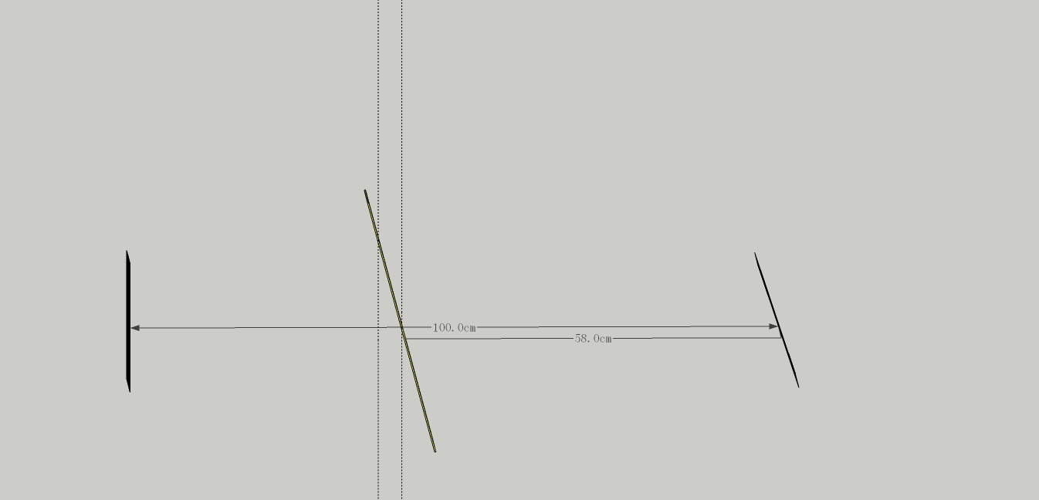
2. Target Scenario Generation
‘PET & RX metal tilted’ Scenario
PET and RX are tilted
TX and PET positions are fixed
RX position varies

Slide 13
2. Target Scenario Generation
Any comments to the proposed scenarios?

Slide 14
Content
Ray Tracer Calibration
Target Scenario Generation
Parameter Extraction and modeling
Channel Realization

Slide 15
3. Parameter Extraction
Spatial path-specific channel transfer function
Obtain the complete channel transfer function
All path-CTFs must be weighted with the TX and RX antenna characteristics gTX and gRX

Slide 16
3. Parameter Extraction-type of path
Statistic overview of different order of rays at different Tx-Rx distance for ‘all parallel’ scenario
 | Transmitted | 1st order | 2nd order | 3rd order | 4th order | 5th order | 6th order
Number | 1 | 0 | 3 | 0 | 8 | 0 | 21
Added ratio | -- | -- | 30.09% | -- | 1.98% | -- | 0.20%
Conclusion:
We consider only up to 2nd order reflections, due to the high attenuation at higher orders (low added ratio)
1 transmitted path and 3 second-order reflection paths should be generated for ‘all parallel’ scenario
The 3 types of reflection path are :
type1 (TX->RX metal->TX metal->RX)
type2 (TX->PET->TX metal->RX)
type3 (TX->RX metal->PET->RX)

Slide 17
3. Parameter Extraction-amplitude of path
Transmitted path attenuation:
Calibrated Attenuation due to PET
3 types of second order reflection:
The offset compared with transmitted ray
Slope along delay,
Variation of fitting result
Different distribution models for different types of ref. path

Slide 18
3. Parameter Extraction-Cross Polarization discrimination
XPD can be extracted for each ray from RT simulated results

Slide 19
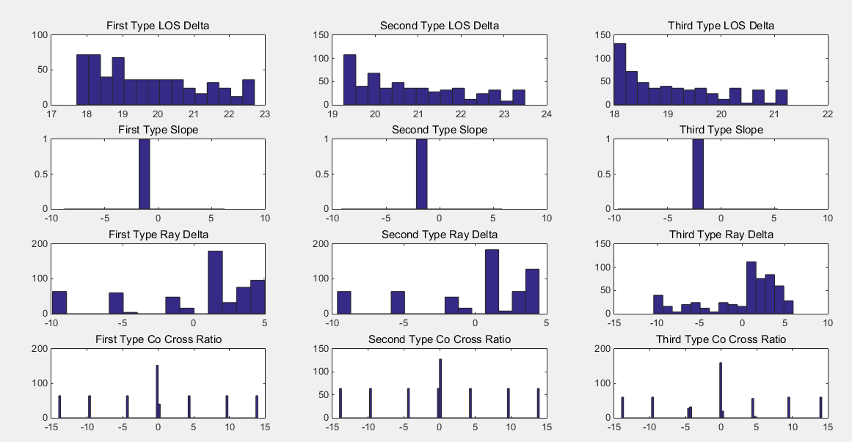
3. Parameter Extraction-Amplitude and XPD
Next Step-> Approximation with proper distribution model

Slide 20
3. Parameter Extraction-Phase
Transmitted path attenuation:
3 types of second order reflection:

Slide 21
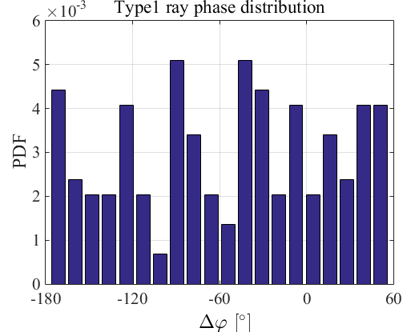
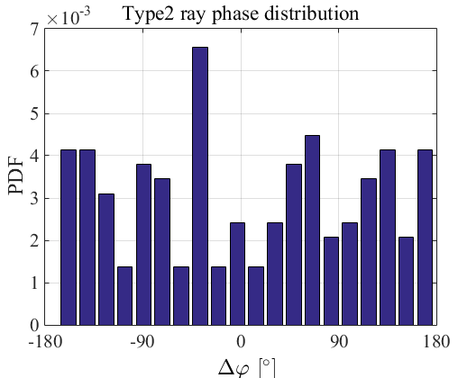
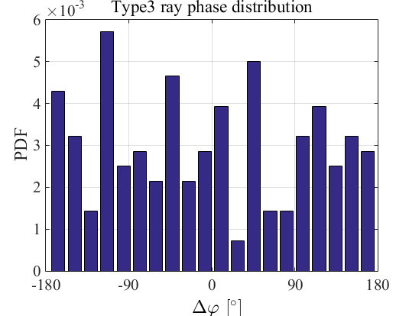
3. Parameter Extraction-Phase
3 types of second order reflection:
Type1: uniformly distributed between -180 and 60
Type2 and type3: uniformly distributed between -180 and 180

Slide 22
3. Parameter Extraction-frequency Dispersion
Should be extracted from RT simulation

Slide 23
3. Parameter Extraction-AOD and AOA
uniformly distributed between and
uniformly distributed between and
AOA should be modeled … could be related with AOD and type of reflection

Slide 24
Content
Ray Tracer Calibration
Target Scenario Generation
Parameter Extraction and modeling
Channel Realization

Slide 25
4. Channel Realization-Generate CTF
Input
d: Distance between TX and RX in [m]
scenario: scenario type (1: all parallel, 2: pet tilted, 3: pet and RX metal tilted)
f: Frequency vector (f_start:f_step:f_stop)
Output
H: Channel matrix
Reflection_Order: Reflection Count Vector
ToA: Time of Arrival Vector in ns
D: Dispersion Factor
AOA,AOD: Angle of arrival/departure
[H,Reflection_Order,ToA,D,a_i_Phi,a_i_Theta,a_i_Theta_Phi,a_i_Phi_Theta,AoA_Phi,AoD_Phi,AoA_Theta,AoD_Theta] = Channel_Realization(d,scenario,f)
In terms of contents, there are many variables could be exported. We should extract those useful for verifying proposals, then derive the format of CTF file.

