Slide 1
Project: IEEE P802.15 Working Group for Wireless Personal Area Networks (WPANs)
Submission Title: [A method for generating realistic wireless traffic through analysis of smartphone operation logs]
Date Submitted: [25 Feb, 2016]
Source: [Yuko Hirabe, Yutaka Arakawa, Keiichi Yasumoto] Company [Nara Institute of Science and Technology (NAIST)]
Address [Takayama-cho 8916-5, Ikoma, Nara 630–0192, Japan ]
Voice:[+81-743-72-5392], FAX: [+81-743-72-5976], E-Mail:[hirabe.yuko.ho2@is.naist.jp, ara@is.naist.jp, yasumoto@is.naist.jp]
Re: []
Abstract: [This document introduces a performance evaluation method for IEEE 802.15-based systems by generating realistic interfering traffic of wireless LAN which smartphones produce. This is informative to discuss significance of performance analysis in IEEE802.15 TG4s.]
Purpose: [For discussion]
Notice: This document has been prepared to assist the IEEE P802.15. It is offered as a basis for discussion and is not binding on the contributing individual(s) or organization(s). The material in this document is subject to change in form and content after further study. The contributor(s) reserve(s) the right to add, amend or withdraw material contained herein.
Release: The contributor acknowledges and accepts that this contribution becomes the property of IEEE and may be made publicly available by P802.15.

Slide 2
A method for generating realistic wireless traffic through analysis of smartphone operation logs
Authors:
Name | Company | Address | Phone | email
Yuko Hirabe, Yutaka Arakawa, Keiichi Yasumoto | Nara Institute of Science and Technology (NAIST) | Takayama-cho 8916-5, Ikoma, Nara 630–0192, Japan | +81-743-72-5392 | hirabe.yuko.ho2@is.naist.jp ara@is.naist.jp yasumoto@is.naist.jp

Slide 3

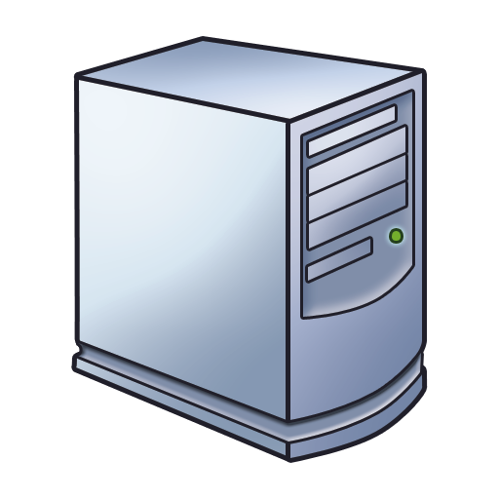



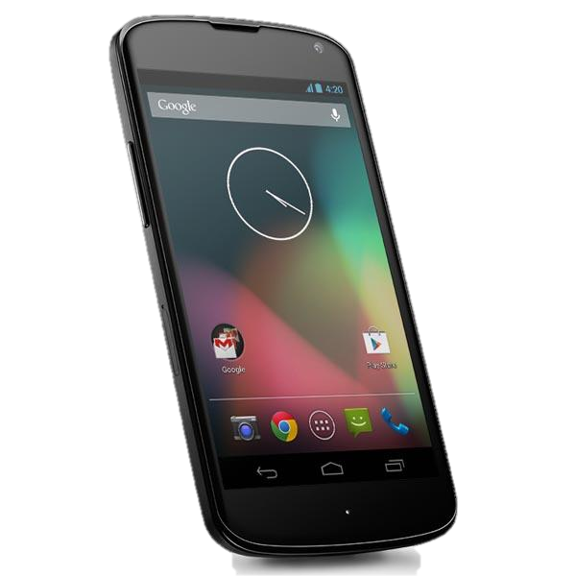

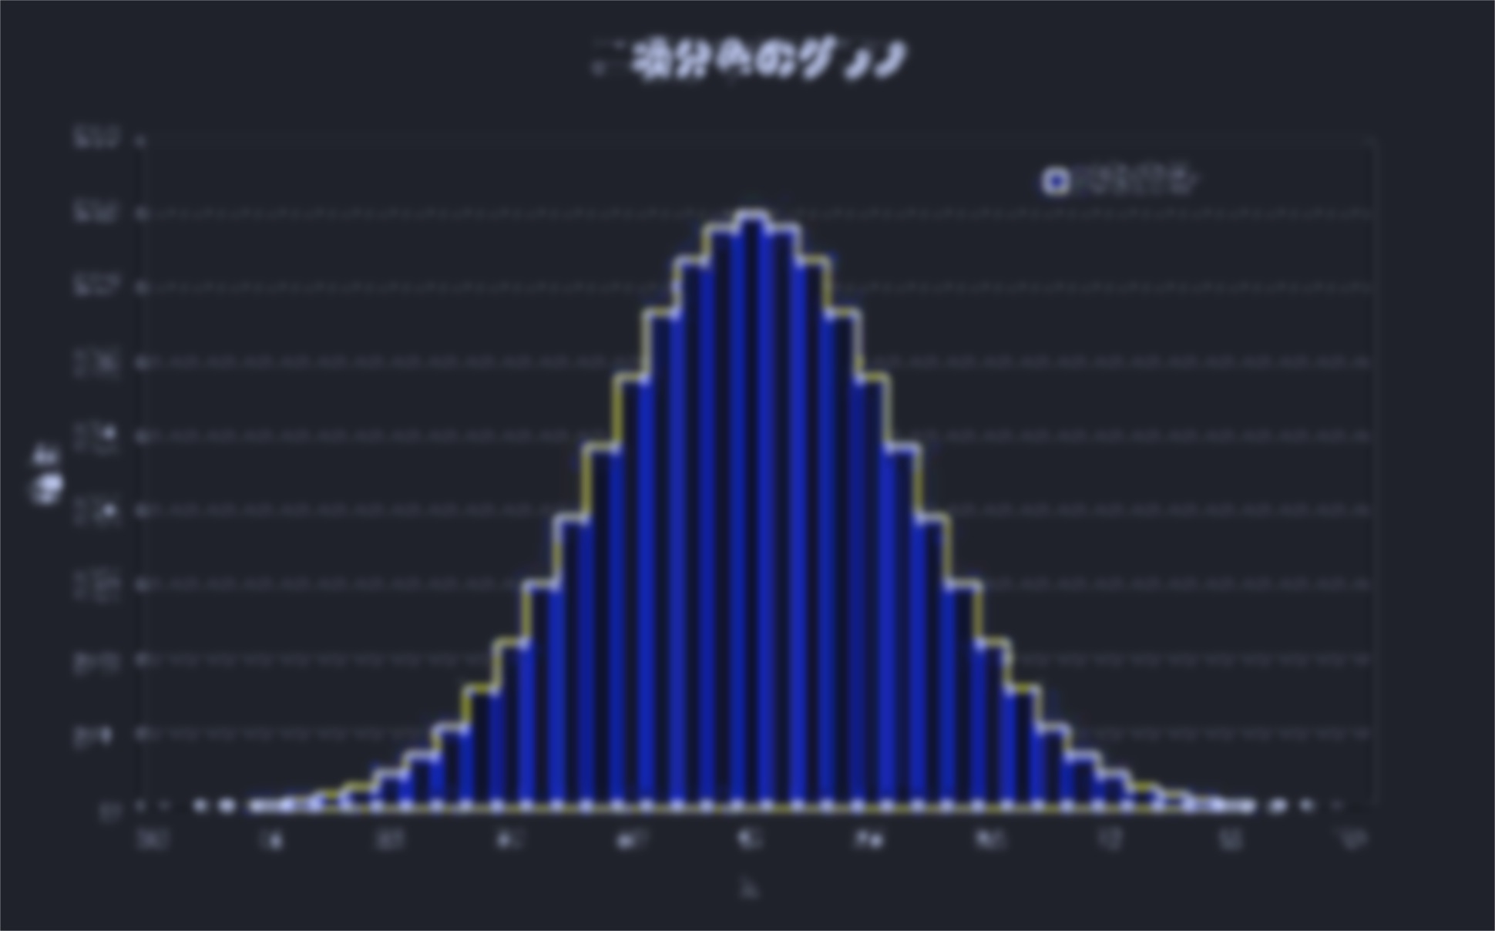

Overview
802.11: Wifi 802.15: Zigbee
IoT + Smart Home
Sensors’ data
Wifi interference
Internet
Gateway
server
Send
Power
consumption
Wifi interference
Temperature,
humidity
Location
Current: realistic performance evaluation of 802.15 (Zigbee)-based systems is difficult
→ realistic Wifi interference is not considered.
Purpose: generating realistic interfering traffic that WiFi devices (e.g., smartphones) actually produce
Proposal: developing a statistic model generating realistic 802.11 (Wifi) traffic,
and clarify interference patterns to 802.15 (Zigbee)
→apply the model to realistic performance evaluation of 802.15 (Zigbee)-based systems

Slide 4
Background
802.11: Wifi 802.15: Zigbee
Sensors’ data
IoT + Smart Home
Penetration of the Internet of Things (IoT) in homes
  Increase of networked appliances and sensors (IoT devices) in smart homes
      ex) power meters, ambient sensors
Sensor data are sent by Zigbee
Smartphones/tablets are also used in homes
IoT devices(Zigbee) + smartphone(WiFi)
→ cause interference
  E.g., Sensor data may not be sent via Zigbee
Internet
Gateway
server
Send
Power
consumption
Wifi interference
Temperature,
humidity
Location
Current: realistic performance evaluation of 802.15 (Zigbee) base system is difficult due to Wifi interference.
A method for realistic performance evaluation of 802.15 (Zigbee)-based systems, considering realistic Wifi interference is needed

Slide 5
How to model the Wifi interference?
General performance evaluation of wireless communication system
  Wireless traffic generation by random/probabilistic traffic model ^{[1]}
Wifi coexists with 802.15 in a home environment.
  Wifi traffic may disturb Zigbee data communication.
  Current main WiFi traffic source is a smartphone.
Need to generate realistic Wifi traffic from a smartphone
1. H. Zhai et al., Performance analysis of IEEE 802.11 MAC protocols in wireless LANs, Wireless Communications and Mobile Computing 4.8, 2004.

Slide 6
Wifi traffic pattern depends on the type of apps.
Various mobile apps generate different traffic
  SNS: Facebook, Twitter, Instagram
    Text, Photo, Movie
  Multimedia: YouTube, Youku, iCloud, Google Photo
    Movie, photo （huge traffic [2]）
  Map: Google Maps, Apple map
    map tile data
  File: Dropbox, Box, Google drive
    Every types
Usage pattern also affects to the generated traffic.
  preload, play a video, input text, share photo
2. Chart by BI Intelligence, used in Business Insider event, IGNITION

Slide 7

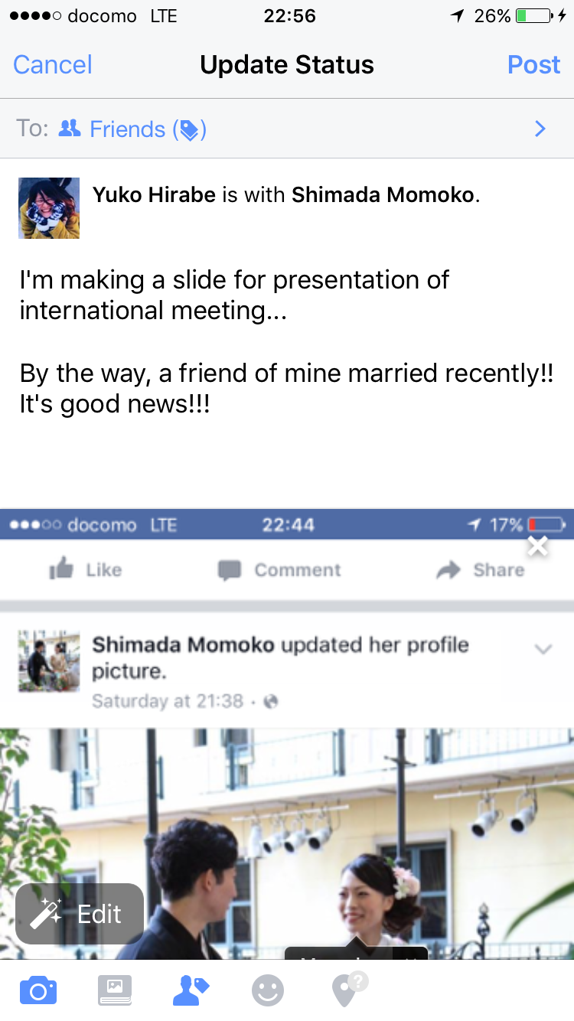
Different traffic for different usage pattern
View posts by others
(Download)
Post items
（Upload）
Scrolling
→preload & increase of traffic
Contents
Text, picture, movie
Comments：Like, text
Posts: text, picture, movie, share
→larger traffic
DL happens in only displayed range

Slide 8
Traffic generation pattern on Facebook
Facebook
View：Download
Posts: Upload
Operations of 4 types
With scrolling
Without scrolling
Comments
Posts
Traffic
Big (DL)
Small (DL)
Small (UL)
Big (UL)

Slide 9
Goal and approach
Goal: developing the realistic 802.11 (Wifi) traffic generation model
to clarify the interference to 802.15 (Zigbee)
Approach:
Step1: Recognize a user’s operations on each app.
Step2: Measure a generated traffic for each operation
Step3: Construct a statistical traffic generation model by associating each operation with the measured traffic
Step4: Clarify the interference of 802.11 (Wifi) to 802.15 (Zigbee) by using a spectrum analyzer or packet loss evaluation.

Slide 10
Step1. Recognize a user’s operations on each app by using smartphone logs
Challenge: recognize each operation (4 types)
Difficulty of accomplishing the challenge:
With smartphone logs, we can easily know what apps are running, but cannot know what operations are happening on all the apps.
Approach：
Try to recognize through analysis of touch panel logs

Slide 11
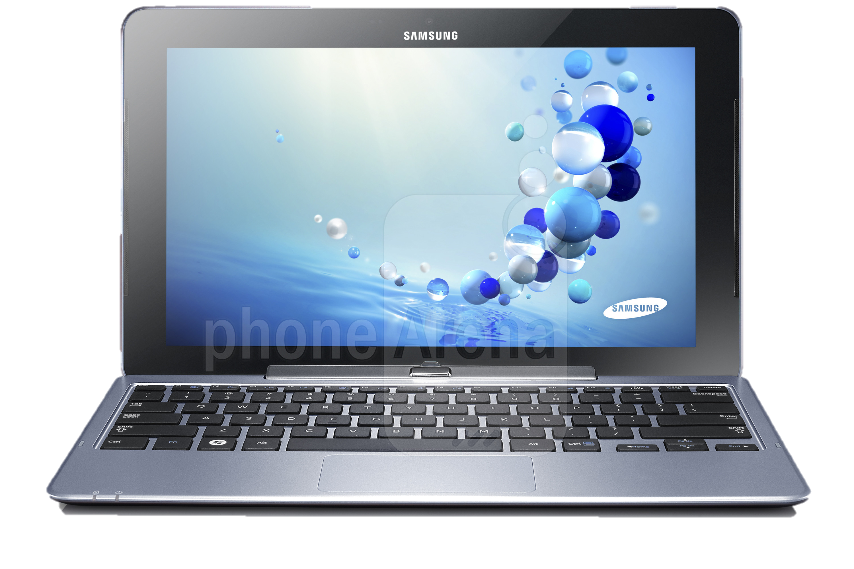
Developed system: TouchAnalyzer^{[3]}
The system for acquisition and analysis of touch panel logs
TouchAnalyzer
Acquisition of touch-panel logs
Identify touch operation behaviors
Touch
Swipe
  Statistical processing
  Identify gesture's name and the number of fingers
  Calculate speed of swipes
  Aggregation for each application
Rotate
Pinch
[3] Hirabe, Y, et al. ICMU 2014

Slide 12
Developed system: TouchAnalyzer^{[3]}
The system for acquisition and analysis of touch panel logs
TouchAnalyzer
Acquisition of touch-panel logs
Recognize touch operations (touch, swipe, rotate, pinch) by analyzing touch panel logs
Identify touch operation behaviors
Touch
Swipe
  Statistical processing
  Identify gesture's name and the number of fingers
  Calculate speed of swipes
  Aggregation for each application
Rotate
Pinch
[3] Hirabe, Y, et al. ICMU 2014

Slide 13
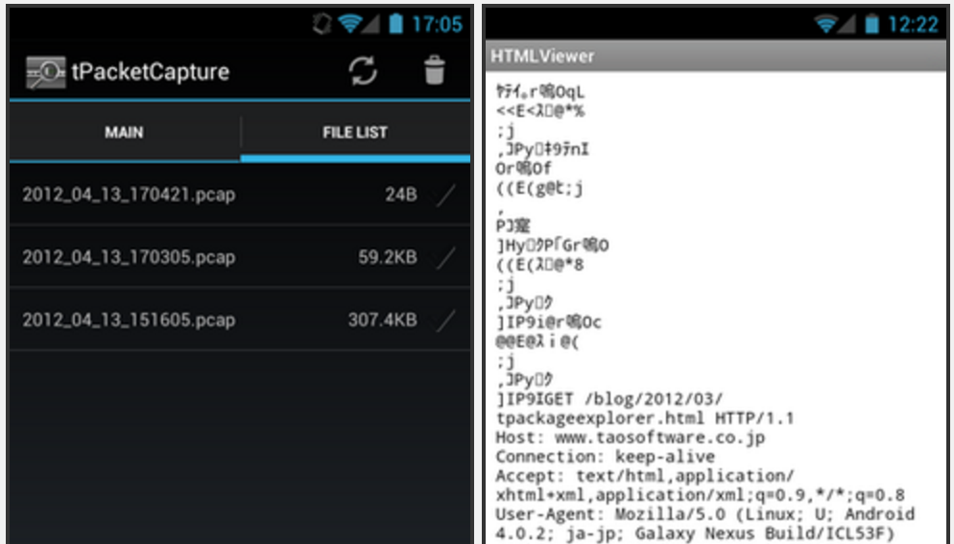
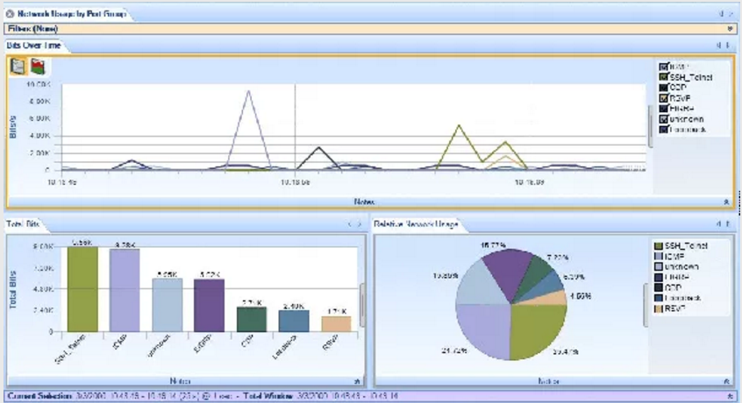
Step2. Measure communication traffic for each operation
Goal: acquisition of communication traffic for each app. operation
Approach １：
Obtain packets in a smartphone
  ex）tPacketCapture^{[4]}
Approach ２：
Obtain packets on PC (router)
  ex）Wireshark^{[5]}
→Associate each app. operation
with the measured traffic
  Construct statistical model
Screen capture of tPacketCapture
Screen capture of Wireshark
4. Tao Software, tPacketCapture, http://www.taosoftware.co.jp/android/packetcapture/
5. WIRESHARK, https://www.wireshark.org

Slide 14
Step3. Construct statistical traffic generation model for each app. operation
Goal: Integration of communication traffic which are generated on apps
Approach：
Construct a histogram of generated traffic for each operation
→ probabilistic distribution of traffic
Construct a state transition model among 4 app. operations
Traffic distribution
View w/o scroll
Traffic generation model of each mobile user
Comment
View w. scroll
Post

Slide 15
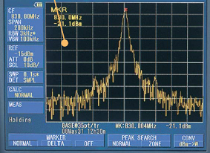
Step 4: Measure commun. traffic of 802.11 (Wifi) and 802.15 (Zigbee), using a spectrum analyzer
Goal: Measure interference patterns between 802.11 and 802.15
Observe 802.15 traffic signals in a smart home, producing Wifi traffic by the proposed model
IoT + Smart Home
Sensors’ data
Internet
Gateway
server
Investigate occurrence degree of interference by using a spectrum analyzer^{[6]}
Send
Power
consumption
Wifi interference
Temperature,
humidity
Location
Screen capture of spectrum analyzer
6. Handheld spectrum analyzer/Signal analyzer, http://www.micronix-jp.com/english/product/product_1.html

Slide 16
Result of pilot study with Facebook
Difference among different app. operations
Confirmed that classification of app. operations is possible
Classification algorithm will be developed

Slide 17
Summary and discussion
Proposed a performance evaluation method for IEEE 802.15-based systems by generating realistic WiFi interfering traffic especially smartphones produce.
Constructed a realistic WiFi traffic generation model, reflecting mobile users’ operations in specific applications (SNS applications such as Facebook)
Future work
Develop classification algorithm of users' application
  Operations through analysis of touch panel logs and measurement of WiFi traffic generated by each operation
  target apps: Instagram, Facebook, LINE
Measure interference patterns between 802.15 and 802.11
Implement the model, and incorporate it into network simulators

