Slide 1
Project: IEEE P802.15 Working Group for Wireless Personal Area Networks (WPANs)
Submission Title: [A method for generating realistic wireless traffic through analysis of smartphone operation logs]
Date Submitted: [16 Feb, 2016]
Source: [Yuko Hirabe, Yutaka Arakawa, Keiichi Yasumoto] Company [Nara Institute of Science and Technology (NAIST)]
Address [Takayama-cho 8916-5, Ikoma, Nara 630–0192, Japan ]
Voice:[+81-743-72-5392], FAX: [+81-743-72-5976], E-Mail:[hirabe.yuko.ho2@is.naist.jp, ara@is.naist.jp, yasumoto@is.naist.jp]
Re: []
Abstract: [This document introduces a realistic wireless traffic generation technique in IEEE802.11, taking into account mobile users’ smartphone operations. This is informative to discuss significance of performance analysis in IEEE802.15 TG4s.]
Purpose: [For discussion]
Notice: This document has been prepared to assist the IEEE P802.15. It is offered as a basis for discussion and is not binding on the contributing individual(s) or organization(s). The material in this document is subject to change in form and content after further study. The contributor(s) reserve(s) the right to add, amend or withdraw material contained herein.
Release: The contributor acknowledges and accepts that this contribution becomes the property of IEEE and may be made publicly available by P802.15.

Slide 2
A method for generating realistic wireless traffic through analysis of smartphone operation logs
Authors:
Name | Company | Adress | Phone | email
Yuko Hirabe, Yutaka Arakawa, Keiichi Yasumoto | Nara Institute of Science and Technology (NAIST) | Takayama-cho 8916-5, Ikoma, Nara 630–0192, Japan | +81-743-72-5392 | hirabe.yuko.ho2@is.naist.jp ara@is.naist.jp yasumoto@is.naist.jp

Slide 3
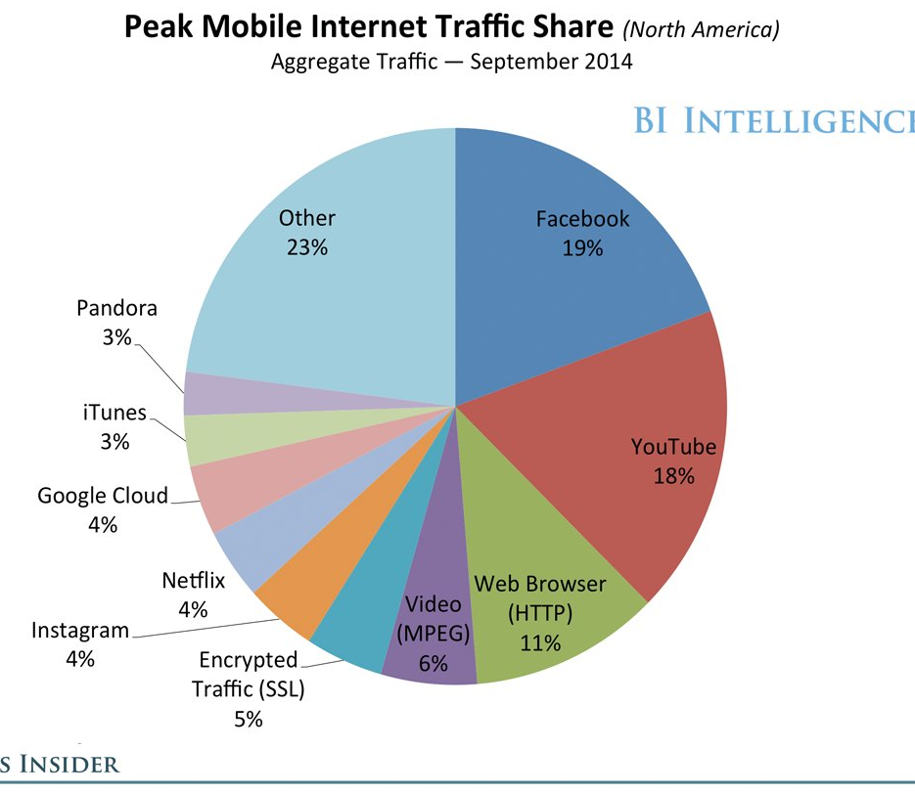
Background
Performance evaluation of
wireless communication system
  Wireless traffic generation by
  random/probabilistic traffic model ^{[1]}
Change of mobile users’ behavior
  SNS apps such as Facebook,
  Instagram, whatsapp, etc. are popular
  Multimedia data (movies) are used
    → cause huge traffic^{[2]}
  Not only download but also upload
→ New traffic generation model is needed
Facebook occupies 20 percent of
all communication traffic
1. H. Zhai et al., Performance analysis of IEEE 802.11 MAC protocols in wireless LANs, Wireless Communications and Mobile Computing 4.8, 2004.
2. Chart by BI Intelligence, used in Business Insider event, IGNITION

Slide 4
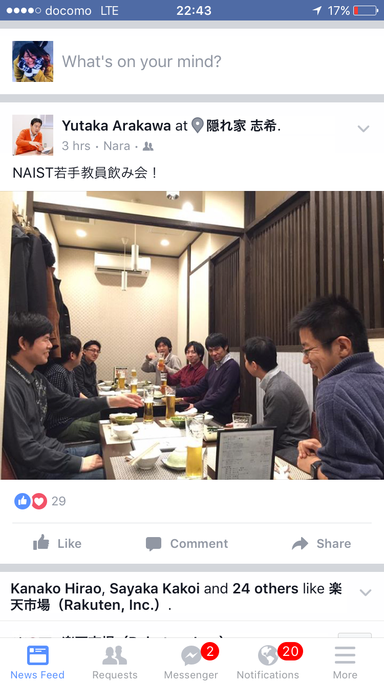
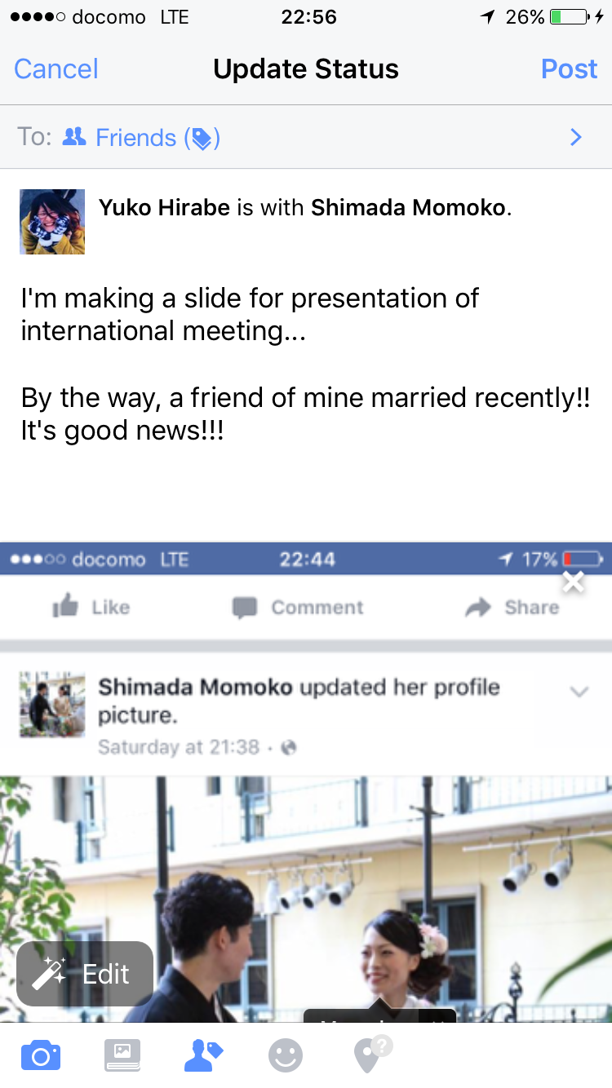
Characteristic of SNS applications
Different operations in app. produces different traffic
View posts by others
(Download)
Post items
（Upload）
Scrolling
→new DL & increase of traffic
Contents
Text, picture, movie
Comments：Like, text
Posts: text, picture, movie, share
→larger traffic
DL happens in only displayed range

Slide 5
Traffic generation pattern on Facebook
Facebook
View：Download
Posts: Upload
Operations of 4 types
With scrolling
Without scrolling
Comments
Posts
Traffic
Big (DL)
Small (DL)
Small (UL)
Big (UL)

Slide 6
Goal and approach
Goal: construction of communication traffic model depending on users' operations on apps
Approach:
Step1: Recognize users' operations on apps, using smartphone logs
Step2: Measure commun. traffic for each operation
Step3: Construct statistic traffic generation model by associating each operation with the measured traffic
→Using the model, realistic traffic can be generated for performance evaluation of wireless commun. systems

Slide 7
Step1. Recognize users' operations on apps, using smartphone logs
Challenge: recognize each operation (4 types)
Difficulty of accomplishing the challenge:
With smartphone logs, we can easily know what apps are running, but cannot know what operations are happening on apps.
Approach：
Try to recognize through analysis of touch panel logs

Slide 8
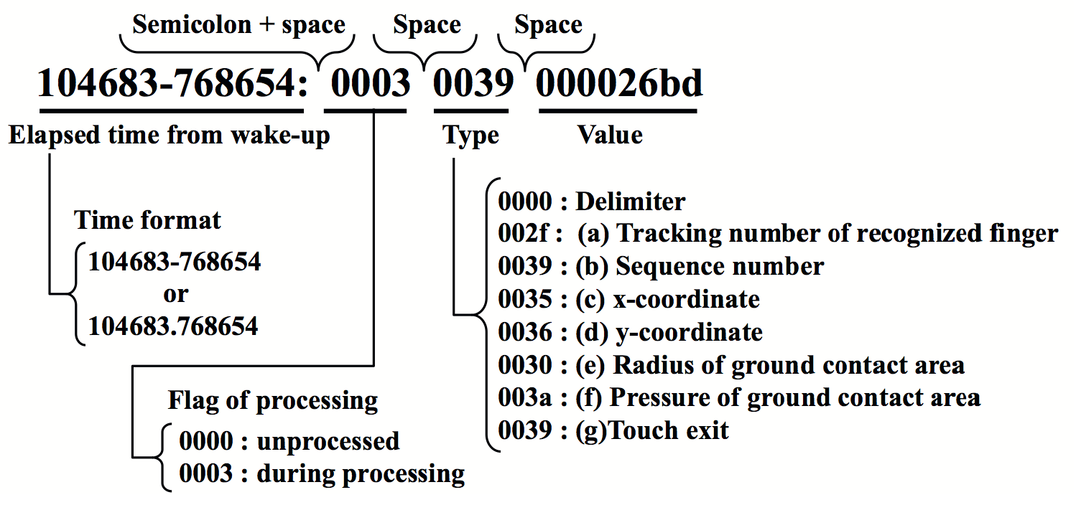
Recognizing touch operations
Difficult to understand touch panel logs
  Each touch operation (swipe, rotate, etc.) is described over multiple lines
  Data format is different among smartphone products
101000-325592: 0003 0032 0000000a
101000-325592: 0003 0035 0000011b
101000-325592: 0003 0036 000002e3
101000-325592: 0003 0030 0000000e
101000-325592: 0003 0031 00000009
101000-325592: 0003 003c ffffffd3
101000-325623: 0000 0000 00000000
101000-337007: 0003 0035 0000012a
101000-337007: 0003 0036 000002d8
101000-337007: 0003 0030 0000000c
101000-337007: 0003 003c ffffffe7
101000-337037: 0000 0000 00000000
101000-348696: 0003 0035 00000142
101000-348696: 0003 0036 000002c3
101000-348696: 0003 0031 00000007
101000-348696: 0003 003c ffffffbd
101000-348696: 0000 0000 00000000
101000-360324: 0003 0032 0000000b
101000-360324: 0003 0035 00000164
101000-360324: 0003 0036 000002a8
101000-360324: 0003 0030 0000000f
101000-360324: 0003 0031 0000000b
101000-360355: 0003 003c 0000005a
101000-360355: 0000 0000 00000000
101000-371800: 0003 0032 0000000d
101000-371800: 0003 0035 0000018c
101000-371831: 0003 0036 00000286
Developed a system to recognize touch operations

Slide 9
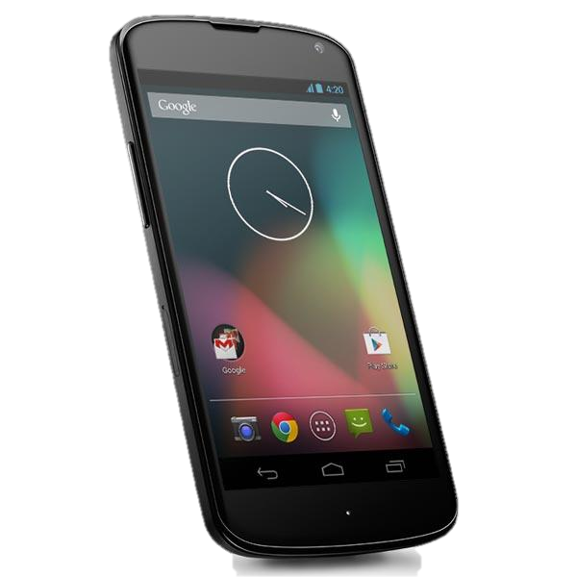
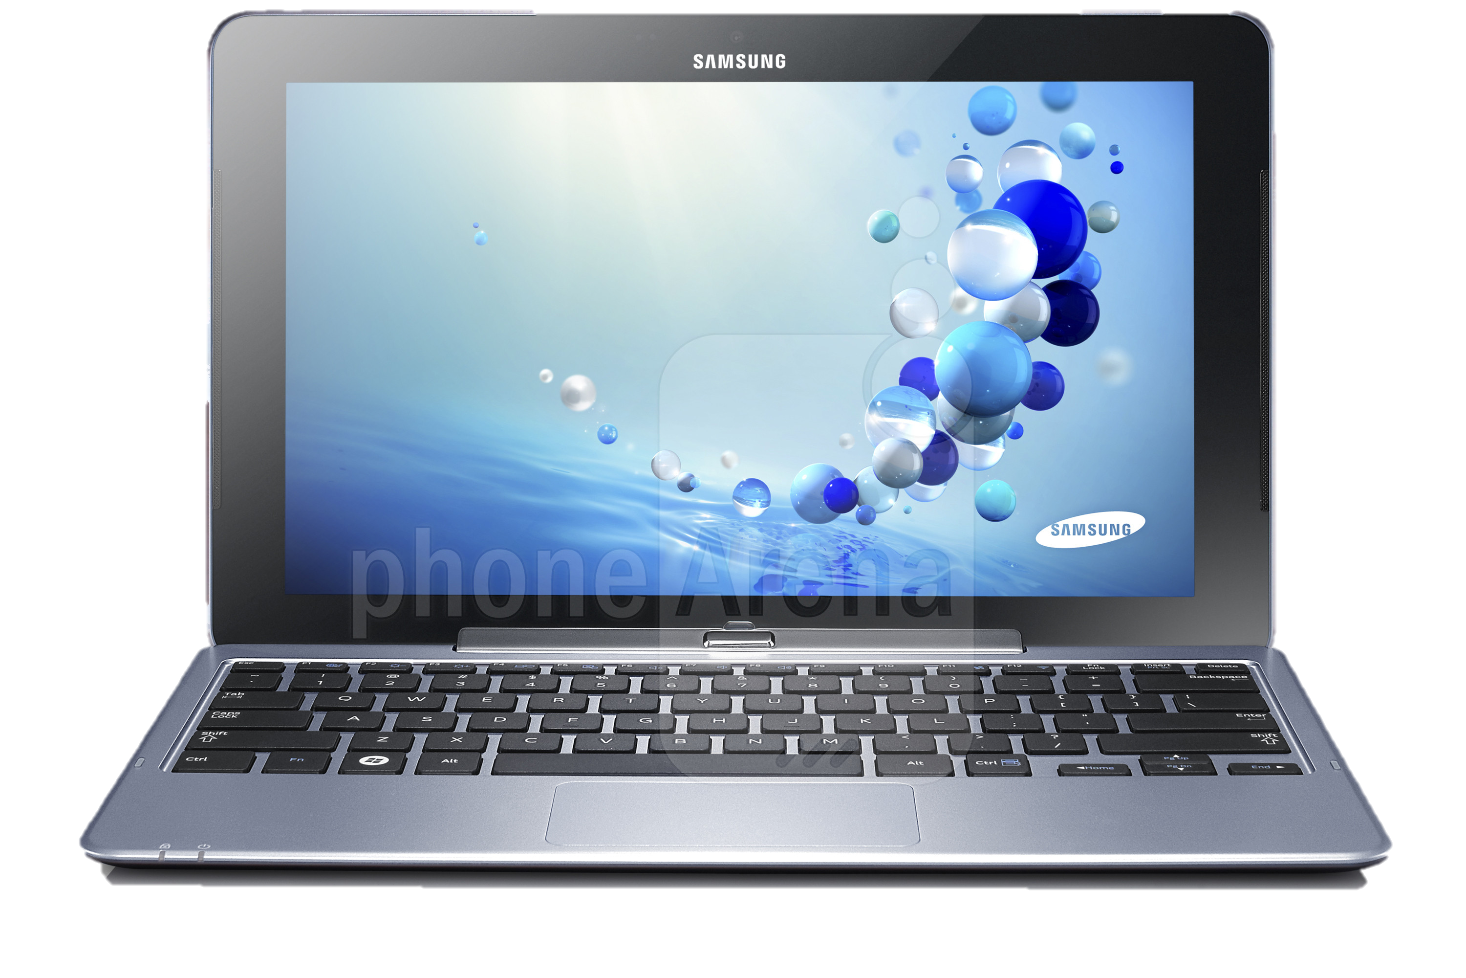
Developed system: TouchAnalyzer^{[3]}
The system for acquisition and analysis of touch panel logs
TouchAnalyzer
Acquisition of touch-panel logs
Identify touch operation behaviors
Touch
Swipe
  Statistical processing
  Identify gesture's name and the number of fingers
  Calculate speed of swipes
  Aggregation for each application
Rotate
Pinch
[3] Hirabe, Y, et al. ICMU 2014

Slide 10
Developed system: TouchAnalyzer^{[3]}
The system for acquisition and analysis of touch panel logs
TouchAnalyzer
Acquisition of touch-operations’ logs
Recognize touch operations (touch, swipe, rotate, pinch) by analyzing touch panel logs
Identify touch operation behaviors
Touch
Swipe
  Statistical processing
  Identify gesture's name and the number of fingers
  Calculate speed of swipes
  Aggregation for each application
Rotate
Pinch
[3] Hirabe, Y, et al. ICMU 2014

Slide 11
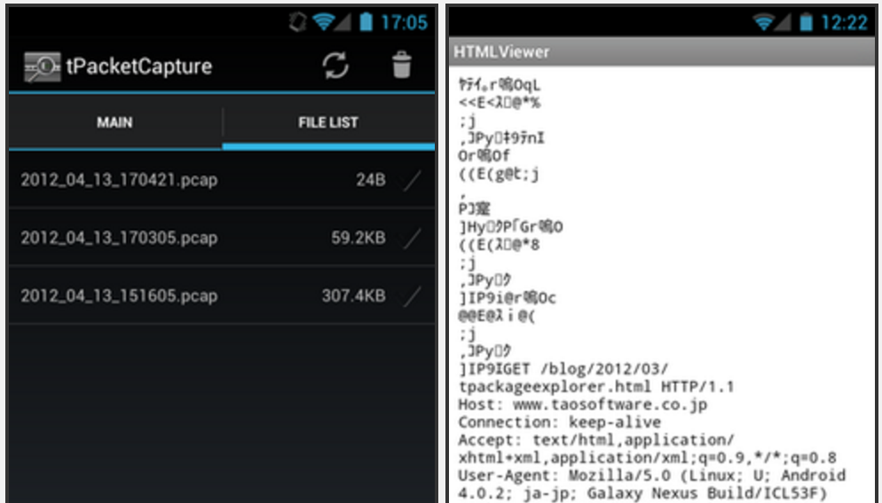
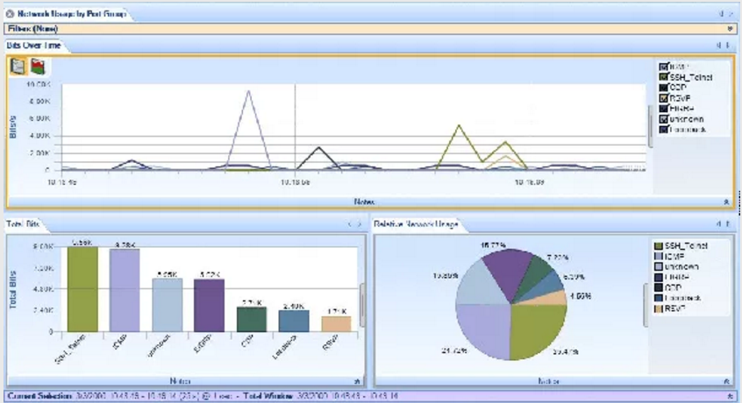
Step2. Measure communication traffic for each operation
Goal: acquisition of communication traffic for each app. operation
Approach １：
Obtain packets by smartphones
  ex）tPacketCapture^{[4]}
Approach ２：
Obtain packets by PC
  ex）Wireshark^{[5]}
→Associate each app. operation
with the measured traffic
  Construct statistical model
Screen capture of tPacketCapture
Screen capture of Wireshark
4. Tao Software, tPacketCapture, http://www.taosoftware.co.jp/android/packetcapture/
5. WIRESHARK, https://www.wireshark.org

Slide 12
Step3. Construct statistic traffic generation model for each app. operation
Goal: Integration of communication traffic which are generated on apps
Approach：
Construct a histogram of generated traffic for each operation → probabilistic distribution of traffic
Construct a state transition model among 4 app. operations
Traffic distribution
View w/o scroll
Comment
Traffic generation model of each mobile user
View w. scroll
Post

Slide 13
Result of pilot study with Facebook
Difference among different app. operations
Confirmed that classification of app. operations is possible
Classification algorithm will be developed

Slide 14
Summary and discussion
Proposed a method for constructing a new wireless traffic generation model, reflecting mobile users’ operations in specific applications (SNS applications such as Facebook)
Future work
Actually develop classification algorithm of users' app. Operations through analysis of touch panel logs and measurement of traffic generated by each operation
  target apps: Instagram, Facebook, LINE
Construct the model, and incorporate it into network simulators

