Slide 1
Project: IEEE P802.15 Working Group for Wireless Personal Area Networks (WPANs)
Submission Title: [A method for generating realistic wireless traffic through analysis of smartphone operation logs]
Date Submitted: [15-20 May, 2016]
Source: [Yuko Hirabe, Yutaka Arakawa, Keiichi Yasumoto] Company [Nara Institute of Science and Technology (NAIST)]
Address [Takayama-cho 8916-5, Ikoma, Nara 630–0192, Japan ]
Voice:[+81-743-72-5392], FAX: [+81-743-72-5976], E-Mail:[hirabe.yuko.ho2@is.naist.jp, ara@is.naist.jp, yasumoto@is.naist.jp]
Re: []
Abstract: [This document introduces a realistic wireless traffic generation technique in IEEE802.11, taking into account mobile users’ smartphone operations. This is informative to discuss significance of performance analysis in IEEE802.15 TG4s.]
Purpose: [For discussion]
Notice: This document has been prepared to assist the IEEE P802.15. It is offered as a basis for discussion and is not binding on the contributing individual(s) or organization(s). The material in this document is subject to change in form and content after further study. The contributor(s) reserve(s) the right to add, amend or withdraw material contained herein.
Release: The contributor acknowledges and accepts that this contribution becomes the property of IEEE and may be made publicly available by P802.15.
Notes:
スマートフォン操作履歴の収集解析に基づいた無線データトラフィック生成モデルの設計
A method for generating realistic wireless traffic through analysis of smartphone operation logs

Slide 2
A method for generating realistic wireless traffic through analysis of smartphone operation logs
Authors:
Name | Company | Adress | Phone | email
Yuko Hirabe, Yutaka Arakawa, Keiichi Yasumoto | Nara Institute of Science and Technology (NAIST) | Takayama-cho 8916-5, Ikoma, Nara 630–0192, Japan | +81-743-72-5392 | hirabe.yuko.ho2@is.naist.jp ara@is.naist.jp yasumoto@is.naist.jp

Slide 3
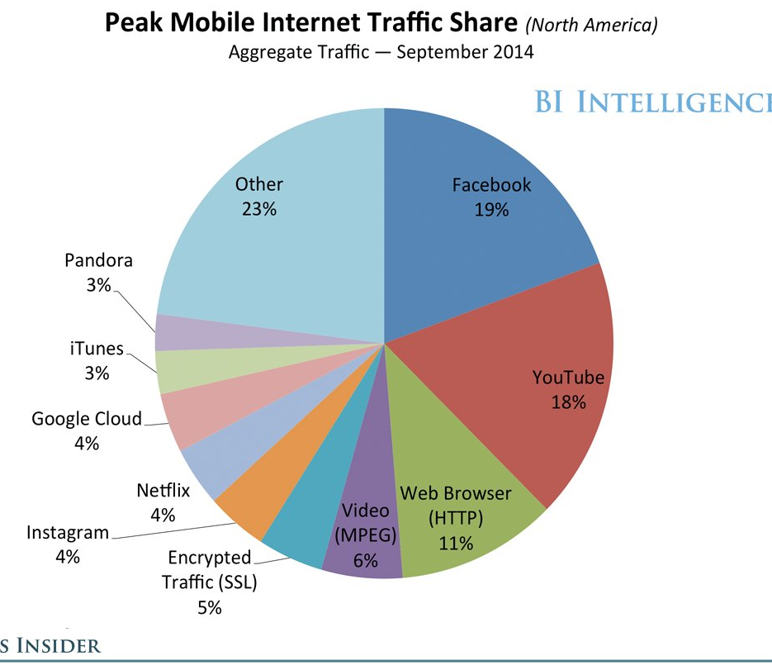
Background
Performance evaluation of
wireless communication system
  Wireless traffic generation by
  random/probabilistic traffic model ^{[1]}
Change of mobile users’ behavior
  SNS apps such as Facebook,
  Instagram, whatsapp, etc. are popular
  Multimedia data (movies) are used
    → cause huge traffic^{[2]}
  Not only download but also upload
→ New traffic generation model is needed
Facebook occupies 20 percent of
all communication traffic
1. H. Zhai et al., Performance analysis of IEEE 802.11 MAC protocols in wireless LANs, Wireless Communications and Mobile Computing 4.8, 2004.
2. Chart by BI Intelligence, used in Business Insider event, IGNITION
Notes:
802.11
従来はデータをランダム、もしくは統計的に取得して分析してきた
新しいアプリケーション（SNS）により、従来手法で評価できない状況が起きている
これらのアプリケーションにも対応したトラフィックの統計的モデリング手法が求められている
--
従来システム： Trafficモデルの例を紹介 （ITU-T, トラフィック・パターンのグラフ）←要調査←←荒川先生に聞こう…
具体的に評価しているもの←ダウンロード、アップロードのトラフィックを考慮した
Facebook, Instagram トラフィック内容の割合（http://agilecatcloud.com/2014/12/12/facebook-%E3%81%A8-youtube-%E3%81%8C-%E3%83%A2%E3%83%90%E3%82%A4%E3%83%AB%EF%BD%A5%E3%83%88%E3%83%A9%E3%83%95%E3%82%A3%E3%83%83%E3%82%AF%E3%81%AE-40-%E3%82%92%E5%8D%A0%E3%82%81%E3%82%8B-%E7%B1%B3/）

Slide 4
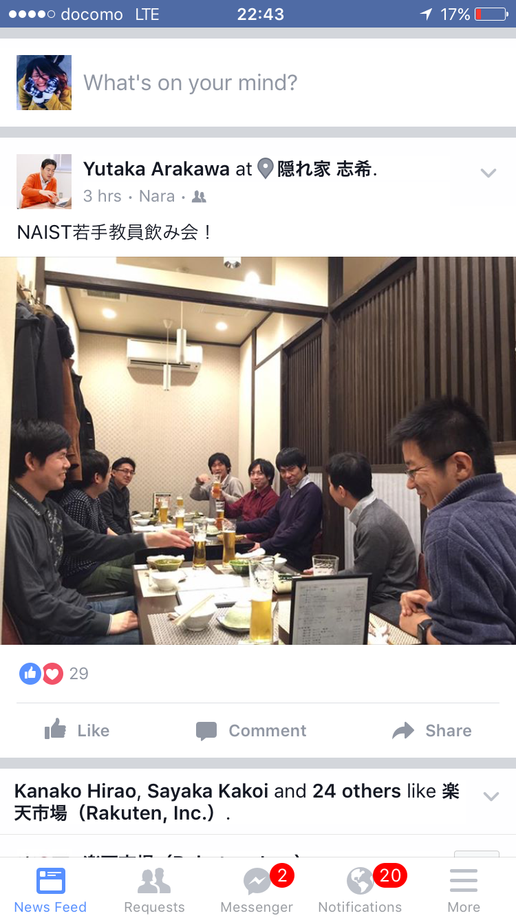
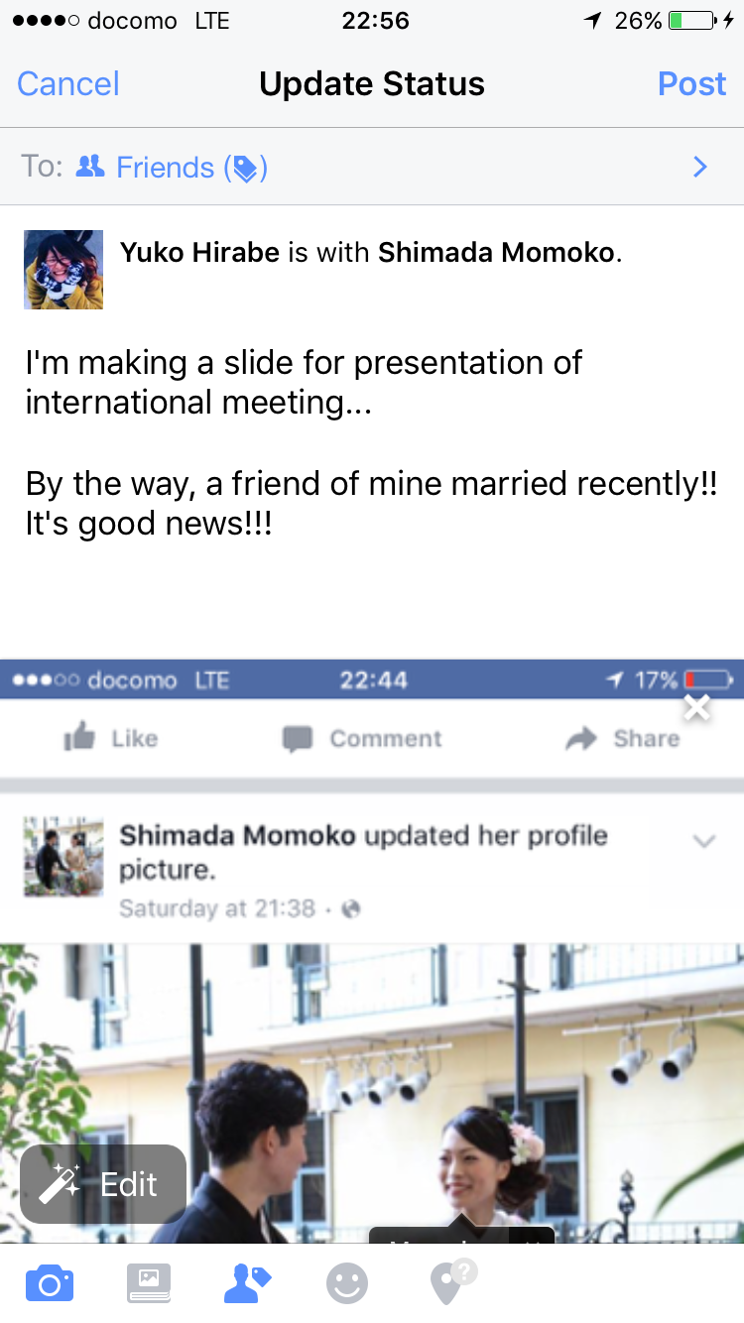
Characteristic of SNS applications
Different operations in app. produces different traffic
View posts by others
(Download)
Post items
（Upload）
Scrolling
→new DL & increase of traffic
Contents
Text, picture, movie
Comments：Like, text
Posts: text, picture, movie, share
→larger traffic
DL happens in only displayed range
Notes:
Facebookの画面付きで→実際に操作している様子について動画？

Slide 5
Traffic generation pattern on Facebook
Facebook
View：Download
Posts: Upload
Operations of 4 types
With scrolling
Without scrolling
Comments
Posts
Traffic
Big (DL)
Small (DL)
Small (UL)
Big (UL)

Slide 6
Goal and approach
Goal: construction of communication traffic model depending on users' operations on apps
Approach:
Step1: Recognize users' operations on apps, using smartphone logs
Step2: Measure commun. traffic for each operation
Step3: Construct statistic traffic generation model by associating each operation with the measured traffic
→Using the model, realistic traffic can be generated for performance evaluation of wireless commun. systems
Notes:
以降でFacebook、（他も転用可能）

Slide 7
Step1. Recognize users' operations on apps, using smartphone logs
Challenge: recognize each operation (4 types)
Difficulty of accomplishing the challenge:
With smartphone logs, we can easily know what apps are running, but cannot know what operations are happening on apps.
Approach：
Try to recognize through analysis of touch panel logs

Slide 8
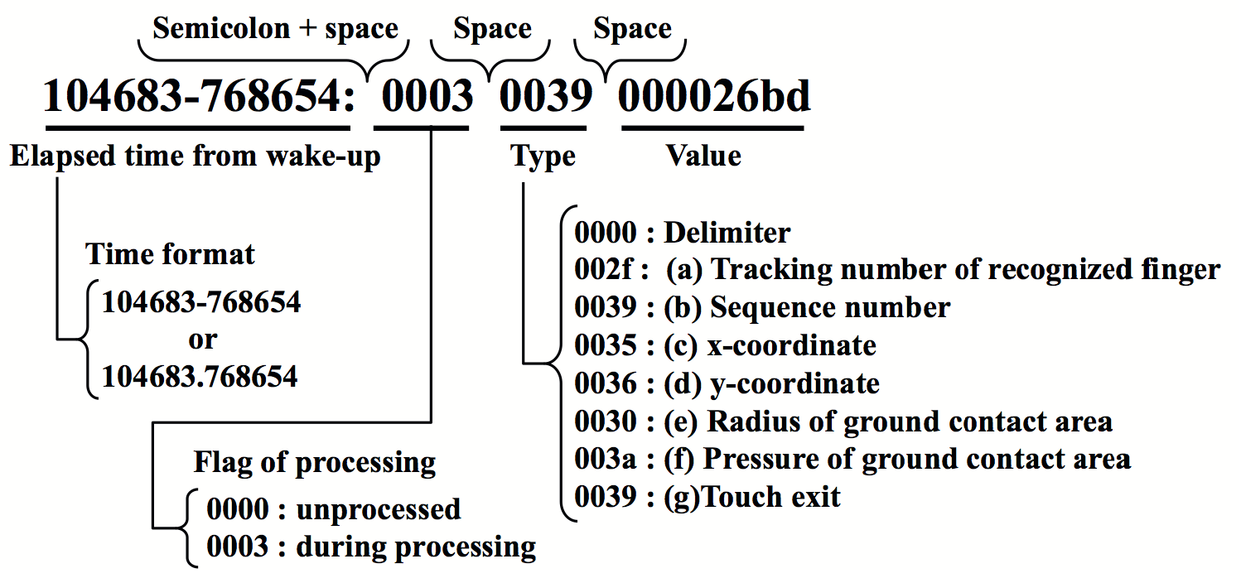
Recognizing touch operations
Difficult to understand touch panel logs
  Each touch operation (swipe, rotate, etc.) is described over multiple lines
  Data format is different among smartphone products
101000-325592: 0003 0032 0000000a
101000-325592: 0003 0035 0000011b
101000-325592: 0003 0036 000002e3
101000-325592: 0003 0030 0000000e
101000-325592: 0003 0031 00000009
101000-325592: 0003 003c ffffffd3
101000-325623: 0000 0000 00000000
101000-337007: 0003 0035 0000012a
101000-337007: 0003 0036 000002d8
101000-337007: 0003 0030 0000000c
101000-337007: 0003 003c ffffffe7
101000-337037: 0000 0000 00000000
101000-348696: 0003 0035 00000142
101000-348696: 0003 0036 000002c3
101000-348696: 0003 0031 00000007
101000-348696: 0003 003c ffffffbd
101000-348696: 0000 0000 00000000
101000-360324: 0003 0032 0000000b
101000-360324: 0003 0035 00000164
101000-360324: 0003 0036 000002a8
101000-360324: 0003 0030 0000000f
101000-360324: 0003 0031 0000000b
101000-360355: 0003 003c 0000005a
101000-360355: 0000 0000 00000000
101000-371800: 0003 0032 0000000d
101000-371800: 0003 0035 0000018c
101000-371831: 0003 0036 00000286
Developed a system to recognize touch operations

Slide 9
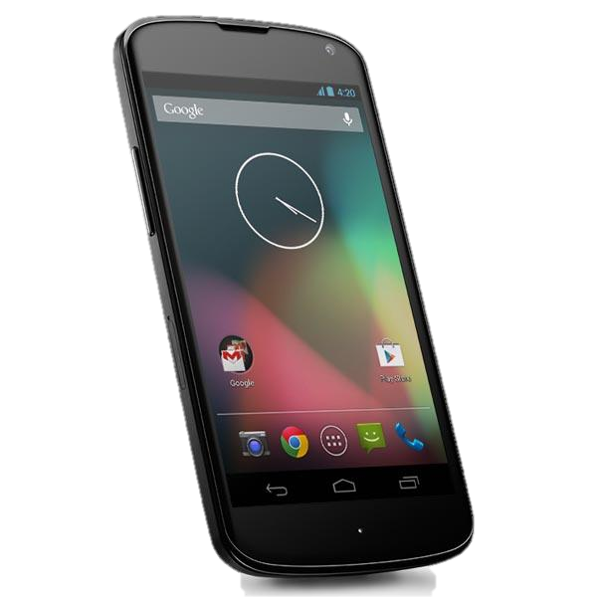
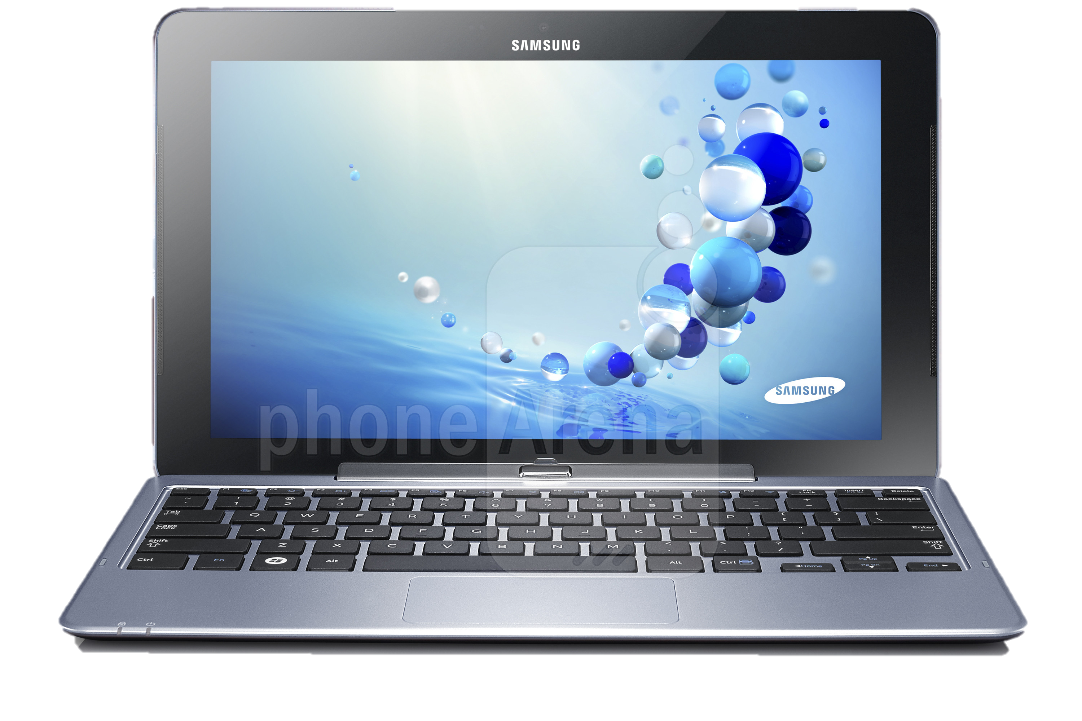
Developed system: TouchAnalyzer^{[3]}
The system for acquisition and analysis of touch panel logs
TouchAnalyzer
Acquisition of touch-panel logs
Identify touch operation behaviors
Touch
Swipe
  Statistical processing
  Identify gesture's name and the number of fingers
  Calculate speed of swipes
  Aggregation for each application
Rotate
Pinch
[3] Hirabe, Y, et al. ICMU 2014

Slide 10
Developed system: TouchAnalyzer^{[3]}
The system for acquisition and analysis of touch panel logs
TouchAnalyzer
Acquisition of touch-operations’ logs
Recognize touch operations (touch, swipe, rotate, pinch) by analyzing touch panel logs
Identify touch operation behaviors
Touch
Swipe
  Statistical processing
  Identify gesture's name and the number of fingers
  Calculate speed of swipes
  Aggregation for each application
Rotate
Pinch
[3] Hirabe, Y, et al. ICMU 2014

Slide 11
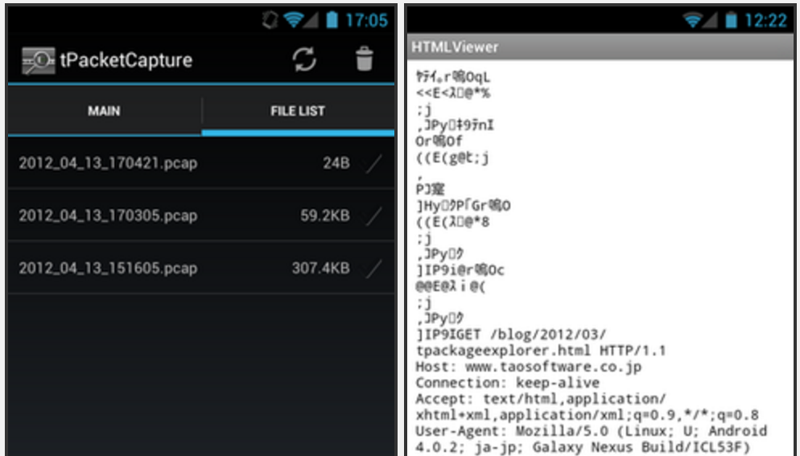
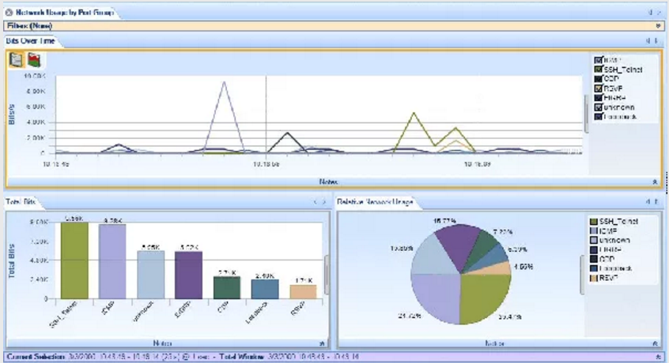
Step2. Measure communication traffic for each operation
Goal: acquisition of communication traffic for each app. operation
Approach １：
Obtain packets by smartphones
  ex）tPacketCapture^{[4]}
Approach ２：
Obtain packets by PC
  ex）Wireshark^{[5]}
→Associate each app. operation
with the measured traffic
  Construct statistical model
Screen capture of tPacketCapture
Screen capture of Wireshark
4. Tao Software, tPacketCapture, http://www.taosoftware.co.jp/android/packetcapture/
5. WIRESHARK, https://www.wireshark.org

Slide 12
Step3. Construct statistic traffic generation model for each app. operation
Goal: Integration of communication traffic which are generated on apps
Approach：
Construct a histogram of generated traffic for each operation → probabilistic distribution of traffic
Construct a state transition model among 4 app. operations
Traffic distribution
View w/o scroll
Comment
Traffic generation model of each mobile user
View w. scroll
Post

Slide 13
Result of pilot study with Facebook
Difference among different app. operations
Confirmed that classification of app. operations is possible
Classification algorithm will be developed
Notes:
・評価環境
→被験者ユーザパターンを知ったうえで
→事前実験の結果
・ヤフーニュース
→今後は、挙動によるパターンをアプリごとに見つけ、そのパターンに対して実験を行なう
→対象アプリケーション（Instagram, Facebook, LINE）

Slide 14
Summary and discussion
Proposed a method for constructing a new wireless traffic generation model, reflecting mobile users’ operations in specific applications (SNS applications such as Facebook)
Future work
Actually develop classification algorithm of users' app. Operations through analysis of touch panel logs and measurement of traffic generated by each operation
  target apps: Instagram, Facebook, LINE
Construct the model, and incorporate it into network simulators

Slide 15
How to know wireless traffic depending on new applications
どのアプリケーションを使っているかを判定
どの挙動（タッチ操作）がアプリ内で起こっているかを判定
その上で通信トラフィックを計測
Notes:
How to know wireless traffic depending on new applications
・どのアプリケーションを使っているかの判定
・各アプリケーションにおけるトラフィックの状況を調査・測定

Slide 16
SNSアプリケーションを対象に
通信トラフィックとタッチ操作のデータの計測
ユーザが頻繁に利用するアプリケーション
  Instagram, Facebook, LINE
計測方法
  通信トラフィック
  タッチ操作の挙動
計測結果
  挙動に対するトラフィック
    写真を投稿する・見る
    文章を投稿する・見る
Notes:
・どの挙動（操作）がアプリ内で起こってるのかを認識
・その上でトラフィックの計測
→通常は各アプリケーションを改造する必要
→トラフィックだけでは、どのような挙動（アプリの操作）が起きてるのかわからない
・タッチ操作で挙動を認識してトラフィックを作る
・挙動頻度やパターンを取得することで、操作パターンを統計的に作成し、リアルな状況におけるトラフィックを生成して評価につなげる

Slide 17
どのように挙動を認識するか
通常タッチ操作の取得にはアプリケーション毎に改造が必須
  アプリを横断したタッチ操作の取得が不可能
  Androidにおいてeventデバイスファイルログを監視
ログ内容は一見しても人間には理解し難い
  ファイルの内容を解析し、どの挙動が起きたか人間に理解できるように出力するシステムを開発
開発システムを用いてアプリを越え挙動を認識
Notes:
How to know wireless traffic depending on new applications
・どのアプリケーションを使っているかの判定
・各アプリケーションにおけるトラフィックの状況を調査・測定
->

Slide 18
統計モデルの構築方法（1/2）
タッチ操作の取得
  開発システムを用いて取得
  取得対象：タッチ操作の種類、スワイプ速度、頻度、挙動が現れる時間間隔
  カメラで操作状況を撮影
取得したタッチ操作の特徴からどのような挙動が起きているか判定
  コンテンツを見る、写真や文章を投稿する、etc.
同時に通信トラフィックを取得
挙動と通信トラフィックを対応づける
  機械学習により統計モデルを構築
Notes:
・タッチ操作の取得→特徴からどの行動からトラフィックをしる
→タッチ操作とトラフィックとの対応関係
←開発システムを用いる、スワイプ速度、頻度、現れる時間
←カメラ等で撮影
→機械学習により作成
・トラフィックを取得
・ユーザの分類→複数ユーザのパターンを作成

Slide 19
統計モデルの構築方法（2/2）
ユーザを挙動パターンで分類
  最初に投稿を見る
    じっくり見る or ゆっくり見る
  最初にコメントを返す
  写真を読み飛ばす or 写真は必ず見る
  etc…
複数ユーザの挙動パターンからモデルを作成
Notes:
・タッチ操作の取得→特徴からどの行動からトラフィックをしる
→タッチ操作とトラフィックとの対応関係
←開発システムを用いる、スワイプ速度、頻度、現れる時間
←カメラ等で撮影
→機械学習により作成
・トラフィックを取得
・ユーザの分類→複数ユーザのパターンを作成

Slide 20
Project: IEEE P802.15 Working Group for Wireless Personal Area Networks (WPANs)
Submission Title: [Add name of submission]
Date Submitted: [The date the document is contributed, in the format “21 May, 1999”]
Source: [Add name of submission Author] Company [Add name of Affiliation]
Address [Add address Street, City, PC, Province/State, Country]
Voice:[Add telephone number], FAX: [Add FAX number], E-Mail:[Add e-mail address]
Re: [If this is a proposed revision, cite the original document.]
[If this is a response to a Call for Contributions, cite the name and date of the Call for Contributions to which this document responds, as well as the relevant item number in the Call for Contributions.]
[Note: Contributions that are not responsive to this section of the template, and contributions which do
not address the topic under which they are submitted, may be refused or consigned to the “General Contributions” area.]
Abstract: [Description of document contents.]
Purpose: [Description of what the author wants P802.15 to do with the information in the document.]
Notice: This document has been prepared to assist the IEEE P802.15. It is offered as a basis for discussion and is not binding on the contributing individual(s) or organization(s). The material in this document is subject to change in form and content after further study. The contributor(s) reserve(s) the right to add, amend or withdraw material contained herein.
Release: The contributor acknowledges and accepts that this contribution becomes the property of IEEE and may be made publicly available by P802.15.
NOTE: Update all red fields replacing with your information; they are required. This is a manual update in appropriate
fields. All Blue fields are informational and are to be deleted. Black stays. After updating delete this box/paragraph.
Notes:
http://grouper.ieee.org/groups/802/15/pub/Download.html

