Slide 1
Project: IEEE P802.15 Working Group for Wireless Personal Area Networks (WPANs)
Submission Title: ASCII-Format for the Channel Transfer Functions
Date Submitted: 8 February 2016
Source: Alexander Fricke, TU Braunschweig
E-Mail: fricke@ifn.ing.tu-bs.de
Re: n/a
Abstract: Proposal of an ASCII-format for providing the channel transfer functions as defined in the Channel Modeling Document.
Purpose: Contribution towards developing an intra-device channel model for use in TG 3d
Notice: This document has been prepared to assist the IEEE P802.15. It is offered as a basis for discussion and is not binding on the contributing individual(s) or organization(s). The material in this document is subject to change in form and content after further study. The contributor(s) reserve(s) the right to add, amend or withdraw material contained herein.
Release: The contributor acknowledges and accepts that this contribution becomes the property of IEEE and may be made publicly available by P802.15.

Slide 2
ASCII-Format for the Channel Transfer Functions
Alexander Fricke
TU Braunschweig

Slide 3
Thoughts on Channel Realizations (Reprise)
System proposals will have to be tested against a set of channel realizations that will be derived as described in the CMD
These channel realizations come in the form of Channel Transfer Functions (CTFs)
A set of 10 mandatory and 100 optional CTFs will be provided for each application case
These CTFs have to be evaluated by the proposers to create the Channel Impulse Responses needed for the system simulations
The proposers have to take care of the adequate methodology, e.g. IFFT parameters, filter functions. The methodology has to be documented in the respective proposal
The CTFs shall be stored in ASCII format, utilizing appropriate variable names, indices and annotations
The ASCII-files will then be provided on mentor, preferably embedded within the CMD

Slide 4
Proposed Format (1)
Each ASCII-file shall start with a header containing at least
The frequency range and the number of frequency bins
Information on the assumed antenna characteristics (if multiple exist)
Information on the geometrical configuration (if multiple exist)
Each CTF shall have its unique id indicating the application case (Close Proximity, Intra-Device, Backhaul/Fronthaul, Data Center), imperative (mandatory, optional) and serial number (1…10 for mandatory and 1…100 for optional)
The CTFs may be stored in more than one ASCII-file as long as a consistent indexing is preserved

Slide 5
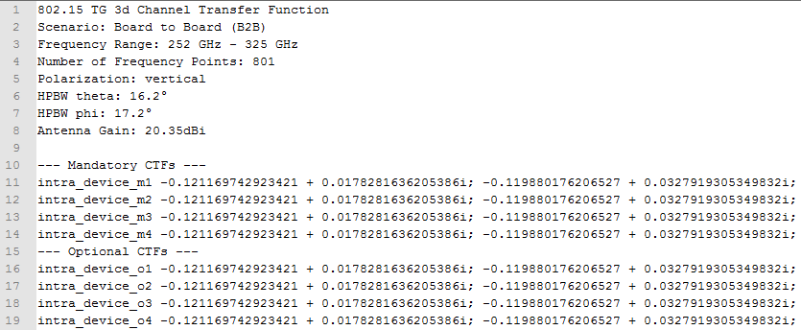
Proposed Format (2)
Geometrical Configuration
Frequency-Range & Number of Bins
Antenna Characteristics
Application Case
Imperative
Unique ID for each CTF
Serial Number

Slide 6
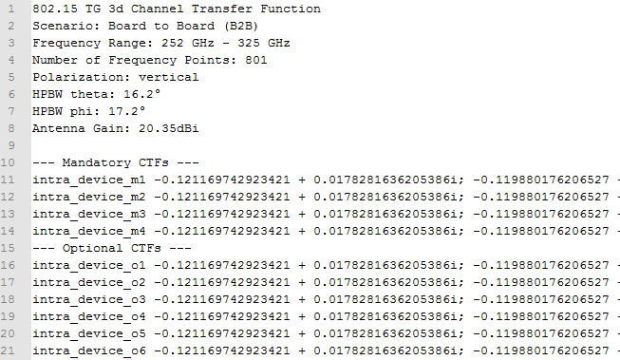
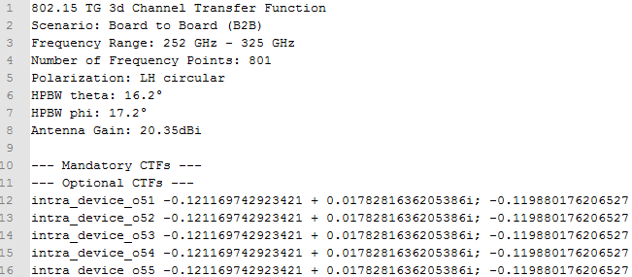
Proposed Format (3)
Multiple files providing sub-sets of CTFs
The entirety of ASCII files contains 10 mandatory + 100 optional CIRs
Consistent numbering is preserved

Slide 7
Thank You for Your Attention

